Slide 1
Waking the sleeping giant: creating a coherent brand and corporate strategy for Credit Union
Research Excellence Awards
Submission for: Strategic Brand Research
Submitted by: RED C Research; Robin McGhee & Ciara Clarke
Client: Irish League of Credit Unions

Slide 2
Research Rationale
THE PROJECT PURPOSE
To create foundational insight into the Credit Union sector brand, its consumers, competitors and culture, as well as identifying pathways to durable and step-change growth, re-energising its member base
THE PROBLEM
The Credit Union was facing a demographic time bomb with Gen Z and younger Millennial non-members. They were disinclined to consider the brand, attached to the main banks by a combination of inertia, superior digital offerings and a lack of a compelling brand narrative from Credit Union
The Credit Union needed to uncover drivers for acquisition as well as lapsed membership reactivation
It also needed to identify how to outmanoeuvre the competition, creating marketing activity with more targeted and smaller budgets delivered by over 300 individual businesses and their marketing teams in the Republic of Ireland and Northern Ireland
OUR ROLE
To provide an effective knowledge framework for the Credit Union sector by examining the market and business from a series of perspectives
To create a framework for delivering change in market
To align siloed businesses around a single coherent purpose

Slide 3
The Methodology
There were four interlocking phases to this strategy programme
BRAND EVALUATION | BRAND ANALYSIS | BRAND DIRECTION | BRAND SHOWCASING
Nationally Representative Quantitative Study across Island of Ireland | Foundational qualitative groups across life stage | Workshop summit with key ILCU stakeholders | Conferences in Limerick and Dublin with Credit Union businesses

Slide 4
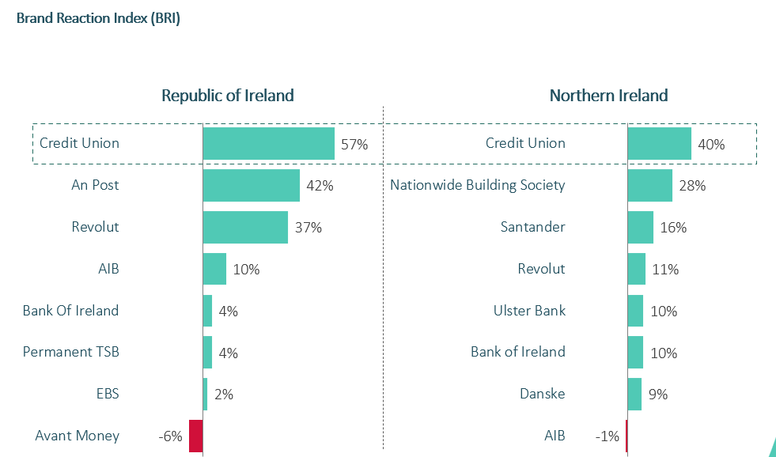
Central findings- Consumer - I
Many consumers are in love with the brand, but don't need the brand
There is a very powerful emotional connection to the Credit Union, often stemming from family of origin, and an appreciation of its community roots
But the main conversion barriers, which are worse with younger consumers, are low mental availability, perceived poor technology and a weak understanding of the product offering
Credit Union is seen as an old economy solution to modern Financial Solution needs.

Slide 5
Central findings – Consumer - II
There is a demographic timebomb facing the brand, with younger consumers in both ROI and NI displaying worrying signs of detachment
Credit Union Brand Reaction Index x Age
Republic of Ireland
Northern Ireland
Vulnerability zone
Vulnerability zone

Slide 6
Central findings – Consumer - III
A series of structural challenges confront the brand
Nonetheless, the Credit Union is seen as fundamentally well-intentioned: there is positive community involvement.
‘Local’ in this sense takes on at least five dimensions:
Local branches and catchment area
Local people
Support for local businesses
ESG initiatives
Informal and decentralised approach
Local is a big idea, but not enough by itself to propel the Credit Union to growth.
Outside a core and older membership, most of which is 45+, the predominant rational perceptions of the Credit Union are critical
essentially a poor man’s bank
lacking in relevance for young people
has limited products compared with its competitors
has poor technology- convoluted, manual processes

Slide 7
Central findings - Competitor
THE PROBLEM
Revolut has set an impressive digital benchmark to which Credit Union’s core Gen Z target has become habituated
Main banks are seen to have process and account access superiority, which increasingly accentuates a vulnerability for Credit Union
Meanwhile, banks are activating local sponsorship and ESG initiatives, which leverage community value
THE OPPORTUNITY
Research identified that Credit Union has a superior service ethic
Local, friendly and accountable alongside, crucially, face-to-face access when needed
Banks have largely disintermediated the process and experience of banking
In the end, Credit Union’s service capability emerged as the greatest strength,
provided the brand can create complementary and effective digital processes to support consumers.

Slide 8
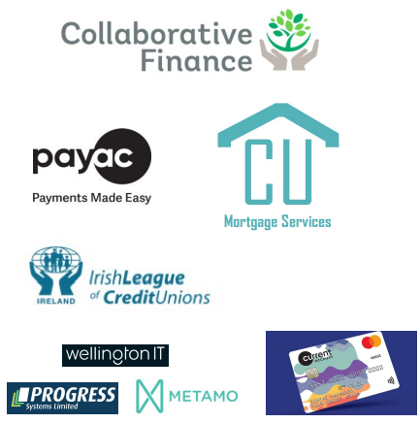
Central findings - Culture
The Credit Union was a fundamentally fissiparous body
The Irish League of Credit Unions (ILCU) acts as an oversight unit, providing centralised support.
But responsibility for activation and strategy was devolved to 300 separate businesses, resulting in a diverse and sometimes incoherent activation
The project provided fresh perspective on organisational opportunity and collaboration
This has led to a more coherent and strategic approach across ALL Credit Unions, working to a unified goal, underpinned by demonstrable research insights.

Slide 9
The first impact was fundamentally structural and strategic
Embedding research at the heart of the process drove greater co-operation between business units and cooperatives
Our study achieved a strong and compelling strategic architecture in three senses:
Brand: what the CU said about itself
Product & Service: what the Credit Union did to support those claims
Experience: how consumers understood the CU
Core to the mission was unlocking the brand expression, “For You” and driving a centralised alignment behind it
Notes:
Research galvanised a disparate group of individual Credit Unions to cohere around a central consumer-driven purpose

Slide 10
The second impact was focused on both strategy and tactics
The insight leveraged a significant strength in service accountability and neutralised a key conversion barrier (in digital)
Activation planning also settled on a primary demographic, focusing on an elusive Gen Z consumer for whom Credit Union has waning relevance.
It addressed in detail delivery considerations like drivers of standardisation and a unified model of what the Credit Union should stand for.
It also identified a common set of KPIs, the first time there was a coherent battery, to help the business navigate the journey to delivery.
The activation planning module helped define the Credit Union’s central purpose. It put at its heart a core insight that consumers want the best of both worlds - digital efficiency alongside a human touch, expressed in this way:
“Digital when you want it; human when you need it”
Notes:
The task for the action planning module was to bring a coherent framework. The workstream addressed
the role and value of current accounts;
a strategy for apps;
savings account design;
communications architecture to accommodate local initiatives from branches,
alongside a holistic brand campaign;
and new product development.

Slide 11
The third impact was about consistent and compelling brand communications
For People, Not Profit
The award-winning campaign created an effective uplift in loans from the Credit Union and delivered strategic value, namely communicating:
that the CU offers bigger sized loans- assumed to be c. €10k
that the brand is approachable and delivers consistently warm service
that the CU has a person-to-person service capability
Nonetheless the creative mechanic was polarising. For various reasons it failed to capture the full ambition of the invigorated brand, which required a more human-centric articulation of its competitive advantage
Our analysis confirmed that the necessary direction of the brand would be in the territory defined by For you, not profit.
Monsters
Notes:
Credit Union had pursued a number of campaign strategies with no one approach achieving pre-eminence until the brand launched its Monsters campaign.

Slide 12
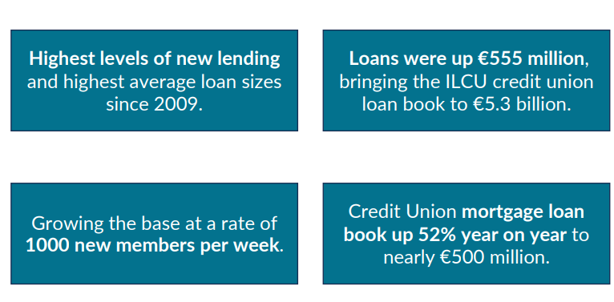
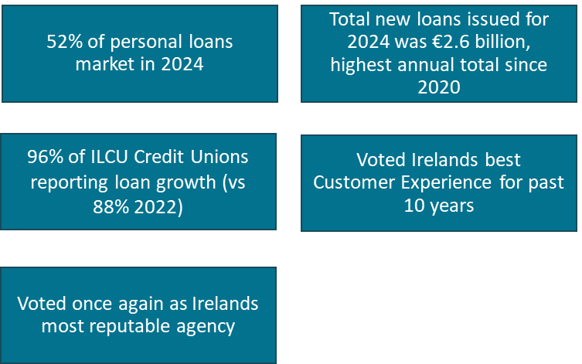
The application of evidence-based strategic consultancy triggered an organisational impact which rippled outwards and delivered a durable framework for success. That success has been demonstrably achieved via tangible organisational wins, and the evident resurgence of Credit Unions in their sector.

