Slide 1
How to Solve a Problem like the Climate Crisis
National Dialogue on Climate Action
Marketing Society Awards Showcase
January 2025

Slide 2
According to the UN, climate change is the defining threat of our time...
…but there are problems that have big implications for policy makers

Slide 3
We are worn out hearing about the crisis…
© Ipsos B&A | MarSoc Awards Showcase | Jan 2024 | Final | Strictly Confidential
3

Slide 4
…with Our levels of concern dropping
© Ipsos B&A | MarSoc Awards Showcase | Jan 2024 | Final | Strictly Confidential
4

Slide 5
Climate crisis is happening somewhere else, to someone else and/or at some time in the future.

Slide 6
The public has a very poor understanding of which actions are most beneficial.

Slide 7
There is a focus on behaviours such as recycling yet how we heat our homes and travel around our country are most impactful.
59th

Slide 8
Policy Implications for engaging individuals
© Ipsos B&A | MarSoc Awards Showcase | Jan 2024 | Final | Strictly Confidential
8

Slide 9
The National Dialogue on Climate Action
National Youth Assembly on Climate
150 – 200 young people 12 – 24
2 National Climate Stakeholder Forum Events
200+ stakeholders engaged in cocreating policy
2023 Climate Conversations Online Survey
4,000 people consulted
12 workshops inc. vulnerable populations
EPA Climate Change in the Irish Mind
Providing nationally representative data
Behavioural Insights Mapping
Exploring 11 barriers to climate action

Slide 10
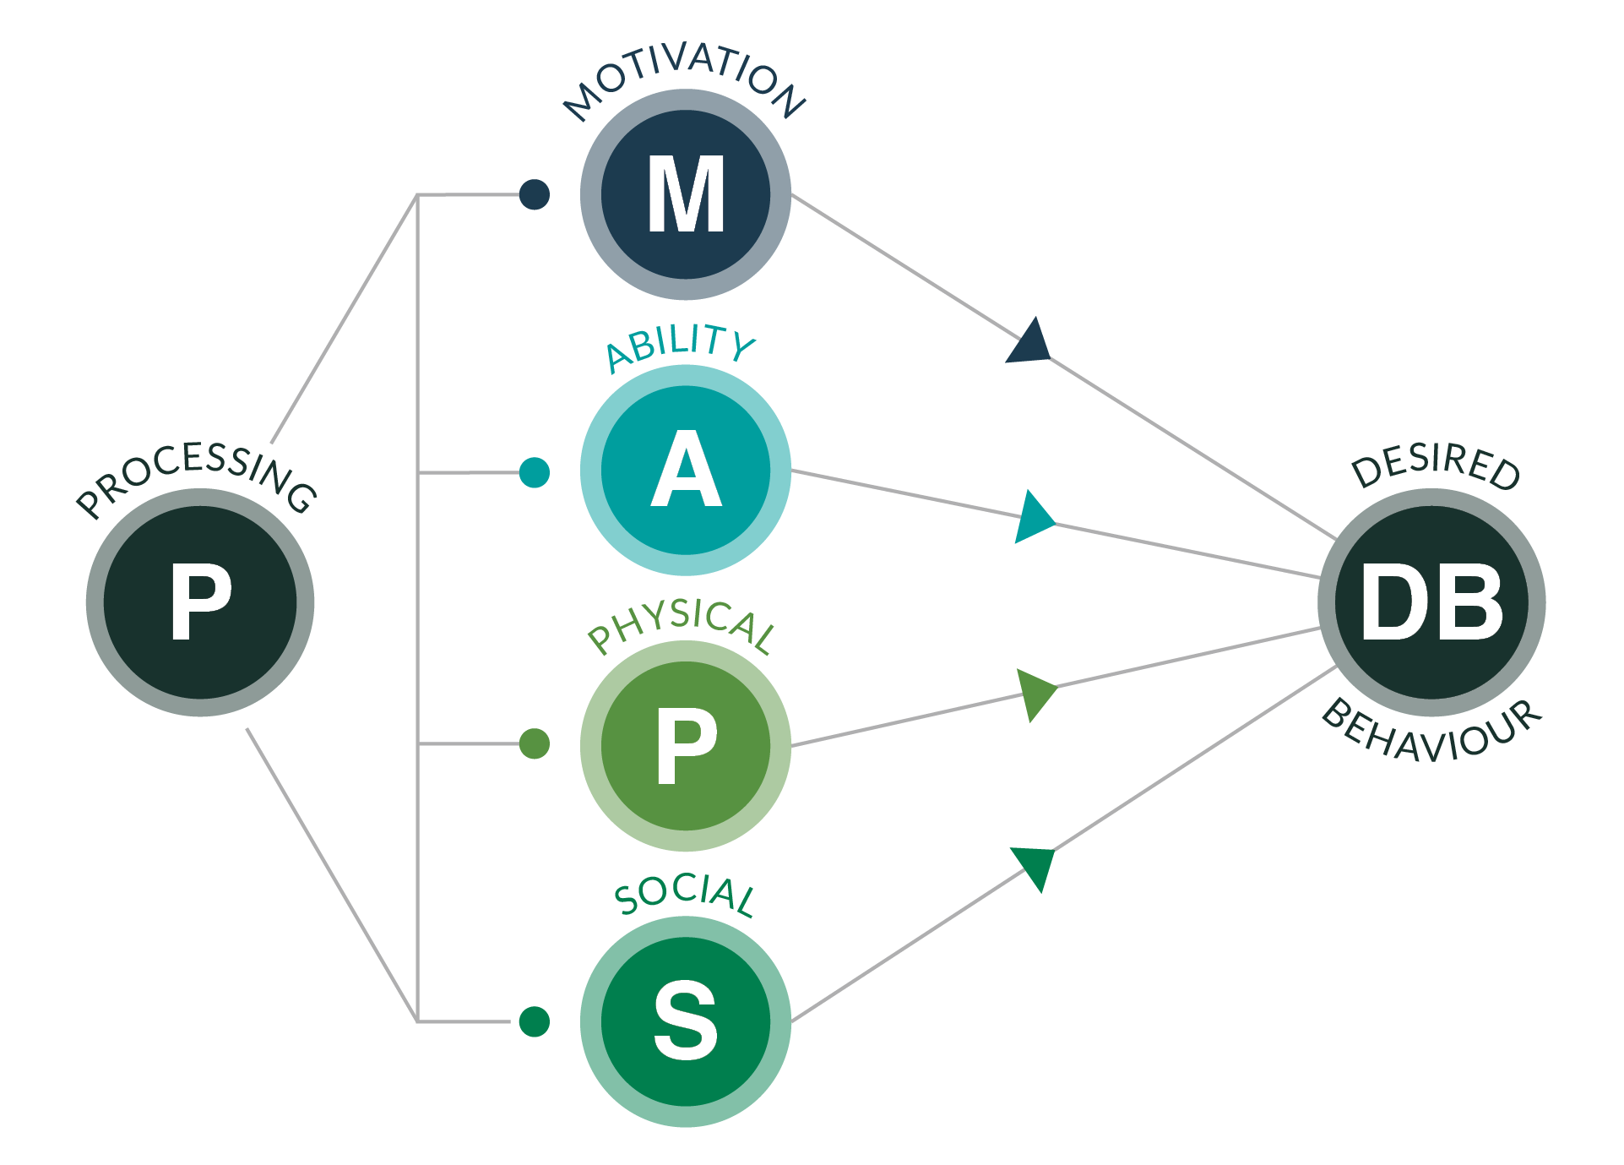
MAPPS Utilising Behavioural Insights to Overcome Barriers

Slide 11
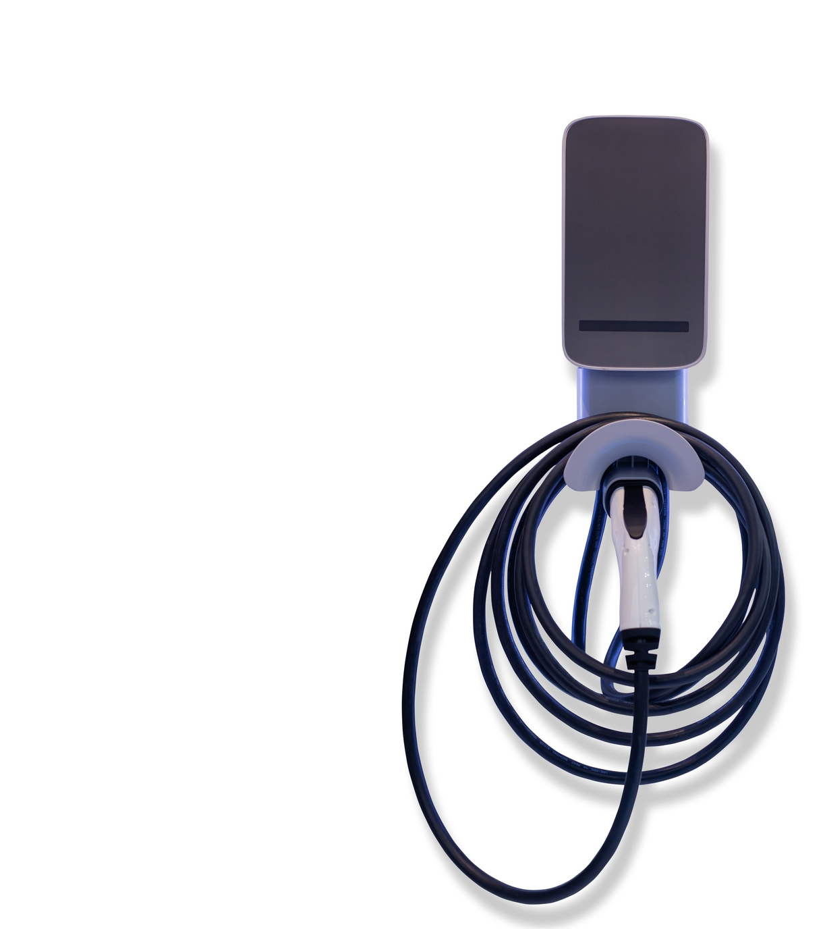
Doubts about Infrastructure and
Environmental Benefits
are evident, particularly for men
Electric Vehicles

Slide 12
Barriers to Solar (& Wind)
Physical barriers combined with doubts about the Environmental Benefits (Male) and Capability (Female) stand out.

Slide 13
Barriers to taking fewer flights
Living on an island we identify as a nation that flies. Particularly challenging for those under 35.

Slide 14
What do you see here?
14
14

Slide 15
Or here?
15
15

Slide 16
The NDCA - Multiple Elements of this Evolving Project
Understanding where citizens are, not where we want them to be.
Consider the limited capacity that citizens have.
Targeting behaviours that make a difference.
Building on individual to community initiatives.

Slide 17
Outcomes in 2024…
Inputs
Activity
Communications
Replicable model
More people supported to take climate action
National events
Community activations:
Place, Interest, Vulnerable Populations
Resources and training: mapping, toolkits, training, funding, supports
Identify barriers & real-world solutions
Outcomes: Communities
Better policy
Climate policy
Insights
Outcomes: Policy
Measurable change
Improved social contract on climate action
… are inputs in 2025

Slide 18
THANK YOU
Niall McCaffrey
Dr. Robert Mooney

