Slide 1


RTÉ Player: Real People Behind 4 Screens
Submission for: Media Research
Submission by: RED C (Richard Colwell, Aoife Marron and Colm O’Cleary)
Client: RTÉ

Slide 2
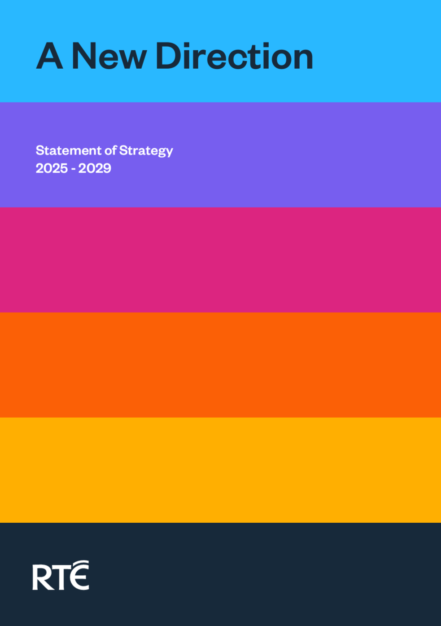
Goal 2: Provide excellent streaming products and services
Quality digital products offering an enhanced and personalised experience
Developing RTÉ Player as a competitive destination for streaming video content
Providing access to an expanded and digitised RTÉ Archives

Slide 3
RESEARCH OBJECTIVE
To gain a deeper understanding of RTÉ Player user behaviour and experience, in order to drive growth both from a user and commercial point of view

Slide 4
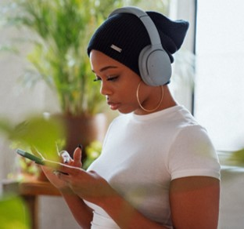


Research Focus
Player & Audience
Commercial Focus
Player Value
A deeper understanding of users and their profile, how viewers interact with the Player and how it fits into their daily lives
Key statistics which can be used as a tool in assisting in advertising sales
Close the gaps in knowledge in terms of incremental reach and advertising effectiveness
Provided RTÉ with the necessary tools to grow audience numbers, increase streams and drive advertising revenue for the RTÉ Player

Slide 5
Research Approach
2

Slide 6




Research Approach: Quantitative Phase
Recruitment
Behaviour Survey
Daily Recall Survey
An online survey – with a core sample of weekly/monthly RTÉ Player users, and a control sample of linear only users
A 15-minute survey, capturing demographic and media consumption information, device usage and user experience metrics
One week diary where each day their media consumption for ‘yesterday’ was captured in a 5-minute recall survey.
Increasing Survey Accuracy
This ‘daily recall’ helped maximise real recall of ads seen on the Player and minimise misattribution of ads to other channels

Slide 7


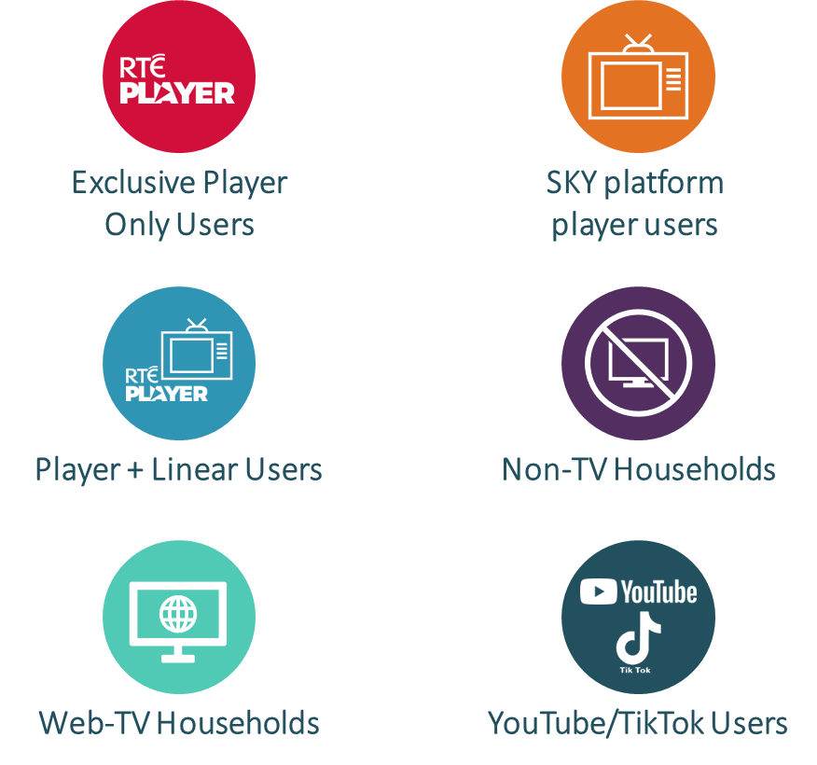
Research Approach: Three Key Objectives
Profiling and Viewing Player Behaviour
Understanding Player Incremental Reach
Proving Player impact on Ad Effectiveness
Providing RTÉ with a greater understanding of who the viewers are and how they interact with RTÉ Player
To measure incremental reach of advertising campaigns that were rolled out across both BVOD and linear channels.
Based on respondents’ viewing ‘yesterday’, recall an engagement of advertising was measured, to assess the impact and effectiveness of the advertising on RTÉ Player, and the extended reach it garnered.
Incremental Contribution
14%
56%

Slide 8


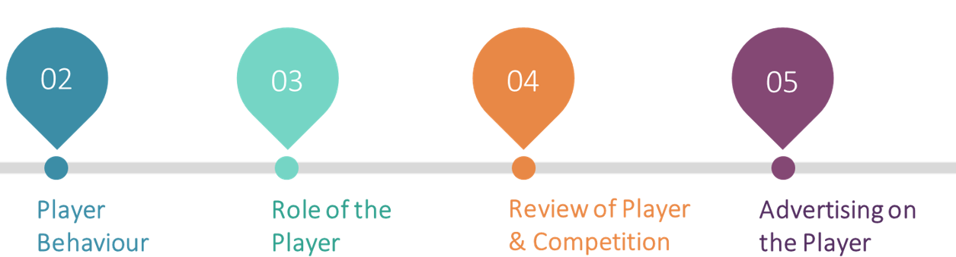
Qualitative Phase
50% Completed a Focus Group Pre-Task
Focus Groups
8 x 60 min online focus groups gave the opportunity to build on the thinking nurtured during the pre-task and explore their behaviour, usage and the Player role and performance. The topics covered the following areas:
WHY?
To collect feedback on BOTH natural and prompted behaviour so as to cultivate in-depth thinking on Player and usage for the group conversation.
TASK:
Player Exposure Diary over 3 days - Each day, a different task was released which involved Player engagement and feedback

Slide 9
Research Findings
3

Slide 10




RTÉ Player offers something unique & inimitable
Irishness
Connectivity
Notes:
Majority view Player as the home of Irish on demand content which makes audiences feel more connected and part of it.
Irishness: Be it location, actors, realities, humour or storylines, there’s pride and appetite for Irish content that feels modern and reflective of real Ireland.
Connectivity: A connection to the nation and a connection to reality.
Connectivity: With RTÉ I feel I’m grounded in reality. You can escape but you’re not removed. With Netflix, you’ve no placement in time.

Slide 11
Heavy vs. Medium and Light Viewers of RTÉ Player
Heavy Users
Medium/Light Users
DEVICE
View Player across multiple devices
Use just one device to view Player, generally a TV set
TIME
Higher mid-week morning and afternoon viewing
Mid-week viewing mostly limited to evenings
LOCATION
Watch in multiple locations within their homes
Mostly living room viewing
CO-VIEWING
Co-viewing with partners, family and children
more likely to view alone most often
ATTENTION
Greater attention paid to content
More likely to be also using a second device while watching
CONTENT
Watch Live content and box sets
Viewing mostly focussed on on-demand
Greater likelihood to watch multiple genres; soaps, news, talent shows, comedy, music
Medium users are slightly more likely to watch documentaries and movies
SHOWS
BEHAVIOUR
More likely to browse Player for something to watch
Already know what they want to watch
Notes:
Call out that the heavier users know what they want to watch.

Slide 12









What People Watch At Home vs On the Go
AT HOME
ON THE GO
#1
Drama
#1
News
#2
Documentaries
#2
Sport
#3
News
#3
Drama
#4
Sport
#4
Comedy
#5
Soaps
#5
Documentaries

Slide 13


Audiences believe RTÉ Player is a good offering, and they like it – in fact, the more they use it, the more they like it!
68%
It really feels like RTÉ are trying to match the likes of Disney+ and Netflix now and they’re doing a good job.
NET: Satisfied
Heavy Users
Medium Users
Light Users
77%
72%
59%
Notes:
Heavy users more likely to…
Access using multiple devices
Use for on-demand and exploration of content
Watch with others in the household

Slide 14
Overall, audiences come to the Player knowing what to watch
Content Loves
Movies
HBO Boxsets
88%
RTÉ produced Boxsets
Non-RTÉ produced Boxsets
Documentaries
Net Agree:
When using RTÉ Player, I generally already know what I want to watch
Notes:
Upside to this is it’s appointment to view – this means they’re engaged.
Vast majority access with intent
CONTENT FANS: for missed habitual view (e.g., soaps).
RECOMMENDATIONS: will tune in based on word of mouth with friends, family, work colleagues.
FOMO: content gaining traction on social will be sought out.
PROMOS: some will take note of programming promoted in ad breaks to watch on Player.

Slide 15
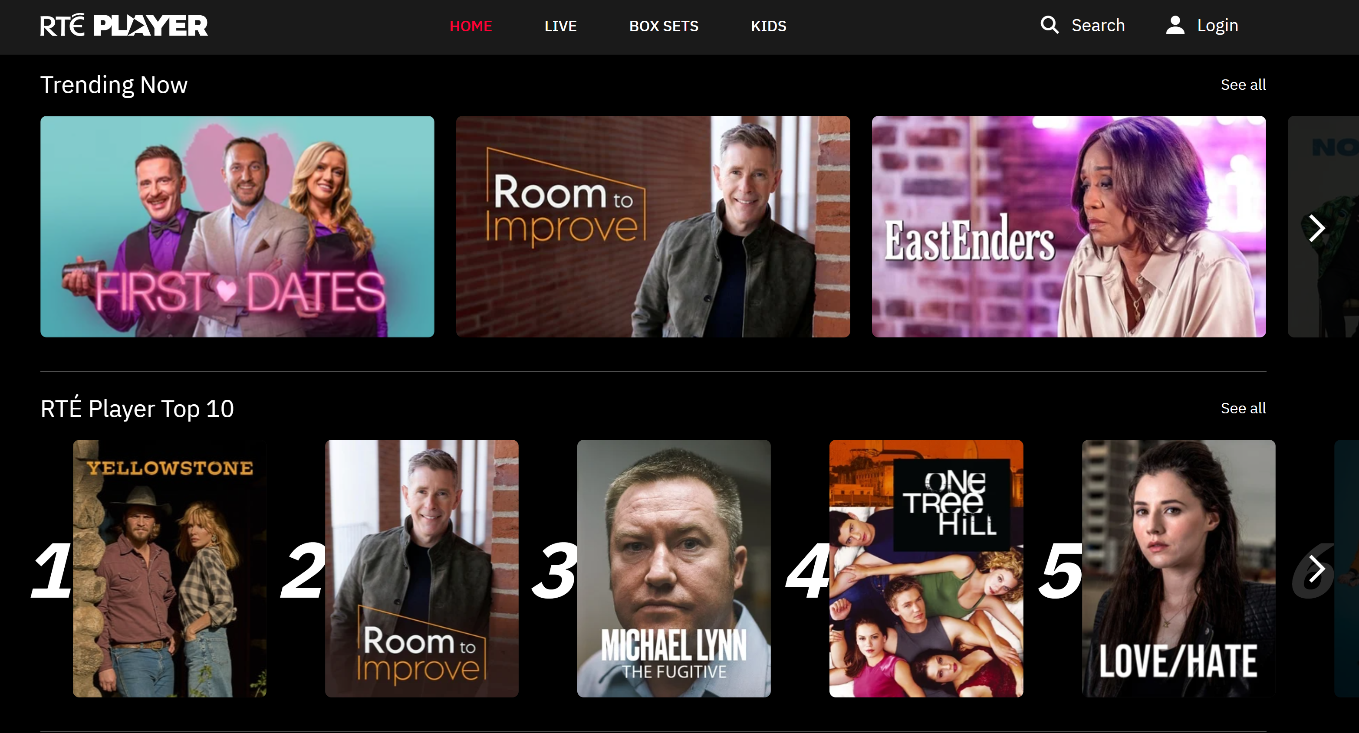
Content range is a surprise to many.
There’s benefit in further promoting what The Player has to offer and how it’s more than what is on linear.

Slide 16


Lighter users are less aware of the breadth of box sets and streaming library on offer.
ACTION - In order to increase engagement there is an opportunity for RTÉ to further promote the strong streaming offerings within Drama, Documentaries and Comedy.
There is an opportunity to promote more streaming

Slide 17

With high levels of solo and dual viewing, and the freedom OD offers, we see strong engagement levels with Player
RTÉ TV
RTÉ Player
NET Engaged
82%
90%
Very engaged
Quite engaged
Not very engaged
Not at all engaged
NET Not Engaged
18%
10%
Notes:
Share opinion as to why this is – choice – they chose and know what they’re watching – more committed and watching with intent.
More engaged on smartphones than on TV.
Call out 82% is a very strong

Slide 18
Daily diary respondents exposed to RTÉ TV and RTÉ Player had an average recall uplift of +26% versus those exposed to RTÉ TV only
Watched RTÉ TV ONLY ‘Yesterday’
Watched RTÉ TV AND RTÉ Player ‘Yesterday’
% proportion uplift
+29%
-24%
-15%
+71%
+42%
+16%
+44%
=
+62%
+38%
Average Recall Uplift
(Top Ten Brands recalled)
+26%
Amongst adults who watch RTÉ TV and RTÉ Player
Notes:
Note: Respondents were shown a list of brands that were advertising on RTÉ TV and Player during the week of the daily diary surveys
Pull out telecoms as an example
Explain Player exposes brands to new and different audiences.

Slide 19

In addition, advertising on RTÉ gives brands legitimacy
I was looking for blinds and I was looking at Hillarys, they kept coming up on social media. Then I saw them on RTÉ Player, and I said, do you know what, they’re reputable if they’re on RTÉ. I don’t know if I’d have gone with them until I saw them on RTÉ Player.
Notes:
Appreciate the freedom of linear and BVOD advertising – don’t feel tracked or listened to which can feel invasive.
Brand advertising on RTÉ are perceived to be successful brands who can afford the premium of the platform. Perception that anyone can pay for advertising on social or YouTube.
A belief that brands advertised on RTÉ go through a form of “vetting” – the organisation would not support/promote brands posing a risk.

Slide 20


ACTION – promote the fact that joint TV and Player advertising positively impacts campaign reach
ACTION – promote the fact that brands advertising on an RTÉ platform benefit from an extra legitimacy (signalling) not secured elsewhere.
The Player can drive extra advertising campaign reach

Slide 21
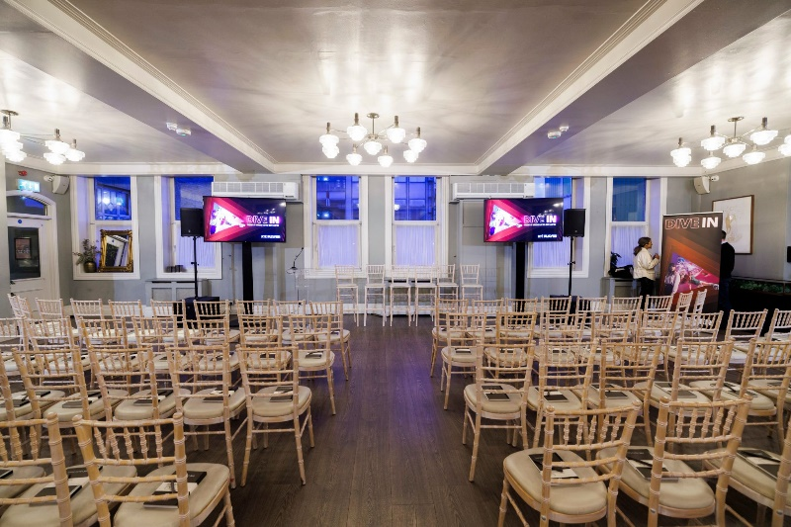
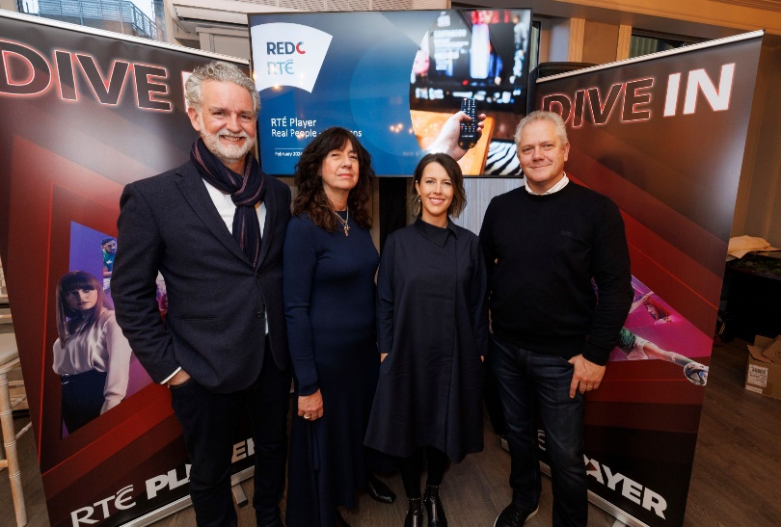
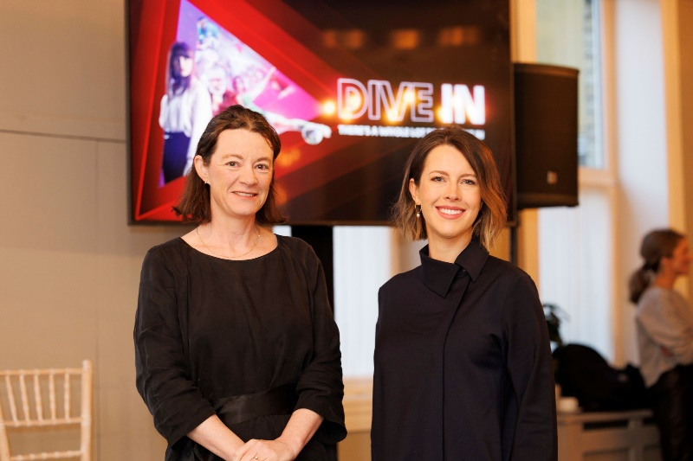
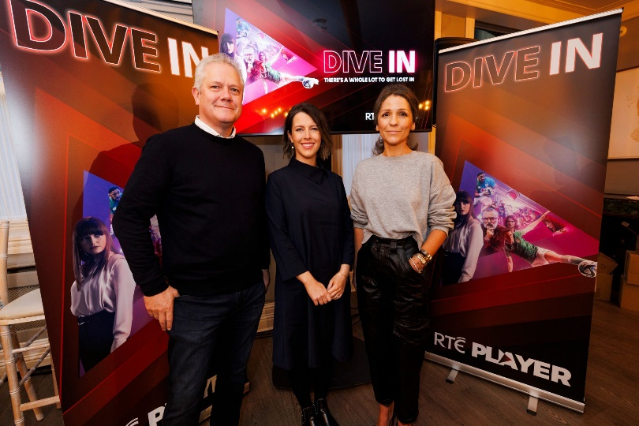
Insights were presented at an Industry event for media buyers
Over 100 attendees gathered to learn about how they could better use RTÉ Player at the Dive In event

Slide 22
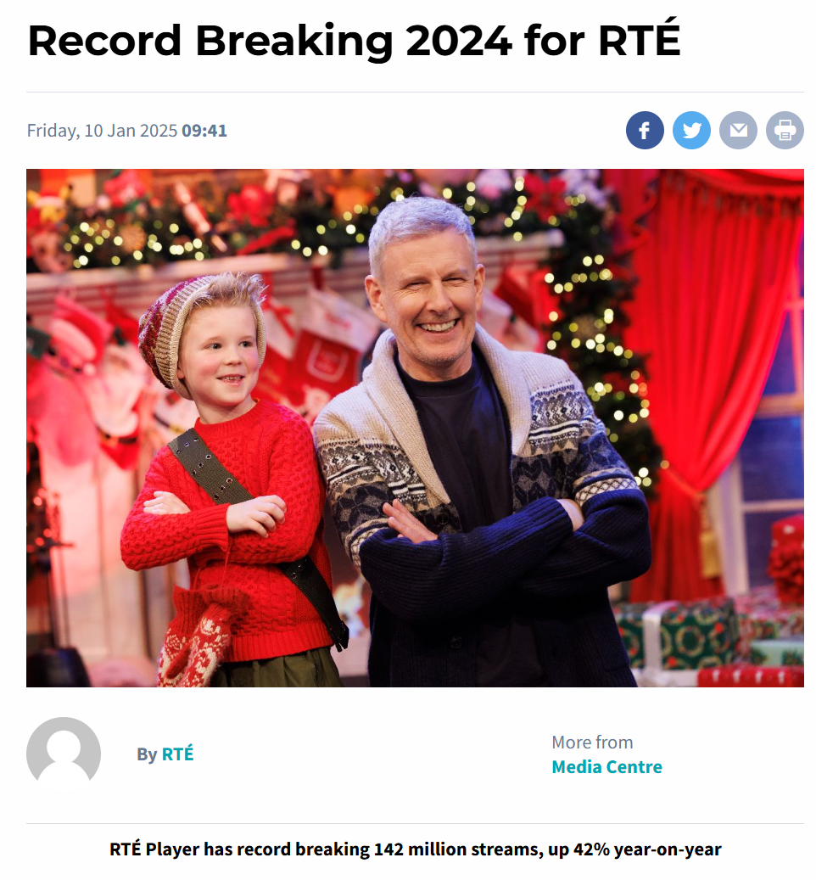
RTÉ Player had it most successful year to date attracting a record-breaking 142 million streams in 2024, representing a year-on-year increase of 42%.
Notes:
The research insights gave RTÉ a deeper understanding of the Player audience and a clearer focus on who to target, which when acted upon helped to drive increased viewership and frequency.

Slide 23


Research Impact
Strengthened Selling Power
Revenue Growth
The findings have also been successfully utilised by the RTÉ sales teams, helping secure strong growth in advertising revenue for the platform.
Demonstrating the effectiveness, increased campaign reach, has strengthened the selling power of the Player and enabled RTÉ sales teams to create premium offerings to clients and agencies
Year-to-date increase in revenues of +31%, the Player’s most successful ever sport sell across RTÉ’s Summer of Sport, and RTÉ’s biggest ever VOD sell in the Late Late Toy Show, with revenues already up +341% Year-on-Year
+26%
+31%
YoY Ad
Revenues
Ave. Ad Recall Uplift

Slide 24
