Slide 1



Irish marketing …
We have a talent problem!
Notes:
I’m usually kind of an upbeat optimistic person, so it’s unusual for me to start a presentation with a negative but the reason I’m here and the reason our company exists is precisely because we have a talent problem.

Slide 2

Key Challenges facing Marketing & Comms
ESG
Re-aligning sales and marketing
Artificial Intelligence
Brand Purpose and authenticity
Marketing effectiveness
The right talent
Notes:
And it’s not just a talent problem……. The whole sector is experiencing a huge amount of challenges because of the seismic changes we have seen in recent years.
I’ve experienced so much of it. When I started working in this industry back in the 90’s (30 years ago) you were lucky to get a job in advertising and when you got one, you held on to it and you were grateful for it even if you were inhaling second hand smoke and generally being a bit of a dog’s body. We embraced technology by investing in an office microwave and digital was just a line at the bottom of the media plan. We would snort and guffaw at the idea of the digital future and believed nothing would ever replace the 30 second TVC.
But it’s all so different now and they say the only constant is change. But in our industry the rate and pace of that change is overwhelming.
Re-aligning sales and marketing.
Navigating ESG
Being effective
Being authentic
Keeping at pace with and leveraging technology effectively …including Gen AI
And with all this change and the pace of it, you need the right talent to keep the show on the road.. And the problem is that highly skilled and experienced people who know what they’re doing are very hard to find.

Slide 3
Skilled workers are taking back control
Notes:
And this was the problem that we set out to tackle back when we set up The Indie List in July 2020.
What we have discovered is that there has been a monumental phycohological shift in how many people who work in our industry feel about full-time employment and while this re-appraisal have been taking place gradually over many years, the pandemic accelerated the changes in peoples’ behaviour, mindset & expectations about their work.

Slide 4
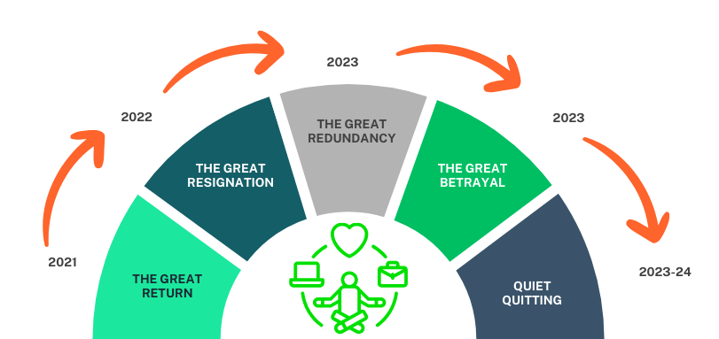
It’s been a career roller-coaster for many
Notes:
Over the last number of years we have been reading about – and experiencing - the Great Resignation, The Great Reconsideration, and Quiet Quitting. Now, we are in the wake of Loud Layoffs, we’re hearing about the Great Betrayal and that’s causing workers to consider breaking up with full-time work and opting for the freedom and flexibility of freelancing and self-employment.

Slide 5

Notes:
We get calls every week from people who are thinking of leaving their jobs and going freelance. Some of them are unhappy, burnt out and fed up and others have gone so far up in their careers that they’ve moved further away from the work that they love doing and have found themselves doing work that leaves them unfulfilled.

Slide 6
Irish marketing …
The invisible talent layer

Slide 7


18,000
Notes:
We estimate that there are roughly 18,000 people working in what we might collectively call the Irish marketing & marketing services sector.
The bulk of these are working in client-side roles in marketing and brand management roles…about 8,000.
However, when one looks at the people serving those companies, marketing depts and brands, we estimate that it now stands at about 10,000 – 3,800 in agencies – creative, digital, design, PR, event, agencies and around 6,000 freelancers and independent marketing consultants.

Slide 8
Serving, creating, implementing
3,800
Advertising, PR, Digital, Media, Sales Promotion, Sponsorship, Design agencies
AGENCIES
6,000
MARKETING & CREATIVE FREELANCERS
Notes:
The bulk of these are working in client-side roles in marketing and brand management roles…about 8,000.
However, when one looks at the people serving those companies, marketing depts and brands, we estimate that it now stands at about 10,000 – 3,800 in agencies – creative, digital, design, PR, event, agencies and around 6,000 freelancers and independent marketing consultants.

Slide 9
…but supported by skilled independents
3,800
Advertising, PR, Digital, Media, Sales Promotion, Sponsorship, Design agencies
AGENCIES
MARKETING & CREATIVE FREELANCERS & CONSULTANTS
6,000

Slide 10
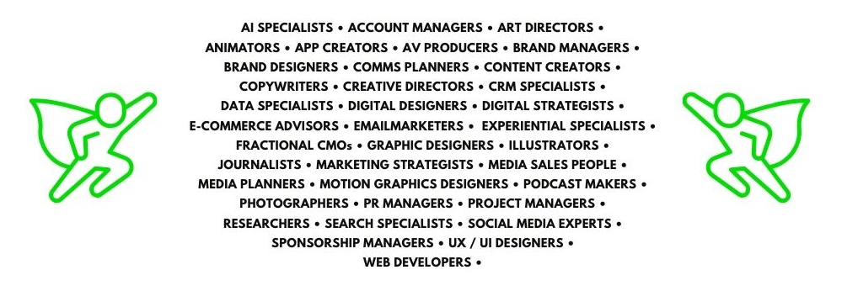
An extensive pool of hidden talent
Notes:
These are not just creative freelancers. Since we started the Indie List the talent pool has become much more specialized. This is just a cross section of the types of skills that are available to companies on a freelance or contract basis.

Slide 11
1.5bn
Notes:
This is by no means unique to Ireland…we are seeing it from many of our friends and colleagues who operate similar businesses to The Indie List in other markets. In fact we know that there are over 1.5 billion (and growing) freelancers worldwide, representing around 35% of the global workforce.
Some are giggers.

Slide 12
The talent genie is out of the bottle
Notes:
So the genie is out of the bottle. There is no going back. People feel let down but their employers; they want more agency over their work and more control in the lives. What they say to us is that they want work to fit into their life, not the other way round.
The factors that are influencing this trend speak to both personal and professional aspirations that traditional employment may not provide.

Slide 13
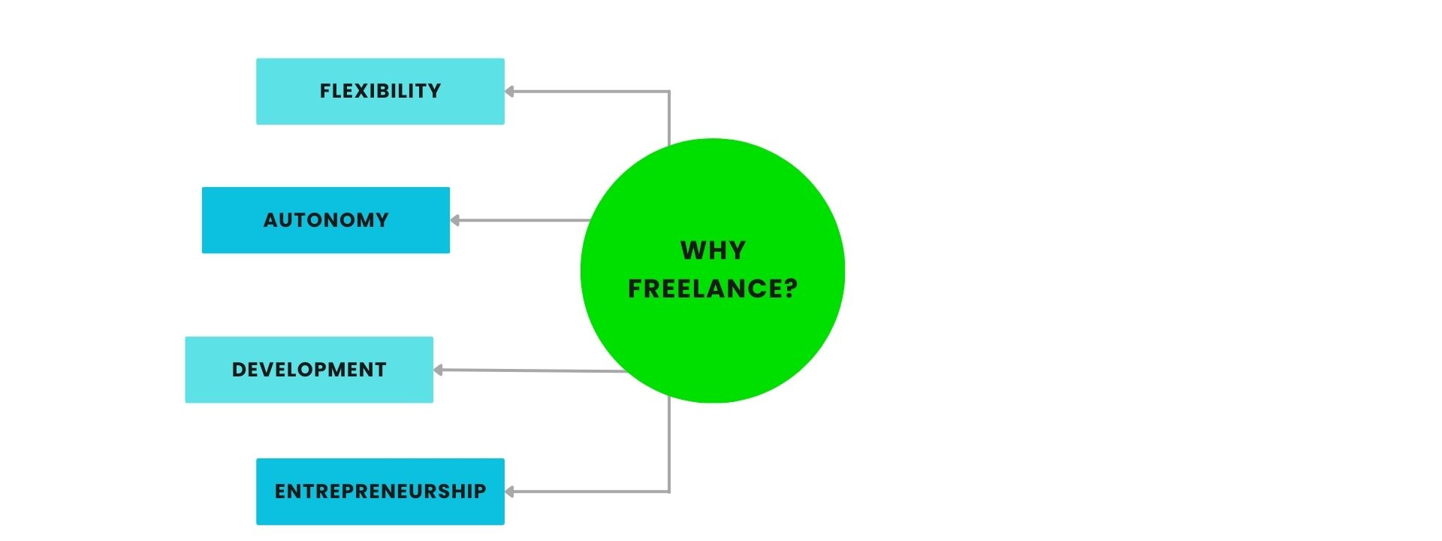
What’s causing this?
Notes:
Flexibility – they want a work-life balance that suits their lifestyle, family commitments and personal preferences.
Autonomy and agency over their work – they want the freedom and permission to choose the projects they find meaningful and fulfilling. They want to choose their clients, set their own rates, develop their own personal brand and choose when and where to work – sometimes even turning work down. The greatest sign of a truly liberated freelancer.
Rapid Skill Development – working on a variety of projects for different clients accelerates learning and skills development. Freelancers are often in a position where they have to adapt quickly to new categories, tools and technologies and this adaptability and agility make them highly competitive.
Entrepreneurial spirit – When I started freelancing I thought it was because I was a bit of a square peg in a round hole. I now know that it was because I was a closeted entrepreneur. Freelancing appeals to individuals with an entrepreneurial mindset who prefer to be their own boss. It allows them to build their brand, expand their professional network, and potentially grow their business beyond solo freelancing.

Slide 14
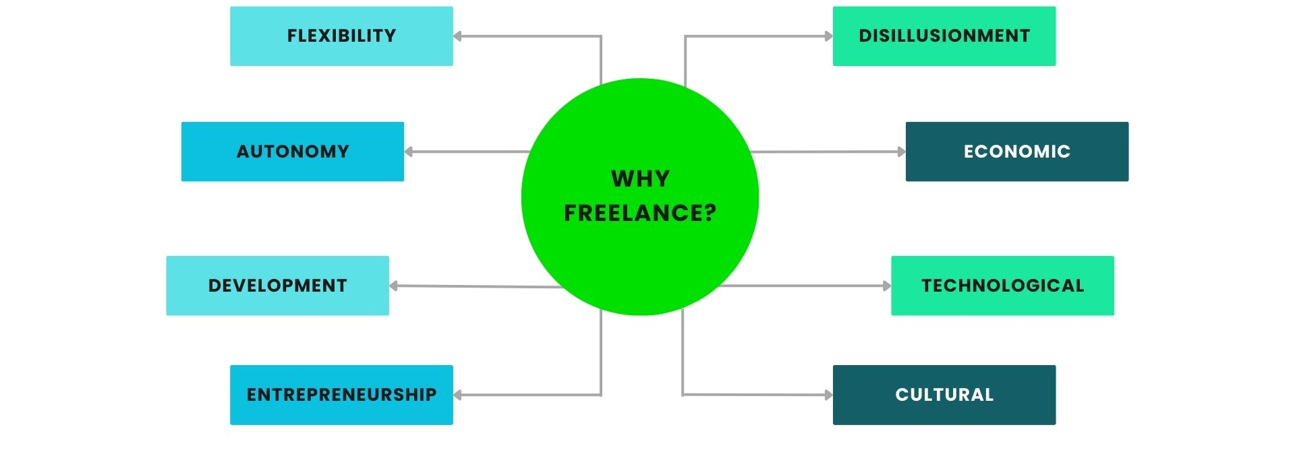
What’s causing this?
Notes:
Disillusionment with traditional employment: Many highly skilled workers become freelancers after becoming disillusioned with some of the realities of traditional employment, such as office politics, bad culture, a lack of appreciation for their work, limited growth opportunities or unhealthy work/life balance.
Economic factors: Economic downturns and shifts in the job market can also push professionals towards freelancing. Companies may reduce full-time positions and rely more on freelancers for specific projects, creating opportunities for independent workers.
Technological advancements – have made freelancing more accessible and viable than ever before. Digital platforms, communication tools, and project management software empower freelancers to work efficiently, find clients, and manage their business from anywhere in the world. The pandemic accelerated all of this and made it acceptable.
Cultural shifts – there has been a psychological shift towards valuing independence, personal growth, and the freedom to choose one's path. The traditional career trajectory is no longer the only measure of professional success.

Slide 15
In conclusion…
Notes:
The rise of freelancing is a huge trend that comes with massive opportunities but there are also some risks and challenges that you need to consider:
First of all, freelancers are not just available to stop the bleeding. They can be used so much more effectively but it means you have to rethink their role in the broader talent and workforce mix and ensure that number one, they complement the skills of permanent staff and number 2, you create the conditions for them to succeed in the same way you would for FTEs.
Having clear policies and frameworks in place for engaging and onboarding freelancers. Working with a platform like The Indie List is a great starting point.
Ensuring there are process and tools in place to facilitate remote work and collaboration.
Building long-term mutually beneficial relationships with trusted freelancers to ensure reliability and consistency.

Slide 16
Irish marketing …
We have a talent problem
solution!
Notes:
I started off this presentation by saying that we have a talent problem. But in actual fact, it doesn’t have to be this week if we would open our minds to the opportunities that are

Slide 17
The smarter way to hire
marketing talent
Strictly Private & Confidential

Slide 18
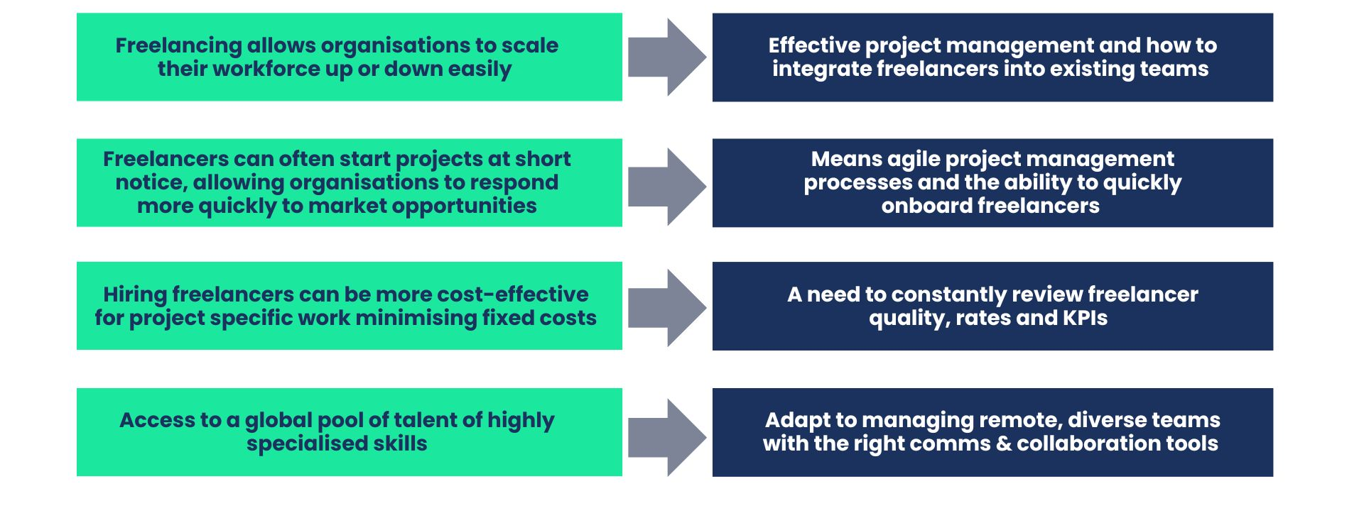
Implications for business

Slide 19
And we’ve made it easier to access it
1,300+ freelancers across all disciplines
Launched Fractional CMO Collective
The first global Trusted Talent Platform Award
1,000 freelancers incl. marketing experts
300 freelancers incl. digital & e-commerce experts
Launched with 55 creative freelancers
Feb 2024
Nov 2023
Feb 2023
Jun 2022
Jan 2021
July 2020

Slide 20
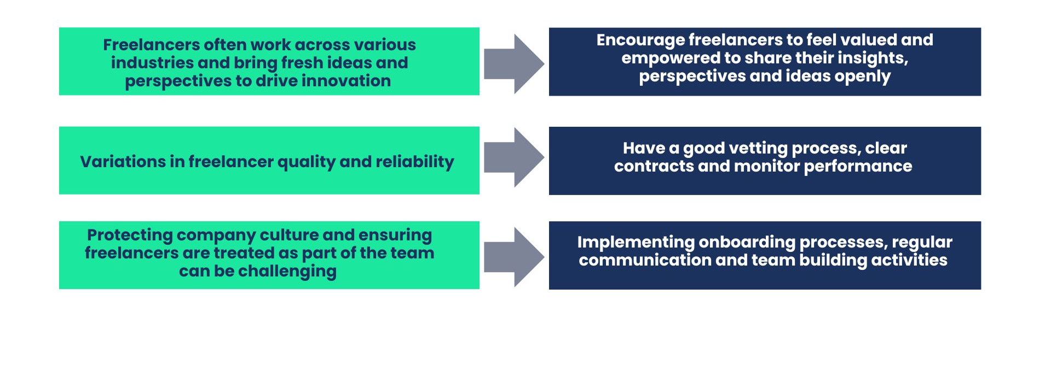
Implications for business

Slide 21
Conclusions

Slide 22
Implications for businesses like yours.
Access to a global pool of talent not limited by geographical constraints = access highly specialised skills for specific projects
Businesses must adapt to managing remote, diverse teams and ensure effective communication and collaboration tools are in place.
-
Freelancing allows organisations to scale their workforce up or down easily without the overheads of permanent staff.
-
Important to have effective project management and a clear understanding of how to integrate freelancers into existing teams seamlessly.
Freelancers often work across various industries and bring fresh ideas and perspectives that can drive innovation within organisations.
Create environments where freelancers feel valued and empowered to share their insights, perspectives and ideas openly.
-
Notes:
There are several significant implications for organisations like yours who need access to talent in order to grow and remain competitive and it requires a rethink about workforce strategies, talent acquisition and project management.

Slide 23
Implications for businesses like yours.
Freelancers can often start projects at short notice, allowing organizations to respond more quickly to market changes or project opportunities.
This requires having agile project management processes and the ability to quickly onboard freelancers and integrate them into teams.
-
Hiring freelancers can be cost-effective for project specific work, reducing the need for full time salaries, benefits and office space.
-
Organisations need to carefully manage freelancer rates and budgets and KPIs, considering the total cost of the engagement in order to justify and promote the business case.
While many freelancers are highly professional and delivery excellent quality work, there will always be variations in quality and reliability.
-
Establishing strong vetting process, having clear contracts and maintaining rigourous performance monitoring can help to mitigate these risks.
Protecting company culture and ensuring freelancers are treated as part of the team can be challenging but it is essential for project success
-
Implementing onboarding processes, regular communication and team building activities can help build a cohesive team ethos.
Notes:
There are several significant implications for organisations like yours who need access to talent in order to grow and remain competitive and it requires a rethink about workforce strategies, talent acquisition and project management.

Slide 24
In conclusion
The rise of freelancing is a significant trend that offers both opportunities and challenges for organisations. To really benefit from this trend, access specialised skills, and drive innovation while being mindful of the associated risk factors and challenges, there are a number of important things organisations need to consider:
Rethinking the role of freelancers in broader talent and workforce strategies, ensuring they complement the skills of permanent staff.
Having clear policies and frameworks in place for engaging and onboarding freelancers. Working with a platform like The Indie List is a great starting point.
Ensuring there are process and tools in place to facilitate remote work and collaboration.
Building long-term mutually beneficial relationships with trusted freelancers to ensure reliability and consistency.

