Slide 1
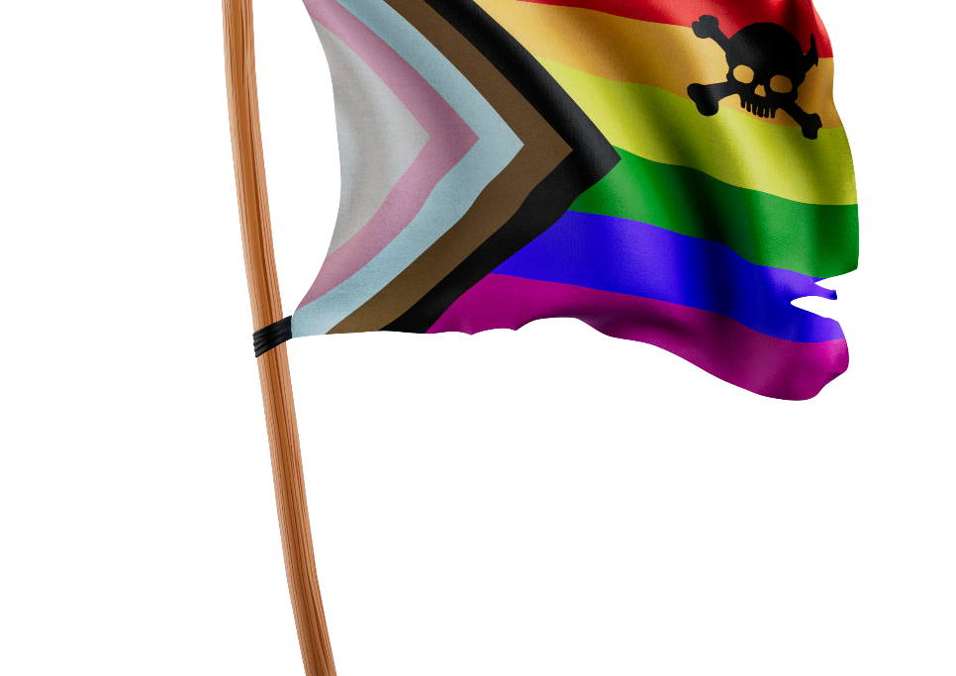


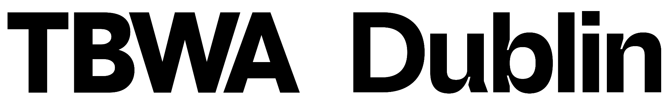
WE
ARE THE
COMPANY
X
The Secret to Effective Creativity: Having an eye for bias.
APR 27, 2023
Notes:
Having an eye for bias, it’s obviously hugely important during the agency’s creative process so here we’re going to share some common biases that we see, how we overcome them and hopefully some useful tips

Slide 2
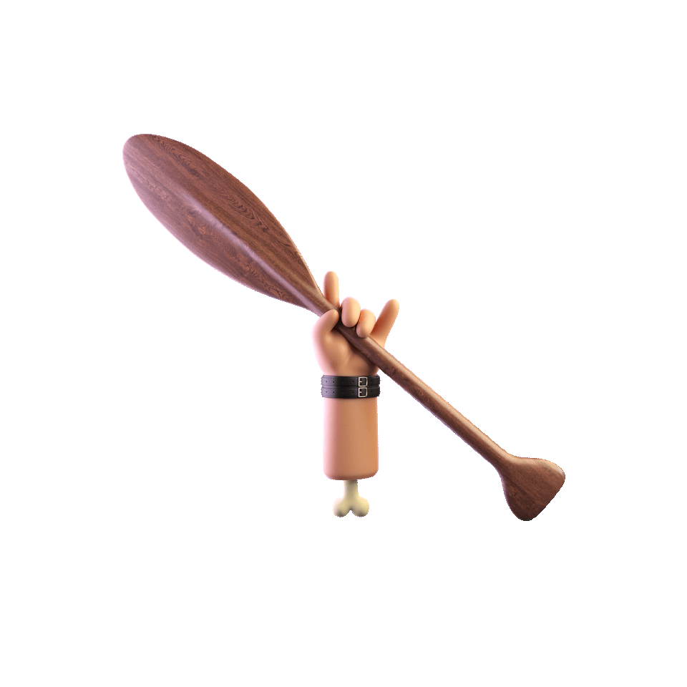
WHY WE’RE
HERE
TBWA\Worldwide
The Disruption Company®
© 2023 TBWA \ Worldwide. All Rights Reserved. Proprietary and confidential.
2
Notes:
Now, We all have biases, good and bad, and many of biases will be unconscious, even when they inform or even dictate what we do. But what happens when those unconscious biases seep into our work and the creative process? There are a couple of ways this can happen; the most well-known is in the actual messaging and creative in our campaigns, whether that’s a lack of diversity in the visuals or a lack of awareness of cultural sensitivity around specific words or phrasing. But also unconscious biases also come into play through out the creative process - from audience segmentation decisions to the very technology we use to run those campaigns.

Slide 3
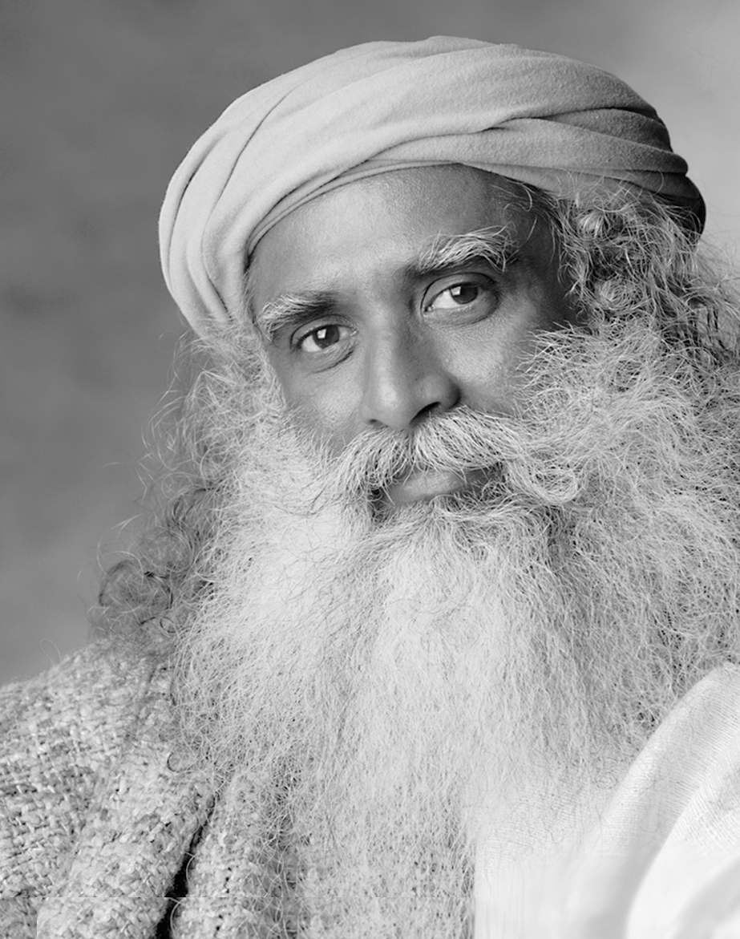
"
When your mind is full of assumptions, conclusions, and beliefs, it has no penetration, it just repeats past impressions.
"
Yogi Sadhguru
TBWA\Worldwide
The Disruption Company®
© 2023 TBWA \ Worldwide. All Rights Reserved. Proprietary and confidential.
3
Notes:
Let’s look at understanding why biases happen. You can help uncover your biases and begin to overturn them by collaborating with people different from you.

Slide 4
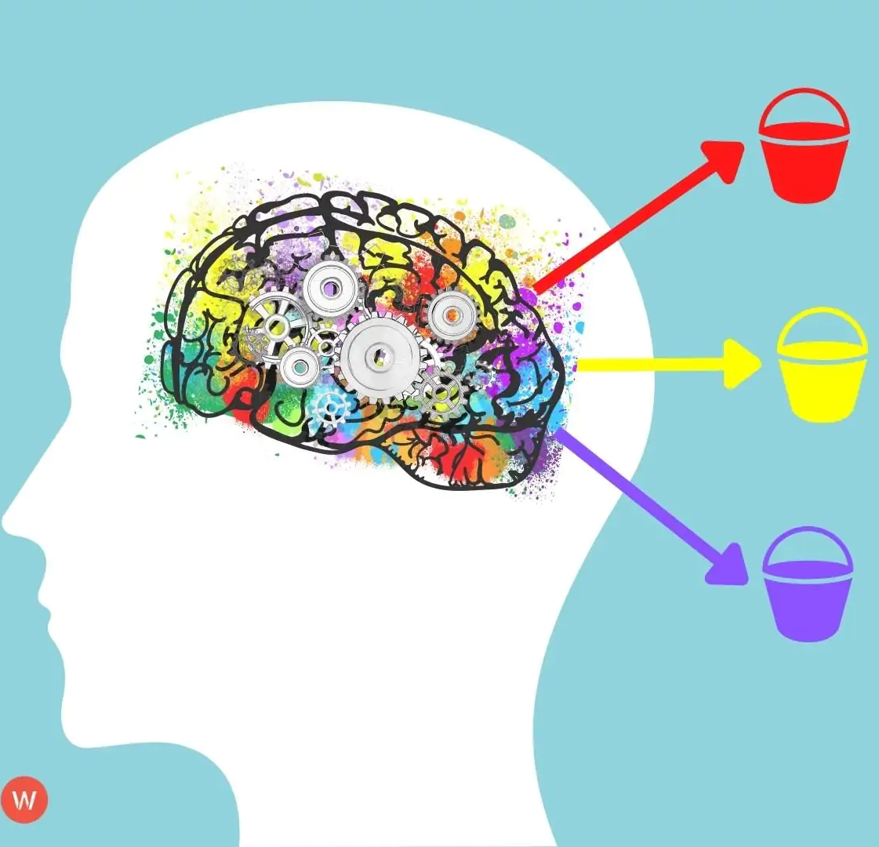
Biases are created because our brains are built to sort a lot of complex input data into simple categories.
Notes:
We shouldn’t be too hard on ourselves here as this is how our brains are built. . So how does bias affect us in advertising? It simply means that we can end up relying on assumptions to make decisions about who our brands are marketing to and what we want to say to attract those consumers

Slide 5

Ethnicity
Religion
Gender
Class
Age
BIAS GROUPINGS
Culture
Sexuality
(Dis)Ability
TBWA\Worldwide
The Disruption Company®
© 2023 TBWA \ Worldwide. All Rights Reserved. Proprietary and confidential.
5
Notes:
These biases spring from a lifetime of exposure to cultural attitudes, norms, traditions, and other factors that affect how we view gender, race, age, ethnicity, religion, economic class, sexuality, disability, and nationality (as well as other groups of characteristics). That’s why they can be very difficult to identify, challenge, or solve for.

Slide 6
LACK OF
DIVERSITY
?
TBWA\Dublin
The Disruption Company®
© 2023 TBWA \ Worldwide. All Rights Reserved. Proprietary and confidential.
6
Notes:
And of course As an industry, our lack of diversity does nothing to help us overcome our biases. The vast majority of workers in the Irish advertising industry are from the affluent middle class, and only 2% of our workforce has a disability, compared with an overall 13.5% of the Irish population. Lots of businesses have DE&I policies in place, but Rome wasn’t built in a day

Slide 7
HOW CAN WE AVOID BIAS
?
TBWA\Dublin
The Disruption Company®
© 2023 TBWA \ Worldwide. All Rights Reserved. Proprietary and confidential.
7
Notes:
So with this in mind, what can we do to avoid bias creeping in right now? Well it really all comes down to collaboration throughout our creative process ….

Slide 8

FEEDBACK,
TESTING
& RESEARCH
HELPS UNCOVER
& BREAKS THE ECHO CHAMBER
TBWA\Dublin
The Disruption Company®
© 2023 TBWA \ Worldwide. All Rights Reserved. Proprietary and confidential.
8
Notes:
Gaining feedback, testing, and carrying out research. Will help us to be LESS TONE DEAF AND MORE IN-TUNE, it really helps us to Break echo chamber Circles in our industry.

Slide 9
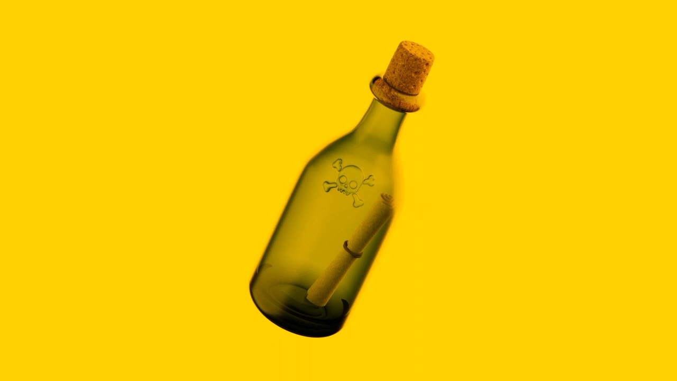
Notes:
THis is why we created 100 voices - human centered design thinking, so at every step of the creative process we stop and check ourselves.
We use it to check diversity of inputs, (e.g. those with Disabilities, LGBTQI, Travelling community,) Strategic outputs, audience targeting & segmentation (e.g. bias playing out in machine learning and you even see it with chatGPT) creative messaging, creative visuals.

Slide 10
CUSTOM CONSUMER PANELS ALLOW US TO ENABLE
COLLABORATION
THROUGHOUT THE CREATIVE PROCESS
& ELIMINATE OUR BIASES
TBWA\Dublin
The Disruption Company®
© 2023 TBWA \ Worldwide. All Rights Reserved. Proprietary and confidential.
10
Notes:
What this kind of a process is about is really collaboration at the core

Slide 11
TODAY
UNCONSCIOUS
BIAS
CONFIRMATION
BIAS
CONFORMITY
BIAS
TBWA\Worldwide
The Disruption Company®
© 2023 TBWA \ Worldwide. All Rights Reserved. Proprietary and confidential.
11
Notes:
And while there are so many kinds of biases , today we will look at three of them for the sake of time - the first being one of the trickiest, the second being the most interesting to leverage, and the third being a very obvious one that big brands have still fallen victim to

Slide 12
1.
Unconscious
Bias
(IMPLICIT BIAS)
TBWA\Dublin
The Disruption Company®
© 2023 TBWA \ Worldwide. All Rights Reserved. Proprietary and confidential.
12
Notes:
Unconscious bias, or sometimes called implicit bias,
is defined as various social stereotypes and judgments that people unknowingly make based on a variety of factors such as we’ve seen above. And because our biases occur without consciously thinking about them as we are so dependent on our brain making a lot of judgment calls we may aren’t even aware of, unconscious biases can have an outsized impact on our actions and behavior. Identifying and correcting for unconscious bias is a critical part of the marketing team’s set of responsibilities because the impact of these assumptions can be so detrimental to your business—and to society as a whole.
Next few slides from https://www.wpromote.com/blog/digital-marketing/biased-advertising#:~:text=Advertising%20bias%20simply%20means%20that,attract%20those%20consumers%2C%20and%20more.

Slide 13
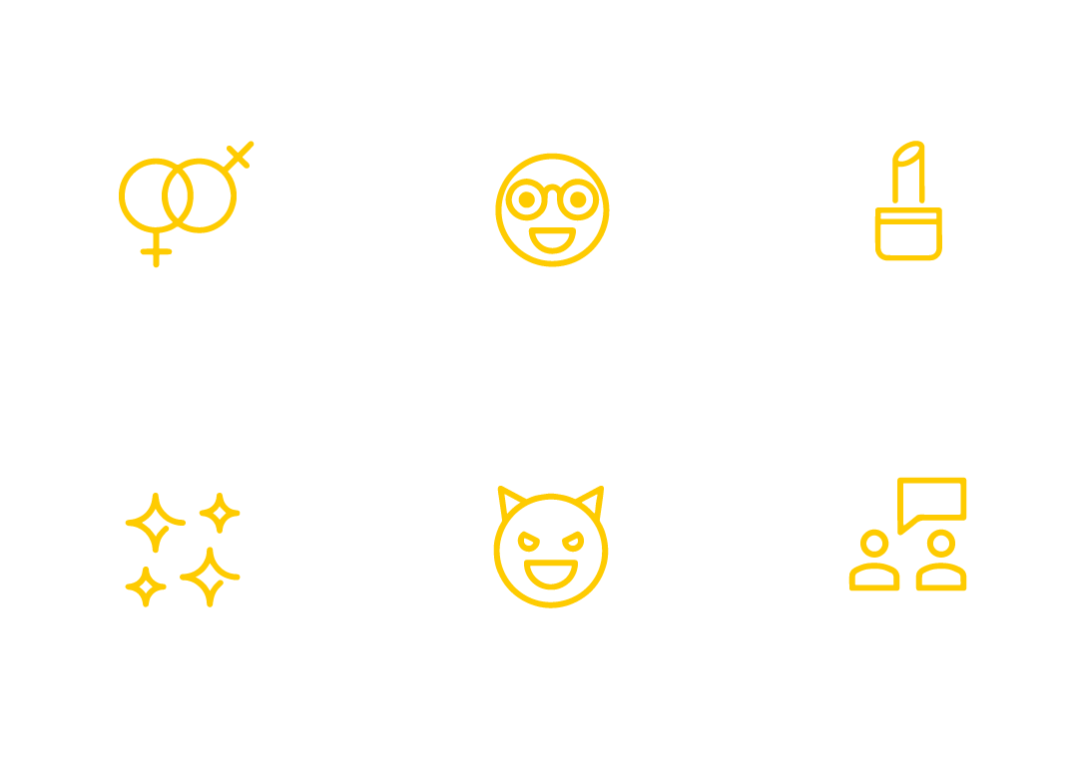
SOME TYPES OF
‘Unconscious biases are social stereotypes about certain groups of people that individuals form outside their own conscious awareness. Everyone holds unconscious beliefs about various social and identity groups, and these biases stem from one’s tendency to organise social worlds by categorising.’
UNCONSCIOUS/
IMPLICIT BIAS
Gender
Ageism
Beauty bias
Halo effect
Horns effect
Affinity bias
TBWA\Worldwide
The Disruption Company®
© 2023 TBWA \ Worldwide. All Rights Reserved. Proprietary and confidential.
13
Notes:
Probably the most commonly known kind of a bias - Overview of unconscious bias

Slide 14
A quick test…
“A father and son were involved in a car accident in which the father was killed and the son was seriously injured. The father was pronounced dead at the scene of the accident and his body was taken to a local morgue. The son was taken by ambulance to a nearby hospital and was immediately wheeled into an emergency operating room. A surgeon was called. Upon arrival and seeing the patient, the attending surgeon exclaimed “Oh my God, it’s my son!’ Can you explain this?”
TBWA\Dublin
The Disruption Company®
© 2023 TBWA \ Worldwide. All Rights Reserved. Proprietary and confidential.
14
Notes:
Around 40% of participants who are faced with this challenge do not think of the most plausible answer—being the surgeon is the boy’s mother. Rather, readers invent elaborate stories such as the boy was adopted and the surgeon was his natural father or the father in the car was a priest. As such, the exercise illustrates the powerful pull of automatic, stereotyped associations. For some individuals, the association between surgeon and men is so strong that it interferes with problem-solving and making accurate judgments.
https://cultureplusconsulting.com/2018/08/16/a-ha-activities-for-unconscious-bias-training/

Slide 15
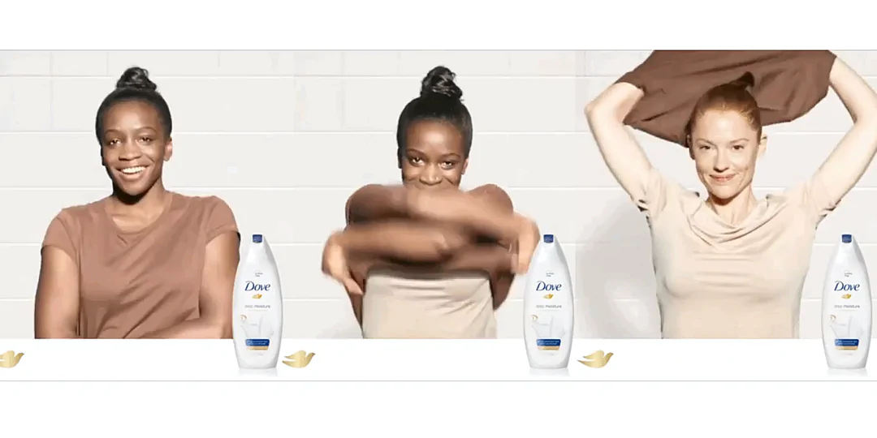
Notes:
In one particularly egregious (and infamous) example, a widely criticized advertising campaign by Dove featured a Black woman that transformed into a white woman after using Dove soap. Dove’s positioning in the campaign was all about purity, which was represented by whiteness in the ad creative, an idea that was immediately identified as overtly if unintentionally racist.

Slide 16


Bias arising
from different automation processes
Measurement
Sampling
Data preparation
Construct space
Observed space
Raw data space
Prepared date space
Social bias
Representation bias
Data preparation bias
TBWA\Worldwide
The Disruption Company®
© 2023 TBWA \ Worldwide. All Rights Reserved. Proprietary and confidential.
16
Notes:
We thought it would be interesting during this section to talk about how automation can actually include bias too. AI tools like ChatGPT are the buzz of the industry but they have pitfalls too. AI and ad targeting can actually reinforce negative bias, in part due to the unconscious bias of the people who program these systems.
E.g. Facebook example in the US, - where ad delivery systems were found to be discriminating based on race, gender and age in photographs
Chat GPT - learns from our inputs, but only a fraction of the world’s privileged will be inputting
Covid comms in the US - where algorithms only serve more of the content that you already have consumed , your own bias then creates an echo chamber around you

Slide 17
SO HOW CAN WE OVERCOME UNCONSCIOUS BIAS IN THE CREATIVE PROCESS?
TBWA\Dublin
The Disruption Company®
© 2023 TBWA \ Worldwide. All Rights Reserved. Proprietary and confidential.
17
Notes:
Issues around disability are one place where unconscious bias can negatively impact on people. When addressing the topic of a hidden disability it would be very easy for us to make judgement calls based on our unconscious bias.
And this is where the power of co-creation really helped us - to get outside our echo chamber. Working closely with members of Invisible Disability Ireland, we learnt about the sometimes awkward and challenging conversations that people with a hidden disability have when asking for a seat on public transport. This campaign would not have been possible without involving these people in its creation from start to end.
The new Please Offer Me a Seat badge removes the perceived need to explain their situation and instead becomes a symbol and opportunity for other commuters to offer up a seat. This forms the core value of the new campaign by TBWA\Dublin.

Slide 18

Please offer me a seat
Notes:
Issues around disability are one place where unconscious bias can negatively impact on people.
When addressing the topic of a hidden disability it would be very easy for us to make judgement calls based on our unconscious bias.
And this is where the power of co-creation really helped us - to get outside our echo chamber.
Working closely with members of Invisible Disability Ireland, we learnt about the sometimes awkward and challenging conversations that people with a hidden disability have when asking for a seat on public transport. This campaign would not have been possible without involving these people in its creation from start to end.
The new Please Offer Me a Seat badge removes the perceived need to explain their situation and instead becomes a symbol and opportunity for other commuters to offer up a seat. This forms the core value of the new campaign by TBWA\Dublin.

Slide 19
Source: CMO
HOW TO CHECK FOR UNCONSCIOUS
BIAS IN CREATIVE
Brand Strategy
Creative
User experience
Approval
Market Segmentation
Channel Targeting
Is your segmentation reflecting actual population demographics, and is targeting basic demographics even necessary?
Has your programmatic and AI been checked for minority bias?
Is the brand purpose aligned authentically, and are you exploiting diversity or minority groups for inauthentic brand noise?
Has your copy been checked by diverse team members?
Are you tracking data that perpetuates stereotypes? Are you asking for data that isn’t necessary?
Are your approval processes taking into account diversity and inclusion? Have you taken out all subjectivity?
TBWA\Worldwide
The Disruption Company®
© 2023 TBWA \ Worldwide. All Rights Reserved. Proprietary and confidential.
19
Notes:
Push against what we naturally do. (Which is to address certain demos/segments as part of solving our business problem or to serve our growth ambition). Where is the line?
So how do we balance the objectives of the brief with our unconsiouyus biasing of creative

Slide 20
2.
Confirmation
Bias
TBWA\Dublin
The Disruption Company®
© 2023 TBWA \ Worldwide. All Rights Reserved. Proprietary and confidential.
20
Notes:
This is a funny one because admittedly, we will often use confirmation bias to convince consumers they are part of an in-group, often playing off stereotypes and cliches to their advantage, or propping up the customers’ brand identity to a product. So this one is one to be leveraged mindfully. Confirmation bias works to re-enforce our ideas about ourselves, often in a positive light - not necessarily negative.
Often asked for directly in client briefs ;’ mirror the target audience. ‘

Slide 21
We are highly susceptible to confirmation bias
What confirms your beliefs
Objective Facts
What you see
TBWA\Dublin
The Disruption Company®
© 2023 TBWA \ Worldwide. All Rights Reserved. Proprietary and confidential.
21
Notes:
MARKETING OFTEN WORKS WELL BECAUSE IT LEVERAGES CONFIRMATION BIAS AGAINST ITS TARGET AUDIENCE

Slide 22
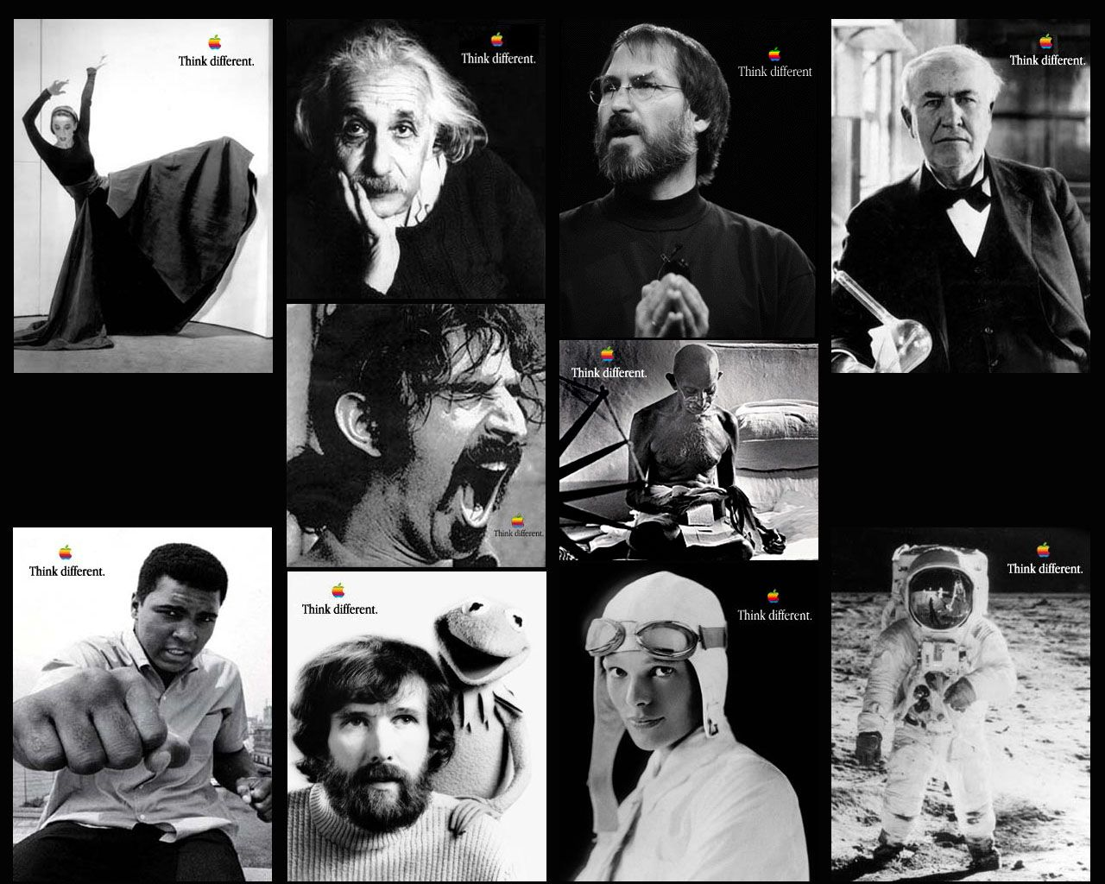
© 2023 TBWA \ Worldwide. All Rights Reserved. Proprietary and confidential.
TBWA\Worldwide
© 2023 TBWA \ Worldwide. All Rights Reserved. Proprietary and confidential.
22
TBWA\Dublin
The Disruption Company®
The Disruption Company®
Notes:
Apple's "Think Different" Campaign: Apple's "Think Different" campaign leveraged the confirmation bias of its target audience who saw themselves as different creative thinkers, by highlighting the company's reputation for innovation and creativity. The campaign featured iconic figures such as Albert Einstein and Mahatma Gandhi, reinforcing the idea that using Apple products would align with a user's identity as a creative, innovative thinker.
“you always had to be a little different to buy an Apple computer.”
Seen as a punt but within 12 months had tripled the stock value, and paved the way for the bestselling coloured iMac launch

Slide 23
Notes:
And here’s an example of leveraging confirmation bias in a positive way. Play first
Citibank’s True Name Initiative, where transgender and non-binary customers are given the choice to have account profiles and credit cards that match who they are,
This campaign was created with the right members of the target audience, and uses cues that members of those communities will recognize
—---
In a Citibank video entitled “The List,” the camera opens tightly on a couple in a car, driving through a tree-shaded street, where sunlight forms a play of shadows and light on their faces. “When I saw that ad, I immediately knew it was for me. They used coded language that trans people would pick up on right away. The image they used was someone cis people wouldn’t recognize as trans, but trans people tend to recognize one another.”
The intentional ambiguity warms up the cisgender audience for the twist in the storyline. At the same time, trans and non-binary folks see themselves from the inside and have already been won over by the recognition.
A few more seconds into the ad, the couple explores possible names, as couples anticipating a baby might try out different names and how those names sound when said out loud. (Still more ambiguity, but this moves the plot forward.)
Placed in everyday settings, the couple is depicted doing what everyone else does: cleaning the kitchen; walking in the park, holding hands; one partner talks on the phone with their mom while the other partner listens. By incorporating transgender people in everyday situations, there is an unspoken acceptance within the ad’s story that rings true and authentic. It contradicts stereotypes of transgender people being outcasts and outliers.
As a mixed-race couple, the couple’s attire reflects their gender biases, similar to how cisgender couples are depicted. The trans/non-binary person who identifies as more male is not depicted as extremely masculine, which is a common stereotype.
The details in clothing, in the chosen activities, and in the dialogue help a cisgender audience assimilate the LGBTQ+ community and family members into our ideas of cultural norms, depicting them as actors in a multicultural society where diversity is accepted.
The effect for CitiBank is that not only have they garnered praise from a subset of their customers, but they’ve also pulled in cisgender audience members whose values of diversity and inclusion are reflected in the ad campaign.
Because nothing is over-simplified, the nuance works.

Slide 24
Avoiding negative use of confirmation bias.
Be objective - start with as many neutral facts as possible.
Can I emphathise with others, especially in different audience segmentations that purchase my product?
Can I listen openly to the opinions of others, especially those with differing views?
Build a diverse creative team and fostered an open culture where the team can work through their implicit biases, ensuring that those ideas are carefully examined.
Am I taking in all my evidence from a curated information stream that confirms what I already believe? Read information from broader sources, especially seeking out fact-based sources that might contradict your own views.
Delve into the uncomfortable. This helps us to become aware of our confirmation bias. Am I exposing myself to people with varying life experiences unlike my own, so that their views can make their way into my work?
Am I hiring artists, photographers, and designers who reflect the target in my campaigns?
Am I giving everything I read the critical reflection it deserves, before developing a marketing campaign that might perpetuate my own beliefs? Go outside your echo chamber and test test test!
TBWA\Dublin
The Disruption Company®
© 2023 TBWA \ Worldwide. All Rights Reserved. Proprietary and confidential.
24
Notes:
A double edged sword

Slide 25
3.
Conformity
Bias
(GROUPTHINK)
TBWA\Dublin
The Disruption Company®
© 2023 TBWA \ Worldwide. All Rights Reserved. Proprietary and confidential.
25

Slide 26
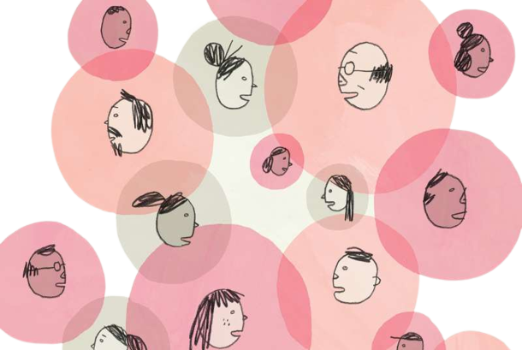
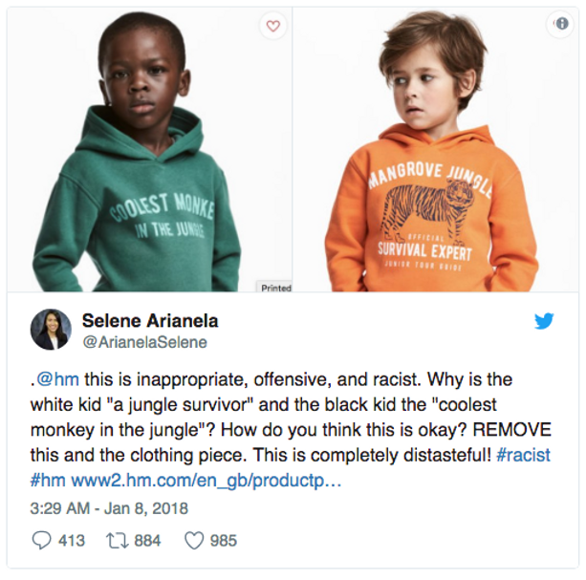
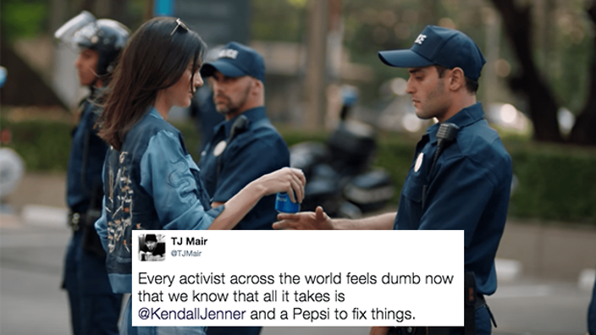
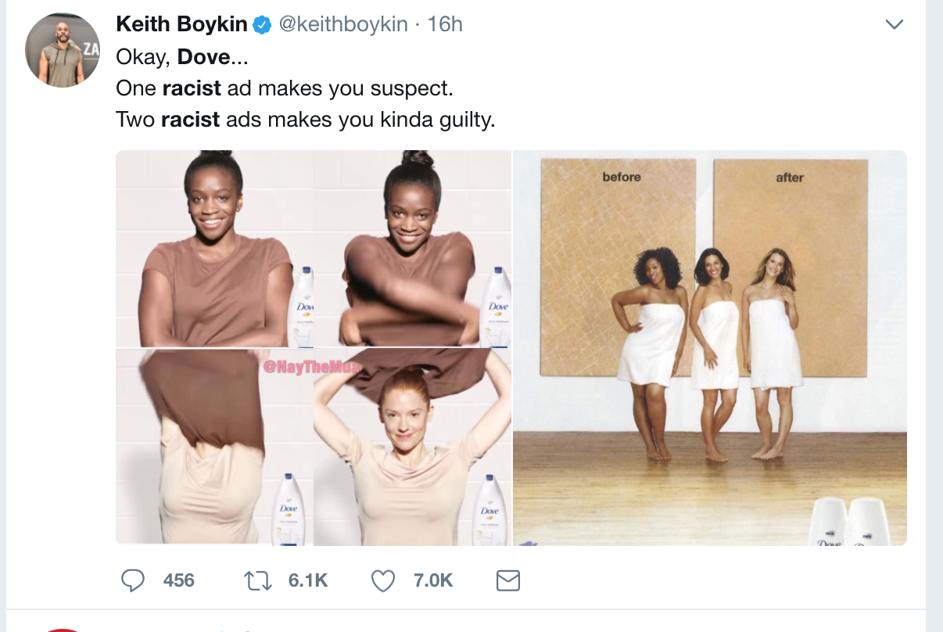
When one mind gets lost in many.
Conformity Bias or Groupthink is a phenomenon that occurs when a group of individuals reaches a consensus without critical reasoning or evaluation of the consequences or alternatives. Groupthink is based on a common desire not to upset the balance of a group of people.
HOW IT MANIFESTS IN CREATIVITY
When you do not have diversity in opinion and different groups aren’t represented in creative rooms, it manifests in the work you do. You arrive at dangerous consensus to keep things in balance— consequences that have caused much controversy in the marketing world
Notes:
Groupthink or conformity bias rears it’s ugly head when you don’t have diversity of opinion in your creative process, and a conscensus is reached without sense checking with outside sources

Slide 27
© 2023 TBWA \ Worldwide. All Rights Reserved. Proprietary and confidential.
TBWA\Worldwide
© 2023 TBWA \ Worldwide. All Rights Reserved. Proprietary and confidential.
27
TBWA\Dublin
The Disruption Company®
The Disruption Company®
Notes:
Pepsi Kendall Jenner -
Full BBC explainer - https://www.youtube.com/watch?v=AY9d5vDjY9A

Slide 28
GROUPTHINK CAN BE EASILY AVOIDED THROUGH OUTSIDE COLLABORATION
TBWA\Dublin
The Disruption Company®
© 2023 TBWA \ Worldwide. All Rights Reserved. Proprietary and confidential.
28
Notes:
As an example, when we worked with the International Organisation for Migration on their human trafficking awareness initiative, it would have been easy for us to deliver an idea through groupthink which would have been a single idea of what human trafficking manifests as.
We researched people’s perceptions around human trafficking and saw that most people think that the victims of human trafficking in Ireland are forced into sex work but in fact there are many industries right under our noses where the victums of human trafficking are working, so that’s what we set out to show. There is no way we could have created this campaign without collaboration with diverse outside sources

Slide 29
© 2023 TBWA \ Worldwide. All Rights Reserved. Proprietary and confidential.
TBWA\Worldwide
© 2023 TBWA \ Worldwide. All Rights Reserved. Proprietary and confidential.
29
TBWA\Dublin
The Disruption Company®
The Disruption Company®
Notes:
IOM - International Organisation for Migration
As an example, when we worked with the International Organisation for Migration on their human trafficking awareness initiative, it would have been easy for us to deliver an idea through groupthink which would have been a single idea of what human trafficking manifests as.
We researched people’s perceptions around human trafficking and saw that most people think that the victims of human trafficking in Ireland are forced into sex work but in fact there are many industries right under our noses where the victums of human trafficking are working, so that’s what we set out to show. There is no way we could have created this campaign without collaboration with diverse outside sources

Slide 30
Create An OPEN HUB OF DIVERSE OPINION
AVOIDING GROUPTHINK:
Create a culture where freedom of opinion is encouraged - make it a safe space for your team to share their diverse perspectives and opinions
Encourage dissenting opinions and debate
Test with diverse audiences from the outset. Ensure your contributions are coming from varied demographics.
Build a network of experts and consultants outside of your organisation that can provide objective evidence and constructive criticism
Notes:
Encourage diverse perspectives: Encourage team members to share their perspectives, opinions, and ideas, even if they differ from the majority. This can help to avoid group polarization and foster a more creative and inclusive team culture.
Encourage dissenting opinions: Encourage team members to challenge assumptions and ask critical questions, even if it goes against the group consensus. This can help to prevent groupthink and lead to better decision-making.
Conduct research and testing: Conduct research and testing to validate assumptions and ensure that advertising campaigns are resonating with the target audience. This can help to avoid the bias of overconfidence and ensure that decisions are based on data and evidence.
Seek outside input: Seek input from outside experts or consultants who have different perspectives and experiences. This can help to bring in fresh ideas and challenge the assumptions of the internal team.
Foster a culture of psychological safety: Create a safe and supportive environment where team members feel comfortable expressing their ideas and challenging assumptions. This can help to reduce fear of reprisal and encourage open and honest communication.

Slide 31
AVOIDING BIAS IN CREATIVITY:
TEST AT ALL STAGES
COLLABORATE WITH DIVERSE VOICES
CREATE A CULTURE OF SAFE SPACES
BEWARE OF AI BIAS
© 2023 TBWA \ Worldwide. All Rights Reserved. Proprietary and confidential.
TBWA\Worldwide
© 2023 TBWA \ Worldwide. All Rights Reserved. Proprietary and confidential.
31
TBWA\Dublin
The Disruption Company®
The Disruption Company®

Slide 32
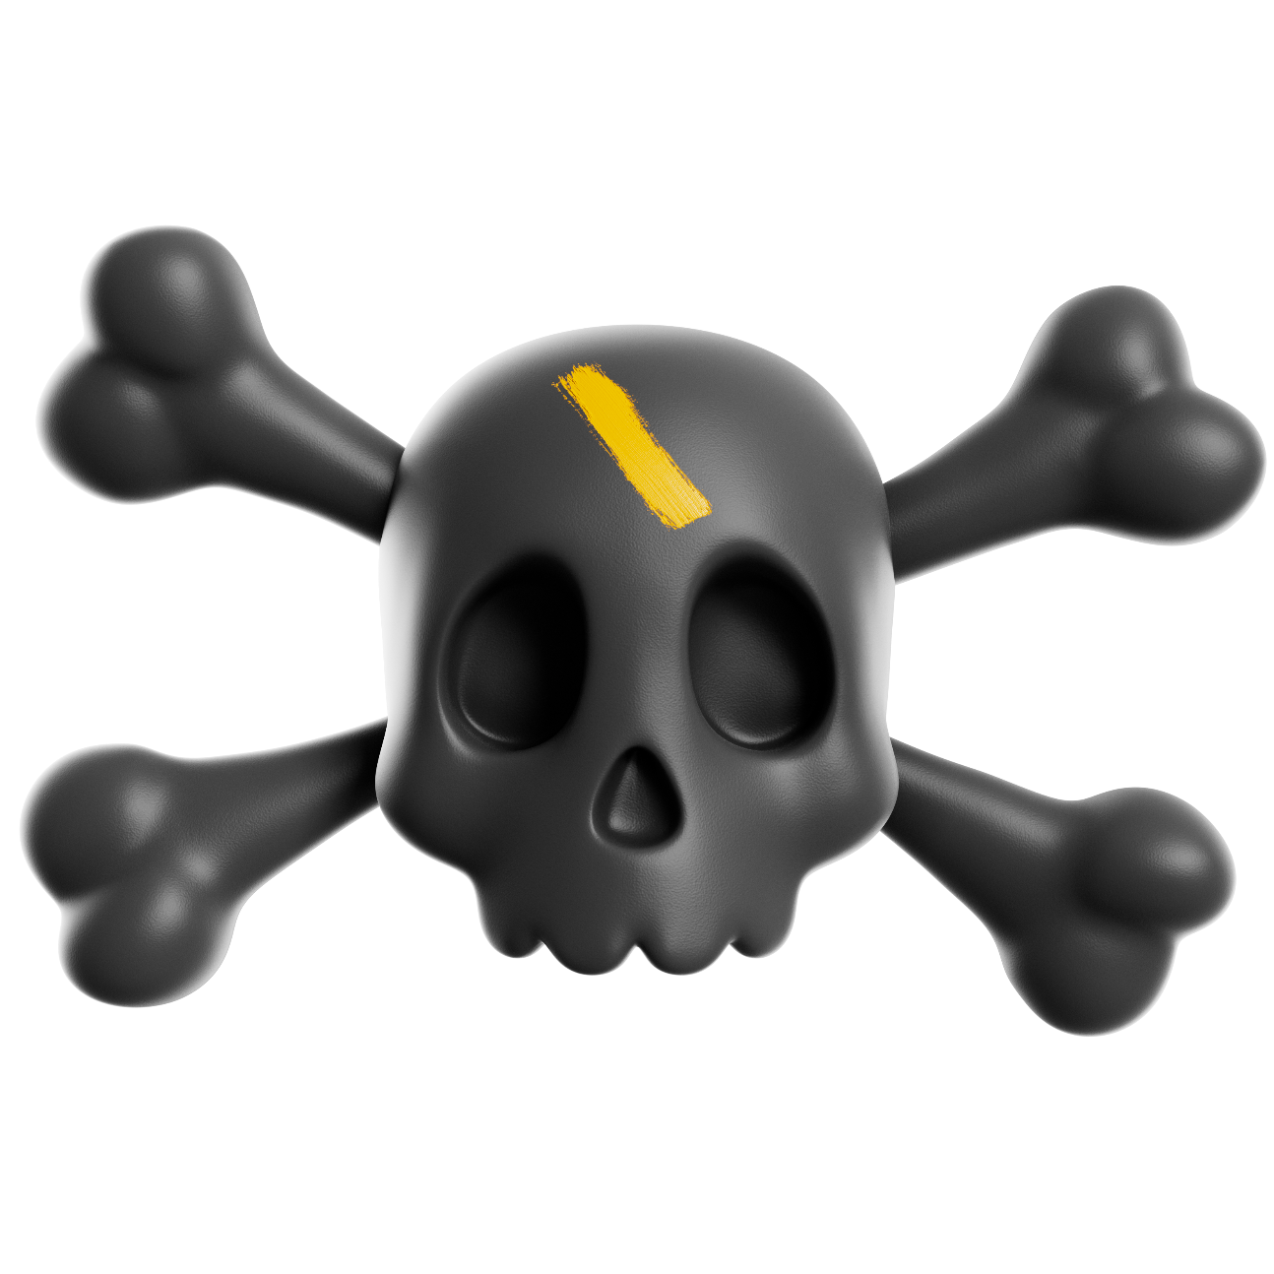
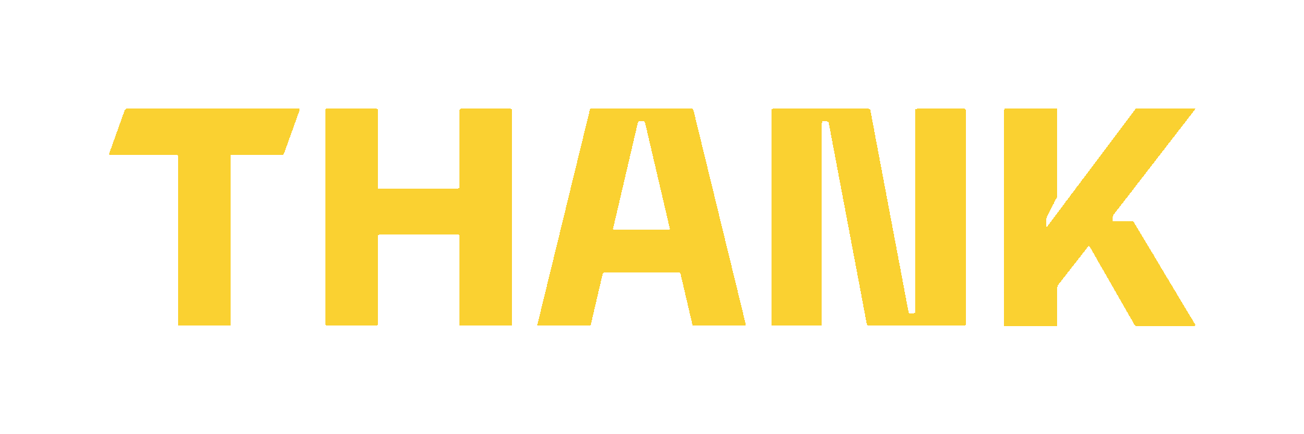

YOU!
TBWA\Worldwide
The Disruption Company®
© 2023 TBWA \ Worldwide. All Rights Reserved. Proprietary and confidential.
32

