Slide 1
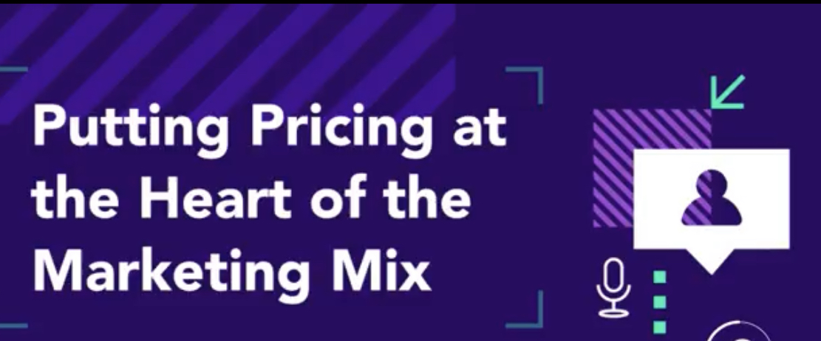
Dr. Marija Grishin
Assistant Professor in Marketing
University College Dublin
marija.grishin@ucd.ie

Slide 2
Inflation and Consumer Behaviour
Perceptions of changes in pricing are based on subjective observations
Changed behaviour
  Buy what is on sale
  Trade down to store brands
  Choose cheaper retailers (Aldi, Lidl)
  Buy more (bulk discounts)
  Buy nicer things (due to savings elsewhere)

Slide 3
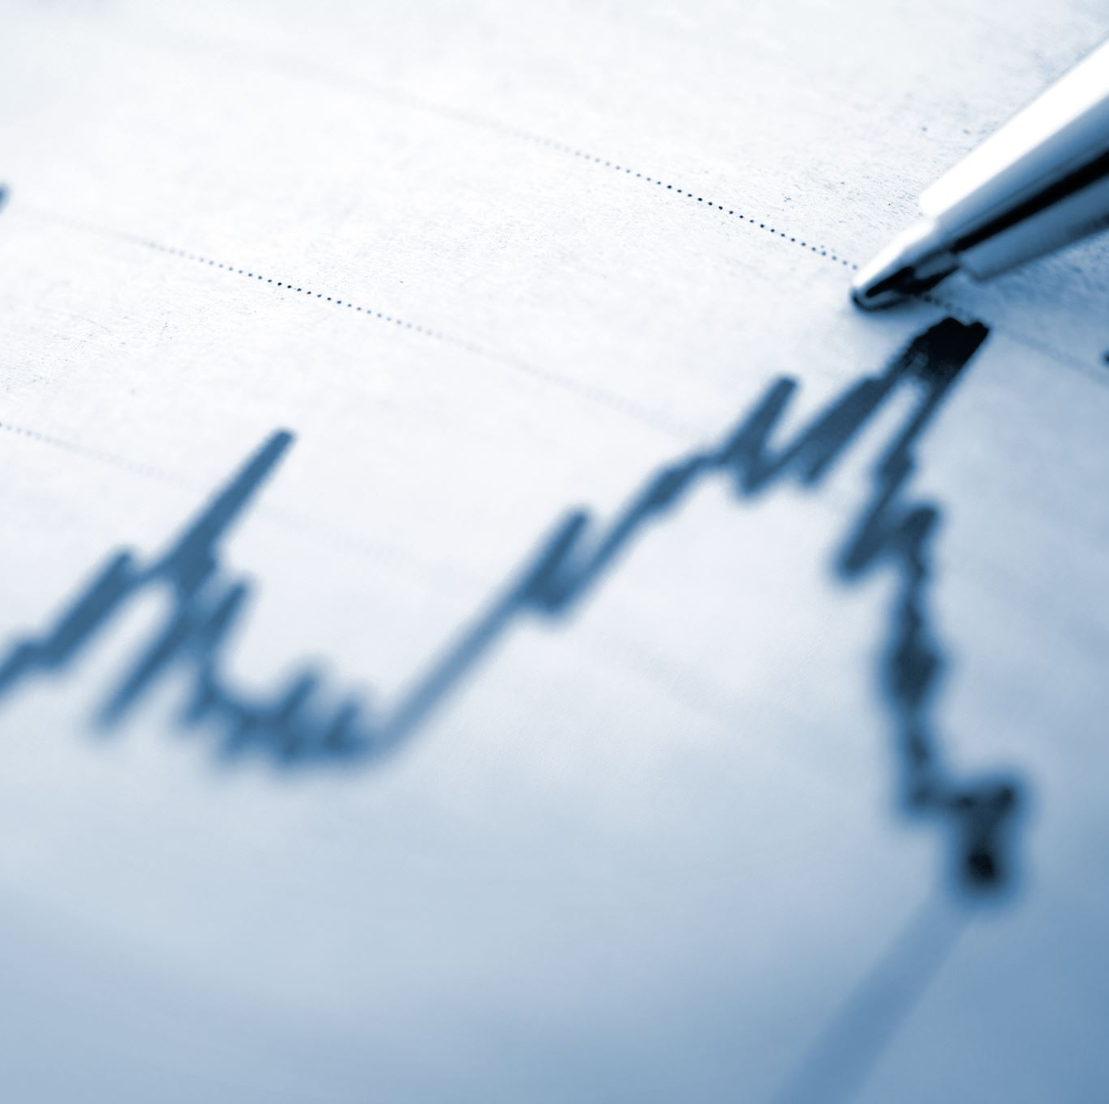
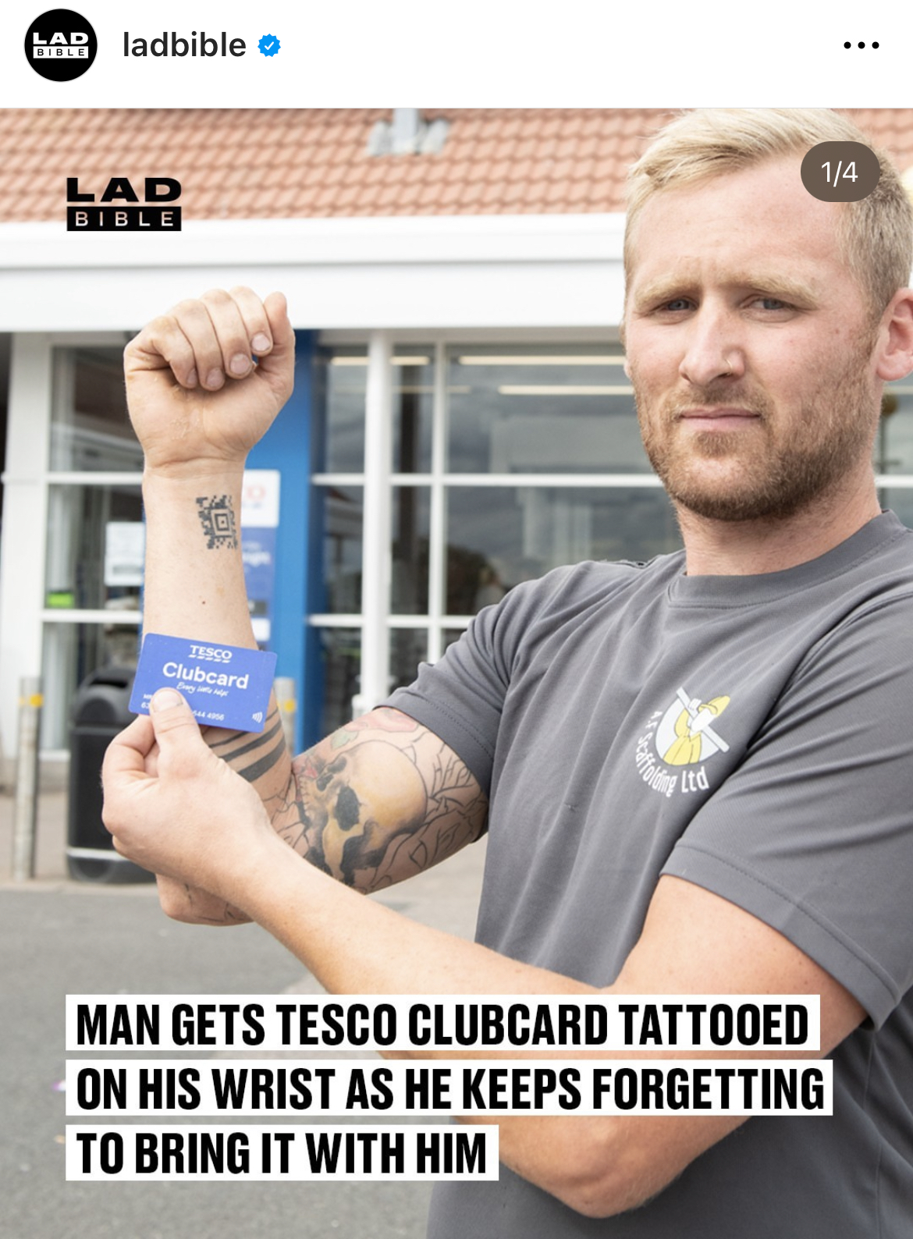
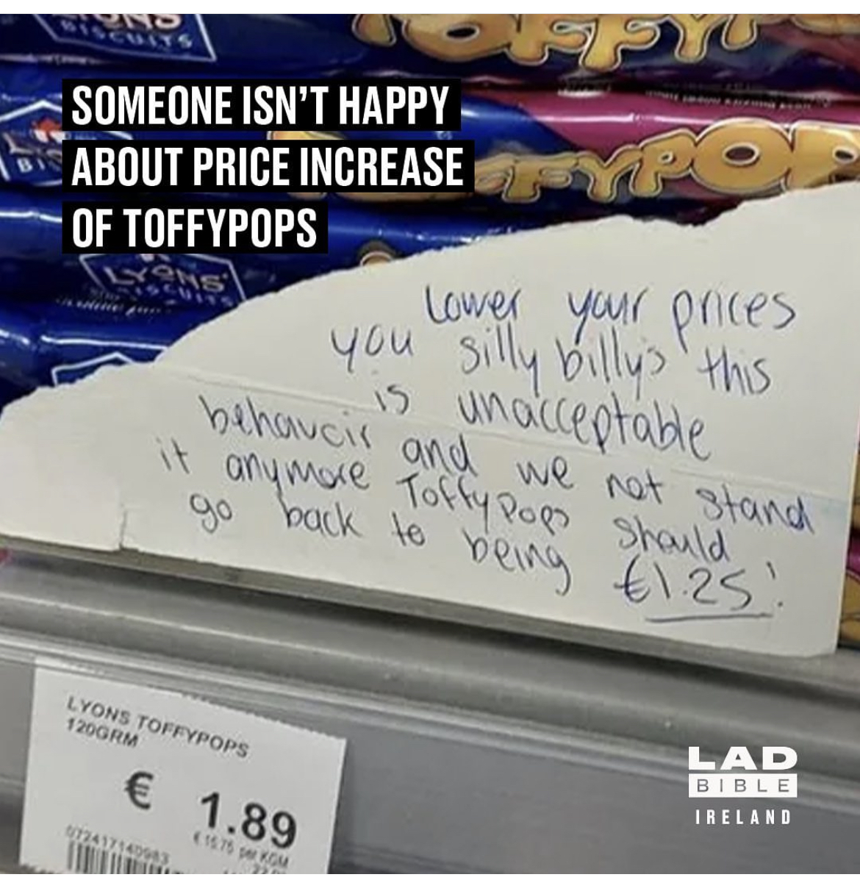
Stress of uncertainty
Shrinkflation (decreasing product sizes)
Greedflation (companies increasing profitability at consumers expense)

Slide 4
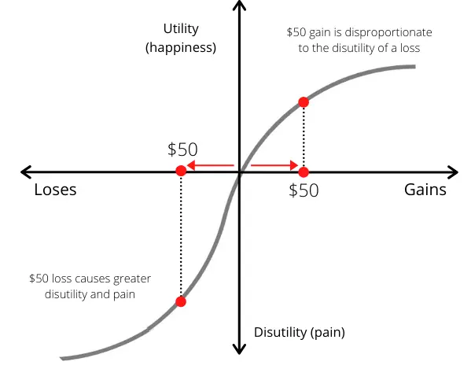
Pain of payment
Losses loom larger than gains
People are generally loss-averse
Handing over money is perceived as loss and cases pain (more so for cash than cards)
Tightwads vs. spendthrifts
  Marketing messages reduce the difference
Kahneman, Daniel, and Amos Tversky. "Prospect theory: An analysis of decision under risk." In Handbook of the fundamentals of financial decision making: Part I, pp. 99-127. 2013.

Slide 5
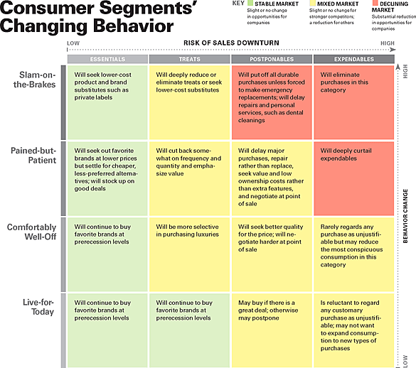
Consumers behave differently

Slide 6
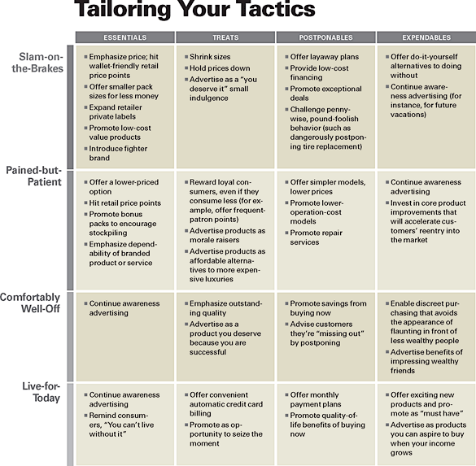
Marketers need to adapt

Slide 7
Marketing actions during recession
Immediate discounts (cash back at point of sale) are more effective
Need to increase the frequency and depth of temporary price promotions
  Carefully monitor perceptions of normal price levels
Premium brands can benefit from introducing a lower priced version of the same product
Use 9-ending prices
  24 pack at 5.99 for pained-but-patient consumers and
  Two-liter bottle for 99 cents for slam-on the brakes consumers

Slide 8
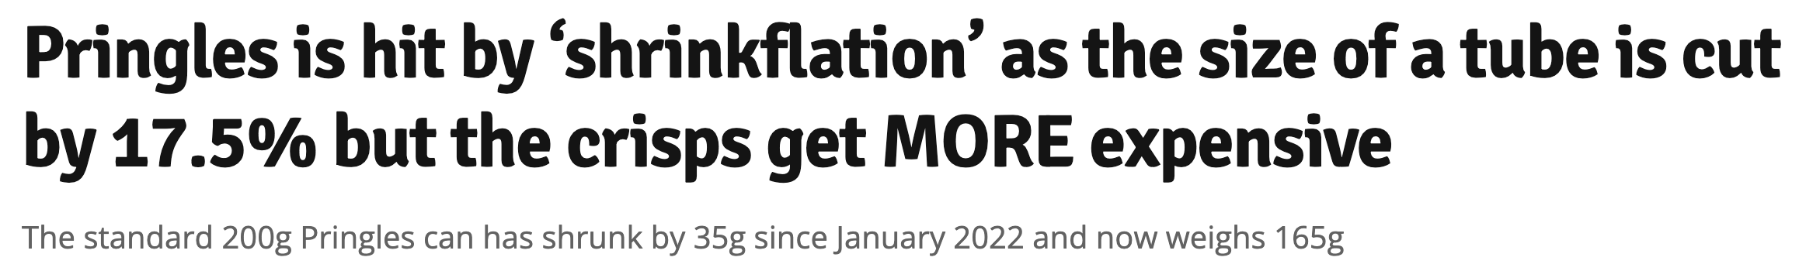
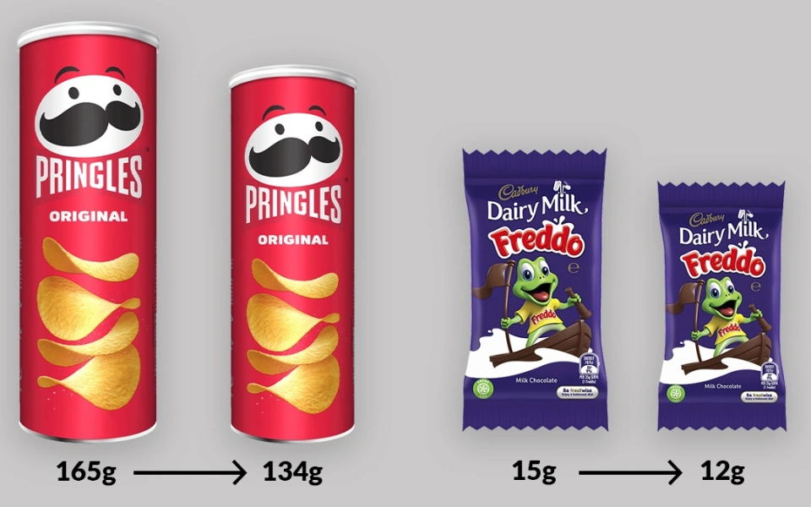
Marketing actions during recession Contd.
Reduce thresholds for quantity discount
Reduce item or serving size (but pricing them accordingly)
Service businesses
  lower up-front adoption costs and penalty charges
  Unbundle or bundle depending on consumer sensitivity

Slide 9

Marketing actions during recession Contd.
Bolster trust
  Reassuring messages to establish an emotional connection
  Backed by actions
Reward big spenders but also small, frequent shoppers
Alert customers before charging fees
Educate how to save money
Remind customers that buying your brand is a sound decision

Slide 10
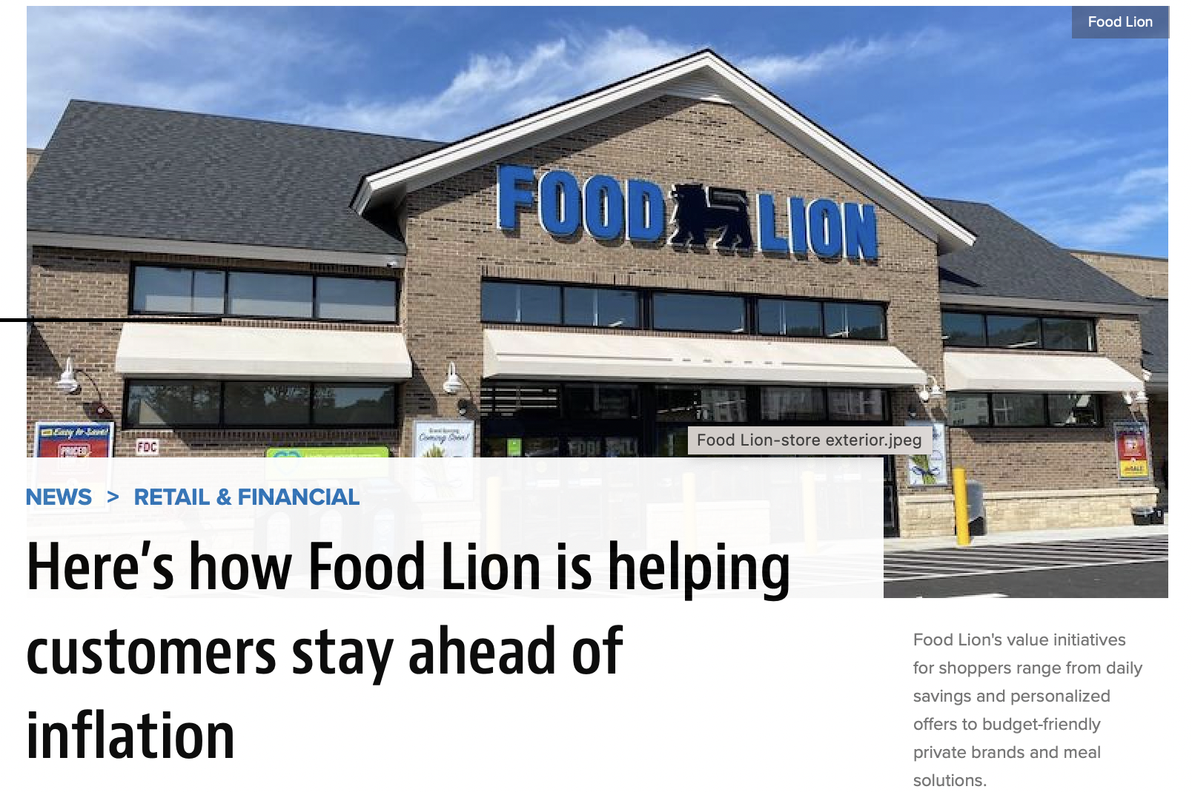
weekly specials on its website
loyalty program, with rewards, digital coupons and exclusive pricing
added more private-brand products
affordable recipes
food donations locally

Slide 11
Private labels vs. National Brands
Private labels saw the strongest growth YOY, up 35.8% with shoppers spending €19m on these
Private label value share has risen from 42.6% in 2021 to 45% in 2023
Kantar Irish Supermarket Data, Feb 2023

Slide 12
Private labels vs. Brands
Consumer perception: PL and NB are the same
Declining market share leads NBs to increase prices, BUT:
WTP increases only when there are perceived differences
  Advertising and innovation (do not cut back on these)
  Distinct packaging
  Price promotions decrease WTP (dilute quality)
Focus on building quality perceptions and personal relevance
Steenkamp, Jan-Benedict EM, Harald J. Van Heerde, and Inge Geyskens. "What makes consumers willing to pay a price premium for national brands over private labels?." Journal of marketing research 47, no. 6 (2010): 1011-1024.

Slide 13
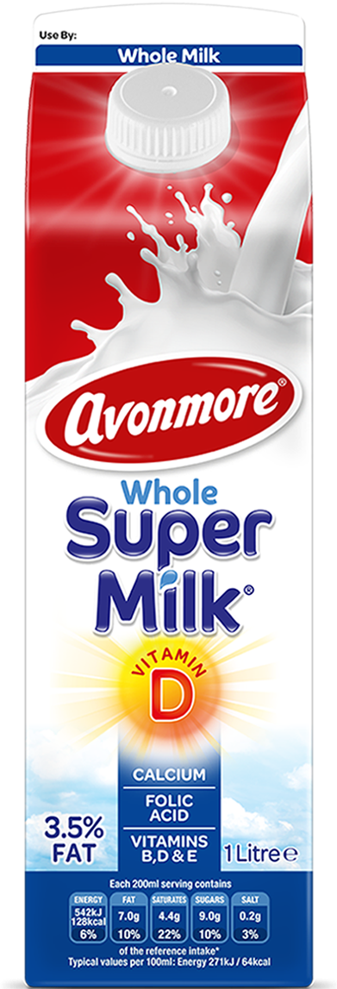
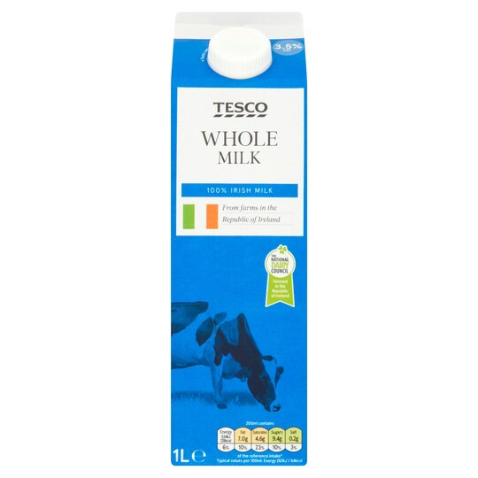
Today Avonmore is the #1 milk brand in Ireland. We believe that it is by sticking to our founding principles of innovation, freshness and quality without compromise that we have achieved our position in the homes of Irish families.
€1.65
€1.15

Slide 14

Summary
Know your customer segments
Pricing decisions involve much more than price setting
Marketers are not advised to cut down on advertising
Brand building is crucial
Empathy with customers to boost trust

Slide 15
References
Kahneman, Daniel, and Amos Tversky. "Prospect theory: An analysis of decision under risk." In Handbook of the fundamentals of financial decision making: Part I, pp. 99-127. 2013.
Rick, Scott. "Tightwads and spendthrifts: An interdisciplinary review." Financial Planning Review 1, no. 1-2 (2018): e1010.
Steenkamp, Jan-Benedict EM, Harald J. Van Heerde, and Inge Geyskens. "What makes consumers willing to pay a price premium for national brands over private labels?" Journal of marketing research 47, no. 6 (2010): 1011-1024.
Ariely, Dan. “Predictably Irrational, Revised and Expanded Edition: The Hidden Forces That Shape Our Decisions” (2010)

