Slide 1
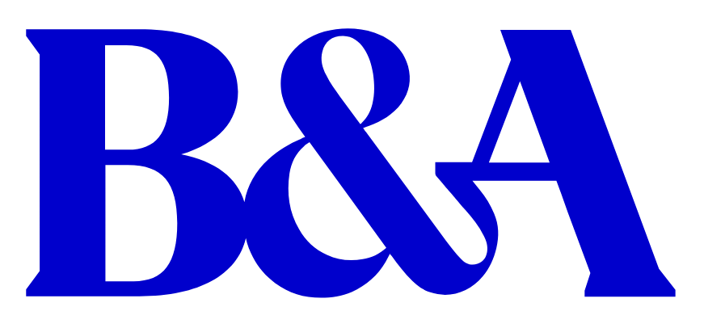

Luke Reaper
B&A
Event Sponsors
Venue Sponsors

Slide 2








2023 report
Putting Pricing at the Heart of the Marketing Mix: Marketing Society 30th March, 2023
Prepared by: B&A
J. 224218
@behaviourandattitudes
Behaviour & Attitudes
@banda_ie

Slide 3


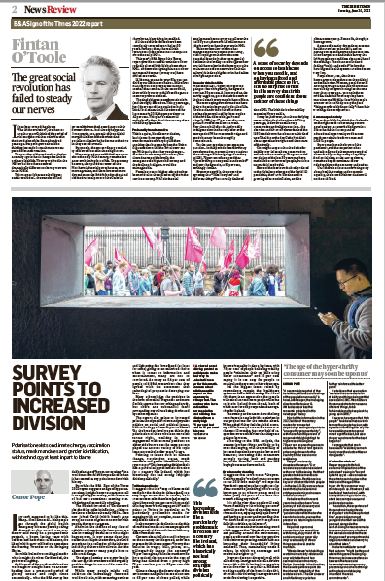

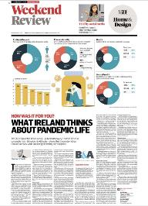

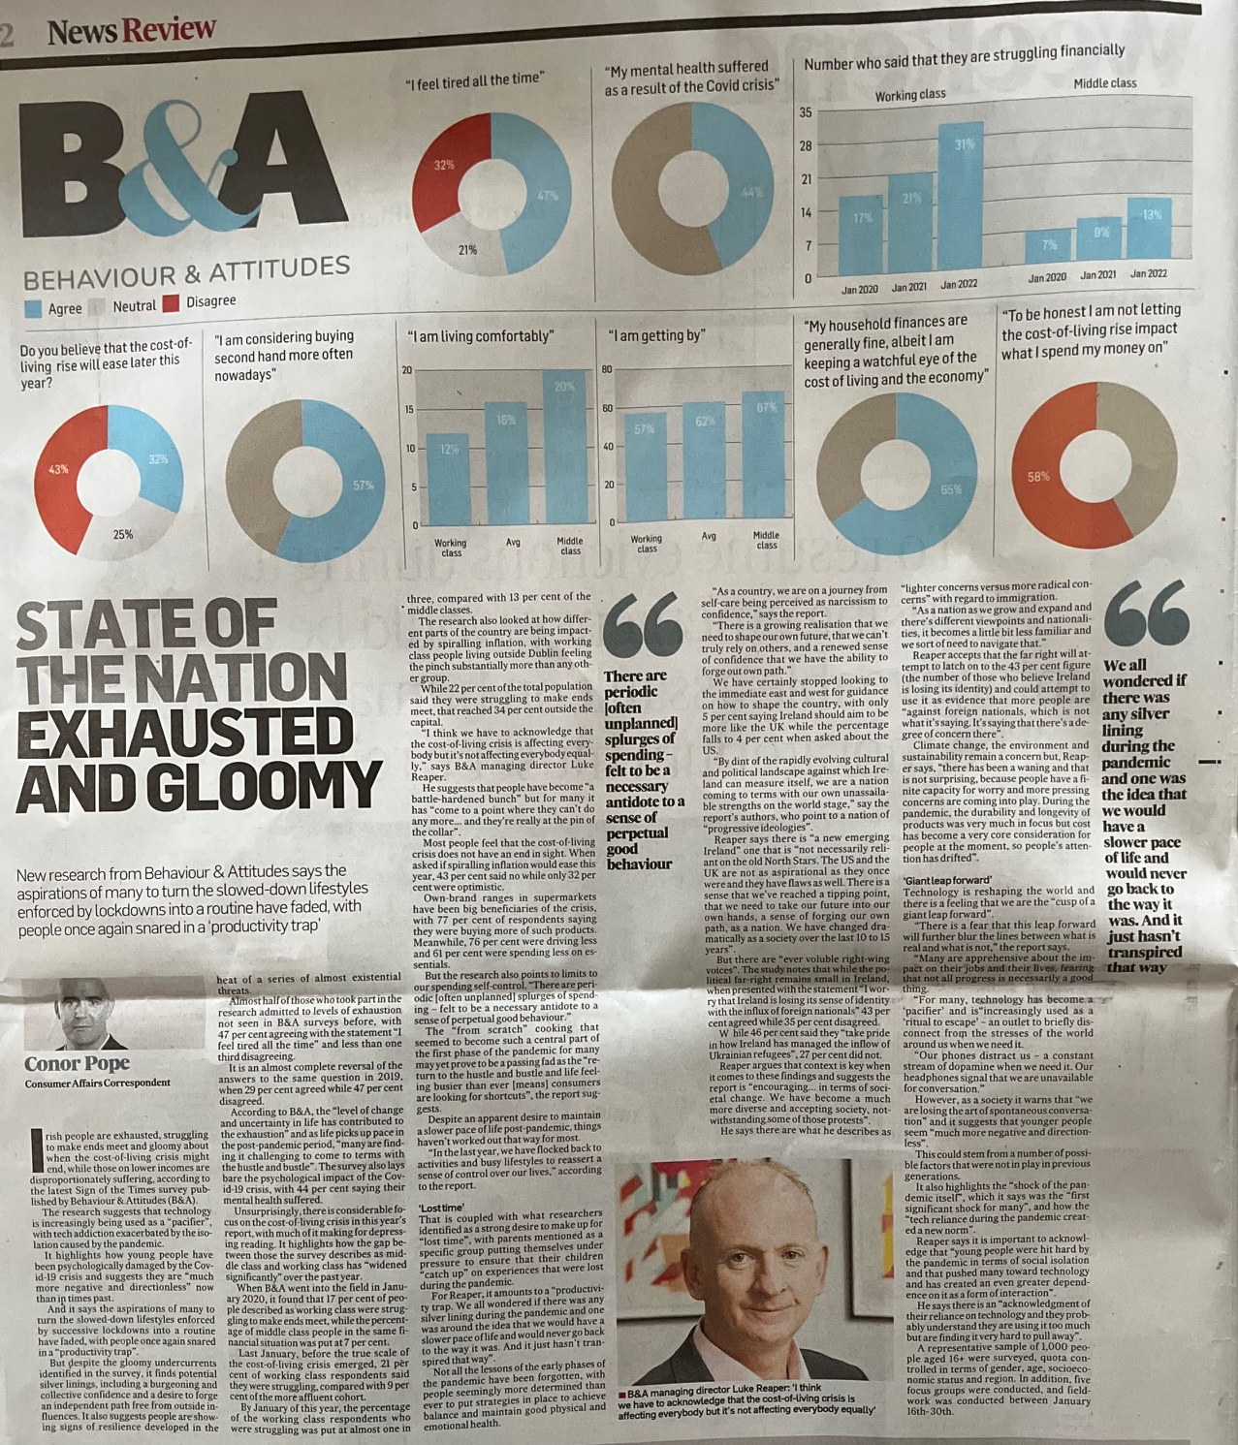


The Methodology
About B&A ‘Sign of the Times’
B&A’s continued connection to culture and social relevance is maintained through our frequent in-house culture and trends projects – Sign of the Times is one. These enable us to get ever closer to people, their contexts and decision making.
Consumer groups
5 groups
ABC1, 24-55, Dublin and Cork
Fieldwork Jan 2023
National online survey
Nationally representative
(n = 1,000 Adult 16+)
Fieldwork January 2023

Slide 4


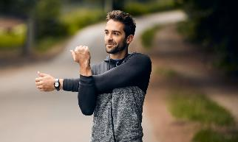

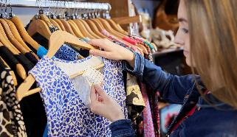
This year’s themes
The cultural backdrop
An increasingly fractured society and fading north stars
Trained to endure
Despite a challenging economic climate, we have learned how to navigate choppy waters
The rise of self care
We have fallen headfirst into a productivity trap but not all lessons have been lost
The battleground of human & technology
A growing desire to have authentic and honest online experiences
A new frontier for sustainability
It’s time to prepare for the age of the circular economy

Slide 5


The cultural backdrop
An increasingly fractured society and fading north stars, yet opportunities
Delve Deeper

Slide 6


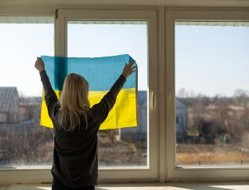



We’ve come a long, long way
AGING SOCIETY
SHIFTING MILESTONES
INCREASED OPENNESS & DIVERSITY
Pension & health service challenges
Decline in influence of church
Foreign nationals
Slowing birth rate
Milestones delayed or out of reach
Identity fluidity
By 2050, Ireland’s population of over 65’s will double to reach over 1.5 million people - with Ireland also experiencing a slower birth rate.
People still want to reach traditional life milestones. However, they are happening later and later in life. The average age of first time mother is now 32 years.
A vastly different country from the mid 90’s when only 1.5% of the population (53,000) were residents born outside of Ireland.
Nearly 70,000 arriving from Ukraine, into Ireland in 2022 alone. Dublin in particular is more diverse.
There are significant demographic changes in train. Important for brands to adjust to this new Ireland.

Slide 7
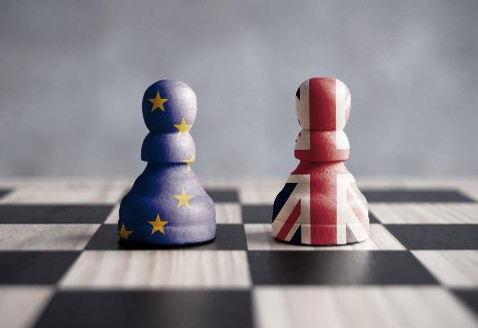
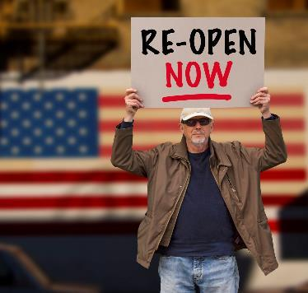


Fading north stars
Brexit
US
The geopolitical map has taken a pounding – it’s a reminder of just how quickly things can get out of control.
And we are finding it hard to find inspiration from any other country.
Only 5% of people say Ireland should aim to be more like the UK
Only 4% of people say Ireland should aim to be more like the US
There is even social unrest in Sweden
And a ‘Polycrisis’
upon us
As a country, there is a sense that we have reached a tipping point. A realisation that we need to take our future into our own hands.
A situation where multiple crises occur simultaneously, compounding and exacerbating each other.
Notes:
There has been a seismic mindset shift in Ireland over the past decade from the times of austerity post the financial crisis…from an Ireland that was kept tightly under control and given a blueprint out of a crisis to an Ireland that got through a pandemic in one piece. There is growing realisation that we need to shape our own future, a feeling that we can’t truly rely on others – and a renewed sense of confidence that we have the ability to forge our own path.

Slide 8

The cultural backdrop
Significant societal change. We are becoming older and much more diverse.
Realisation that we need to shape our own future.
Agility and responsiveness to societal trends are important.
However, it is important to ensure that brands do not lose sight of their core target markets…….
Trying to be ‘all things to all people’ will only deliver bland copy.
Notes:
Its a balancing act for brands – in which they need to be responsive to the new Ireland that is emerging, whilst ensuring that brand differentiation remains front and centre.
Growing pains in Ireland mean that brand voices need to carry a new confidence in ourselves and lean into being of, or from here. We aspire less and less to anything from anywhere else.

Slide 9


Examples of how brands are tapped into our increased ‘openness’
Manufacturers focusing on ‘new’ lifestages rather than just on a variety of discernable youth.
‘Permission to play’ in new challenging spaces is opening up for previously taboo topics: men with erectile dysfunction, women in menopause, teens in puberty, etc.
A deep understanding of customer needs is critical, with consumers seeking out solutions that aid them in their busy lives.
Opportunity for brands to connect with consumers on a deeper emotional level.
Notes:
Brands can engage in conversation around topical issues that really matter to consumers – creating the potential for deeper and more meaningful brand relationships. However, it is crucial that any efforts are authentic, with tangible proof points of a brands commitment to aid consumers lives.

Slide 10

Trained to endure
Despite a challenging economic climate, we have learned how to navigate choppy waters
Delve Deeper

Slide 11

A battle-hardened bunch: Most feel equipped to navigate the cost-of-living crisis, having built resilience from the last few years
Base: All adults 16+ N = 1019
Adapting to circumstances as they arise
A nation feeling the pinch
22% are struggling financially (800k+), 62% are getting by financially, and 16% are comfortable
My household finances are generally fine, albeit I am keeping a watchful eye on the cost of living and the economy
To be honest I am not letting the cost-of-living rise impact what I spend my money on
So most ok?
But still adapting
However, most feel that the current cost of living crisis does not have an end in sight
(I think the cost-of-living rise will ease later in 2023)
Any Agree
We have become
‘trained to endure’
Neither agree nor disagree
Any Disagree
Q.4b To what extent do you agree or disagree with the following ...
Notes:
The challenges of the last few years has trained us to endure economic and social uncertainty – with consumers more able to adapt to circumstances as they arise.

Slide 12
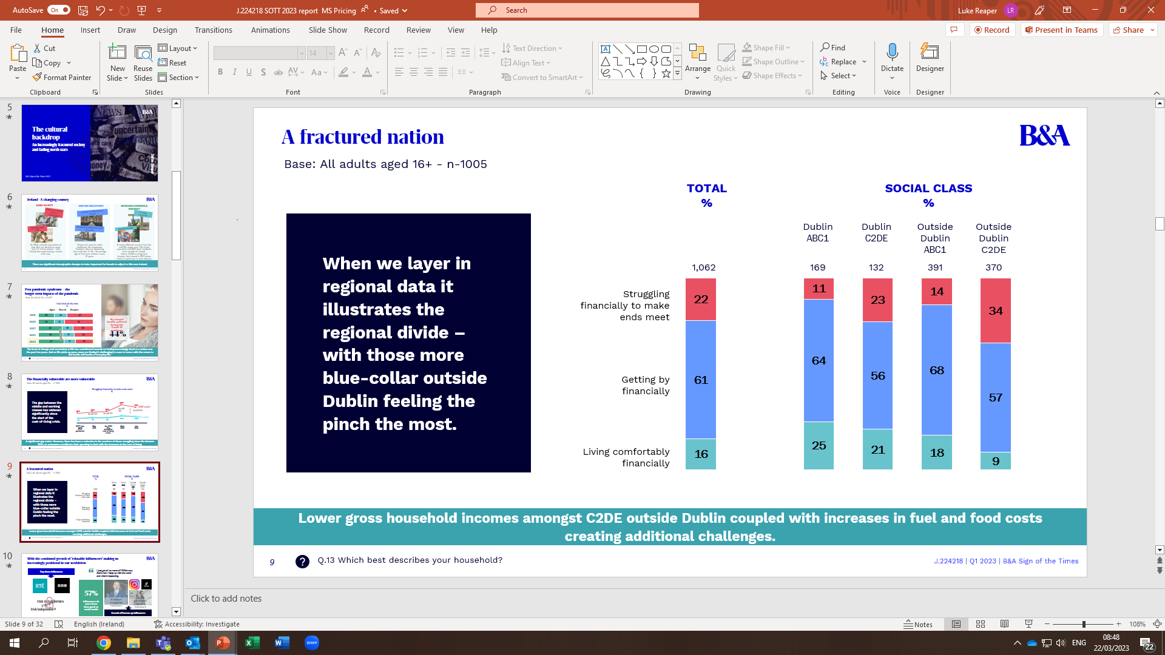
However, the financially vulnerable are more vulnerable
Base: All adults aged 16+ - n-1005
Struggling financially to make ends meet
%
The gap between the middle and working classes has widened significantly since the start of the cost-of-living crisis.
C2DE (total)
ABC1 (total)
SOTT Jan 2020 (Pre-pandemic) | May 2021 | Jan 2022 (Pre escalation cost of living crisis) | Sept 2022 | Jan 2023
A significant gap exists. However, there has been a reduction in the numbers of those struggling since the Autumn 2022, as consumers recalibrate their spending to deal with the increases in the cost of living.
Q.13 Which best describes your household?

Slide 13
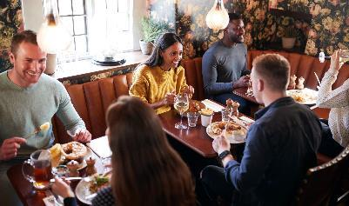



Hence, most are making at least some changes to their buying behaviour
Adjusting frequency
Simple swaps
Value stretching
Pressing pause
Reducing the number of times they go out per month (entertainment/socialising), reduced frequency of buying some discretionary items, etc.
‘Price shock’ means many are on the lookout for potential savings – ‘promotional fishing’ (retailers or brands – note: many find discounters are catching up on prices!)
Expecting more out of the products and services.
Looking for greater versatility from the products that we buy.
Economic uncertainty coupled with a fear that prices have not reached a peak means many are reluctant to purchase big ticket items or commit to expenses in the future (e.g. contracts, etc).
Notes:
Today’s consumer is savvy – making sacrifices and looking for ways to make their money go further while ensuring they still have enough to enjoy the day-to-day. Most consumers horizons have shortened. In fact, versatility and flexibility are increasingly important. Consumers are trimming back, hence the brands that can offer the most versatility will have an advantage in certain categories. Demonstrating relevance to a variety of needs/occasions has never been as powerful.

Slide 14


‘Eagle eyed’ consumers are on the lookout for any shortcuts they notice brands taking
A lot of brands are changing their products, they are cheapening them and making them smaller.
25–34-year-old, Female
93%
Shopping around for better prices
14
J.224218 | Jan 2023 | B&A Sign of the Times
Notes:
Consumers are increasingly sensitive to price increases but also to any shortcuts brands, restaurants etc are making to their product quality or experience.
Shortcuts can be spotted – a handle with care for brands. Think about some research, some proper conjoint analysis for example of brand, pack and price.

Slide 15

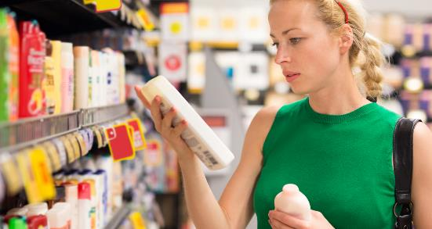
From graduated needs to compromise decisions
Graduated needs
Compromise decisions
77%
buying private label products more often
61%
Some products that previously would have been classified as ‘a treat’ have now graduated to ‘a need’ as a more discerning shopper emerges.
However, consumers are now reassessing value, with many moving back ‘down the ladder’ in their purchasing decisions.
spending less on non-essentials
  The cost of living crisis has been a reality check for many. Most are having to compromise on at least some areas of their consumption behaviour (private label, less on non-essentials, etc). Important for brands to drive home the added value delivered over private label.
Q.15 Which of the following, if any, do you find yourself doing nowadays? -

Slide 16



Despite this, we all still have moments of carpe diem - Brands need to work hard to align with moments of release
Our self control only goes so far...
Moments of Carpe Diem
Most want to splurge on experiences over products
In addition, due to uncertainty about the future and what is around the corner there is a sense of needing to ‘do it while you can’.
… like a muscle it gets tired! There are periodic (often unplanned) splurges of spending - felt to be a necessary antidote to a sense of perpetual good behaviour.
Things we can share with others and things that contribute towards our mental health and social wellbeing.
The value of experience has suddenly become very tangible. Often we seek higher quality experiences to rationalise the cost.
Notes:
The struggle between carpe diem and prudence is real: leading to inconsistent financial philosophies.
Deviations from good behaviour are defended as important for wellbeing – keeping us human.

Slide 17
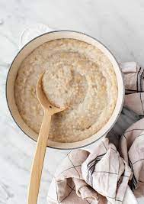
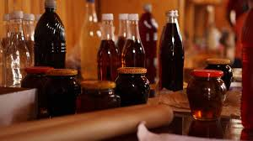



Brands can raise prices
Some brands will be able to charge more based on their brand equity
Some brands can override predictable pricing strategy by using their brand power.
…….But must have a deep understanding of the brand strength. Otherwise, it can go horribly wrong.
This is not confined to very high-end brands!
They reinforce brand equity to reduce price sensitivity.
Not everyone is lucky enough to have a Veblen brand?
  A thorough understanding required of category insights, consumer behaviour and price elasticity.
Notes:
s

Slide 18

Trained to endure
As a nation we are feeling the pinch –consumers adjusting their spending behaviour.
As a battle-hardened bunch since the financial crisis, we have become ‘trained to endure’.
Openness towards private label is increasing as they look for simple swaps - meaning brands need to work extra hard to communicate their added value.
Customers need to be able to justify spending more on brands.
Highlighting product versatility is powerful. However, it is important that brands continue to target consumer segment needs, and usage occasions.
Some brands will be able to charge more based on strong brand equity
Notes:
With consumers on the lookout to make savings, it is important for brands to continually communicate on their value add and equity. Now is not a time for going into hibernation mode, but in fact, a time to be noisy and courageous - reinforcing the value of what a brand brings to the table for consumers.

Slide 19

Parting thoughts
Delve Deeper

Slide 20



How these themes can inform strategy
Each choice, each price point and each cost-of-living trade-off is increasingly a more considered act. How can your brand best articulate its value in an increasingly system 2 thought space?
Invoking emotionally led brand love will be ever more critical as a differentiator.
As consumers reassess value and ‘ladder down/up’ by category –do you understand the category dynamics?
Important to understand where your brand fits within wider consumer decision making.
As a nation we are shining more and more light on historically taboo spaces – resulting in huge.
As brands have ‘permission-to-play’ in new spaces are you ready to play?
Consumers are human beings - never lose sight of human psychology
1) Self control only goes so far
2) We need release
3) Experiences are in vogue.
Can your brand Seize the Day?
Be courageous and brave and assert your added value.
Some brands can override predictable pricing strategy by using their brand power.
But you must have a deep understanding of the brand strength.
We are living with the long tail of pandemic trauma. How can your brand rise up to support the recovery of the nation?
Delve Deeper
.

