Slide 1
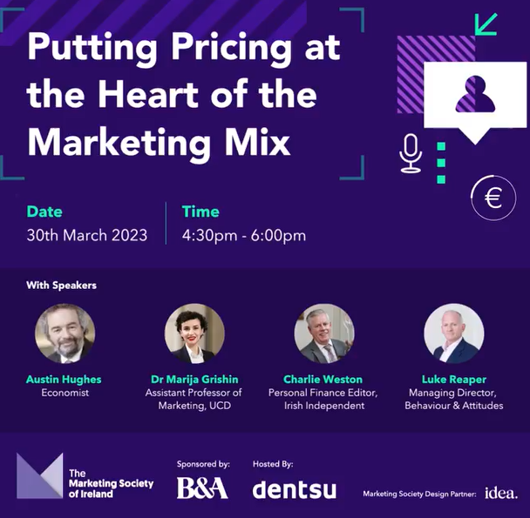
The problems in pricing for a boom and doom economy
Austin Hughes
(30/03/23)

Slide 2
A stream of ‘Shock and Awe’ rather than a steady state
More frequent shocks
More problematic policies
Global financial crisis
Euro area crisis
Brexit
Trump(ism)/Muskism
Covid
Ukraine
Banking…again?
Austerity
Negative interest rates
Economic ‘distancing’
QE/QT
Housing for all; build and ban?
More pressures, more problems, less predictability.
Consumers scarred and scared but surviving…possibly better than feared
Q. Is your offering absorbing or amplifying/exploiting these shocks?

Slide 3
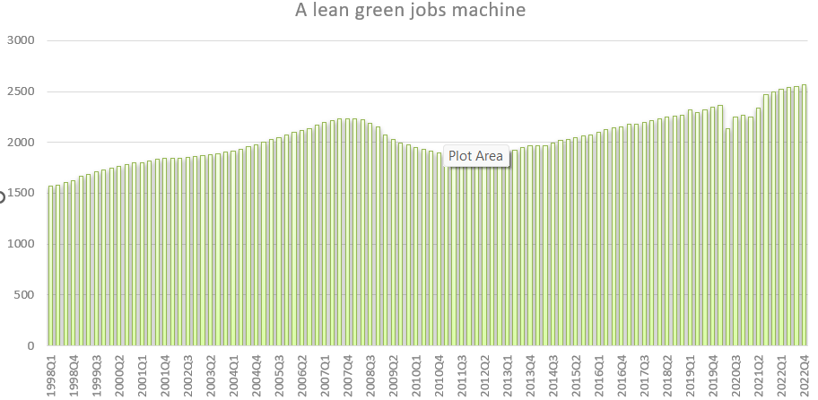
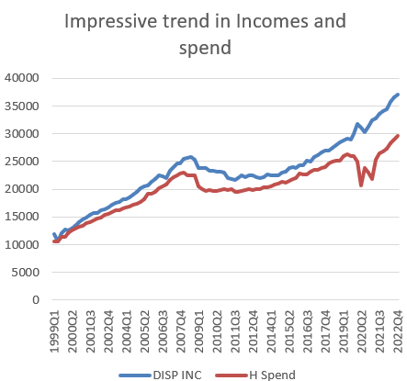
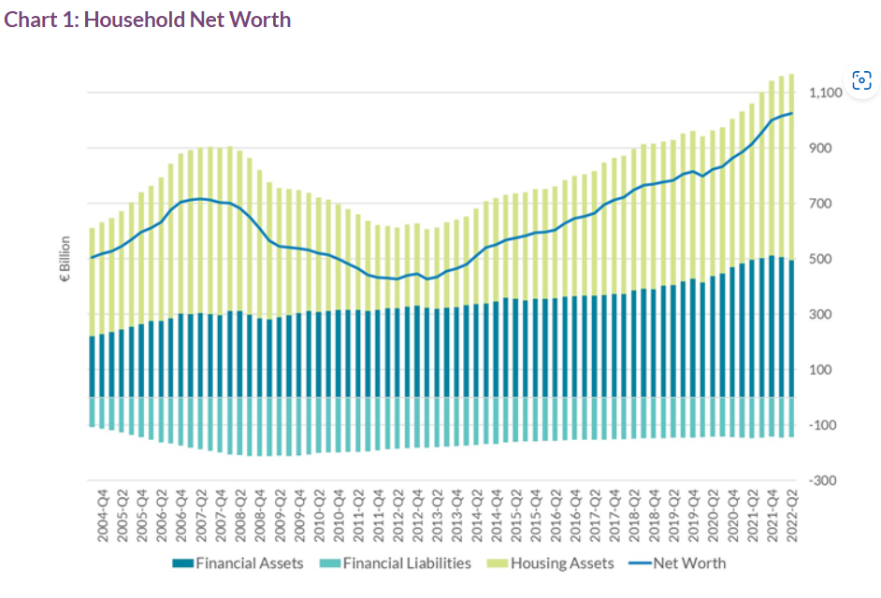
Crisis, what crisis? Most domestic economic news is still positive
Population up 89k in 2022
Employment up 158k in 2022
Household income up nominal 8.3% in 2022
Consumer spend up nominal 13.6% in 2022
Aggregate housing wealth almost €1.1trn
Q. How much focus do you put on these ‘new’ consumers?

Slide 4
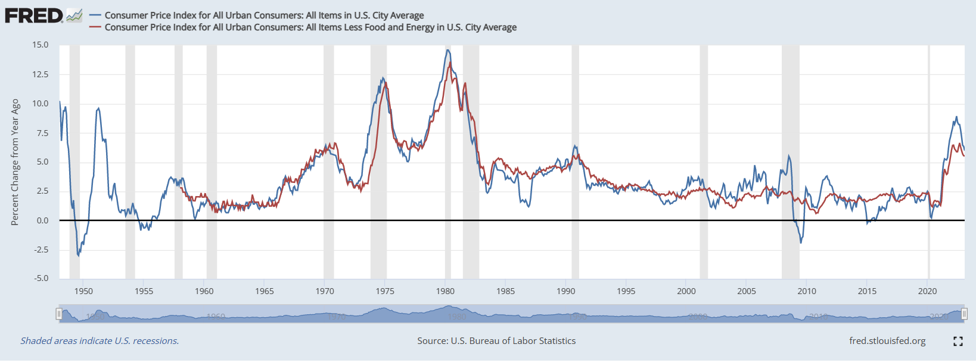
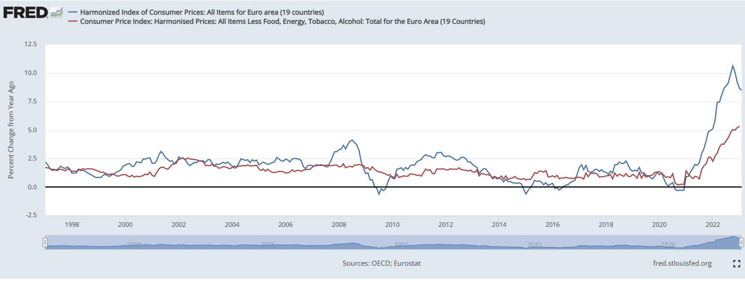
The cost of living crisis; (I) Inflation once again…..if you’re over 40…or possibly over 90
Inflation causes big problems and/or
dealing with it causes big problems
Now clearly past ‘pivot’ point where rising prices seen as a problem that is big and broadly based
Christine Lagarde speech 22/03/23,… we will still have ground to cover to make sure that inflation pressures are stamped out. …. But the public can be certain about one thing: we will deliver price stability, and bringing inflation back to 2% over the medium term is non-negotiable.
Bundesbank president Joachim Nagel FT interview 22/02/23; ‘if we are to tame this stubborn inflation, we will have to be even more stubborn…“I still envision a soft landing”.”.
Q. Are your consumers inflation ‘newbies’?.

Slide 5
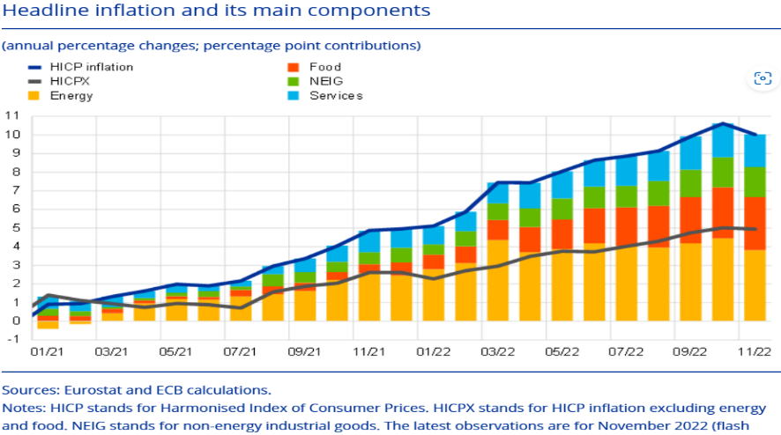
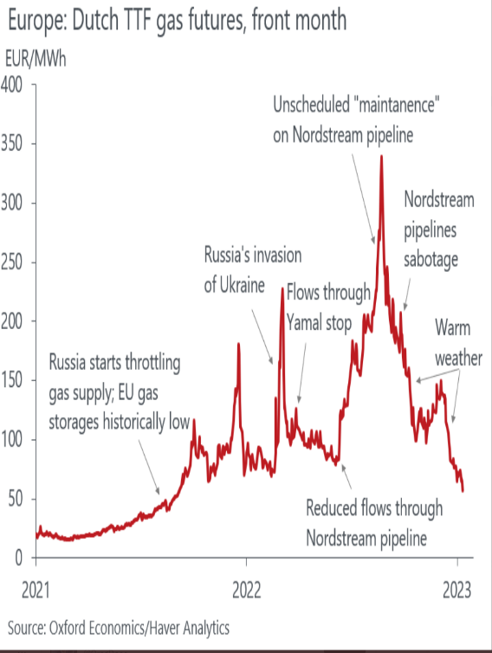
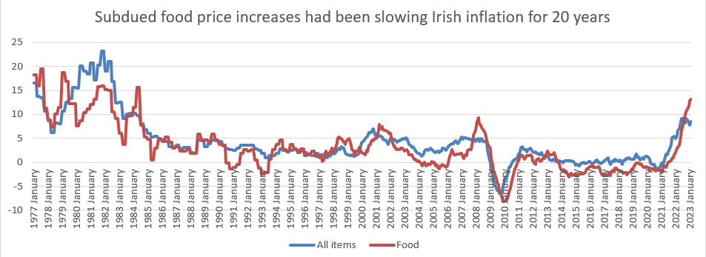
The cost of living crisis (II) What’s driving inflation?
Source; ECB Bulletin 12/01/23
Energy price surge; high profile, high impact, high spillover
Food price surge; even higher profile, higher impact
Q. How publicly visible is your pricing?

Slide 6
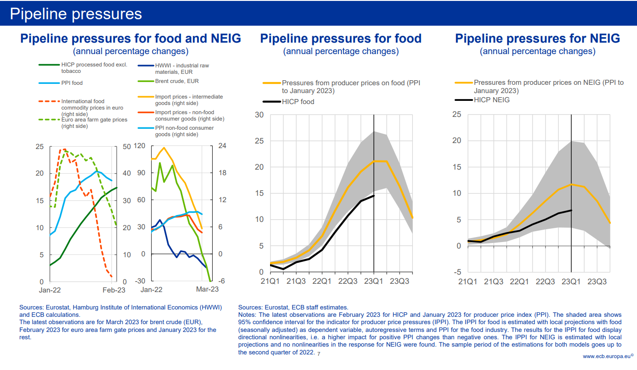
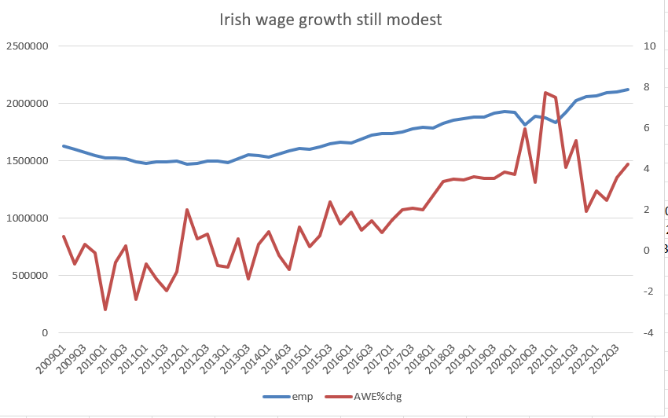
The cost of living crisis (III) Some signs that the pipeline problems are easing
Story varies widely across price categories
Food seen as large and lasting problem
Weather vagaries hold out possibility of very bumpy year
Wages only seeing partial compensation
NB. Emerging easier trend in inflation wont lead to corresponding easing in cost of living pressures
Source; P Lane presentation 06/02/23
‘Pipeline’ Inflation has peaked. Will pressures plummet or pivot?
Q. Will you lead or lag a softer trend… a falling trend?

Slide 7
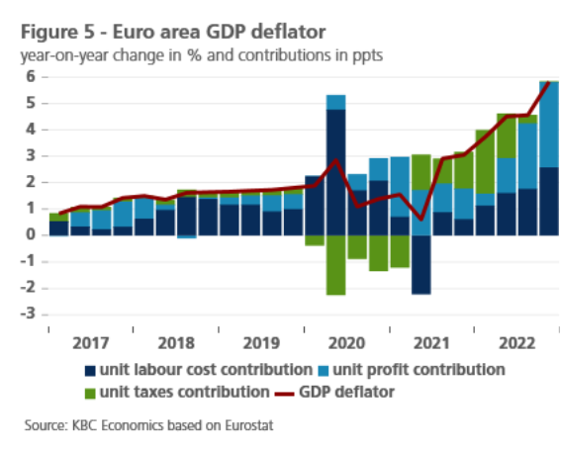
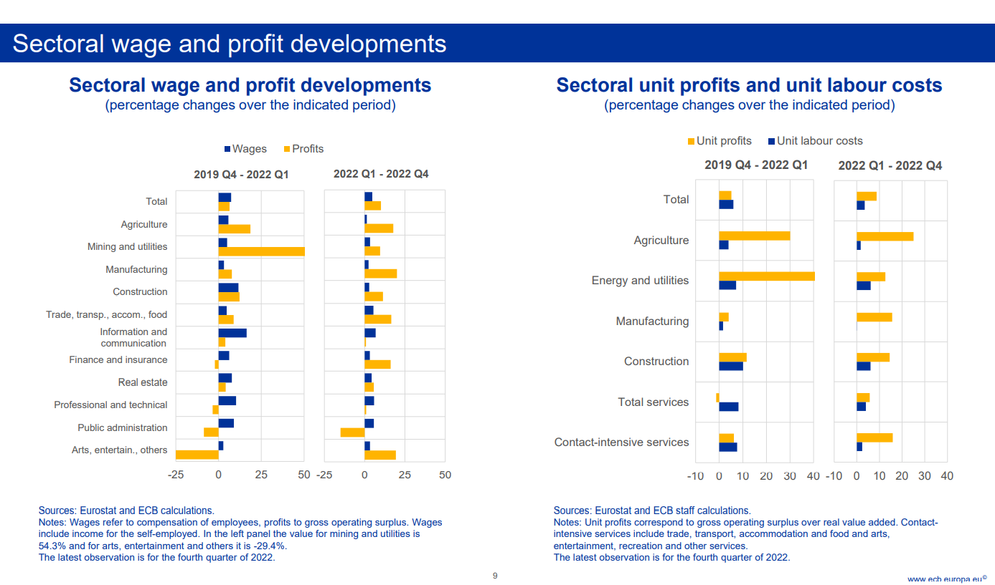
The cost of living crisis (IV) ; ‘ECB confronts a cold reality: companies are cashing in on inflation. Profit margins have been growing as prices have been rising,’ REUTERS 02/03/23
Q. Where are you in the war between good and evil?!
Source; P Lane speech 22/03/23

Slide 8
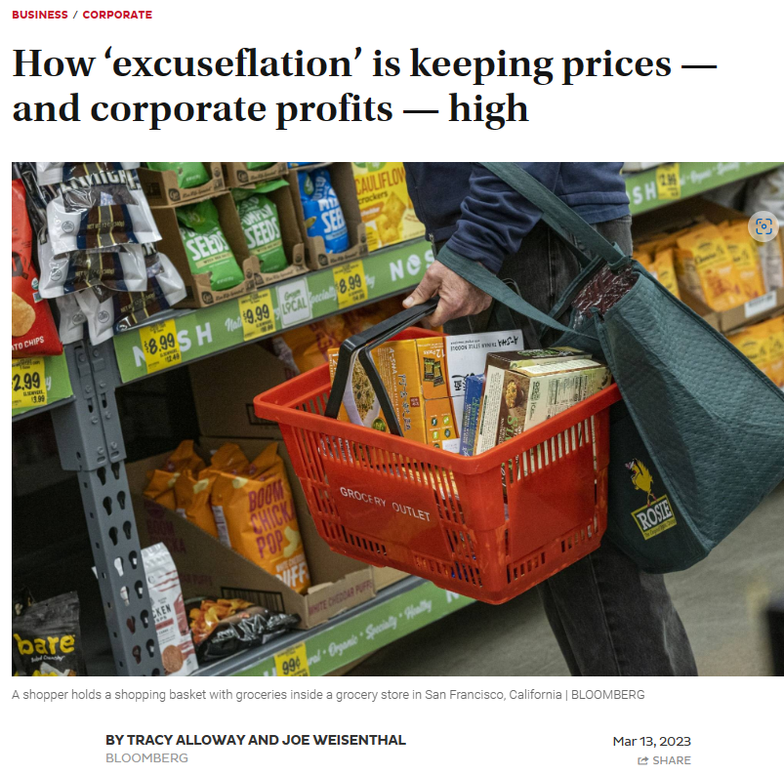
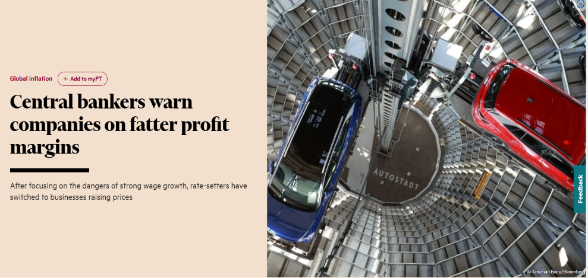
The cost of living crisis(V) It couldn’t happen here?
International data/research suggest companies have engaged in ‘pre-emptive/precautionary/proactive price increases and/or are choosing POV strategies
Irish ‘macro’ data late and limited
2022 Irish GVA Deflator +6.0%
2022 Irish COE Deflator +3.2%
→ profit margins ↑
Cost push inflation,
Excuseflation,
Or …. Exploitflation?
Q. Are you ready for the next big fallout?

Slide 9
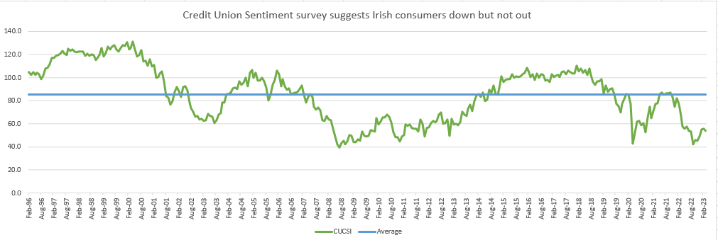
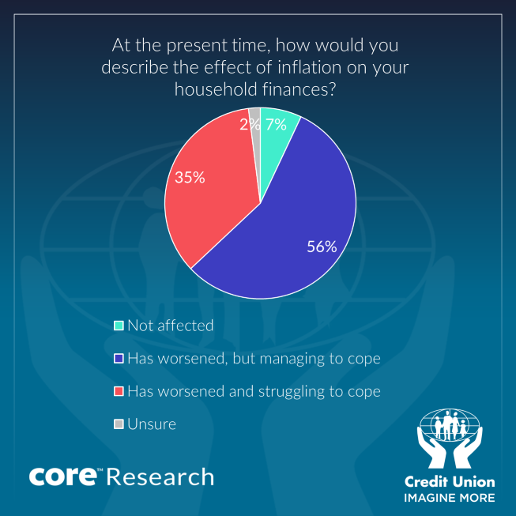
The credit Union consumer sentiment survey suggests fear and fragility but is not signalling an Irish consumer in freefall
Irish consumers scarred and scared and shifting spending …..
No defining demographics
Q. Where are your consumers?

Slide 10
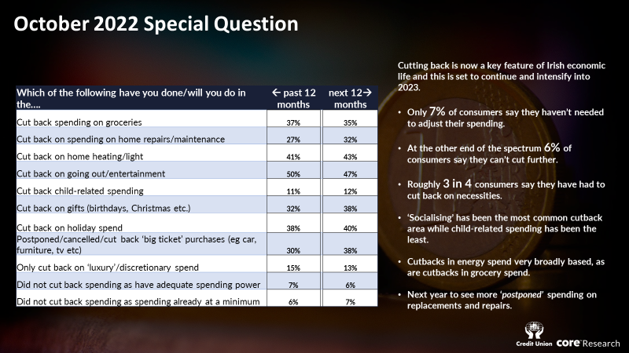
In conclusion; Irish consumers slower but not stopped
Cost of living problem seen as broadly based and requiring wide-reaching responses
Spending adjusting not stopping-survey suggests larger pull-back than ‘hard’ data
Secret spend/splurge may have replaced ‘conspicuous consumption’
Q. Is your offering relevant, reasoned and striving harder to ‘reach’ all or some consumers?
Q. How flexible are you?

