Slide 1
New retail frontiers
—
Virtual worlds have become a format which rethinks the traditional ecommerce look and feel.
Walmart enters the metaverse

Slide 2
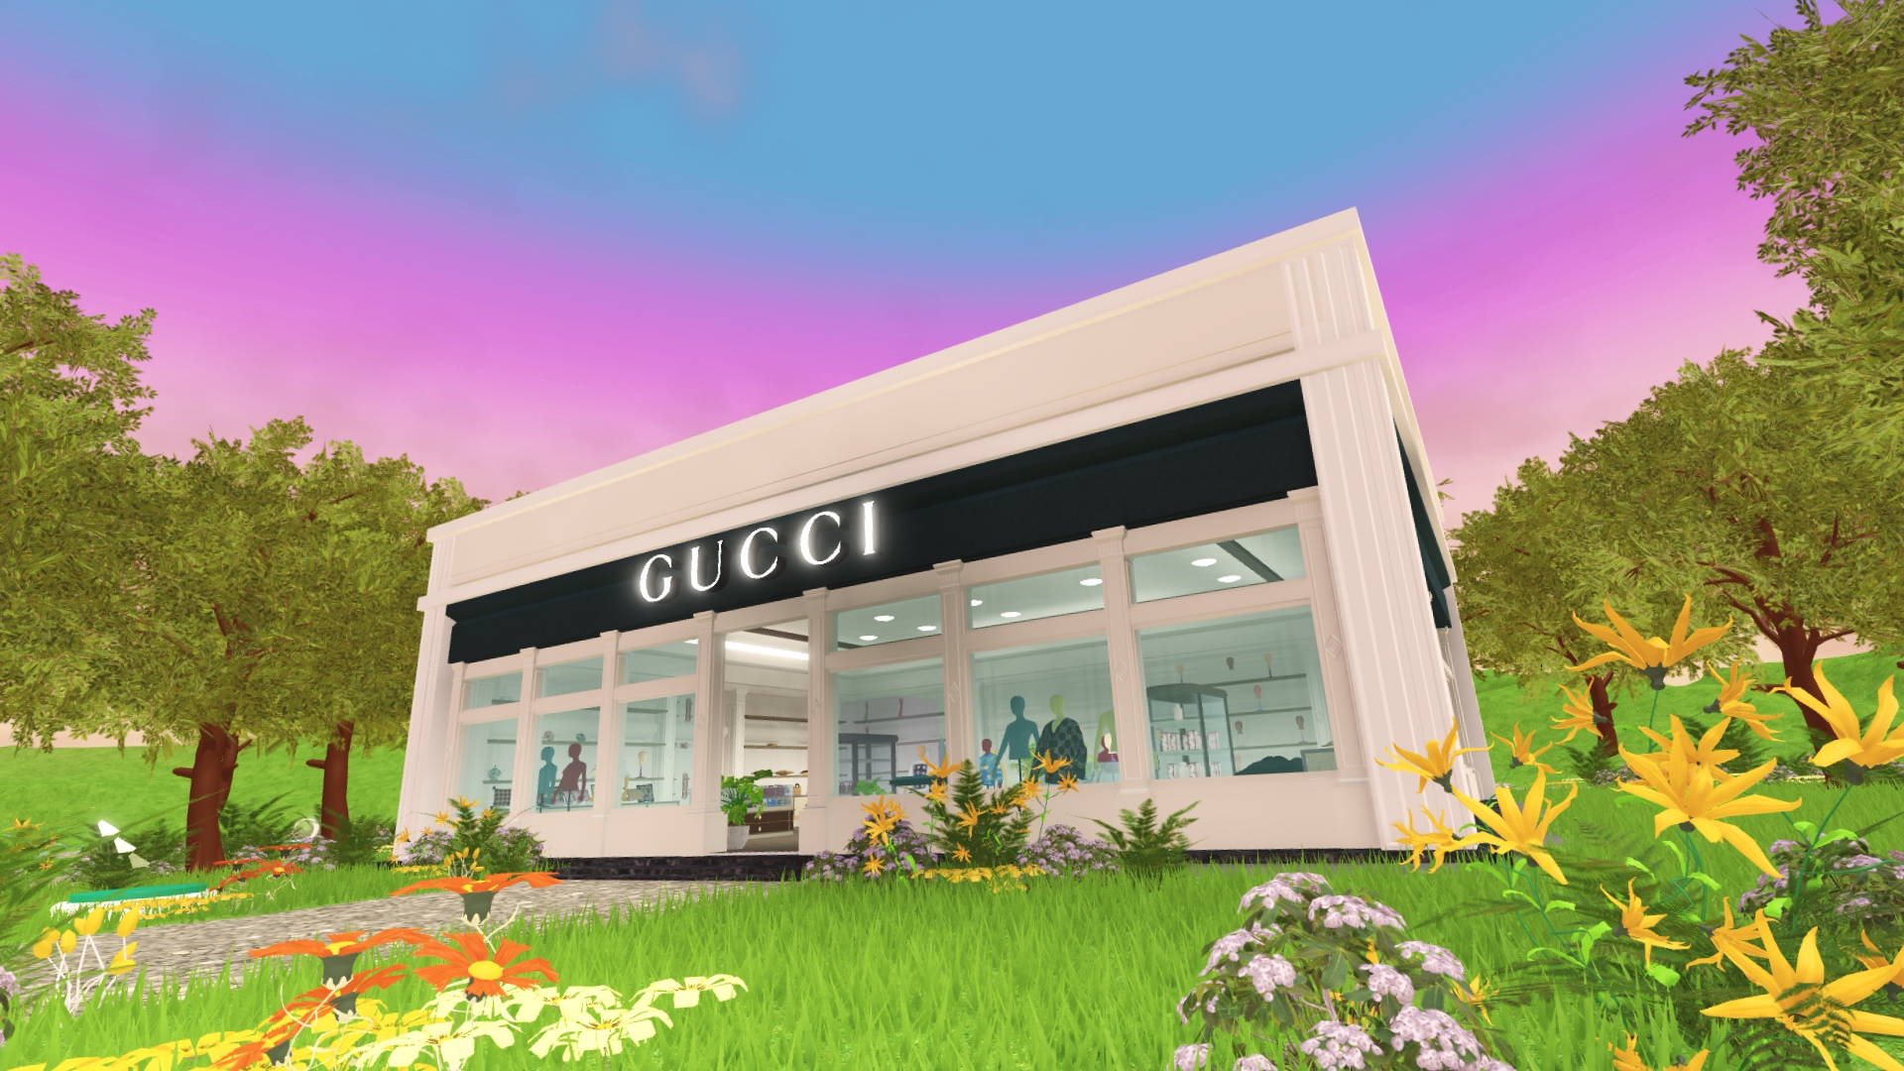
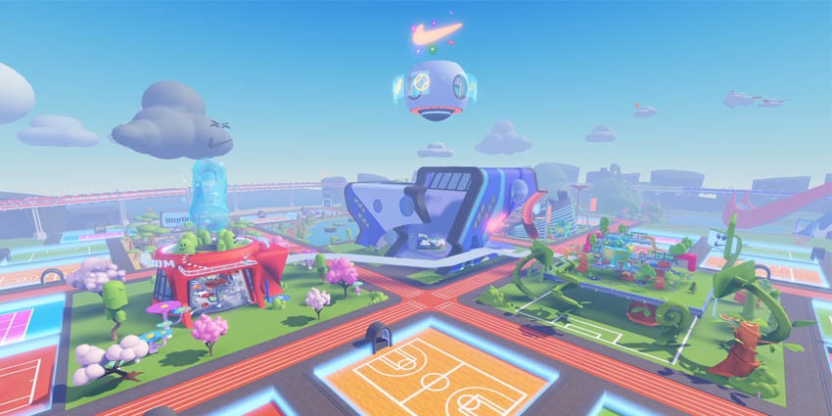
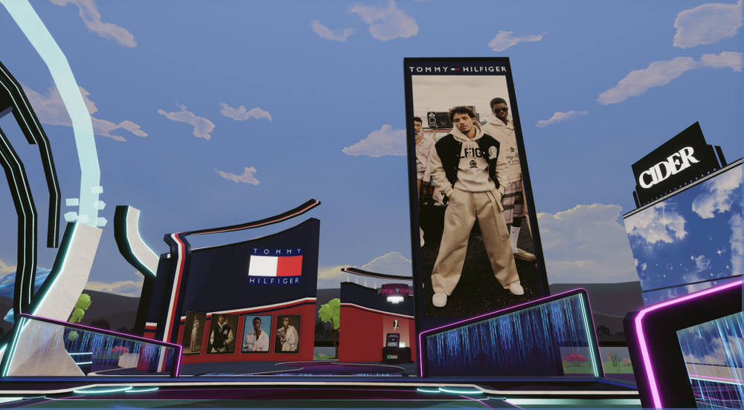
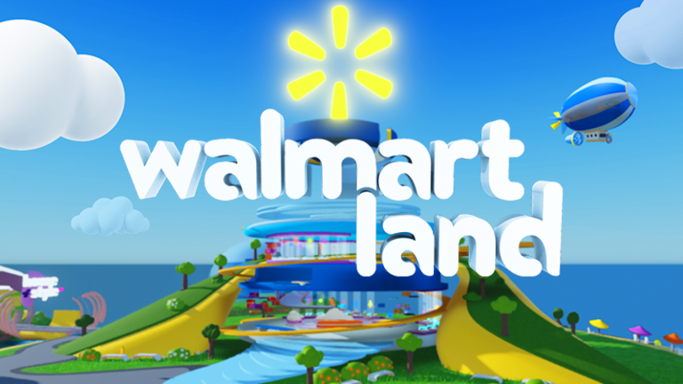

Slide 3
Among those who know what the metaverse is…
aa
Shopping in the metaverse is expected
70
believe it will be
a place to shop
aa
68
say it will be the future of ecommerce and online shopping
Source: Wunderman Thompson Data. Fielded in March 2022 among 3,005 respondents across US, UK and China

Slide 4
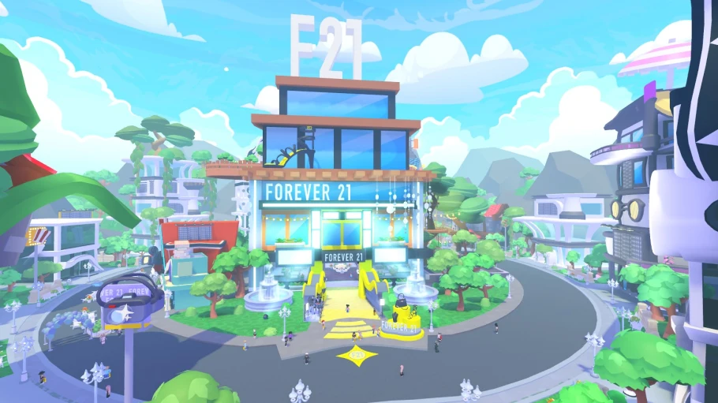
Forever 21 Shop City in Roblox

Slide 5
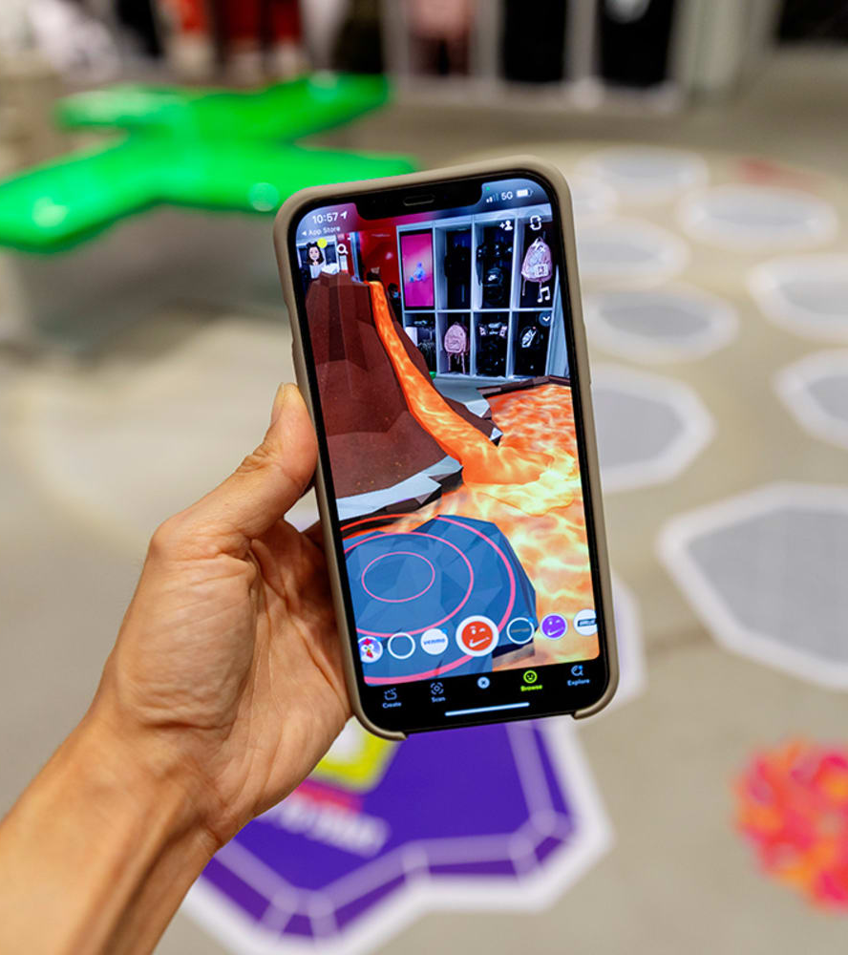
Liminal stores
—
Retailers are bringing the metaverse into the physical world.
Nikeland

Slide 6
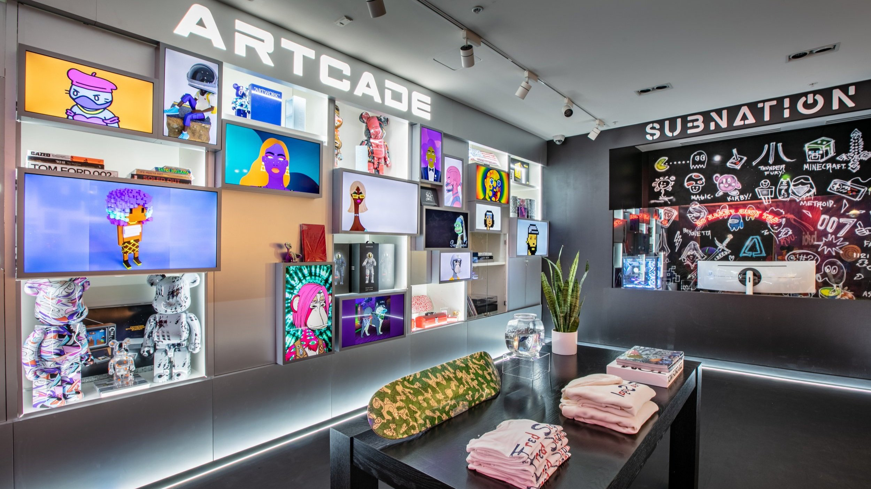
Artcade by Fred Segal

Slide 7
ZERO10 x Crosby Studios

Slide 8
Kylie Virtual World by Kylie Cosmetics for Boots.com

Slide 9
Digital possessions
—
A new type of ownership is ushering in the next era of virtual lifestyles and digital consumption.

Slide 10
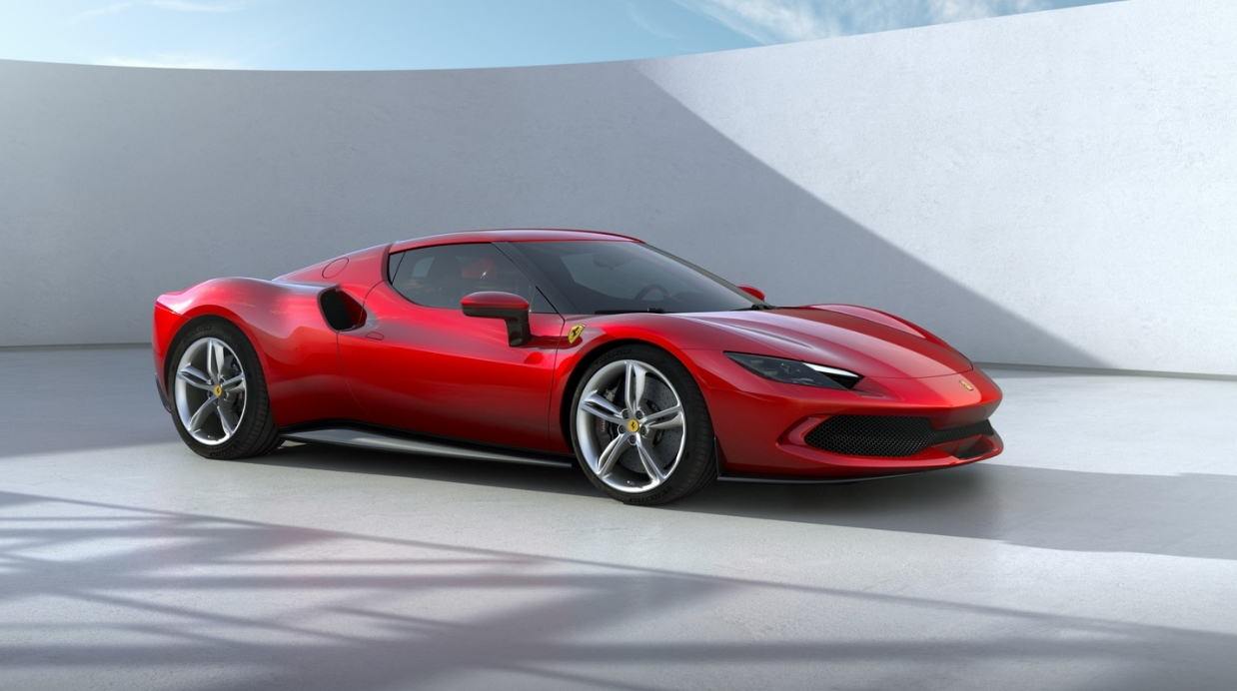
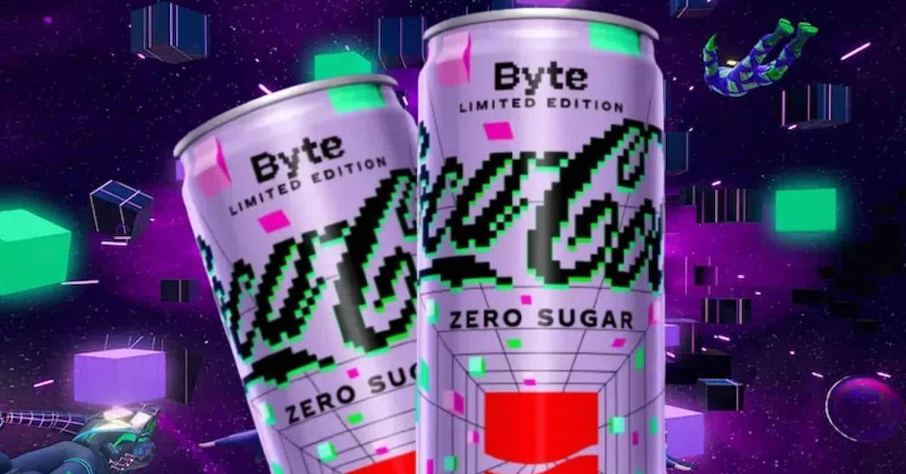

Slide 11
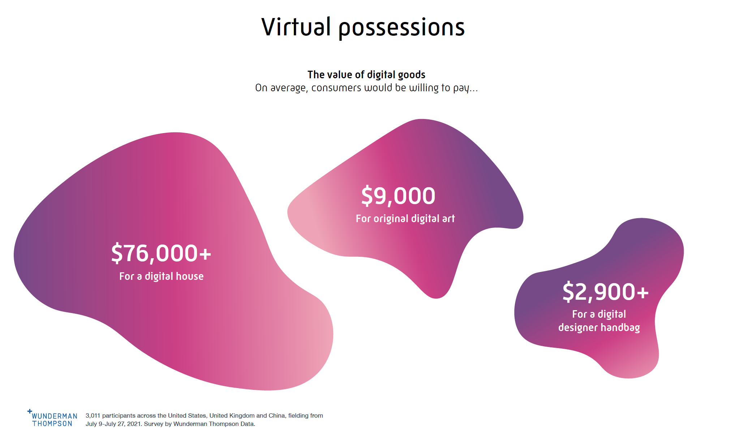

Slide 12
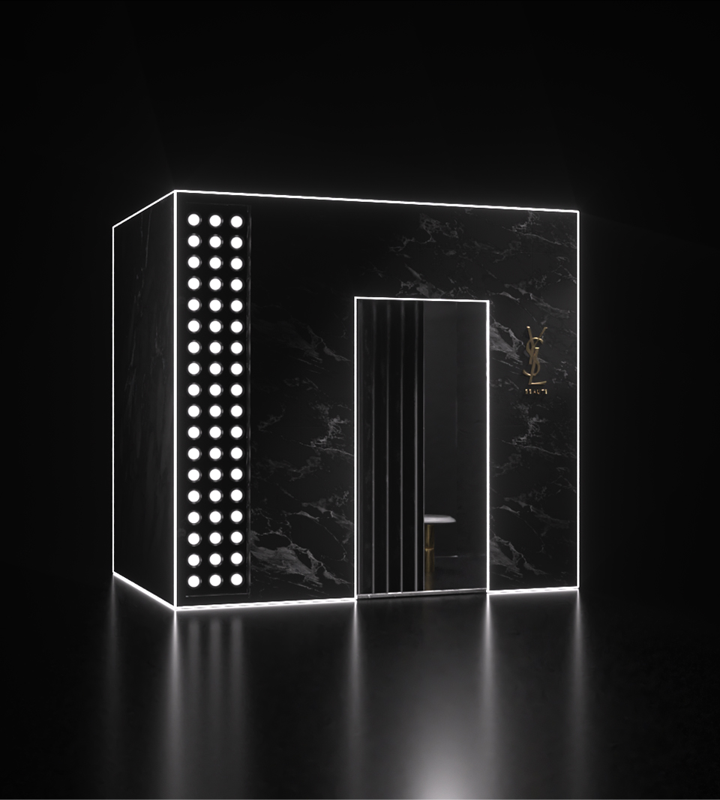
VIP access
—
NFTs are becoming the gateway to exclusive access to brand content, communities and new launches.

Slide 13
Flyfish Club

Slide 14
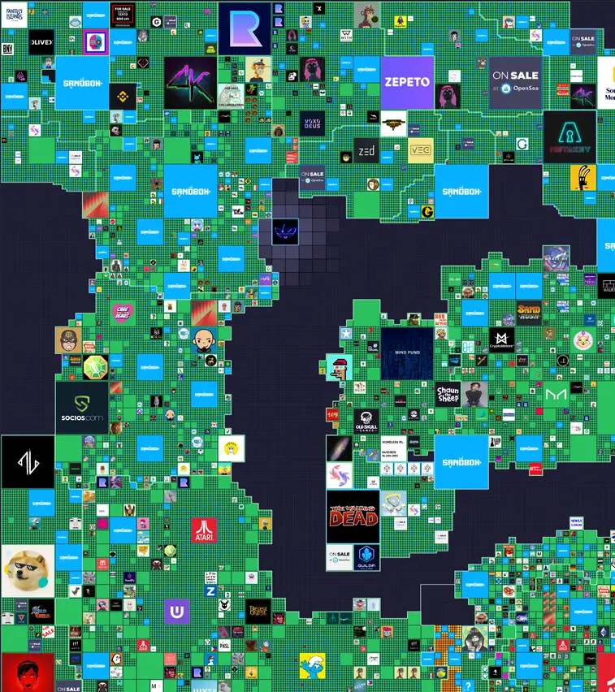
Brand safety
—
Brands are trademarking their territory in the metaverse, in a first pass at establishing brand and user guardrails

Slide 16
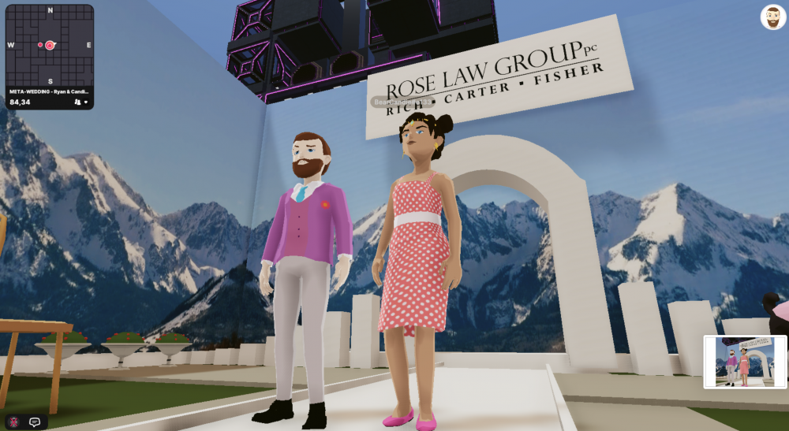

Slide 17
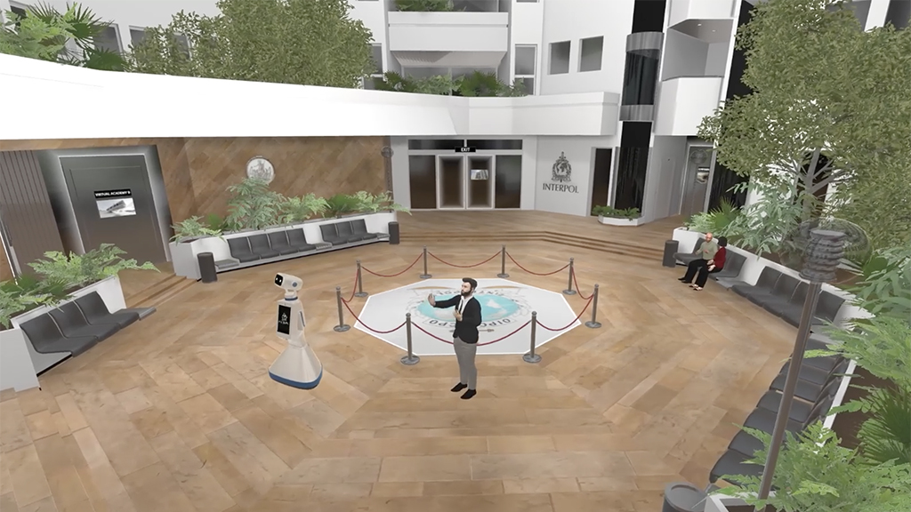

Slide 18
“The metaverse is here, and it’s not only transforming how we see the world but how we participate in it.”
— Satya Nadella, CEO, Microsoft

