Slide 1
Into the Metaverse Digital Trends Shaping the Future
Emma Chiu, Global Director, Wunderman Thompson Intelligence

Slide 2
01
Intro to the Metaverse

Slide 3
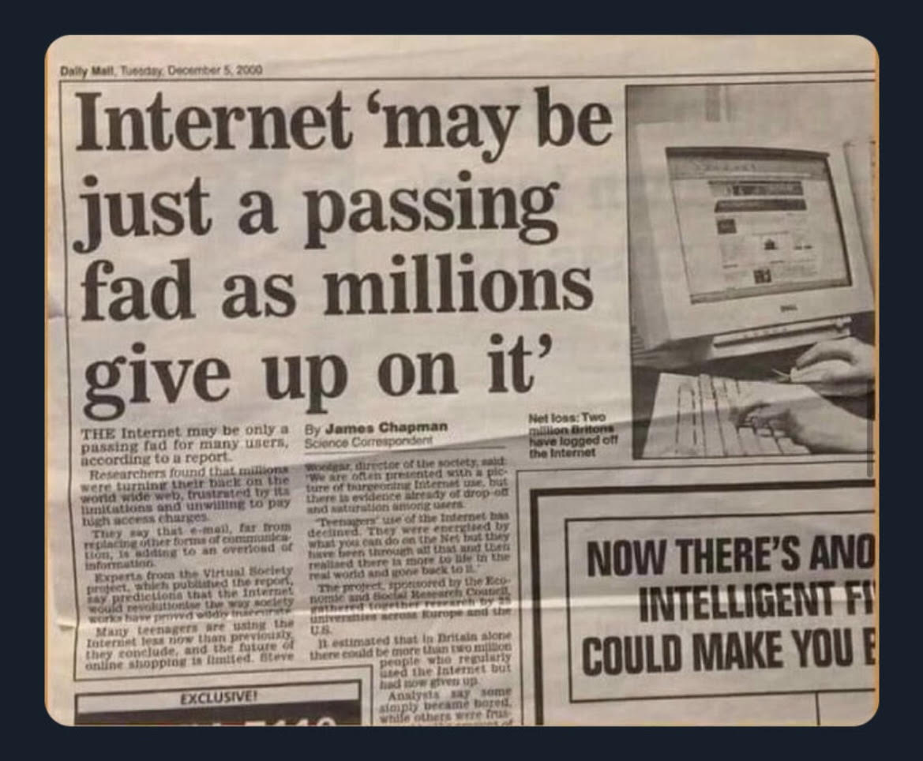

Slide 4
What is
the Internet?
1990s
What is
the Metaverse?
2020s

Slide 5
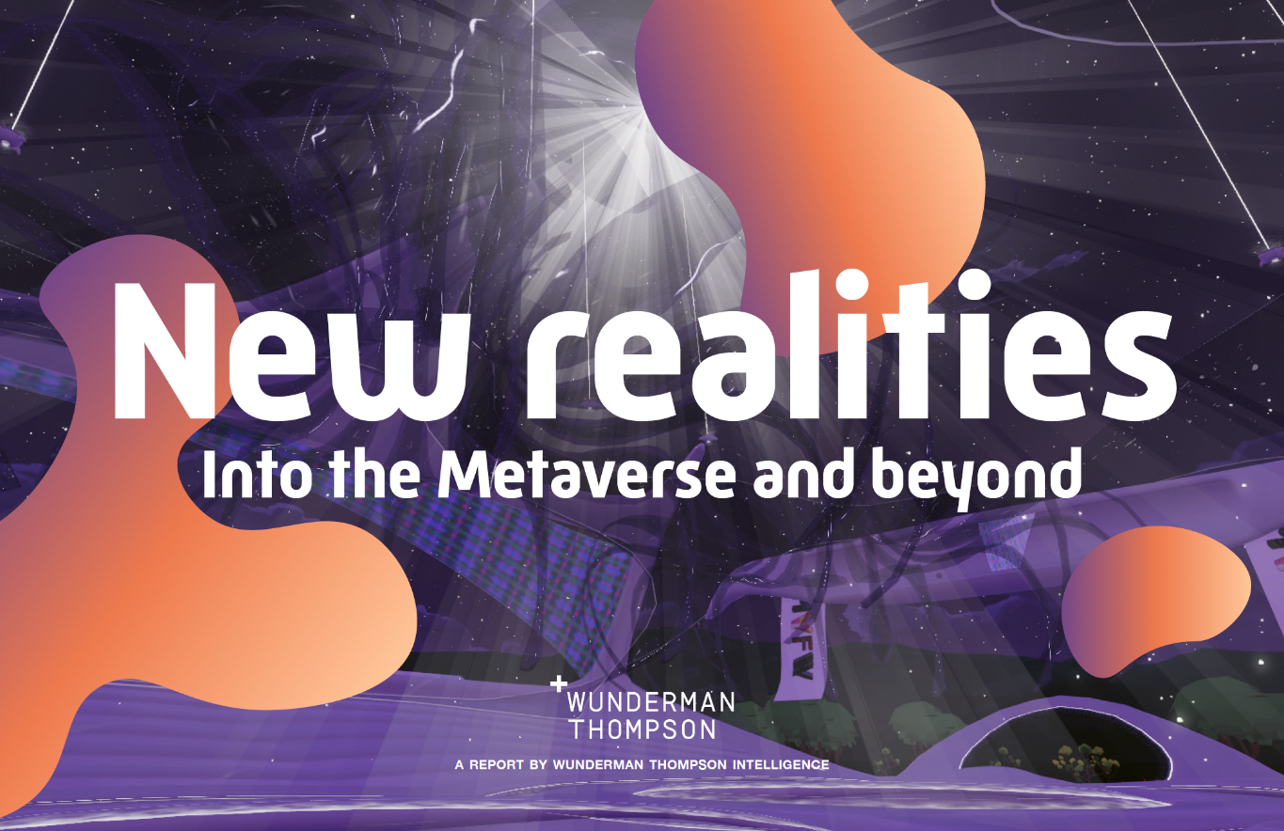
September 2021 release
May 2022 release
Download the reports via wundermanthompson.com

Slide 6
aa
The term ‘metaverse’ has picked up significantly
32
have heard of the term ‘metaverse in July 2021
74
have heard of the term ‘metaverse in March 2022
Source 1: Wunderman Thompson Data. Fielded in July 2021 among 3,011 respondents across US, UK and China
Source 2: Wunderman Thompson Data. Fielded in March 2022 among 3,005 respondents across US, UK and China

Slide 7
aa
know what it is and can explain it well to someone else
But there is still a lack of clarity
15
29
say they have explored the metaverse or a virtual world
Source: Wunderman Thompson Data. Fielded in March 2022 among 3,005 respondents across US, UK and China

Slide 8
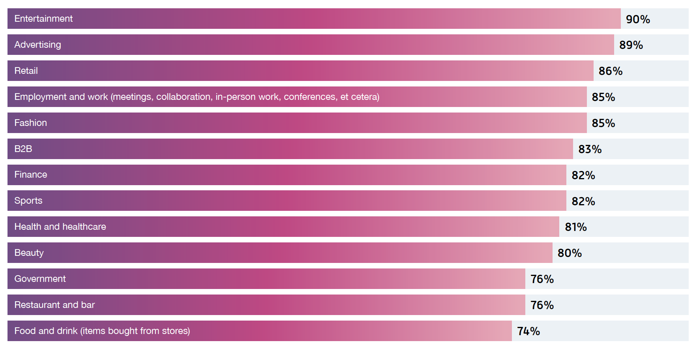
What industries/sectors will be impacted by the metaverse?
Source: Wunderman Thompson Data. Fielded in March 2022 among 3,005 respondents across US, UK and China

Slide 9
Among those who know what the metaverse is…
aa
74
think the metaverse is the future
The metaverse is promising
72
agree it’s the next big thing
66
believe it will be life changing
Source: Wunderman Thompson Data. Fielded in March 2022 among 3,005 respondents across US, UK and China

Slide 10
A trillion-dollar opportunity
JP Morgan: $1 trillion yearly market
Goldman Sachs: $8 trillion opportunity
Citi: $13 trillion with 5bn users this decade
Morgan Stanley: $8.5 trillion in US alone
Notes:
Banks project the metaverse will be a trillion+ dollar opportunity

Slide 11
What is the Metaverse?

Slide 12
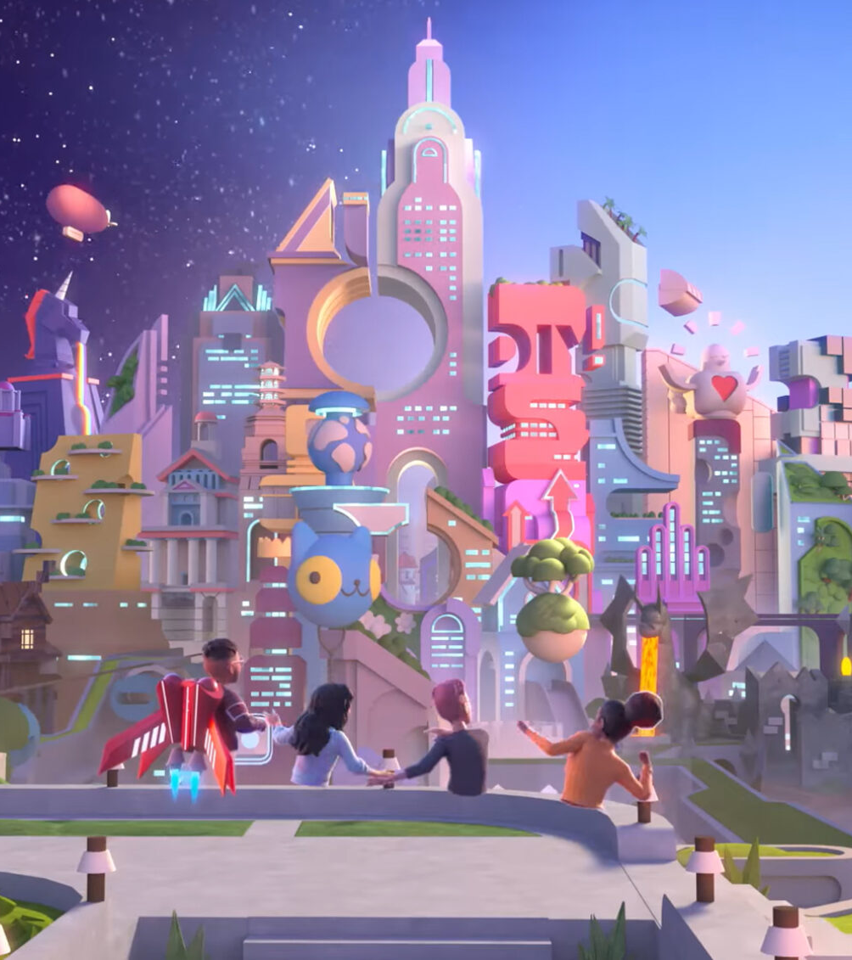
The metaverse currently exists as a series of virtual worlds
Nikeland

Slide 13
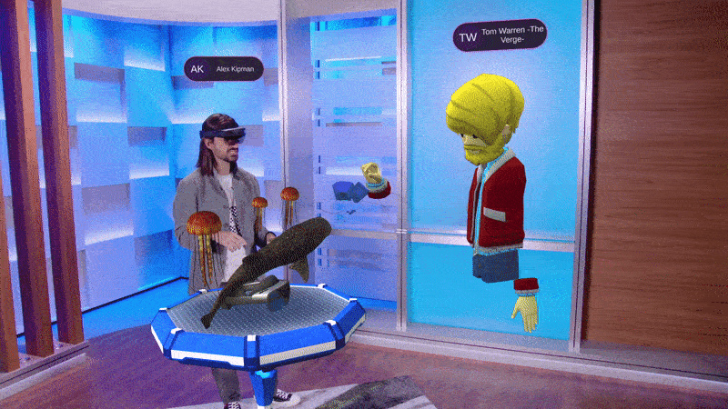
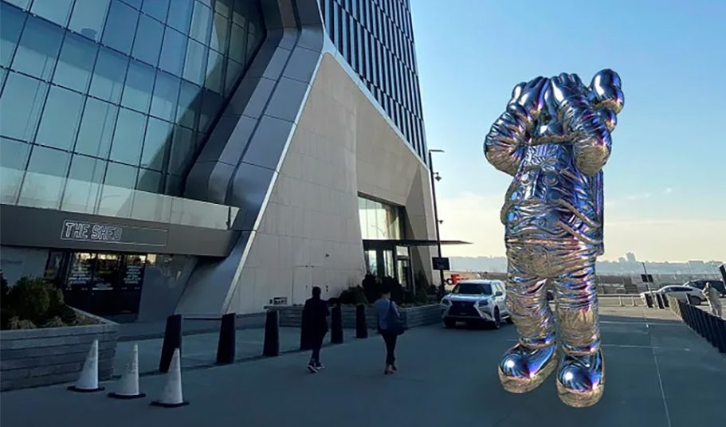
In the future of the Metaverse will be where our digital and physical lives converge

Slide 14
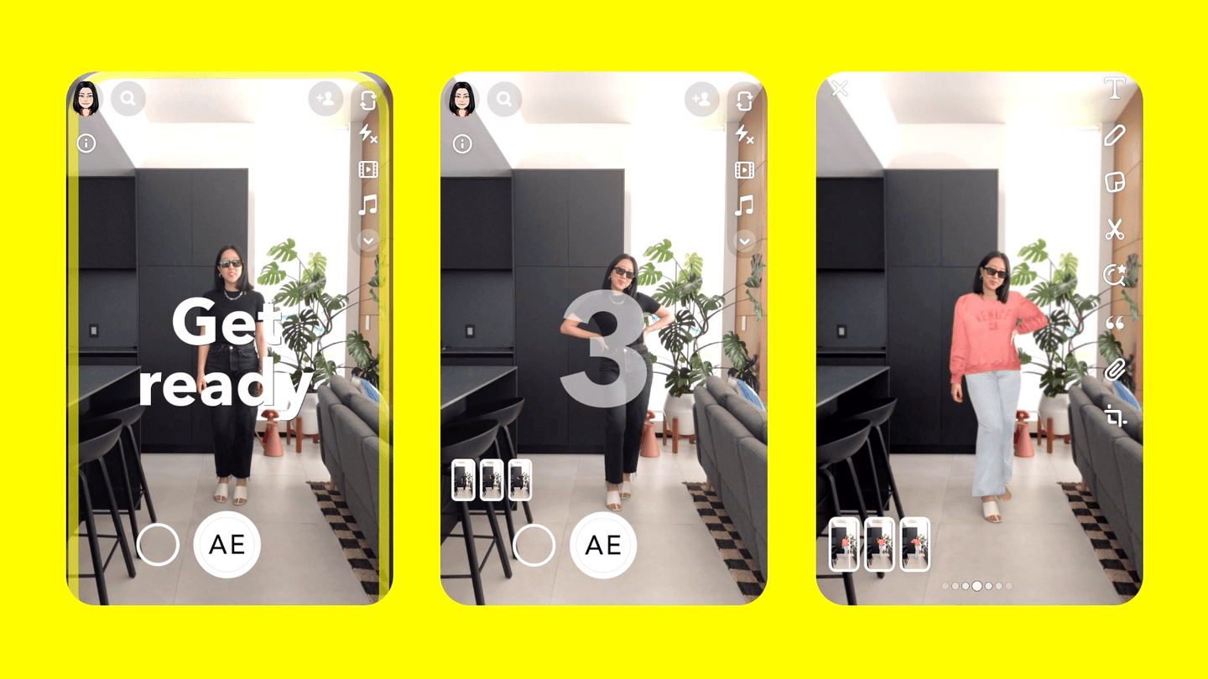
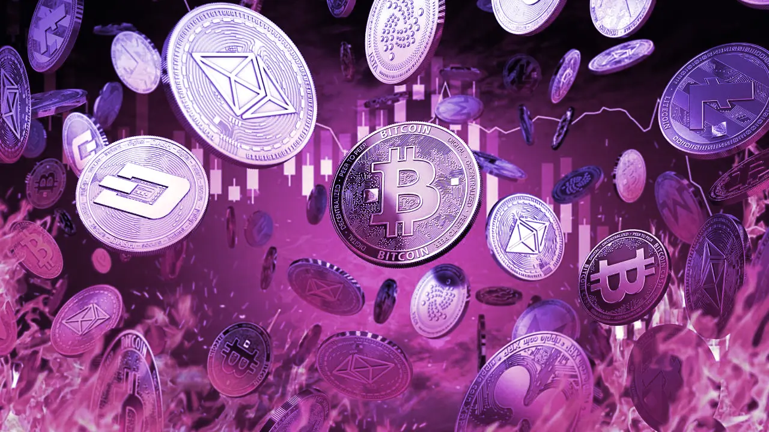
Key components that are contributing to the metaverse
VIRTUAL WORLDS
DIGITAL IDENTITIES
ALT REALITIES
NFTs
DIGITAL CURRENCIES
WEB3

Slide 16
“
There will be no clean Before Metaverse and After Metaverse
Matthew Ball, venture capitalist

Slide 17
02
Key trends

Slide 18
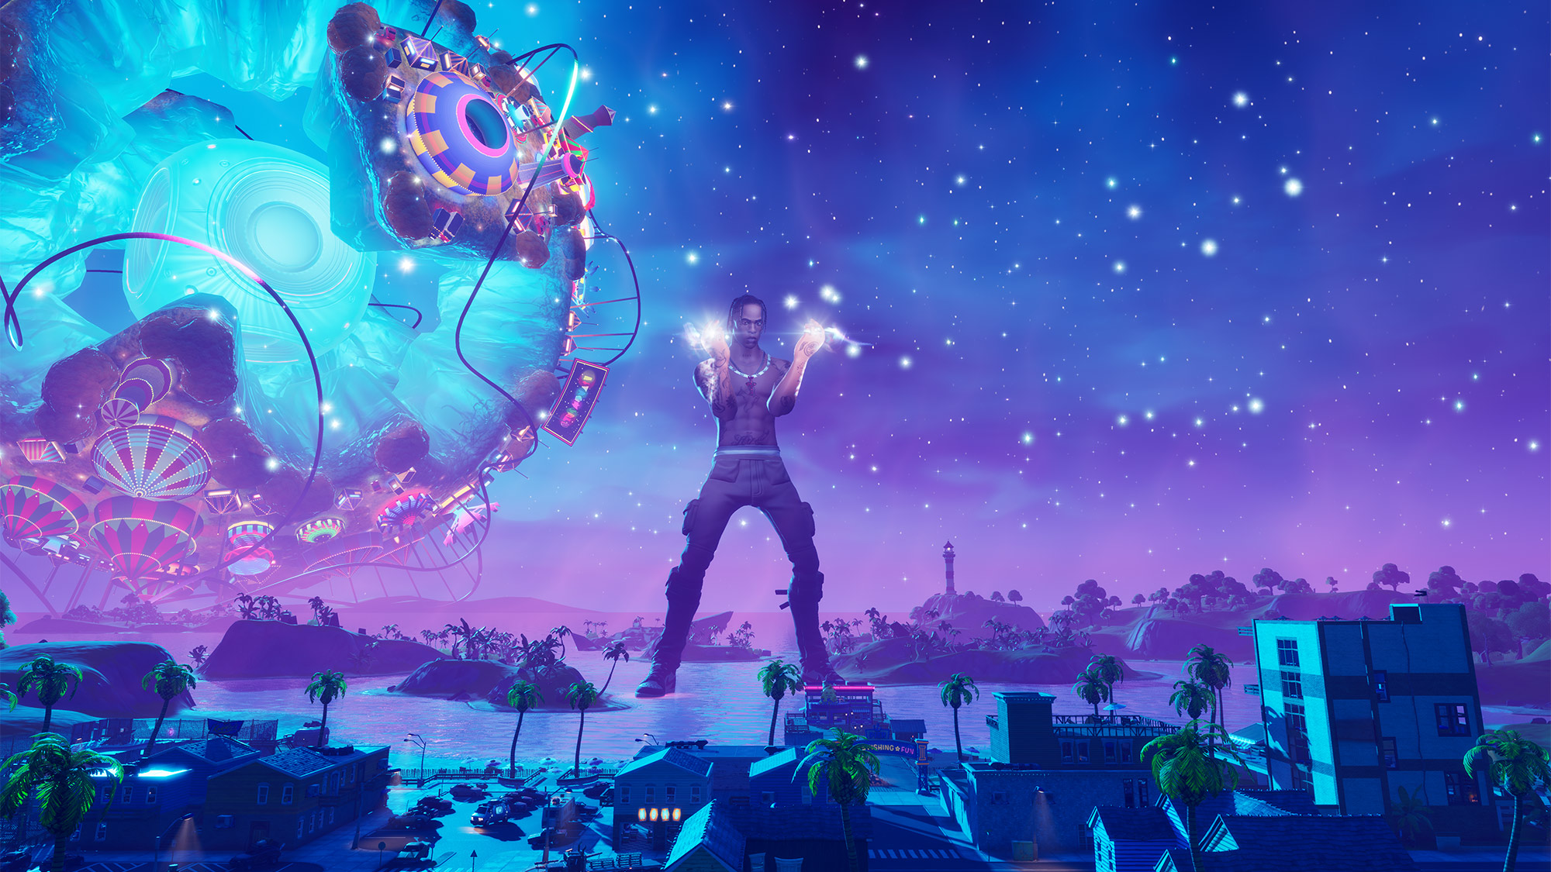
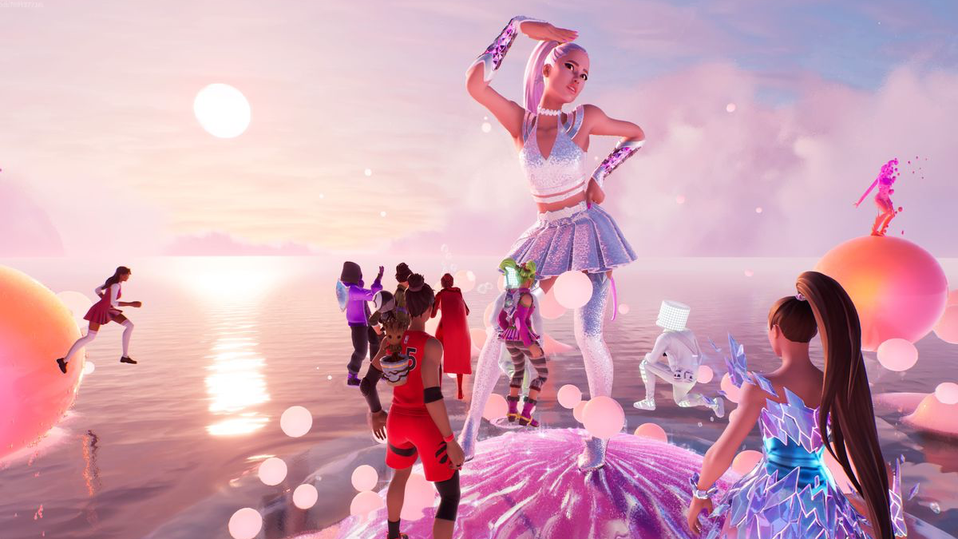
Branded virtual worlds
—
Digital spaces are offering a new repertoire of immersive touchpoints.

Slide 19
82% of people believe the metaverse is a place to socialize
Fortnite x Coachella
Notes:
88% say technology brings people together

Slide 20
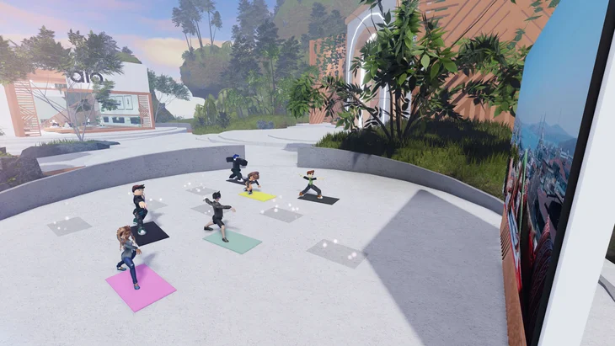
Alo Yoga metaverse in Roblox

Slide 21
Facebook Horizon Workrooms
Notes:
61% of global respondents agree that their livelihood depends on technology.

Slide 22
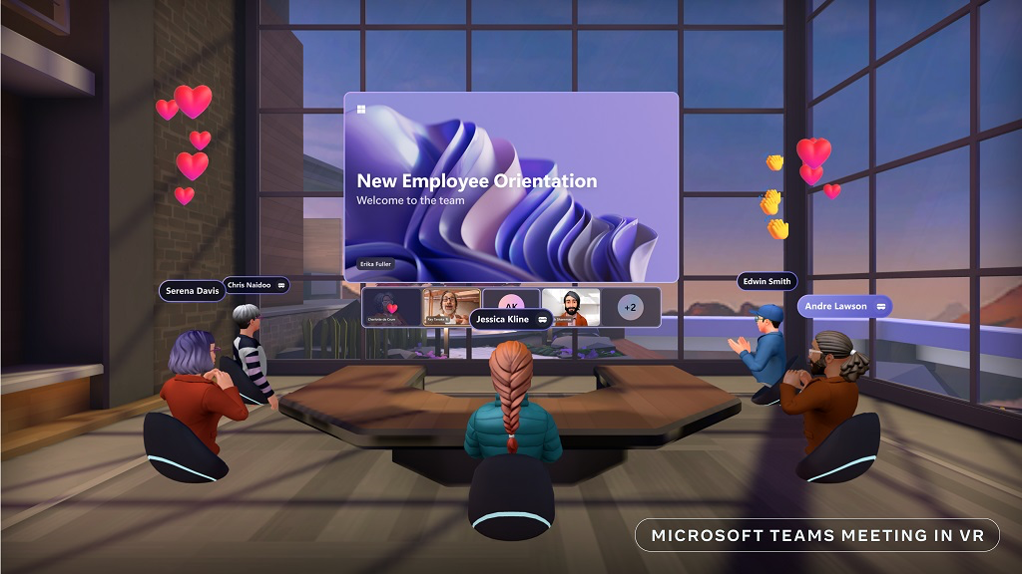
IMVU
Facebook Horizon Workrooms

Slide 23
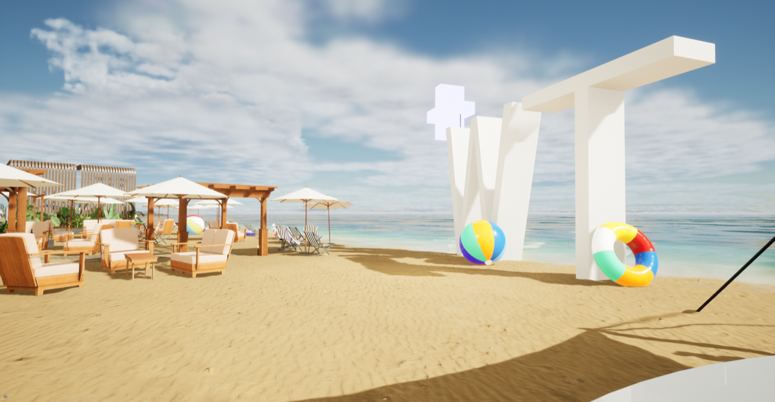
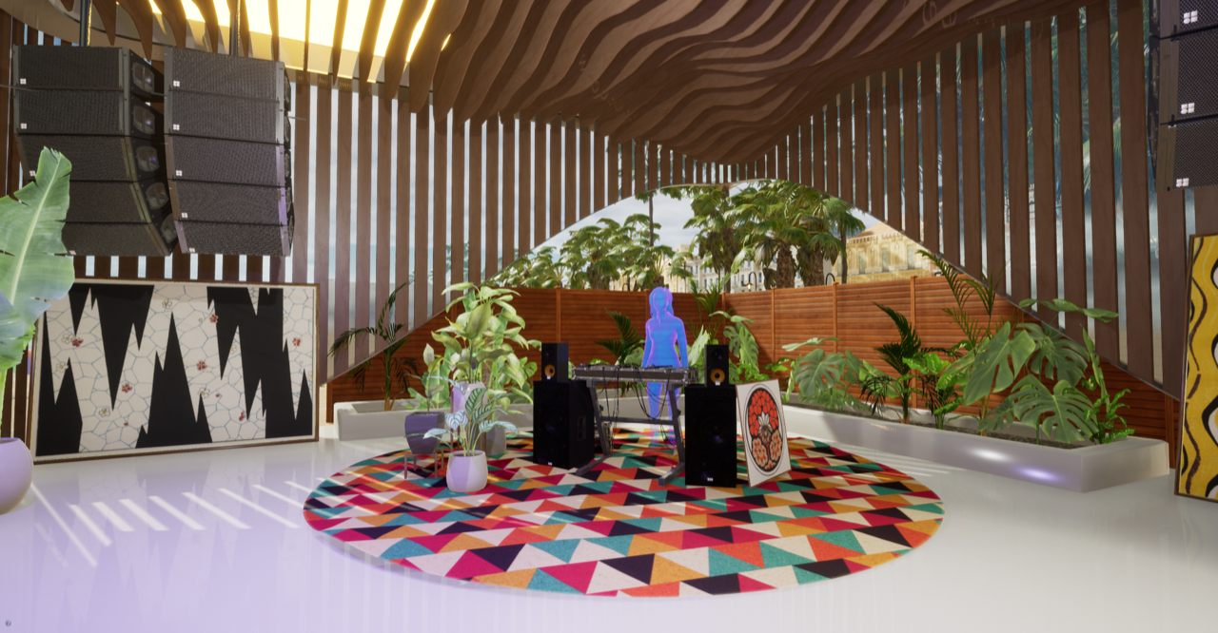

Slide 24
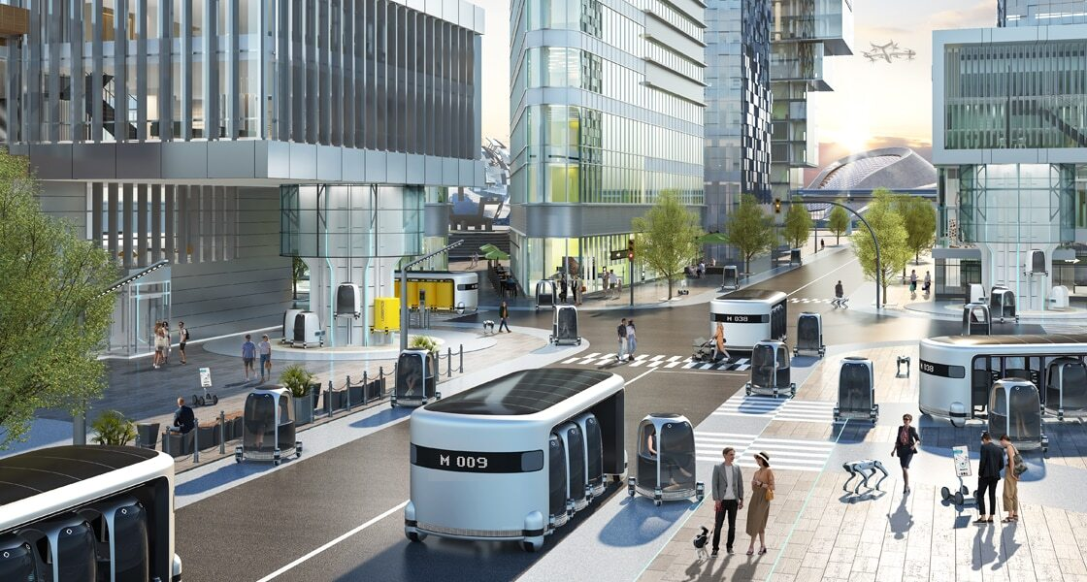
Nikeland

