Slide 1
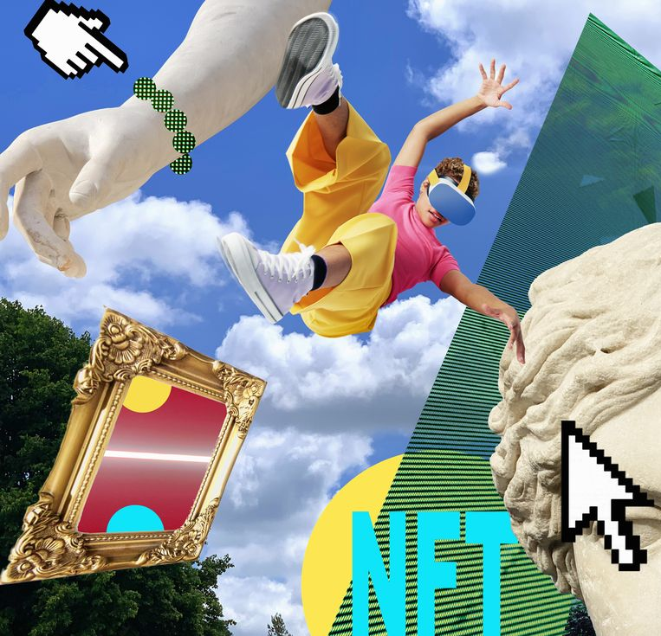
Fan Up!
The Return of Brand Love
in the Age of NFT
Viv Chambers | Bricolage MD
Oct 2022

Slide 2
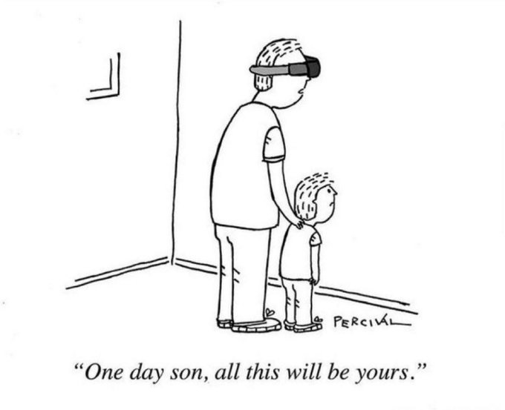
Notes:
Lots of scepticism
This is a new technology – no one got the internet 40 years ago either
But the Irish are among the top 10 most sceptical about this area
If you win here you can win anywhere!

Slide 3
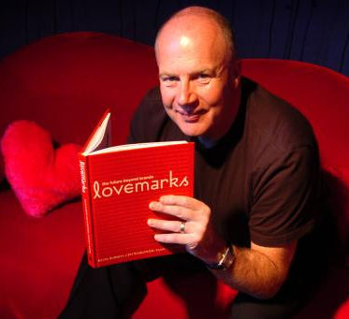
KEVIN ROBERTS
MARTIN WEIGEL
Notes:
An old debate in branding:
Lovemarks – all about how brands are becoming hollow and looks at strategies for a deeper relationship
Martin Wiegel W+K – no one cares about your brand! (Byron Sharp school)

Slide 4
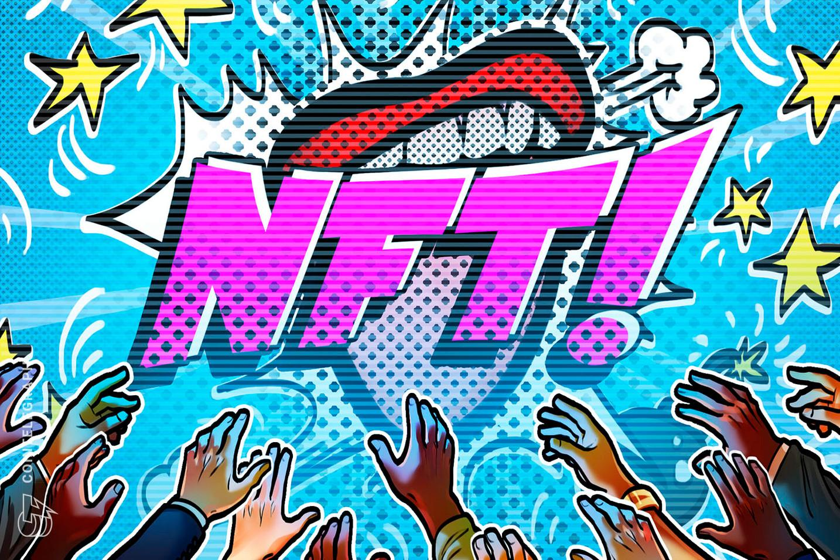
Notes:
NFTs are bringing the Lovemarks into the 20th century! The energy here is in:
Scarcity Community engagement Unique Ownership
Moments that become immortalised on the blockchain …

Slide 5
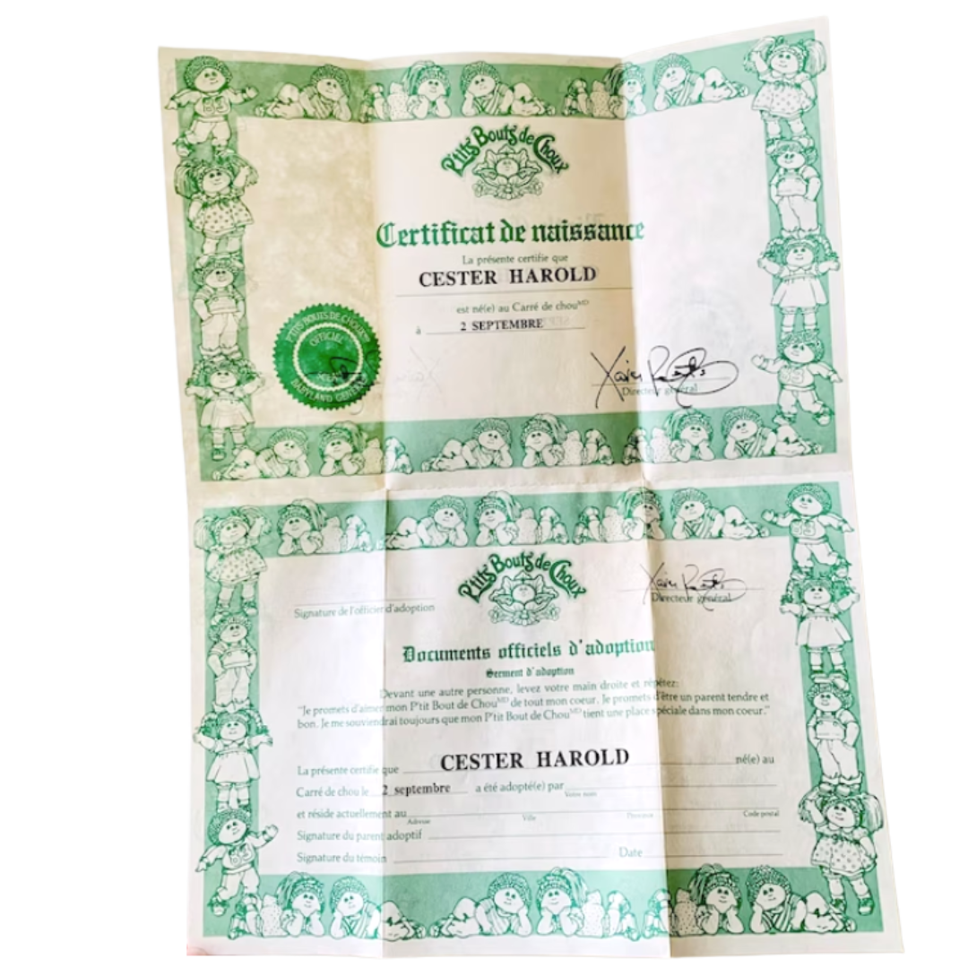
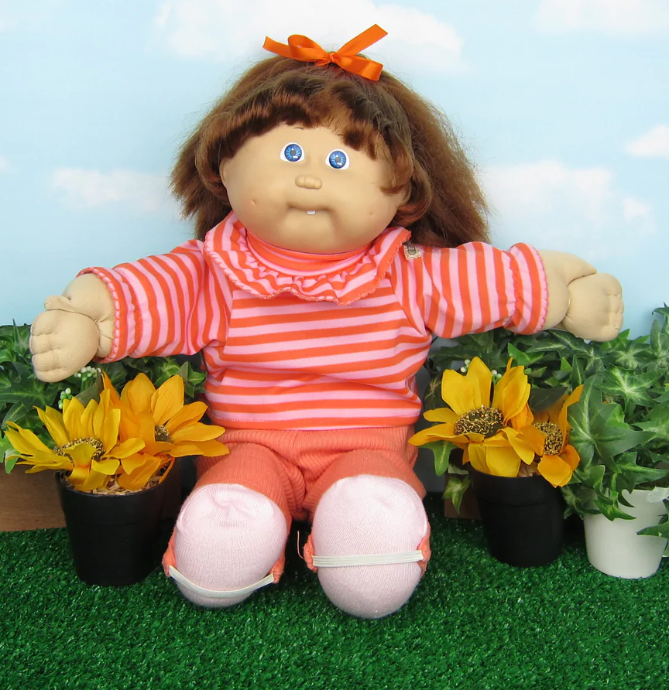
Notes:
The best way to explain what an NFT is: it’s a digital certificate of ownership and authenticity. This confers an aura on the product involved.

Slide 6
QUENTIN TARANTINO
Notes:
. Quentin Tarantino has jumped into NFT. This Tik Tok is the best explanation we have seen. It also predates his jumping into the area.

Slide 7
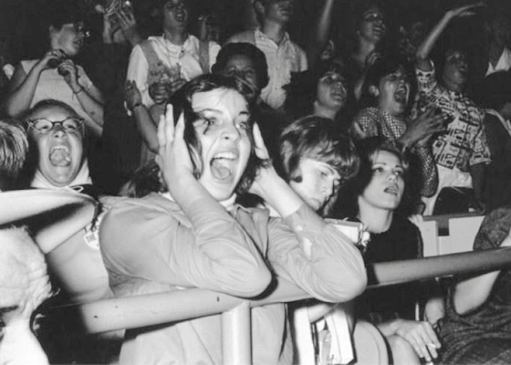
NFT = FANDOM
Notes:
Via Quentin: NFTs provide an amazing ‘backend’ to the product or experiential ‘frontend’. This gives fans crazy deep experiences beyond the usual.

Slide 8
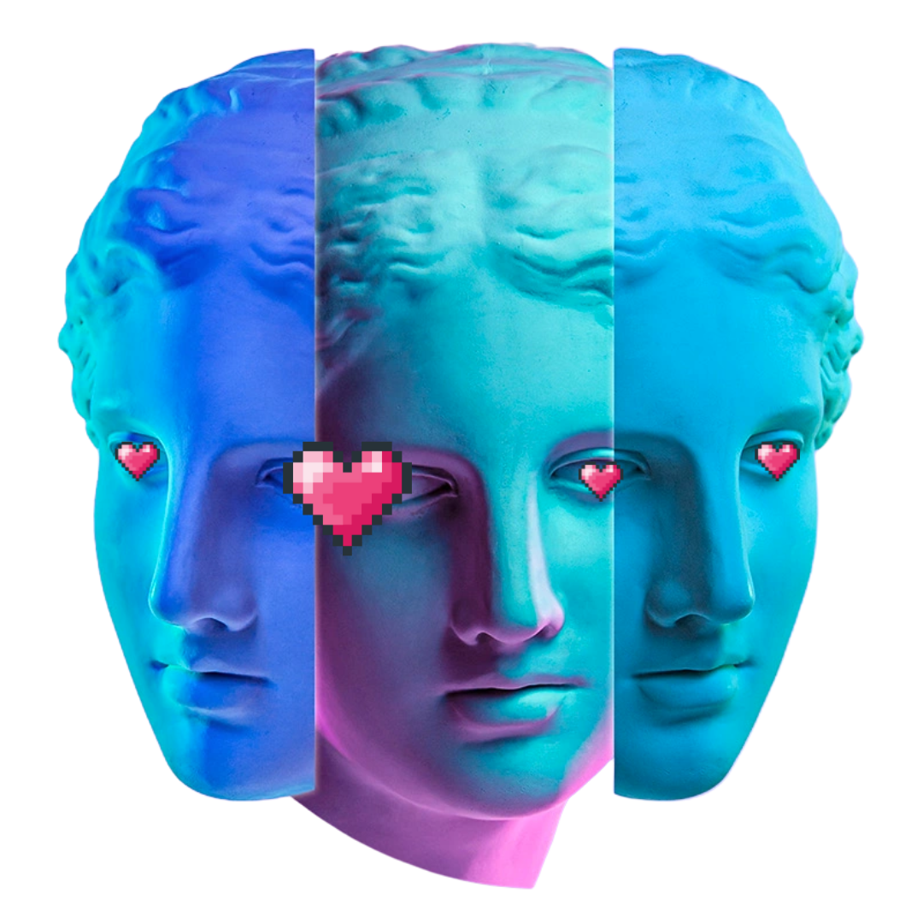
X3 Approaches >>
1
Love Objects
Enhanced Collectables
Love Moments
Elevated Experiences
All My Love
Loyalty + Ownership
2
3

Slide 9
1
Love Objects
Enhanced Collectables

Slide 10
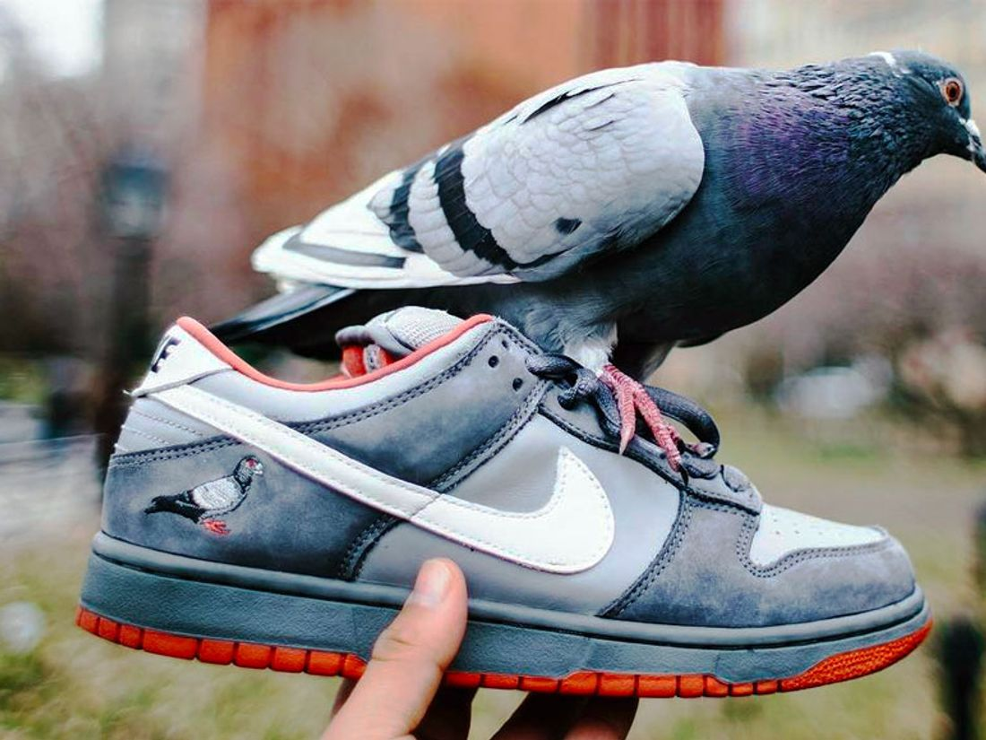
Notes:
2005 – Nike Pigeon Dunk shoes. Extraordinary cult following among sneakerheads culture

Slide 11
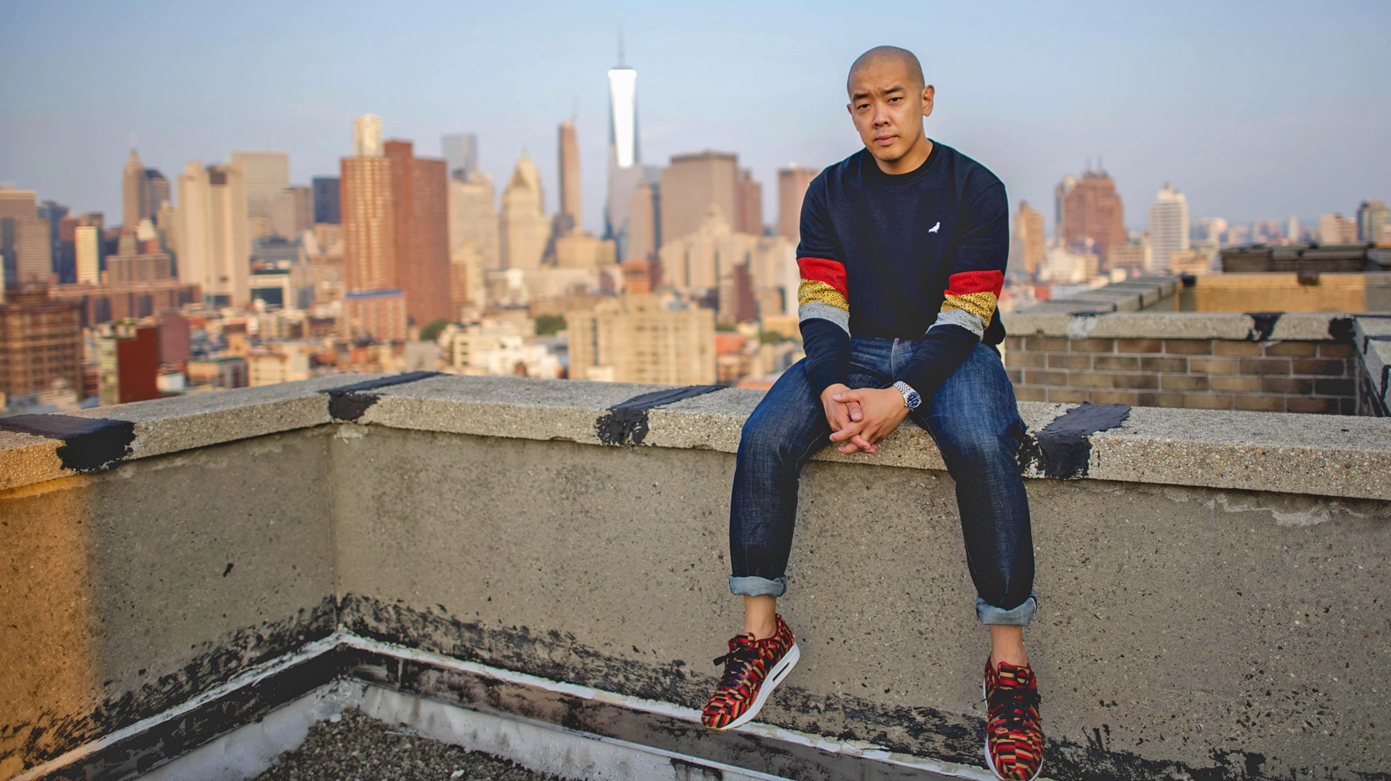
“Cultural game changing moments are often paired together with fear. I’ve trained myself to now run towards it rather than run away from it”
Jeff Staple
Notes:
Jeff Staples is a shoe designer who has revived the Nike Pigeon Dunk as an NFT

Slide 12
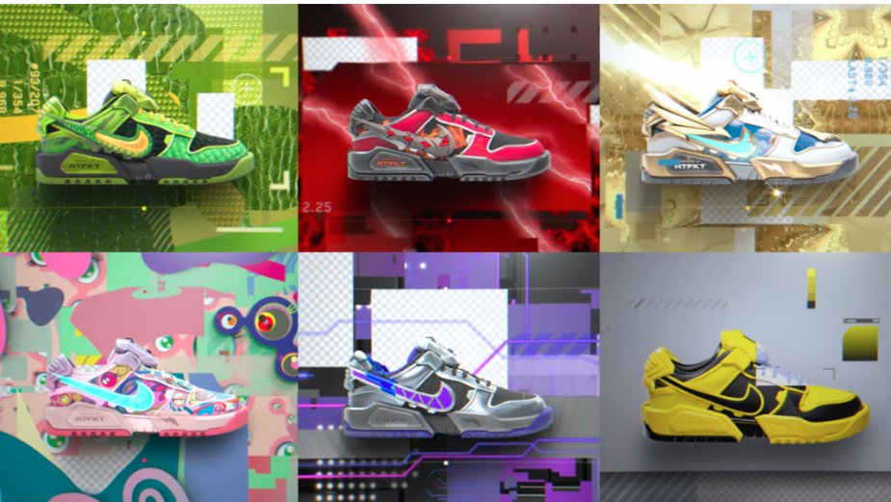
Notes:
Nike x RTFKT – shoes designed firstly as NFTs with the ‘real shoe’ as a physical souvenir should you wish

Slide 13
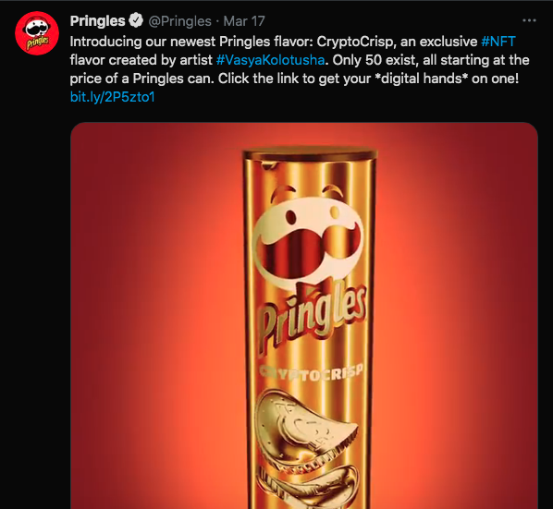
Notes:
Pringles Crypto Crisps – a great way to explore new flavour innovation

Slide 14
WHAT THIS
MEANS
FOR BRANDS?
>> New Product Development
>> Interesting Collaborations
>> Audience Engagement

Slide 15
2
Love Moments
Elevated Experiences

Slide 16
Notes:
NBA Top Shot ‘Trading Cards’ for live moments with a crazy array of backend features and benefits

Slide 17
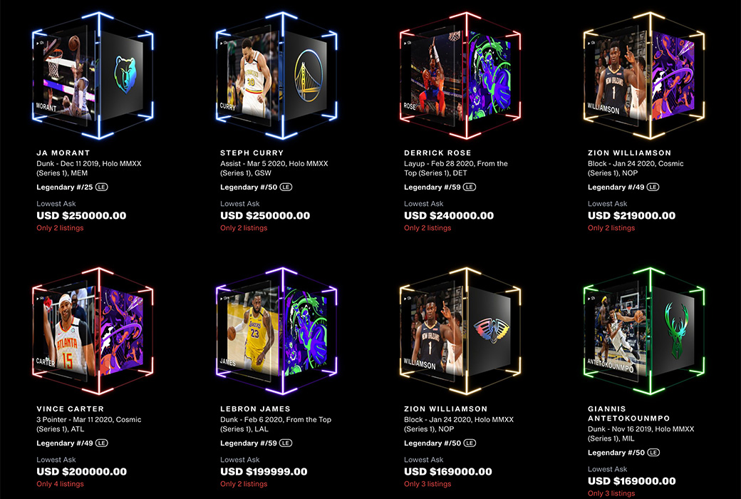
benefits
Notes:
An Asset Bubble … that has calmed down now. But still engaging

Slide 18
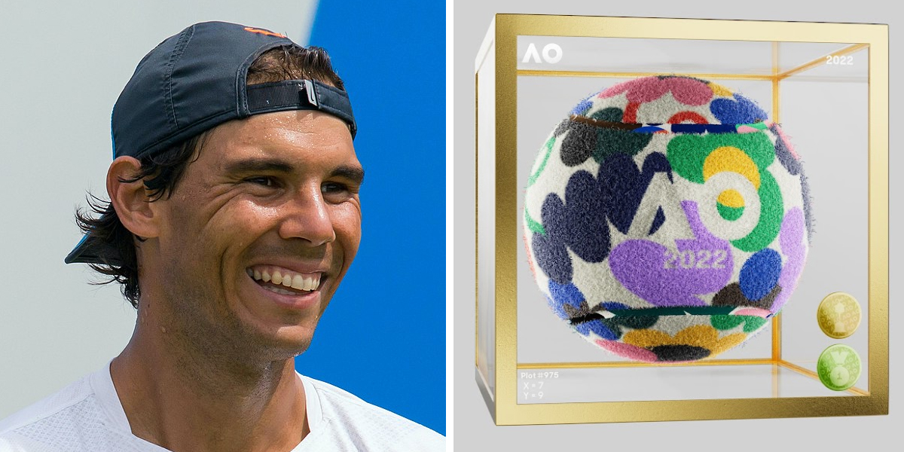
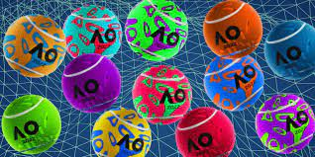
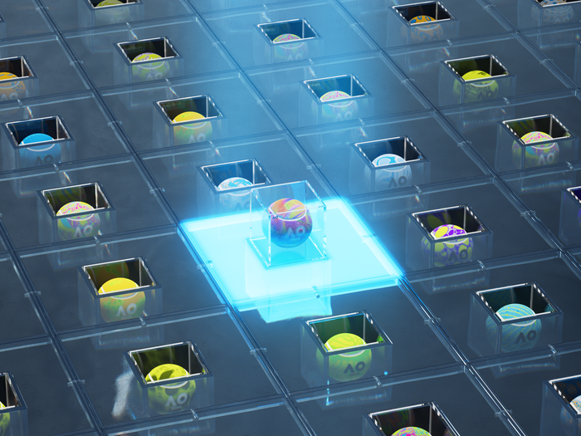
AUSTRALIAN OPEN 2022 >>
Notes:
Our favourite example – art balls from the Australian Open. An extraordinary activation where each owner of a match winning shot NFT got a beautiful physical Art Ball

Slide 19
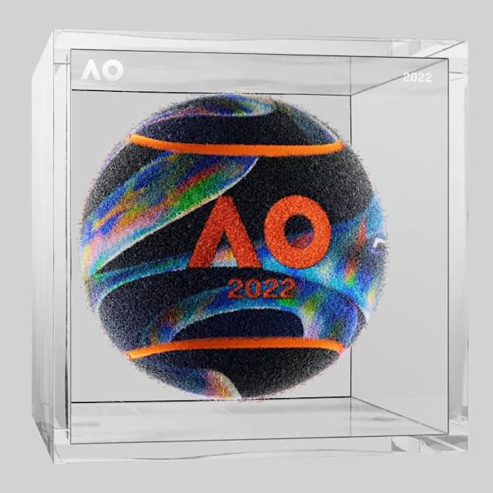
WHAT THIS
MEANS
FOR BRANDS?
>> Enhanced Experiences
>> Souvenir Touchpoint
>> Scarcity and Access

Slide 20
3
All My Love
Loyalty + Ownership

Slide 21
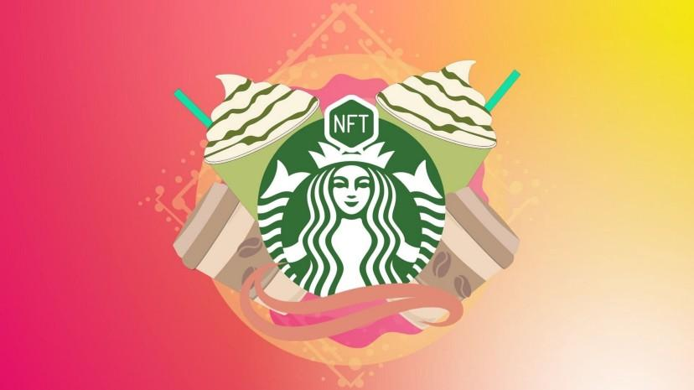
Notes:
Starbucks Odyssey – Built on their existing and wildly successful rewards program – the NFTs are an extension of their Third Place phiiosophy and the idea that you Drink Coffee but you also Do Coffee (a shared experience)

Slide 22
Notes:
https://www.marketing-interactive.com/arsenal-joins-the-nft-league-with-new-fan-token
$AFC Fan Token holders will have engagement opportunities on Socios.com, including the chance to influence the club in a series of interactive polls across a variety of decisions every season.
Fans will also be able to access club-related content and experience Socios.com’s geolocation, augmented reality feature "Token Hunt".
In addition, fans can also interact with other fans through club-related games, competitions and quizzes, competing in global leaderboards and earning real-life and digital club-related benefits and experiences.

Slide 23
Notes:
= Voting Rights!

Slide 24
Notes:
= Voting Rights! So many ways in

Slide 25
WHAT THIS
MEANS
FOR BRANDS?
>> Next Level Rewards
>> Genuine Brand Community
>> Distributed Ownership

Slide 26
WAIT!

Slide 27
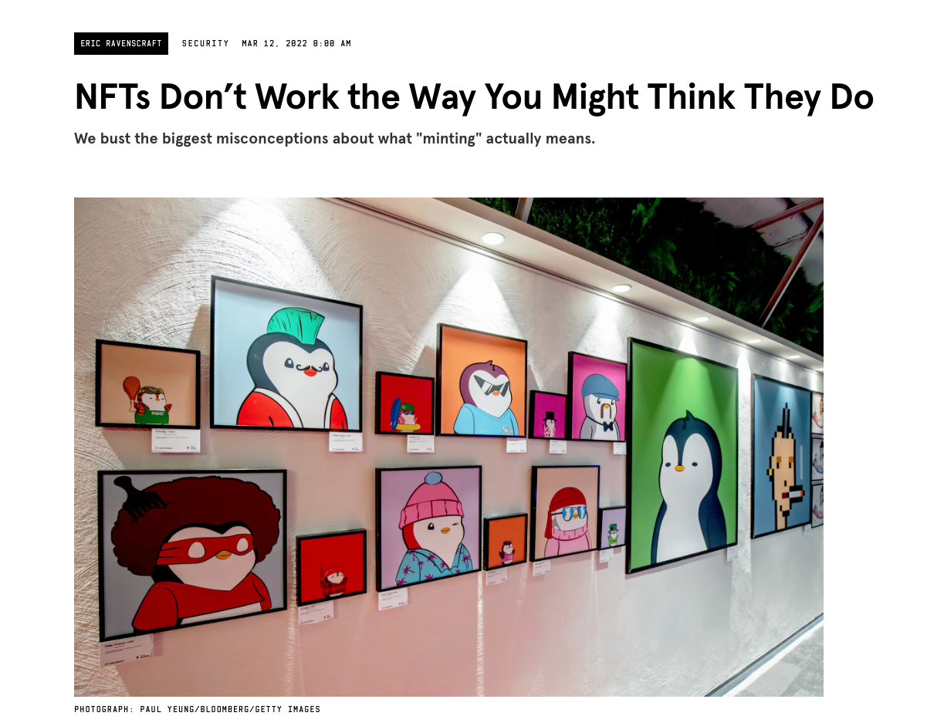
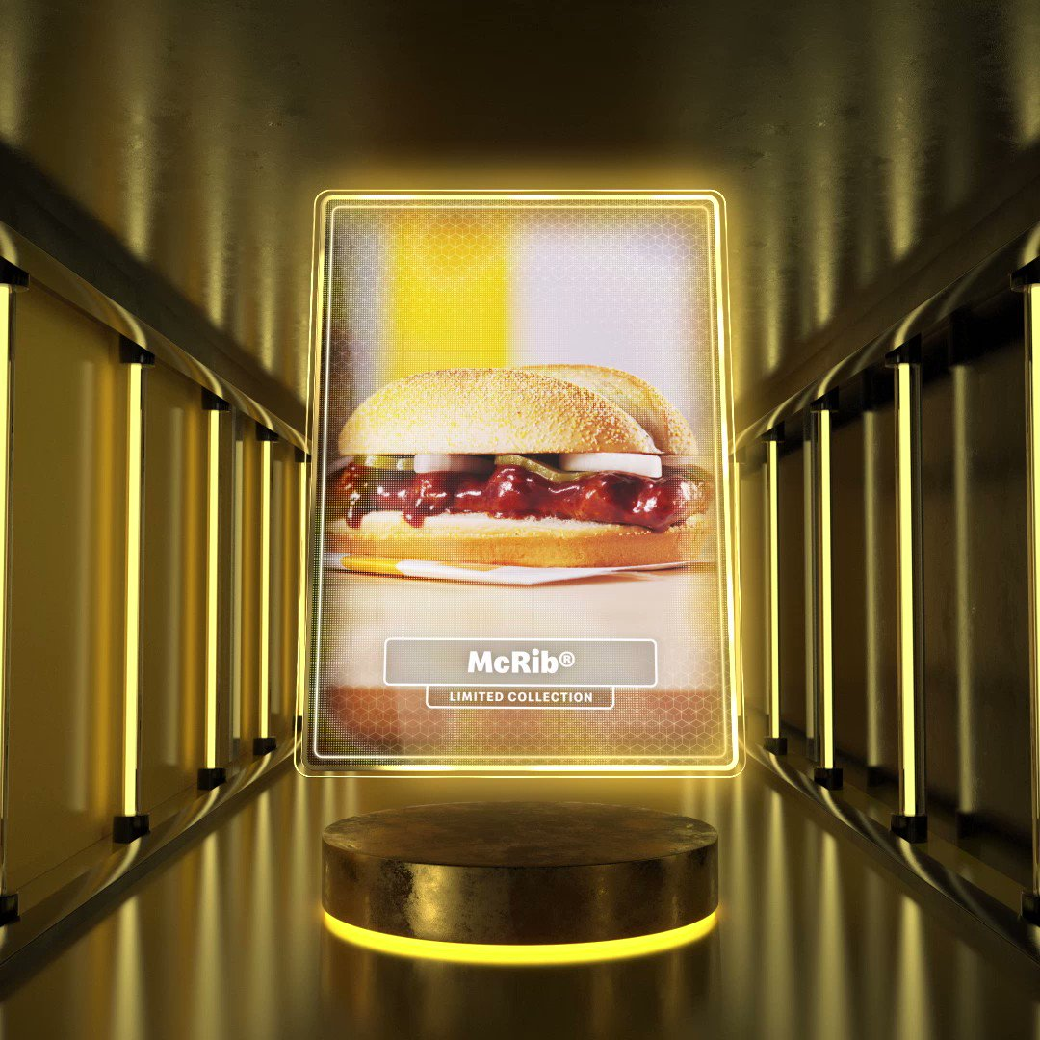
SOME WATCHOUTS

Slide 28
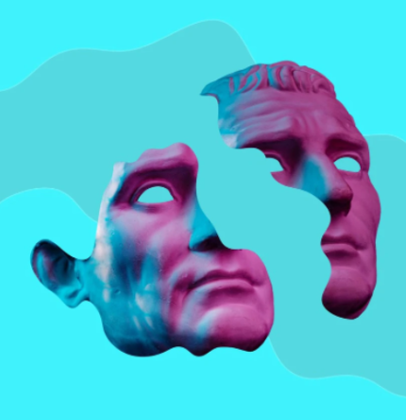
BACK
TO THE
FUTURE

Slide 29
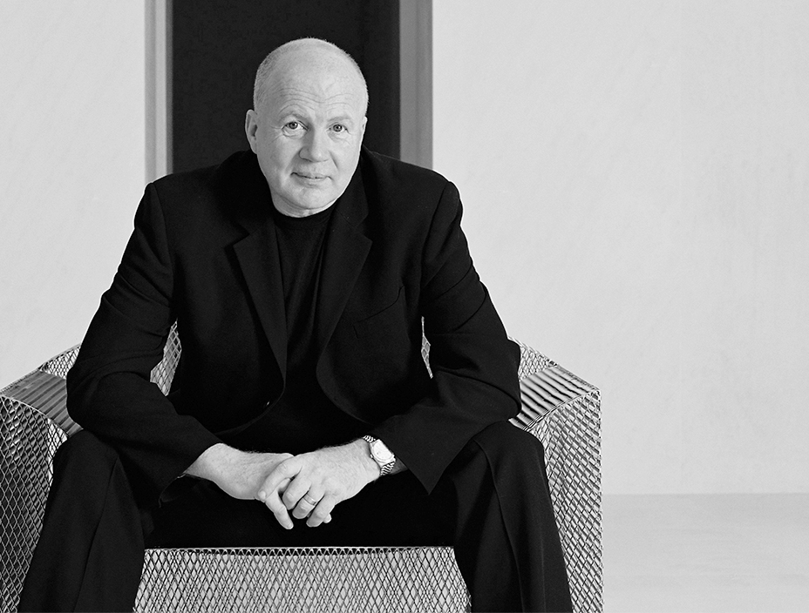
"Creating a lovemark is
all about the ability to understand consumers’ dreams, to know what they want and when they want it and to create great experiences that make your brands a part of their lives."
Kevin Roberts
Notes:
Kevin has been overlooked … his plea way back in 2004 seems ahead of its time. NFTs offer a way to develop genuine, deeper and lasting relationships with brand fans.

Slide 30
THANK YOU!
Notes:
Martin Wiegel took a

