Slide 1
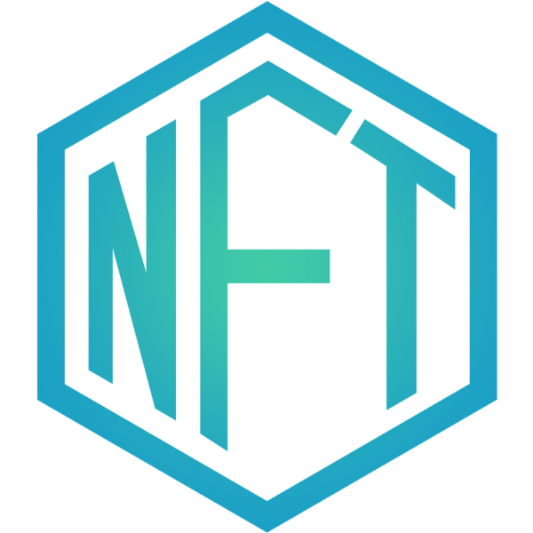
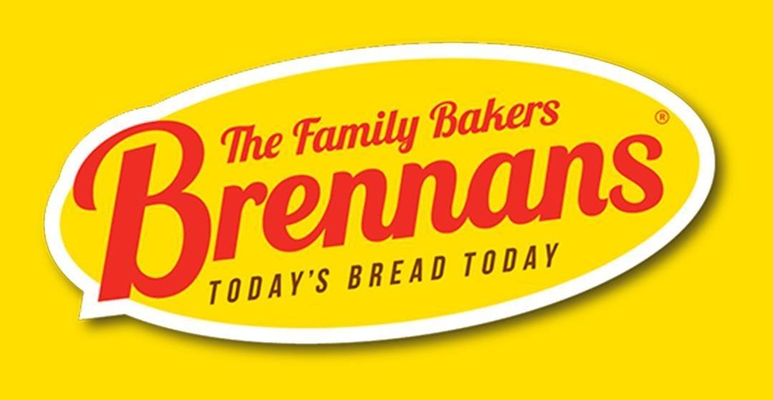

Slide 2
OUR CHALLENGE

Slide 3
THE CHALLENGE
Raise awareness of Brennans Bread in the Irish market focusing on Gen Z
1. Launch Brennans on TikTok with the objective of driving engagement & conversation with our core target audience
2. Disrupt the market by creating a piece of ownable history (NFTs) to commemorate the moment Brennans went “GenZ”

Slide 4
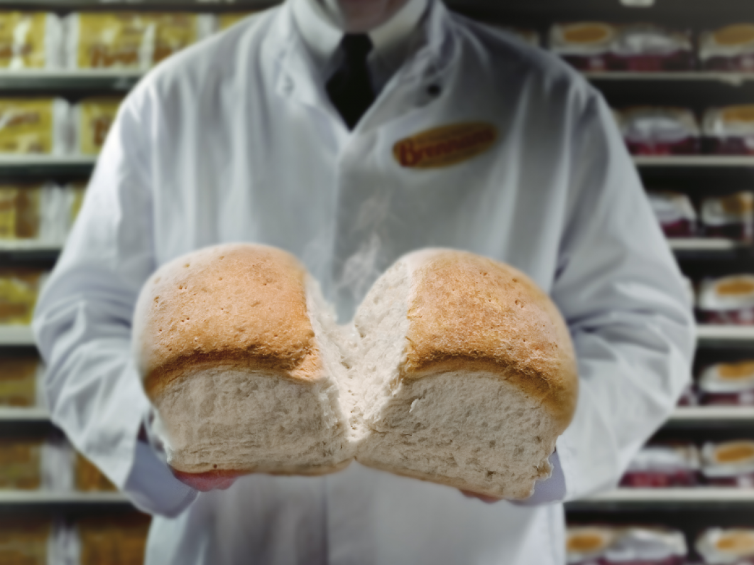
OUR APPROACH
OUR APPROACH

Slide 5
OUR APPROACH
Create comms strategy that drives Brennans messaging to the Gen Z audience through the TikTok Platform
Notes:
Timely, Trend, Consistency, Not ”Overly” Produced, Authentic, Personality

Slide 6
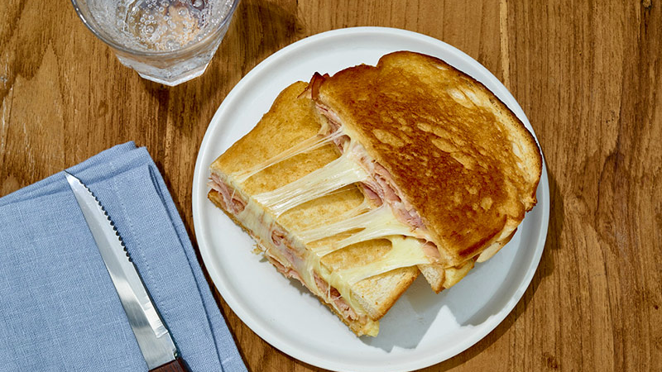
OUR LAUNCH

Slide 7
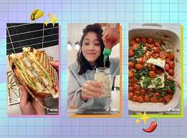
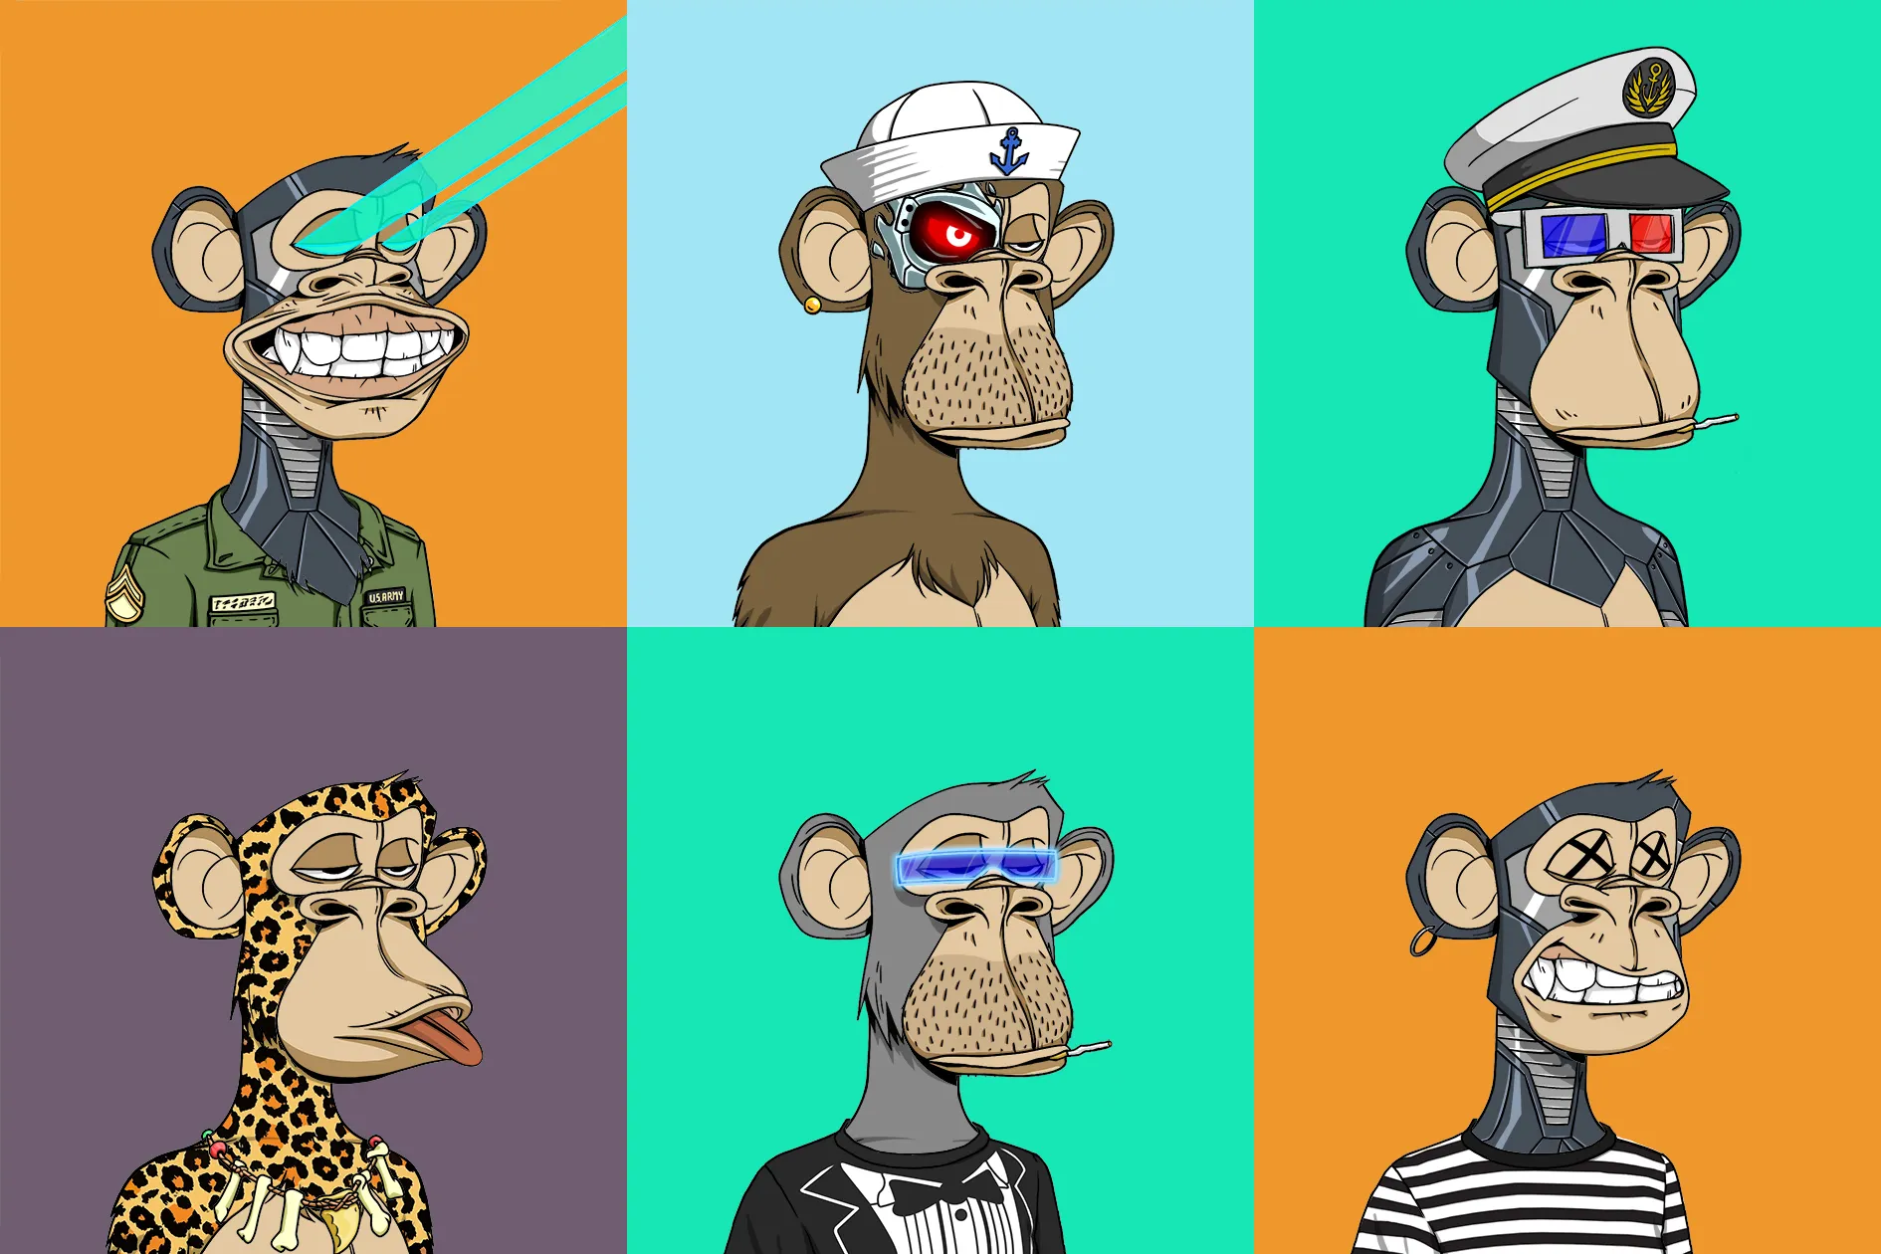
OUR LAUNCH
TIKTOK
By launching an NFT campaign that targets 18-24 year olds in Ireland that is marketed and promoted through the new Brennans Bread TikTok Channel. Thus building our core TikTok audience.
+
NFT

Slide 8
THE CREATIVE MESSAGING
Embracing the new to stay relevant:
The Brennans NFT Series:
Today’s Bread Forever

Slide 9
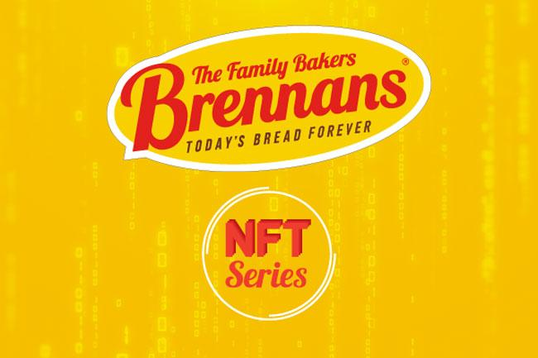
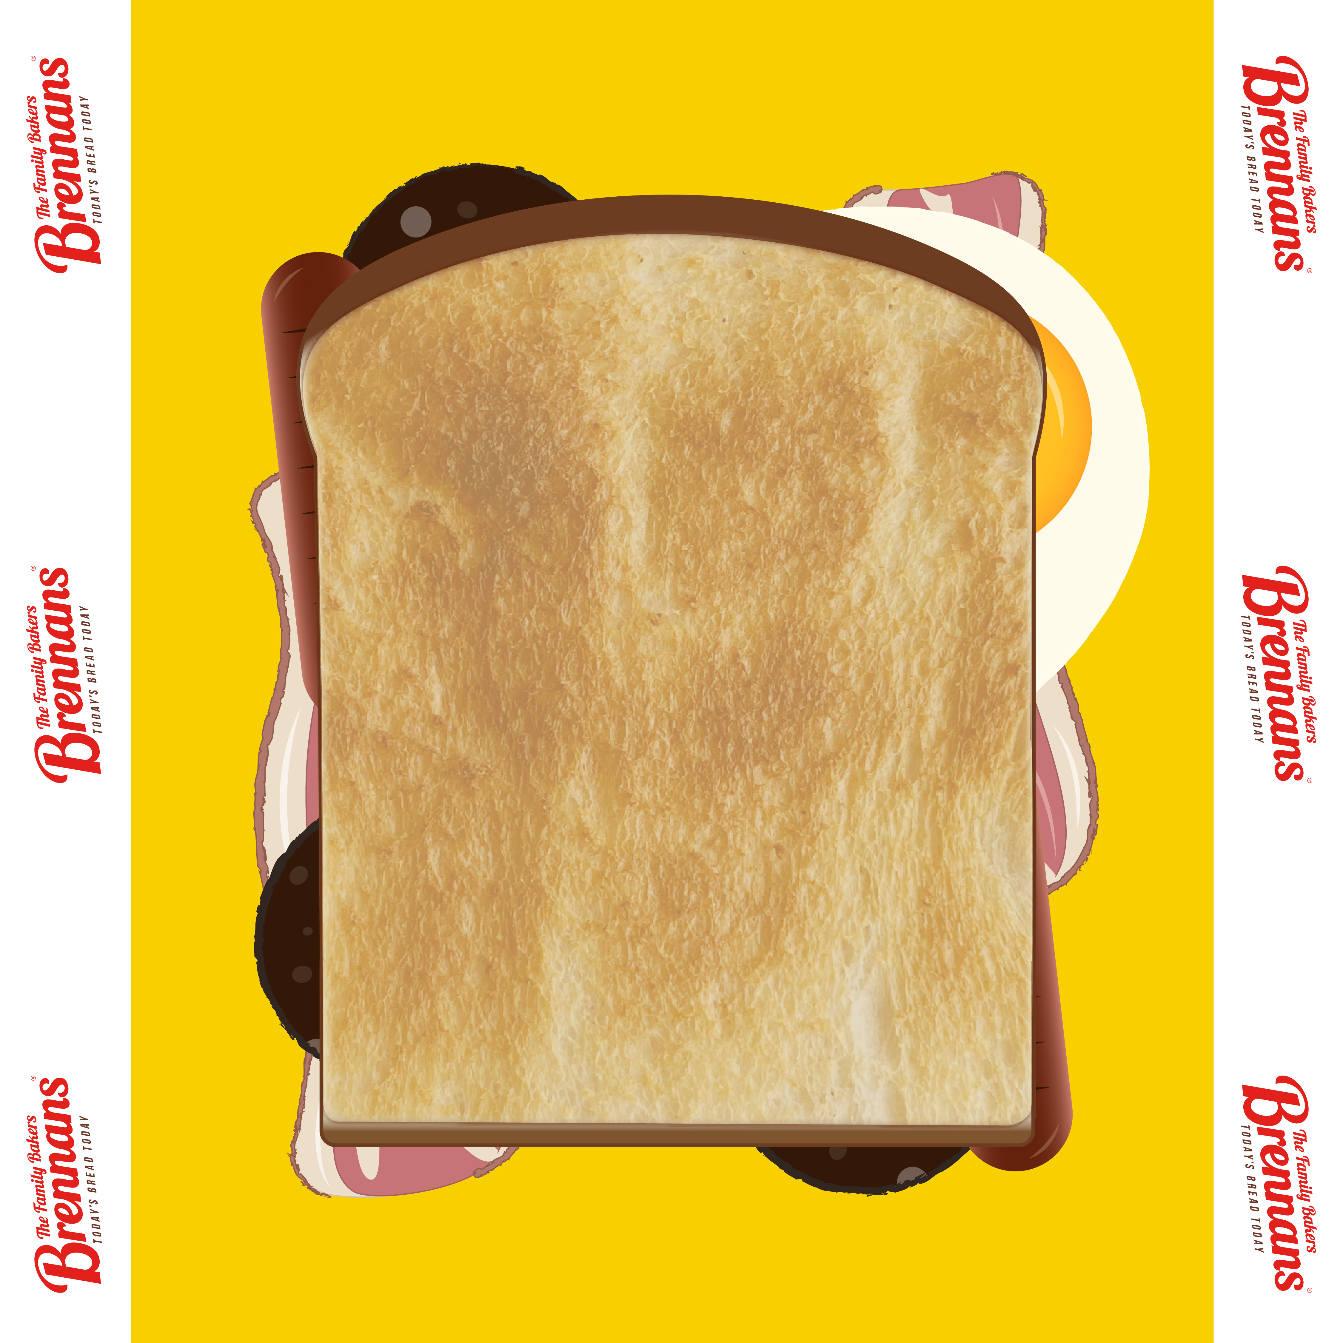
THE NFT LAUNCH CONCEPT
NFT series of Ireland’s favourite sandwiches
Release 4 per week for 4 weeks
Release 10 Units per NFT
Final NFT sourced from audience to drive participation and intrigue
Total NFT’s = 160 (limited)
Sold on Bubblehouse (carbon neutral marketplace & accepts cash payment making adoption easier)

Slide 10
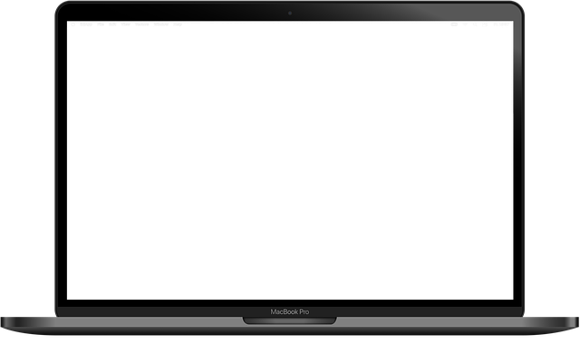
THE CREATIVE – LAUNCH
Launch

Slide 11
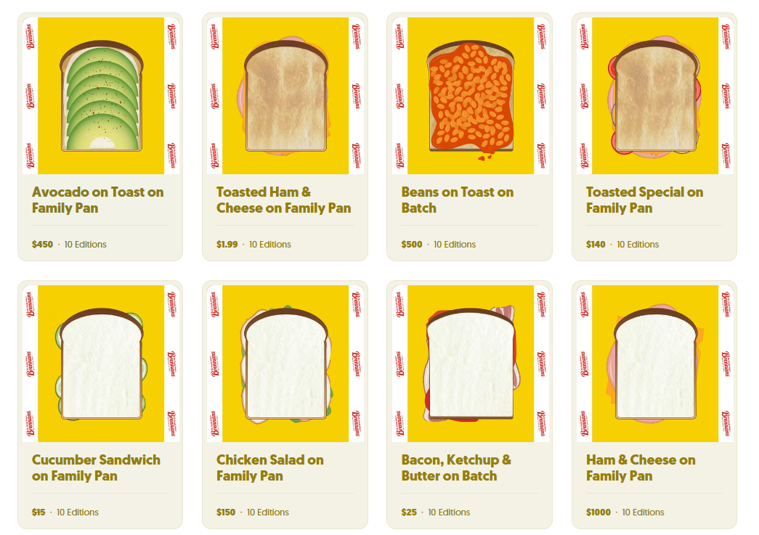
THE CREATIVE – THE SANDWICHES

Slide 12
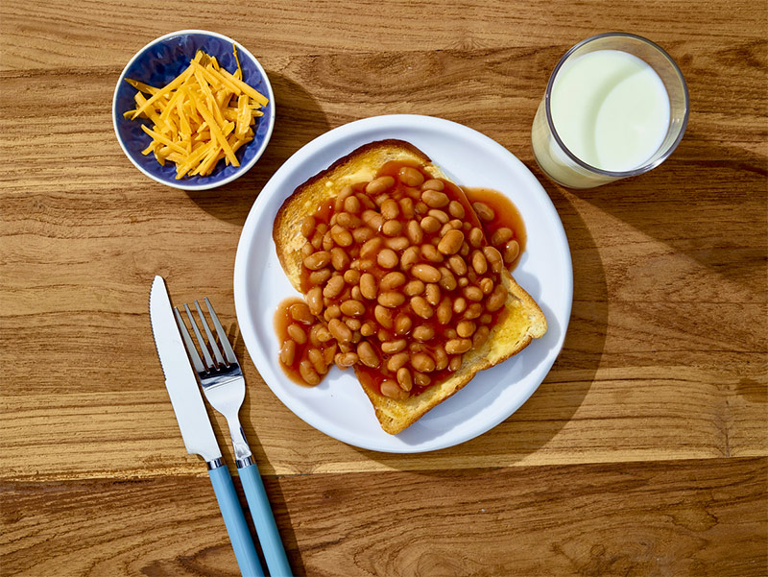
Engagement
RESULTS

Slide 13
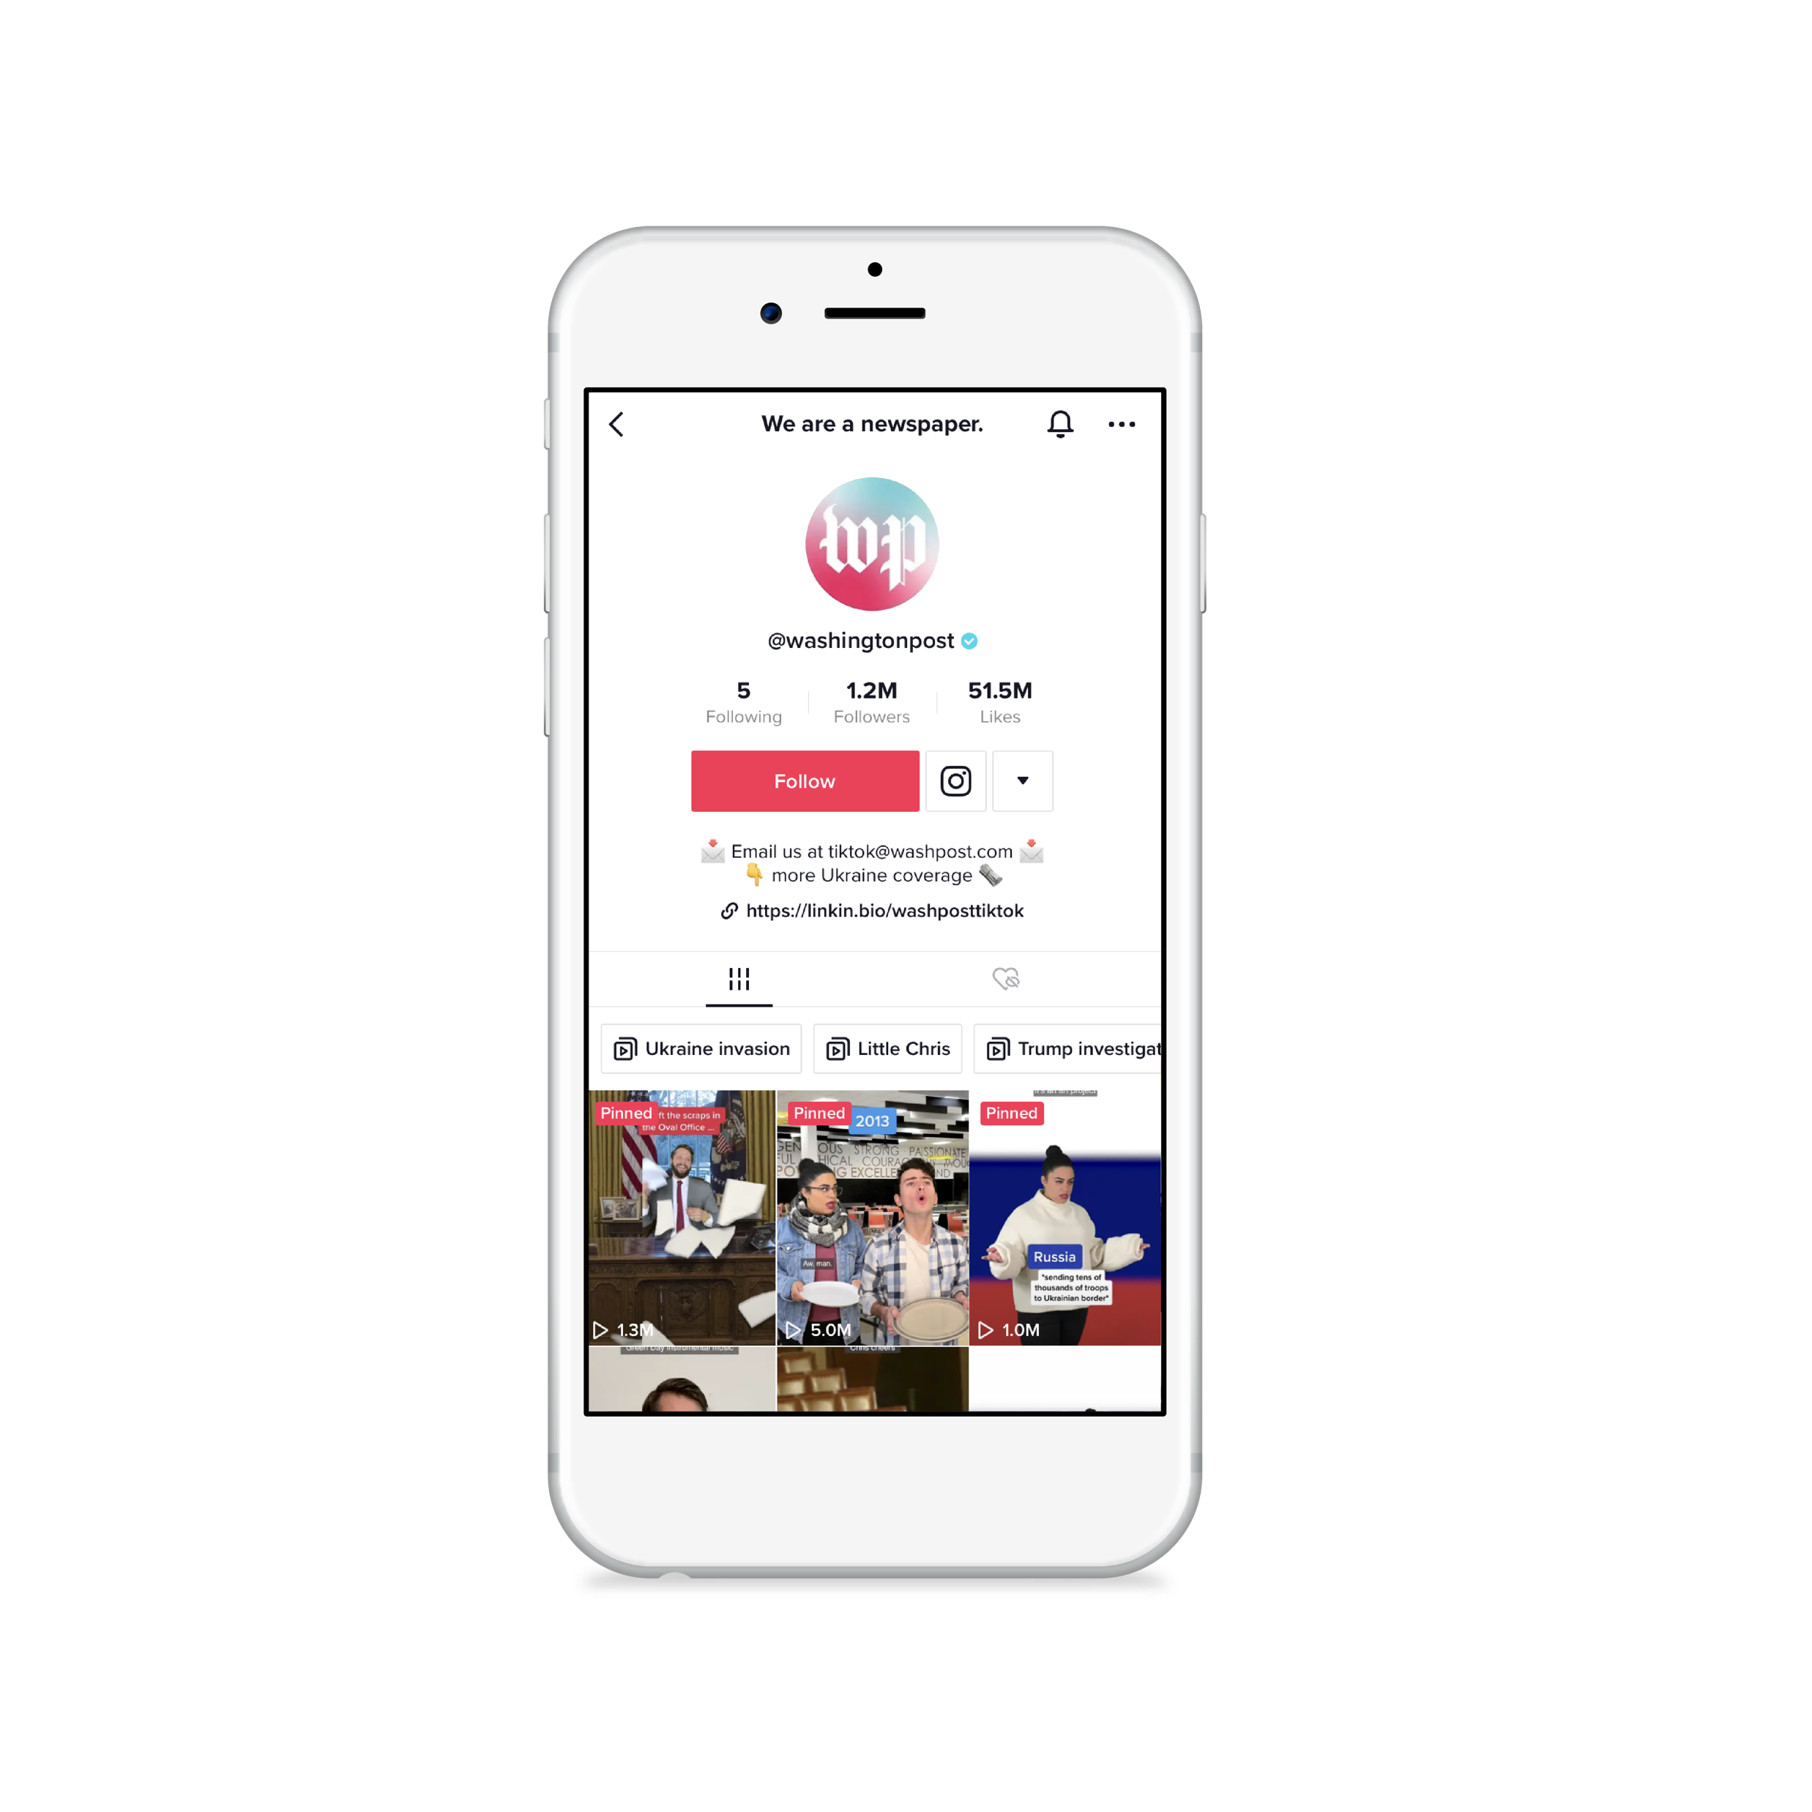
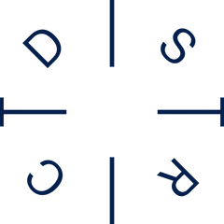
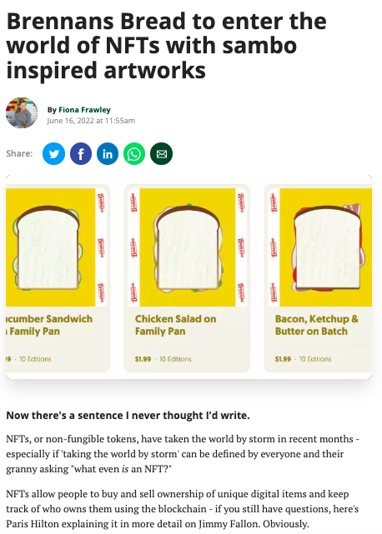
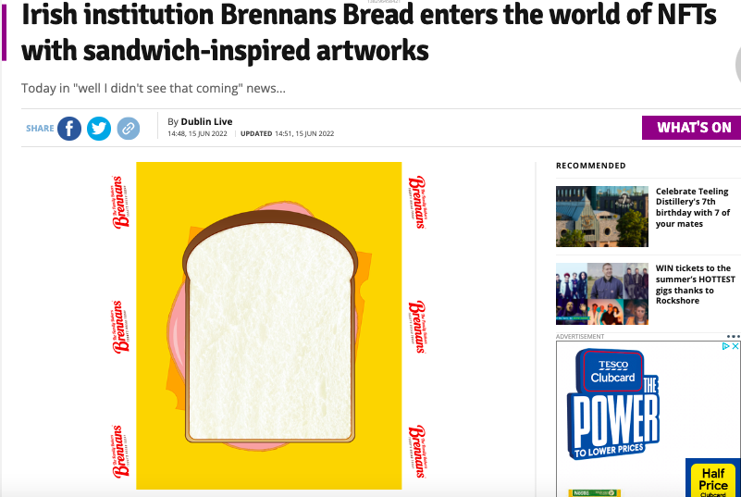
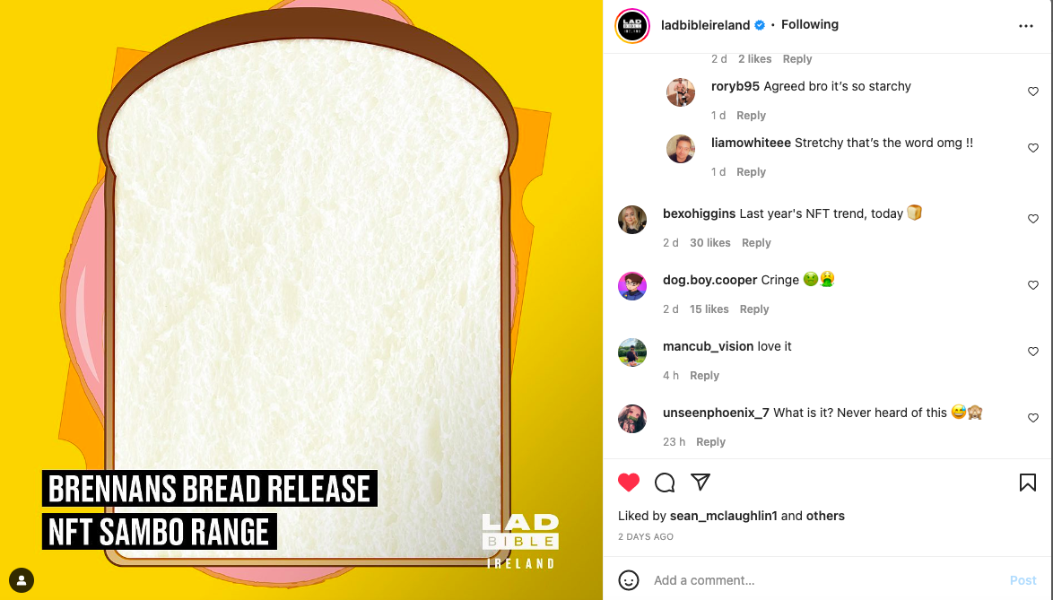
EARNED MEDIA COVERAGE

Slide 14
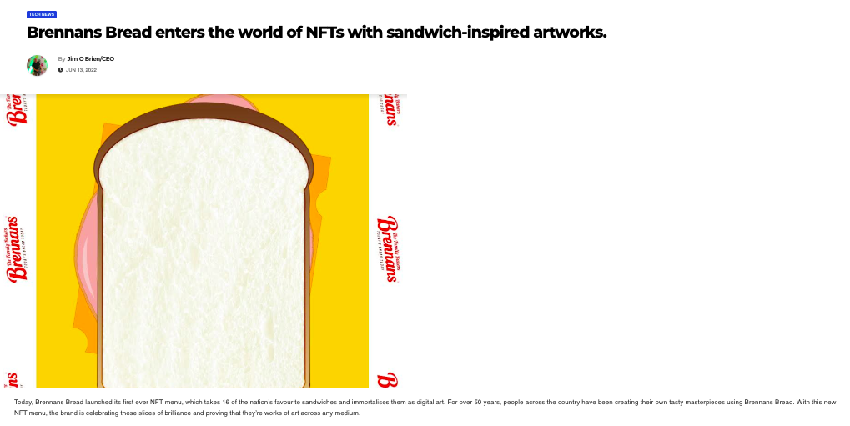
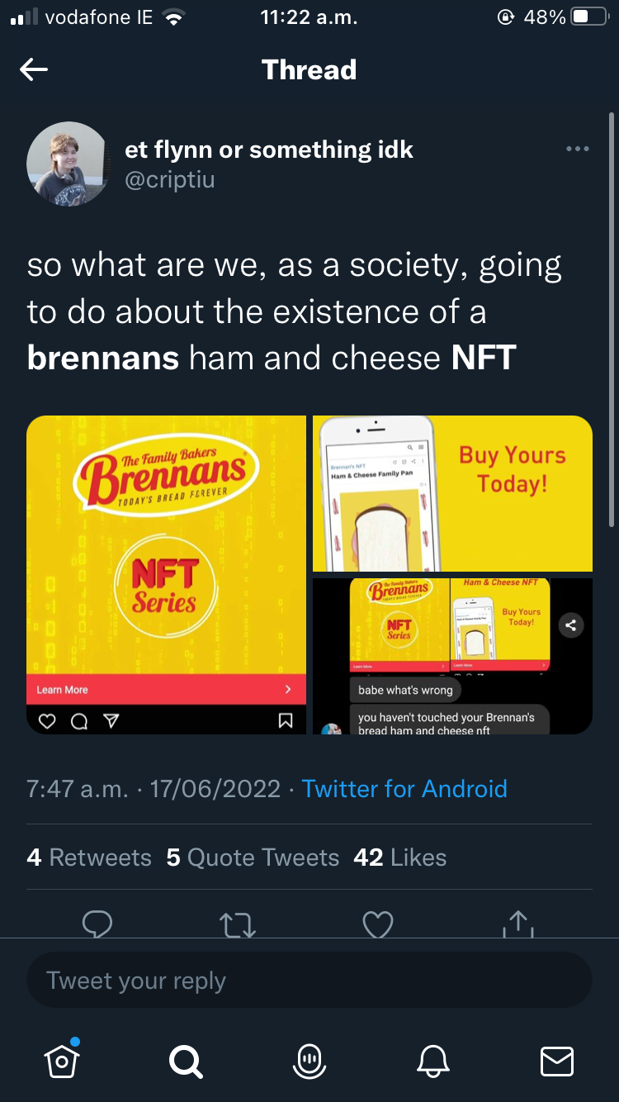
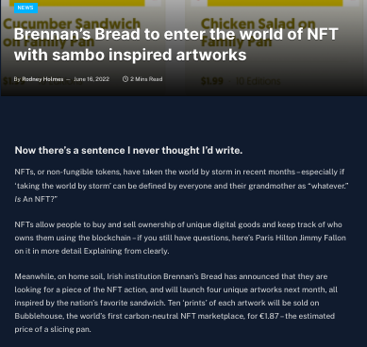
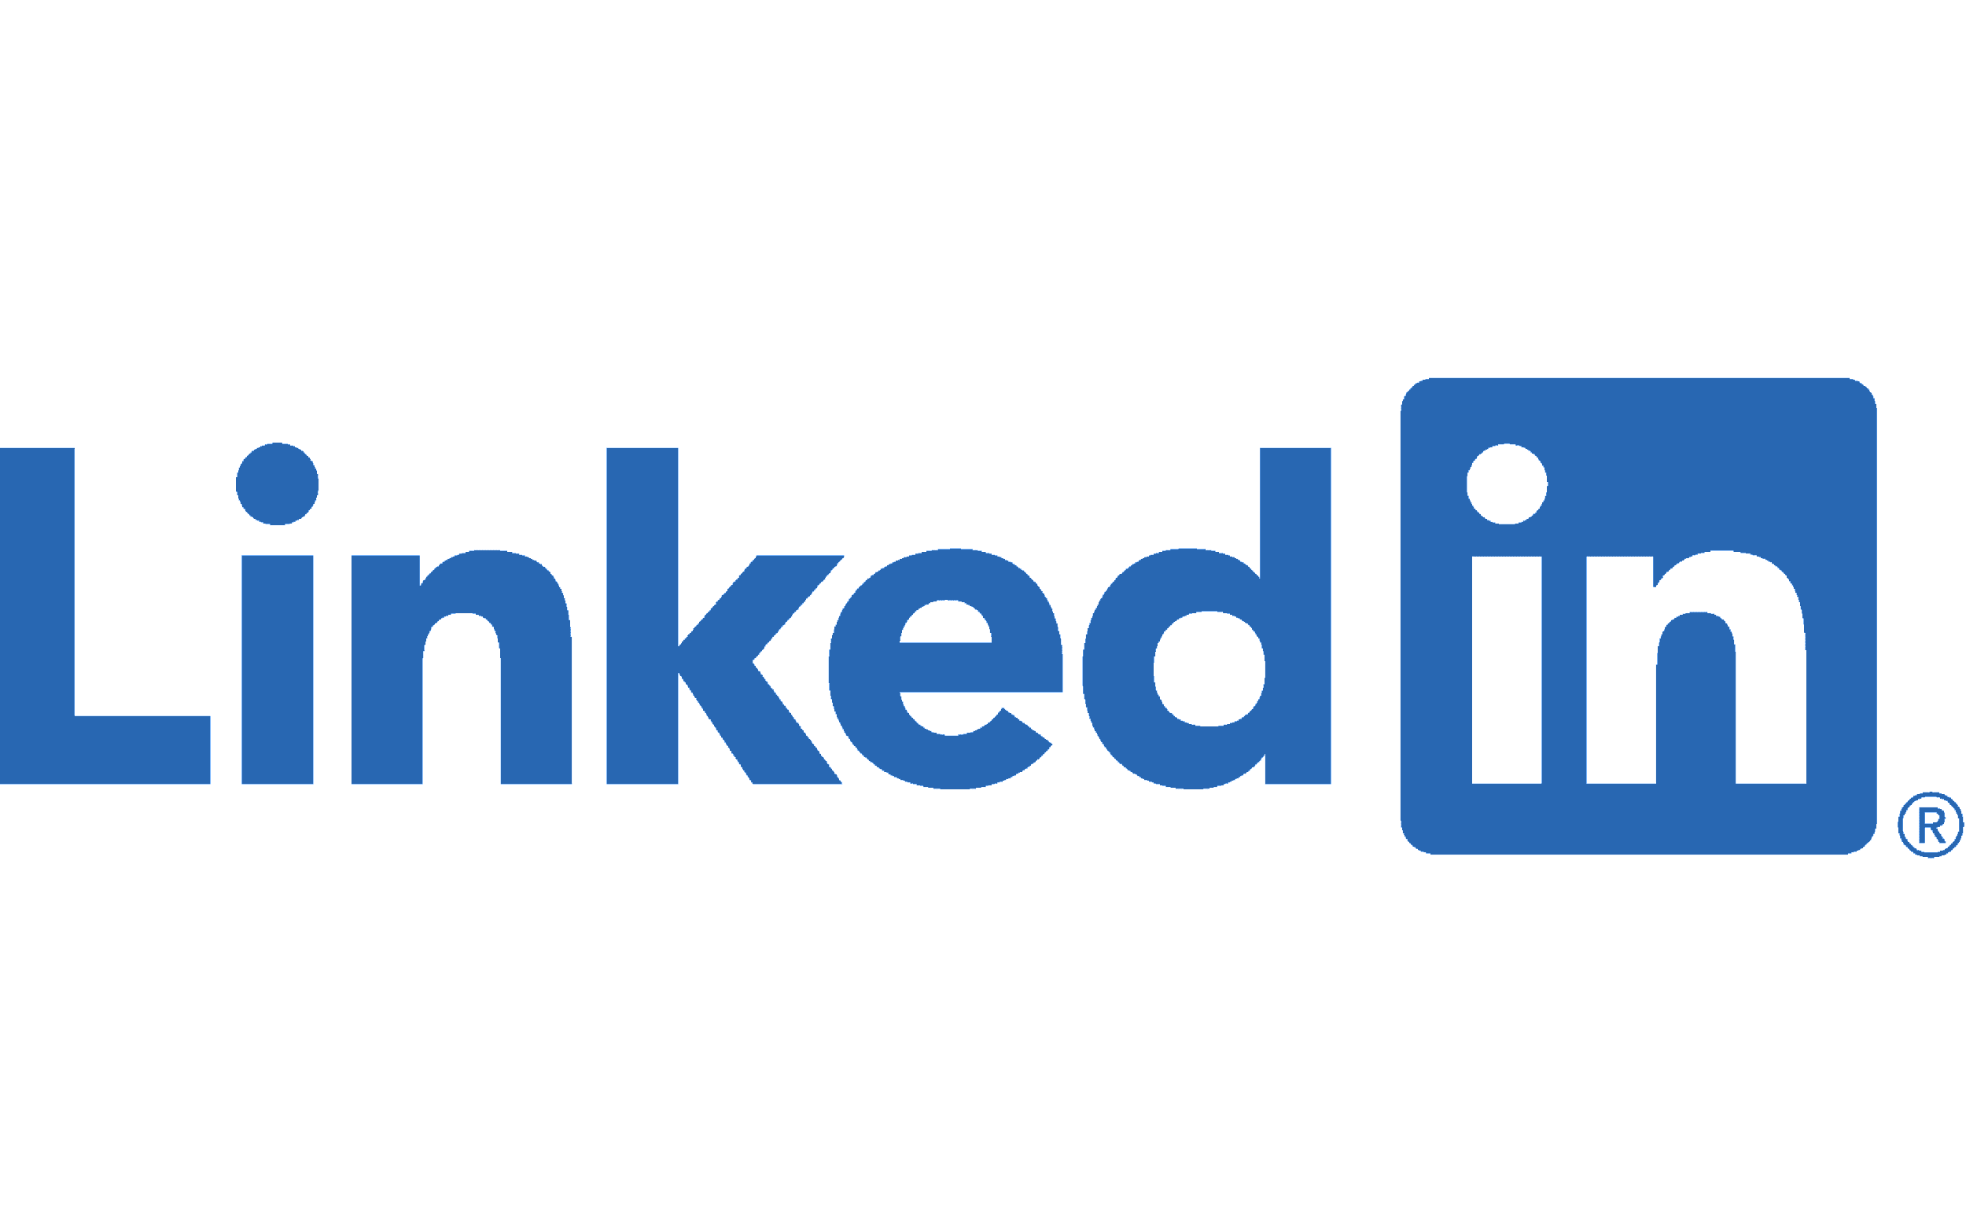
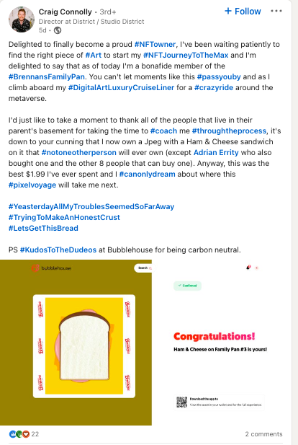
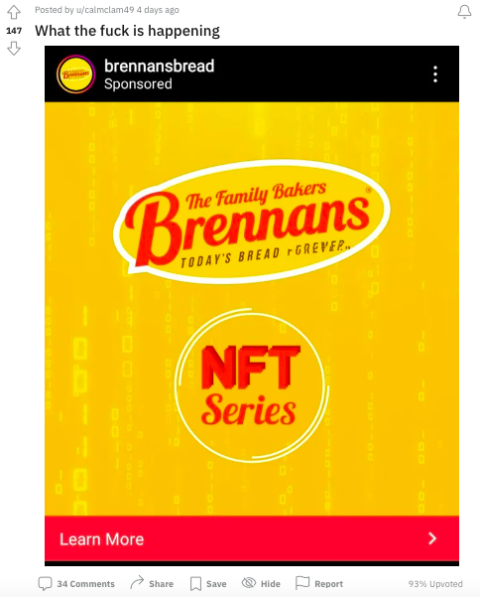
EARNED MEDIA COVERAGE

Slide 15
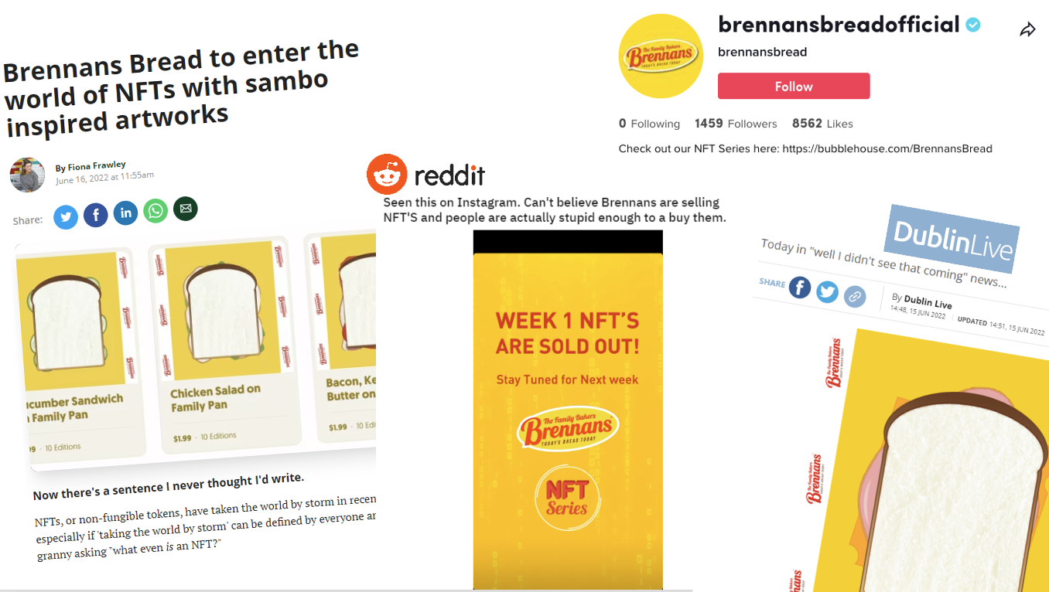
EARNED MEDIA COVERAGE – REACH
Est. Earned Reach
+450,000
=
Est. Earned Media Value
€9,000

Slide 16
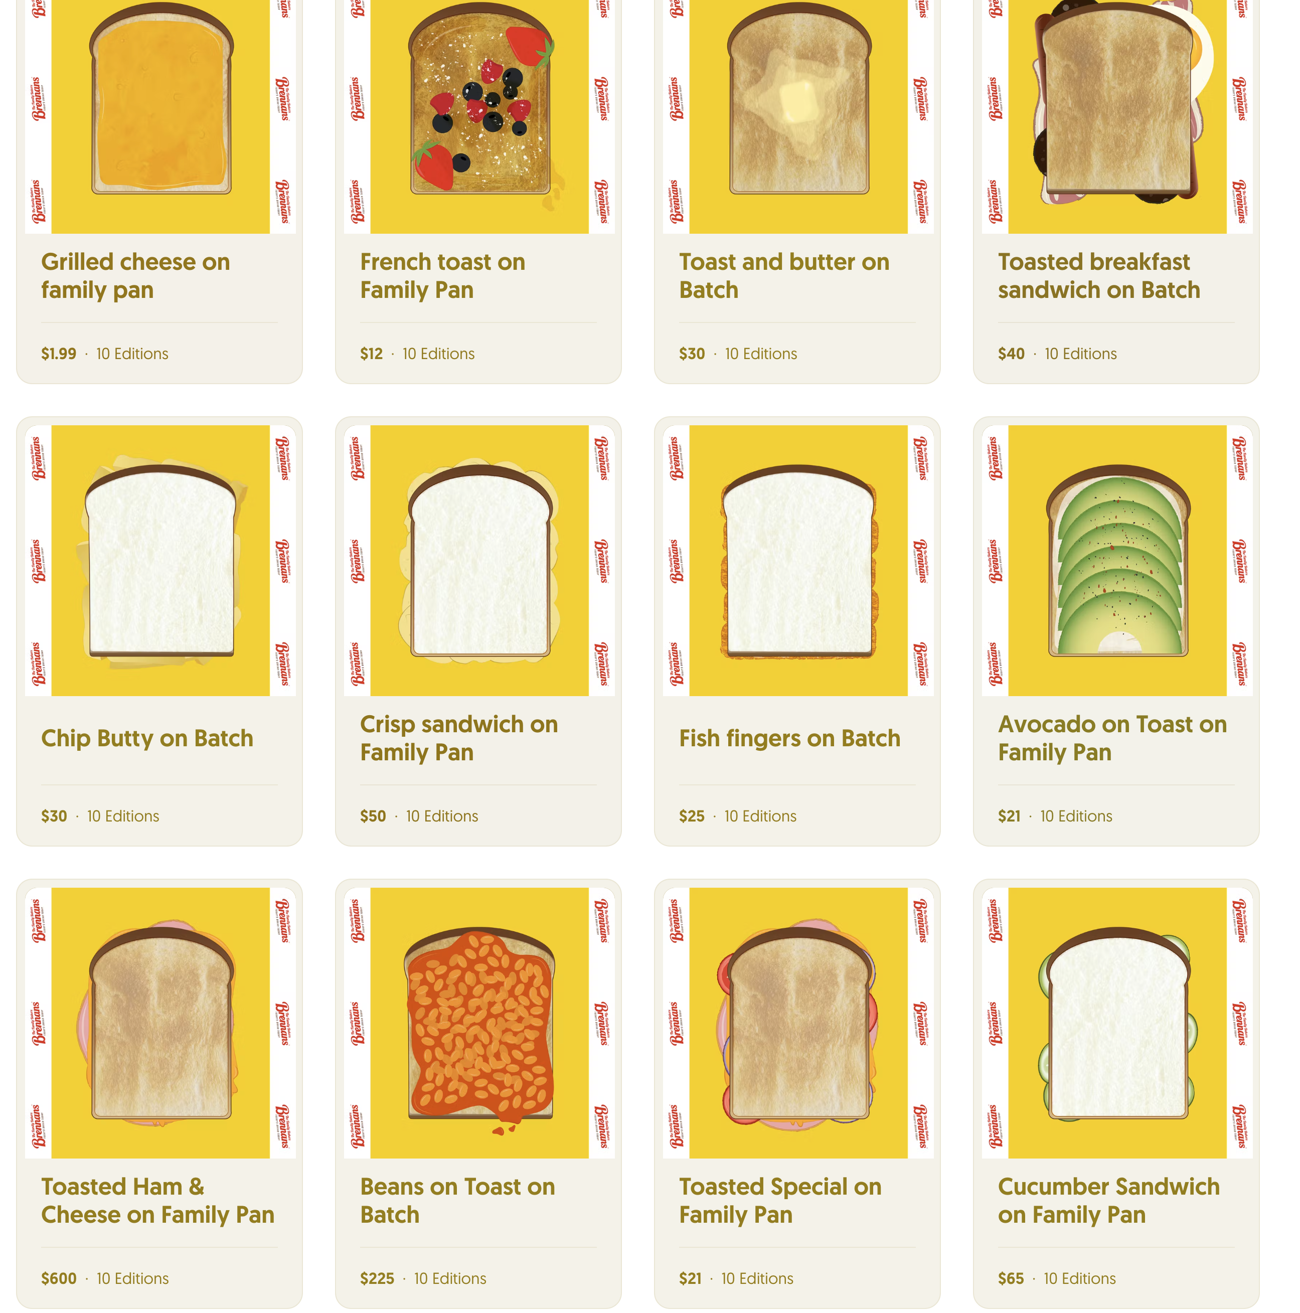
ACTIVE RESALE MARKET
Week 1: Sold out in days
Week 2, 3 & 4: Sold out in seconds!
The owners of the Brennans NFT series have kickstarted a huge resale market.
Resale market: averages at €24 which is over 12X their investment!

Slide 17
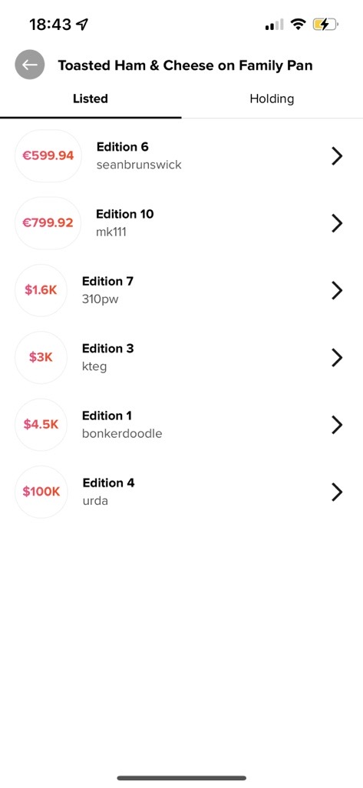
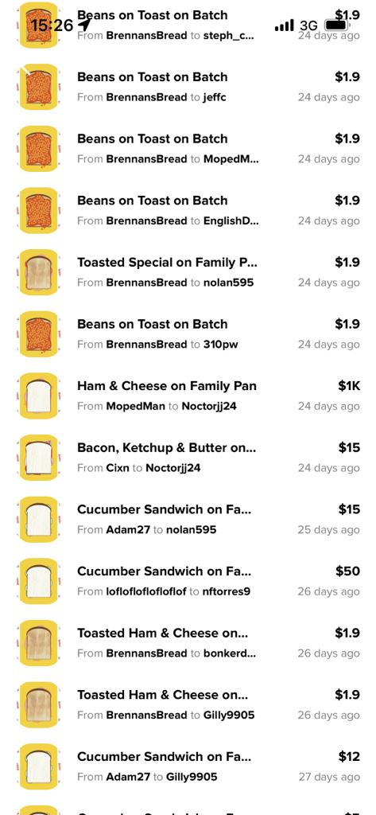
HIGHEST VALUE
The highest value associated to a specific sandwich is the Toasted Ham & Cheese! Where 1 user is trying to sell this at 100K!
The highest sale so far recorded on the platform is $1,000!

Slide 18
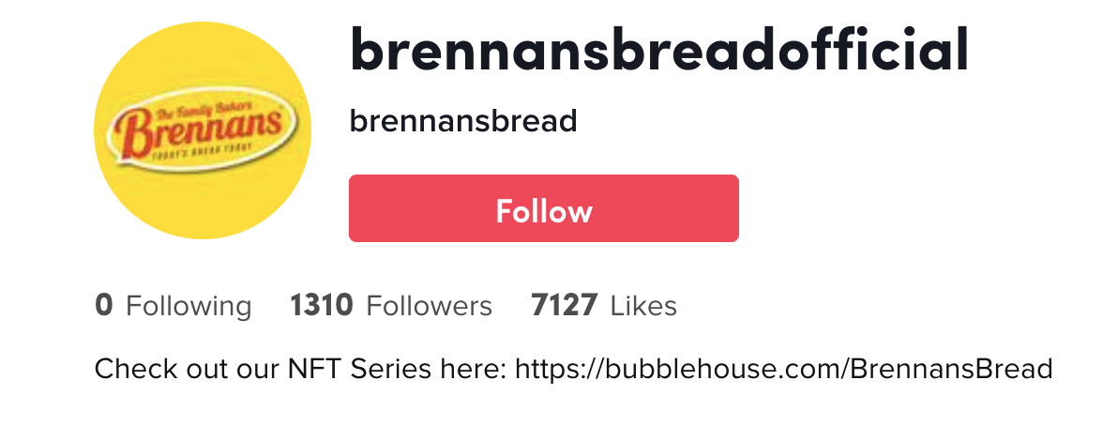
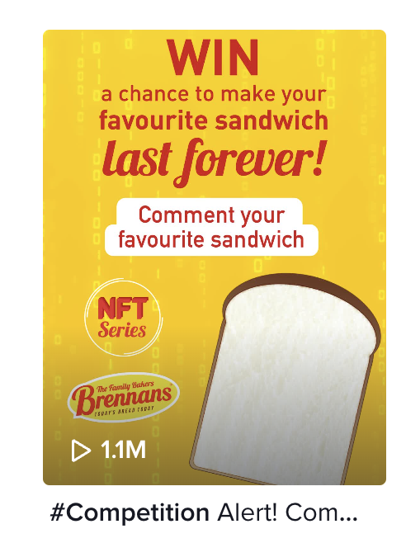
INTEGRATING Social + NFT
With just running our NFT content on the TikTok Channel we have seen fantastic engagement and follower growth considering we have not showcased food content.
Our competition post to find the 16th and final NFT performed brilliantly with over 1.1M views that resulted in 800+ comments
The traction we’ve built so far, sets us up well next week when we start to push out our Food content consistently to this engaged audience.

Slide 19
What did we learn?
The people have spoken and they love the Brennans brand
Keep innovation going focusing on GenZ Audience
Future NFTs need utility
Notes:
The people have spoken and they love Brennans – the success of NFT’s is based on ‘Hype attributed towards brand value, the fact that users purchased these and are reselling them shows what people think of the brand
Keep innovation going focusing on GenZ Audience – This could be anything across digital, experiential, product placement, messaging etc. But we need to consistently speak their language
Future NFTs need utility – With this success of this campaign, we see that the audience want to be part of this movement but in order to drive further brand connections, we need to connect the Virtual world with Reality and drive product usage.

Slide 20
THANK YOU

