Slide 1
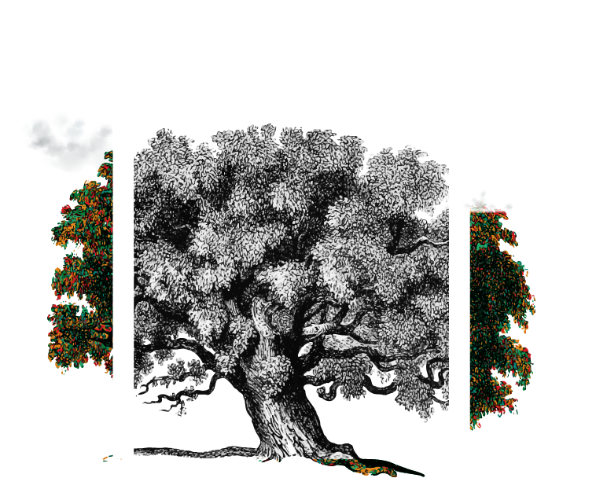
In the space of weeks, we travelled up Maslow’s hierarchy of needs
Mid-May ‘21
At different rates, we all seem to be climbing-up the pyramid like the text book says we do
Early-March
www.outoftheboxresearch.co.uk

Slide 2
You couldn’t find bog roll in early March
Mid-May ‘21
Early-March
Loo rolls and pillow packs of pasta
www.outoftheboxresearch.co.uk

Slide 3
Soon after, hand sanitizers were selling on Amazon for £50!
Mid-May ‘21
Early-March
Hand sanitiser, Dettol and paracetamol
Loo rolls and pillow packs of pasta
www.outoftheboxresearch.co.uk

Slide 4
Gallows humour united us along with zoom and Netflix doubling subscriptions
Mid-May ‘21
Early-March
Netflix, Zoom, dating apps,
Hand sanitiser, Dettol and paracetamol
Loo rolls and pillow packs of pasta
www.outoftheboxresearch.co.uk

Slide 5
Concealing grey roots becomes key and don’t forget to hand-clap the NHS on Thursdays
Mid-May ‘21
Hair-grooming, hair dye, Joe Wicks, volunteering to support elderly
Early-March
Netflix, Zoom, dating apps,
Hand sanitiser, Dettol and paracetamol
Loo rolls and pillow packs of pasta
www.outoftheboxresearch.co.uk

Slide 6
Since April 1st, 19% of UK pop. have started a new hobby (yougov. poll)
Mid-May ‘21
Sourdough starters, pasta machines, soup-makers, food blenders, board games (ref: John Lewis)
Hair-grooming, hair dye, Joe Wicks, volunteering to support elderly
Early-March
Netflix, Zoom, dating apps,
Hand sanitiser, Dettol and paracetamol
Loo rolls and pillow packs of pasta
www.outoftheboxresearch.co.uk

Slide 7
The World is likely to be very different as we learn to adapt to this and future crises
We will be better prepared for the next one
We may take more drastic measures to ‘save our planet’, now we’ve all felt the effects of nature being disrespected
We may treasure our work, if we are lucky enough to have it
And work from home more often
We may protect our loved ones more closely
We may feel less wanderlust and travel less
We could likely feel less cavalier about our wellbeing and that of others
We may even come out of this, respecting the need for a collective community again?
www.outoftheboxresearch.co.uk

Slide 8
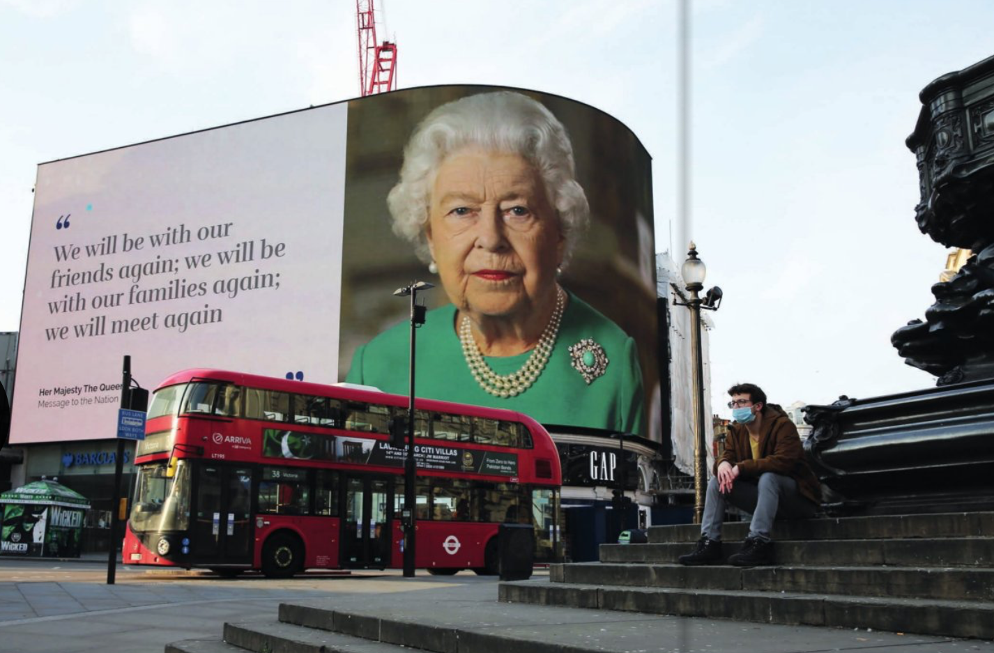
But it’s less about changing and more about resetting – recalibrating our values
We haven’t changed, but the World certainly has
We still behave in the way a psychologist claimed we behaved over 80 x years ago
Instead of changing us, crises tend to reset us; our expectations, our values, our hopes and fears
A reset one would hope for good – but likely to be a mix of both
Out of fear comes relief.
Out of relief comes realisation.
www.outoftheboxresearch.co.uk

Slide 9
Such that many of these pressure points may experience a seismic shift
Religious prejudice
Geo-Political
Stereotype discrimination
Racism
Spiritual retardation
With movement, there’s even more creative fertility to nudge and cajole
Ageism
Gender inequality
Environmental
Community fragmentation
Sexism
Familial
Natural
Financial
Societal
www.outoftheboxresearch.co.uk

Slide 10
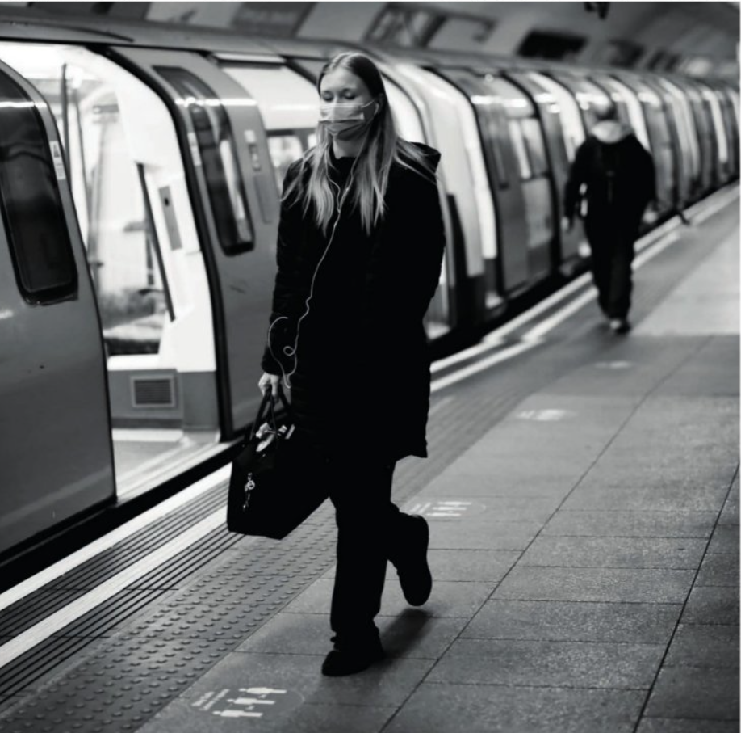
But with it will come a heightened sense of insecurity and craving for belonging
There won’t really be a recovery in the way we recover from a financial crisis. We all know there won’t be a return to the normal of yesterday.
And let’s face it, for the foreseeable future, we will inhabit the clothes of the social distancer in public, wear facemasks when in close proximity to others on public transport or in supermarkets, break the law if we attempt to handshake and refrain from travelling abroad or avoid making any great plans for the future.
www.outoftheboxresearch.co.uk

Slide 11
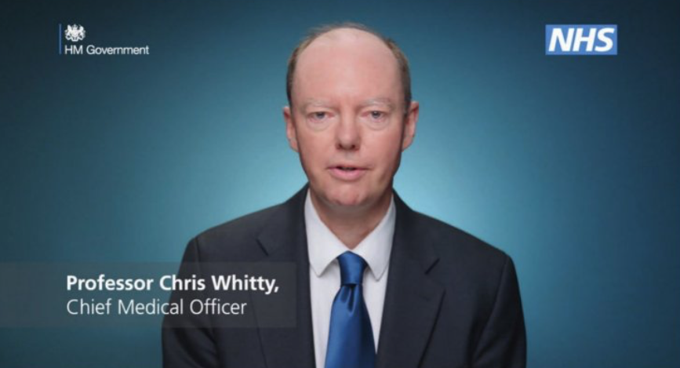
Perhaps for a good while yet…
As Chris Whitty, UK’s Chief Medical Officer admitted only last week, “we might never find a vaccine”. WHO backed this up soon after.
And we have to live with this, not wait for it to simply disappear
And as time goes on, the effects of our physical and social freedoms being pruned will be felt all the more
www.outoftheboxresearch.co.uk

Slide 12
Brands have been on the descendancy, but seeking faith in institutions will rise
Brands used to enjoy a greater faith than they do now. That’s a very generalised comment and is probably truer for FMCG brands than say, tech brands. But such is the World today, most Brands certainly don’t enjoy the loyalty and trust they once earned. And launching new brands in this uncertain climate feels daunting.
When consumers share in a crisis, they crave that belonging and human contact, guidance and support from trusted, faithful institutions; with an increased need for belonging, you can imagine club affiliations will increase, be that football, religion, golf or wherever else you may place your faith or seek solace in.
www.outoftheboxresearch.co.uk

Slide 13
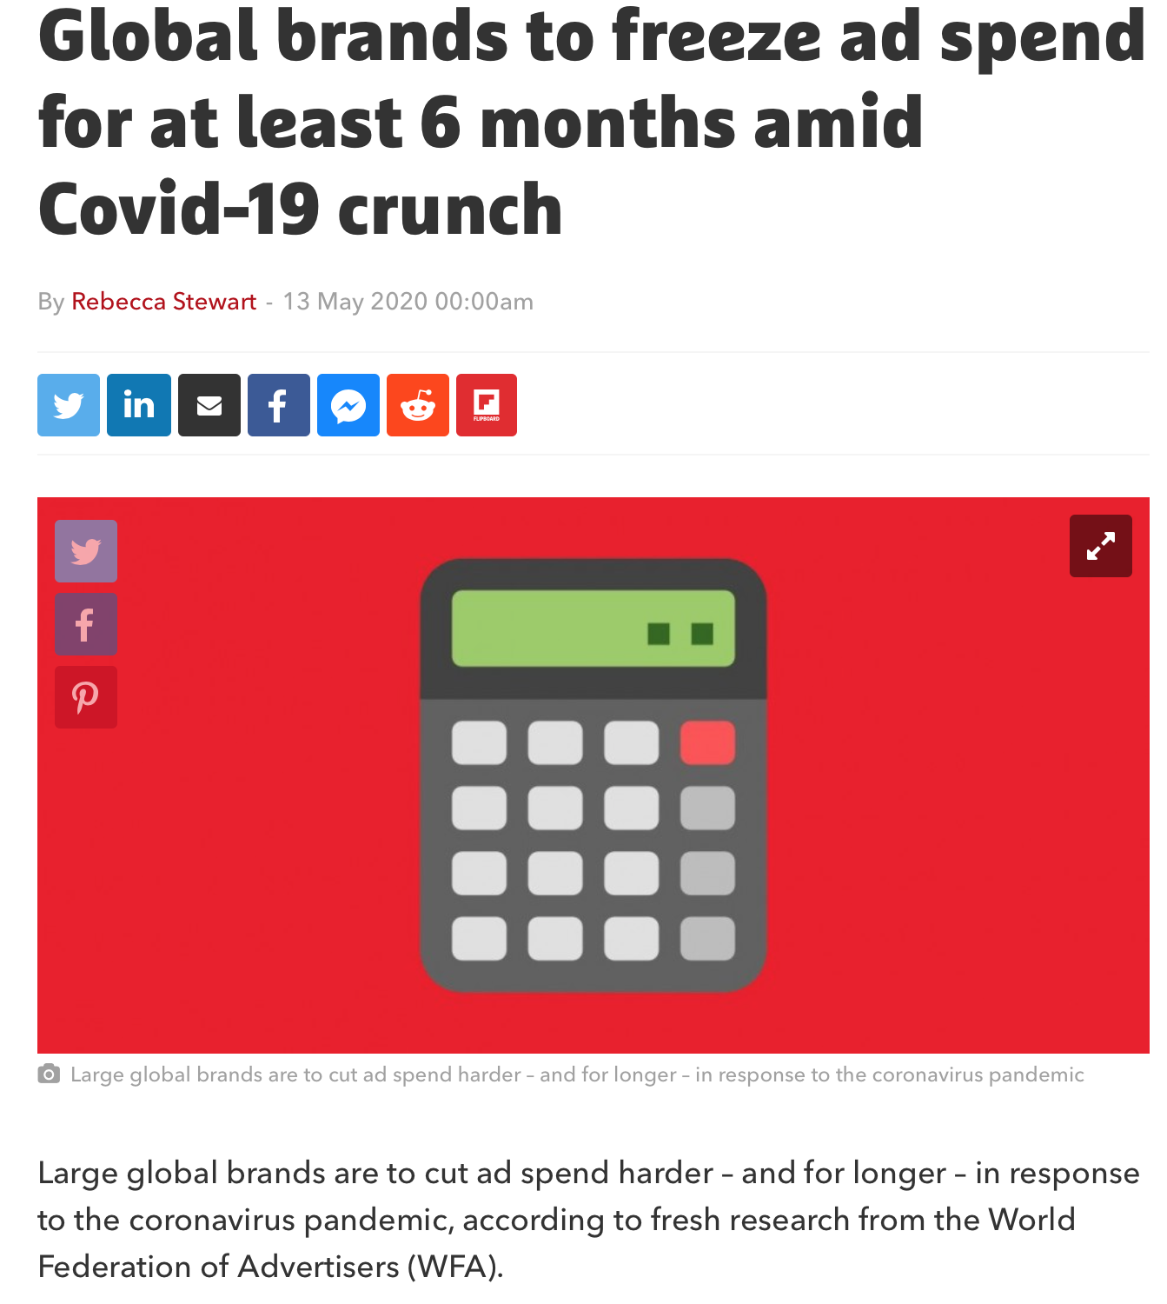
Brands have a greater role to shine light when many are retreating into the dark
Large global brands are to cut ad spend harder – and for longer – in response to the coronavirus pandemic, according to fresh research from the World Federation of Advertisers (WFA).
89% of large multinational companies have deferred marketing campaigns this April, up from 81% in March
52% of marketers at these companies said they’ll now hold back ad spend for six months or more, compared to just 19% who mulled taking similar medium-term action last month
www.outoftheboxresearch.co.uk

Slide 14
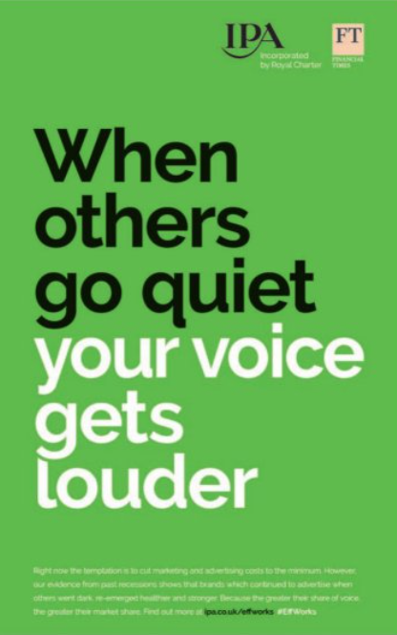
To go mute, when consumers need you more than ever, lacks courage and foresight
Field and Binet concluded from the financial crisis of 2008, those brands that were there for consumers in their hour of need, benefitted from genuine consumer loyalty post-crisis, whilst other brands that bottled-it found it expensive and slow to regain trust and value
Today Peter Field recommends that
“With appropriate sensitivity to the fearful state of most people, brand building (as opposed to sales activation) may in fact be the best approach…that may involve eye-catching initiatives that reflect the mood of the times… Brand advertising is not about profiting in recession, it’s about capitalising on recovery”
www.outoftheboxresearch.co.uk

Slide 15
In this Crisis, Brands have an even greater purpose as lifebuoys in a sea of uncertainty
As beacons of trust
As rays of hope
As moments of light relief
As resources for empathy
As rocks of reliability
As sources for inspiration
Even more so, when subsequent peaks prompt Governments to yee and yaw, backtrack and contradict, blame and bluster
www.outoftheboxresearch.co.uk

Slide 16
And to shirk from courageous creativity will only neuter efforts to connect and engage
www.outoftheboxresearch.co.uk

Slide 17
Where solid, comforting, wholesome values resonate all the more in a crisis
www.outoftheboxresearch.co.uk

Slide 18
Where less can be more
www.outoftheboxresearch.co.uk

Slide 19
Where the lightest of relief unites us and enhances our sense of belonging
www.outoftheboxresearch.co.uk

Slide 20
Where authentic and personable trump glitzy and sentimental
www.outoftheboxresearch.co.uk

Slide 21
Where brands encourage connections when none are allowed
Spotify using the power of audio to bring people together even during lockdown
www.outoftheboxresearch.co.uk

Slide 22
Where sheer brilliance can still shine bright
www.outoftheboxresearch.co.uk

Slide 23
So, creativity craves a crisis like Covid-19
Now, more than ever, Brands need to fulfil their purpose and step-up to the plate
They need cojonas to lead where others have bottled-it
If you ever wish consumers to question, wonder or think, then you really don’t have a choice
In 35 x years I’ve never seen a Brand achieve any of this without creativity that stretches
Think re-set, not change – and creativity will flourish
Creativity Craves Crisis
www.outoftheboxresearch.co.uk

