Slide 1
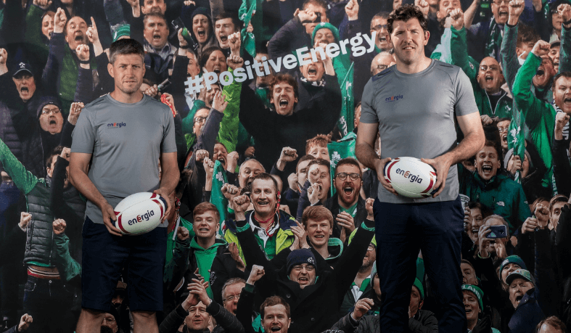


From Challenger to Contender:
Unearthing the foundation of Trust to build a brand for the future
Brand Development & Strategy and Grand Prix
Presented by Cathy Glennon (B&A) & Geoff Codd (Energia)

Slide 2


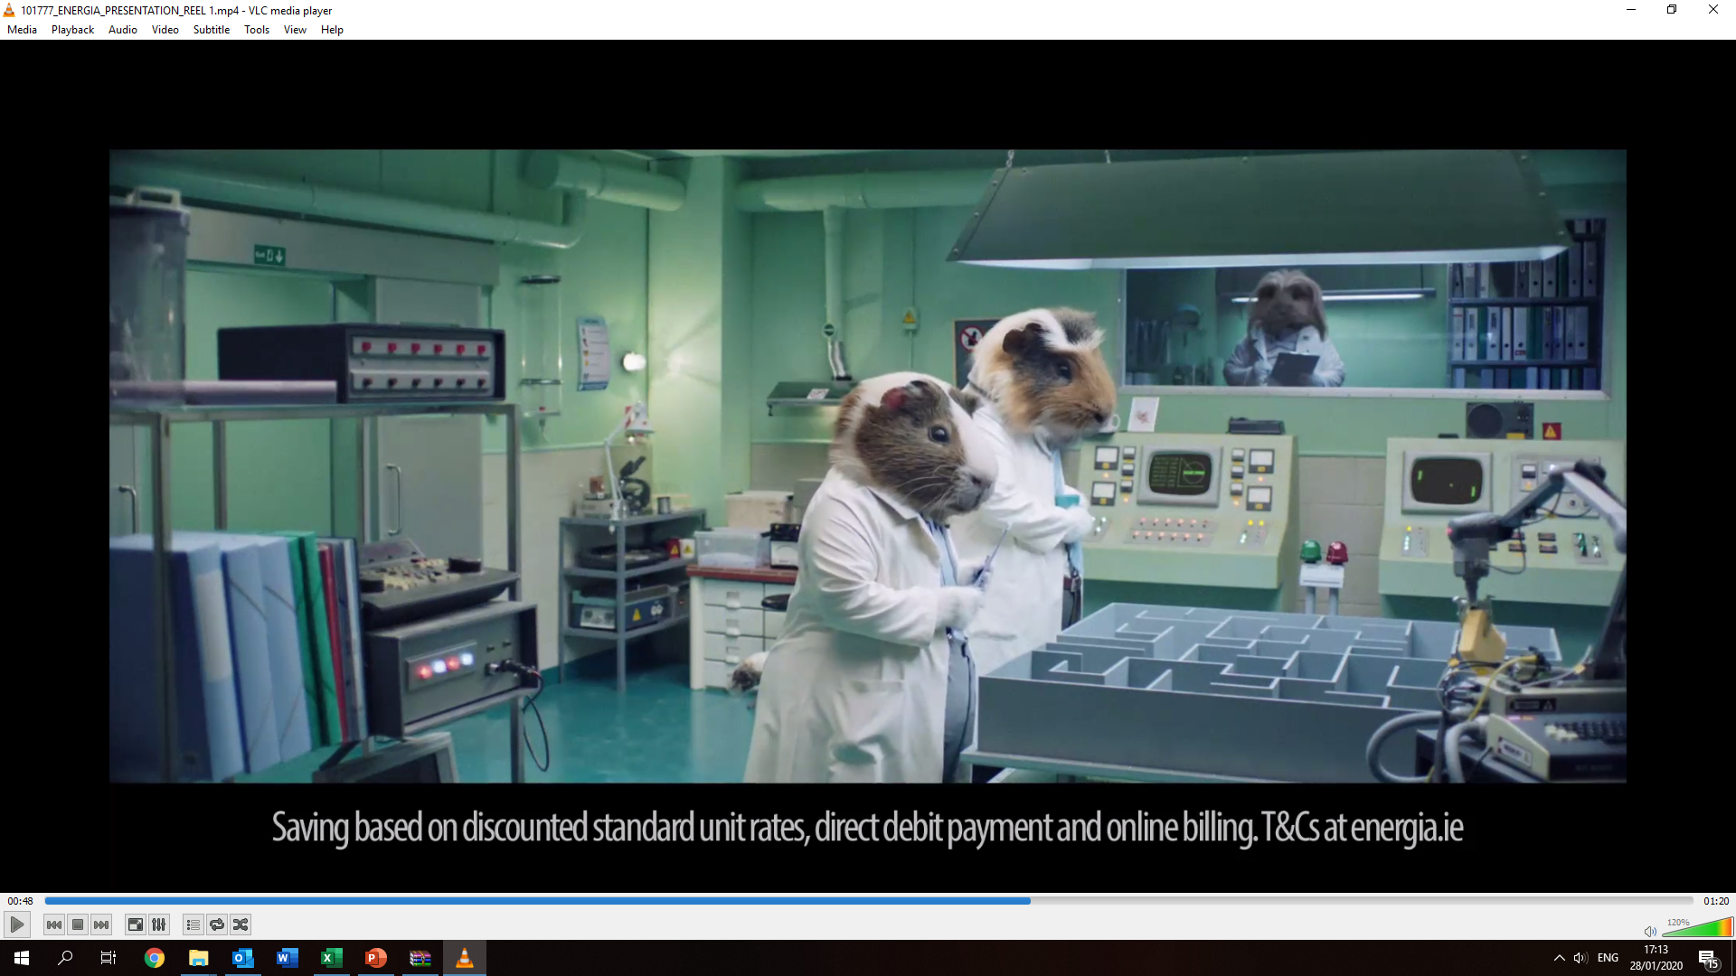
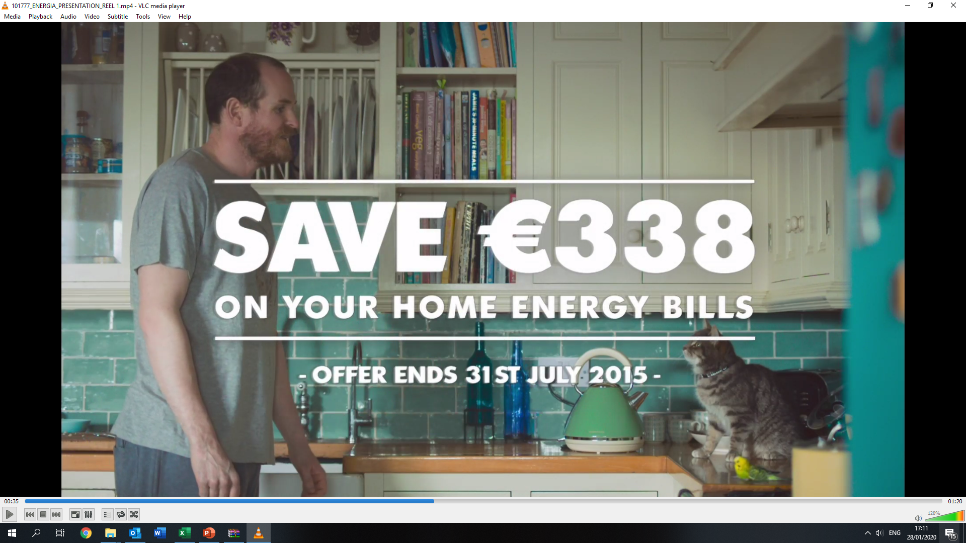
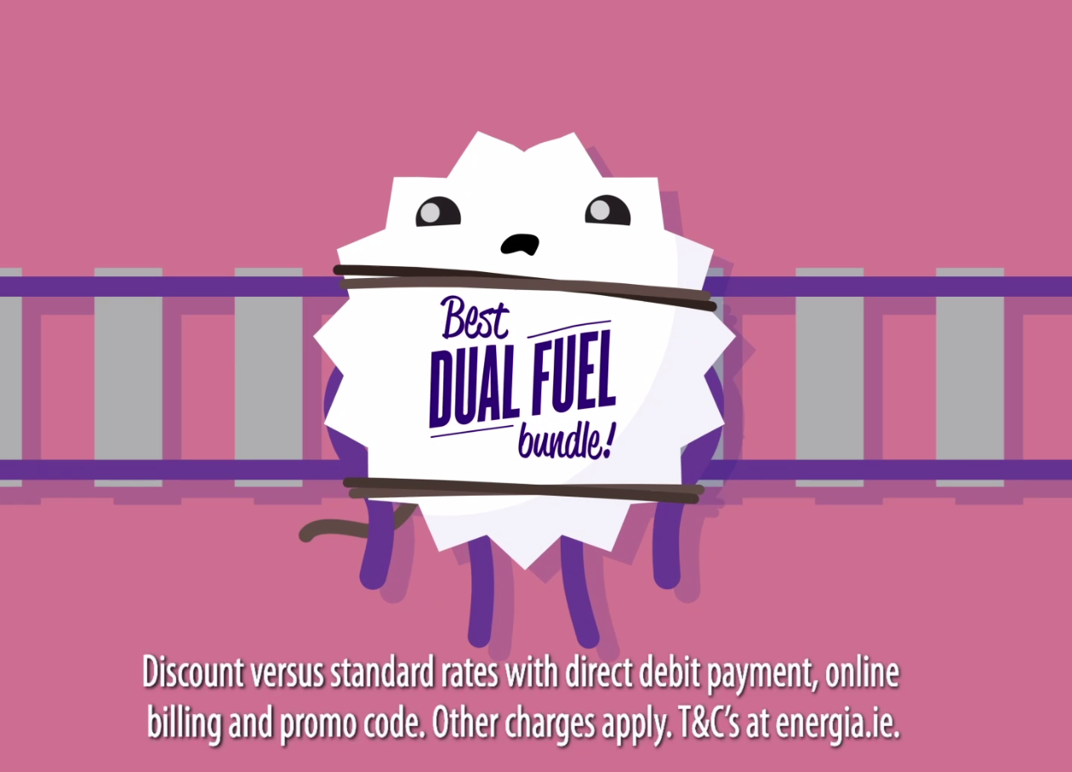
Notes:
Energia joined the residential market in 2013. Starting out, they did what any brand/provider would do, they focussed on acquisition. And to do that, they did what many energy providers have done over the past decade, their communications centred around the savings to be made if you switch to Energia.

Slide 3
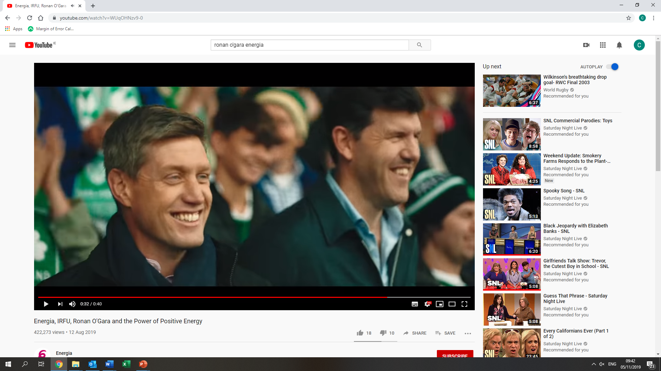
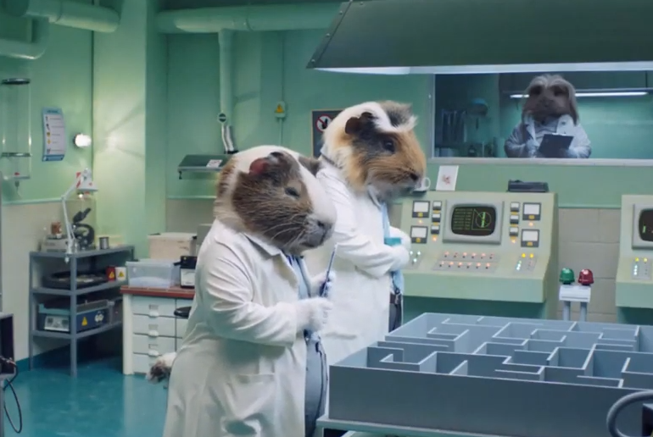
Went from these lads…
to these lads!

Slide 4

WHAT WILL WE COVER…
What we did & what we found
  Quantitative: defining our focus
  Qualitative: drivers of trust & roadmap
How research was used & the impact on results

Slide 5

Diagnostic deep dive, to define our focus (Quant)

Slide 6
Techniques to define our focus
Review of correspondence maps
Cross analysis of brand metrics by key KPIs
Review of brand pyramid
Establish key areas of weakness for Energia vs. competitive set
Strength:
Weakness:
Current customer
Prompted consideration
Spontaneous mention
Prompted awareness
Prompted consideration

Slide 7

Key findings: quantitative
A company I know a lot about
More likely to consider switching to Energia
A company I trust

Slide 8



Key findings: quantitative
Customers
All adults

Slide 9

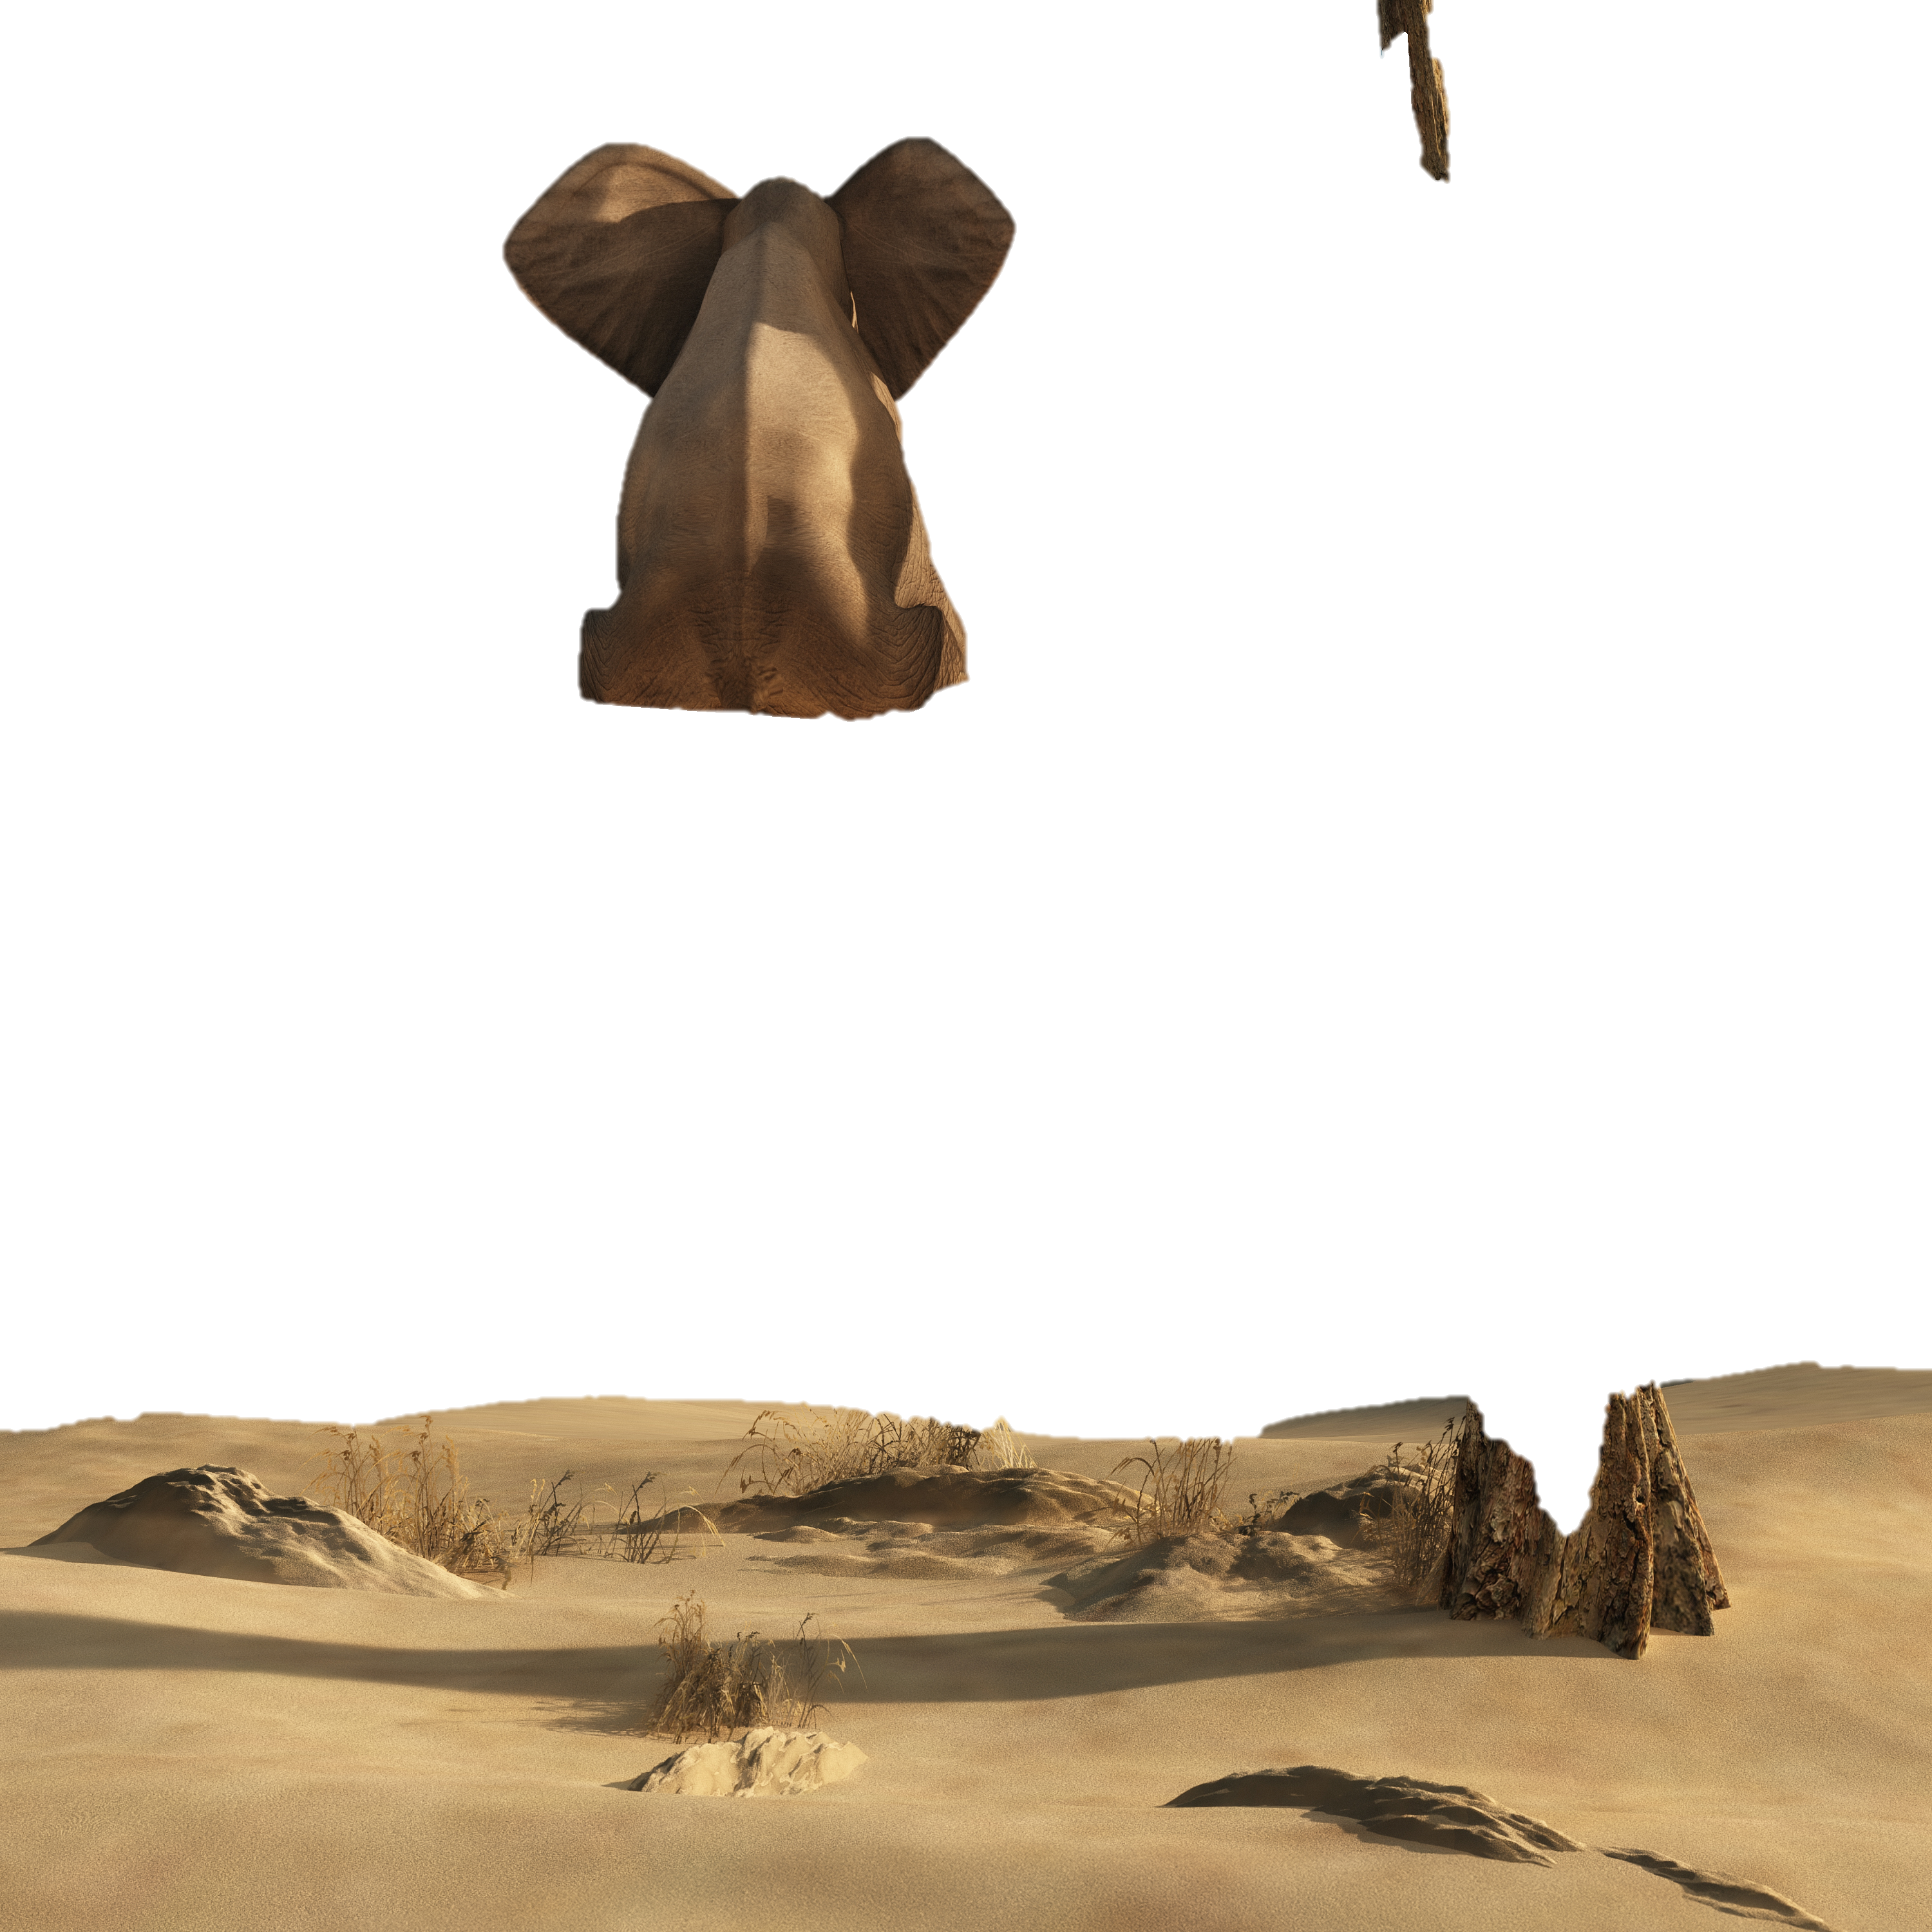
Trust is the answer!

Slide 10
But wait a minute…

Slide 11

Drivers of trust and brand road map (Qual)

Slide 12

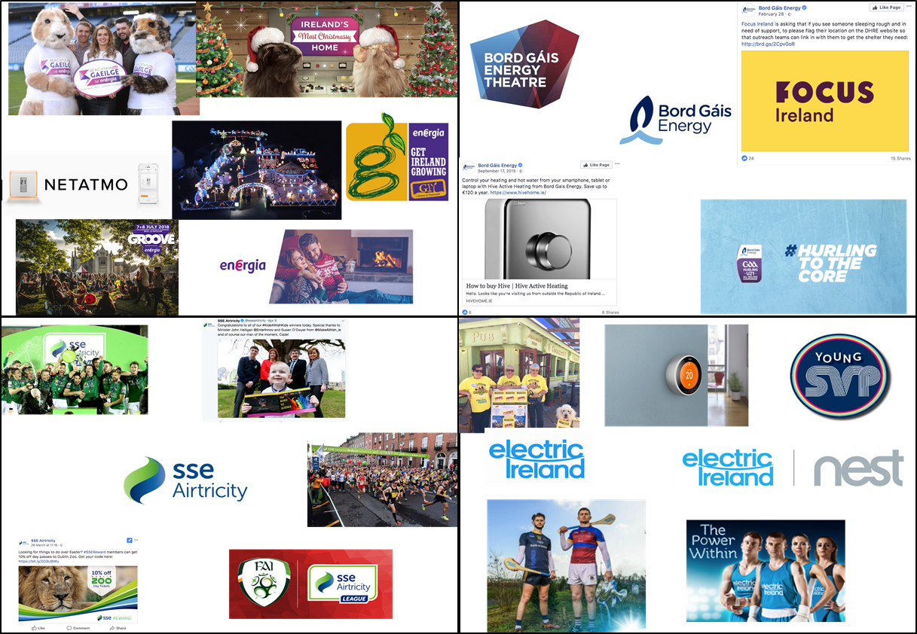
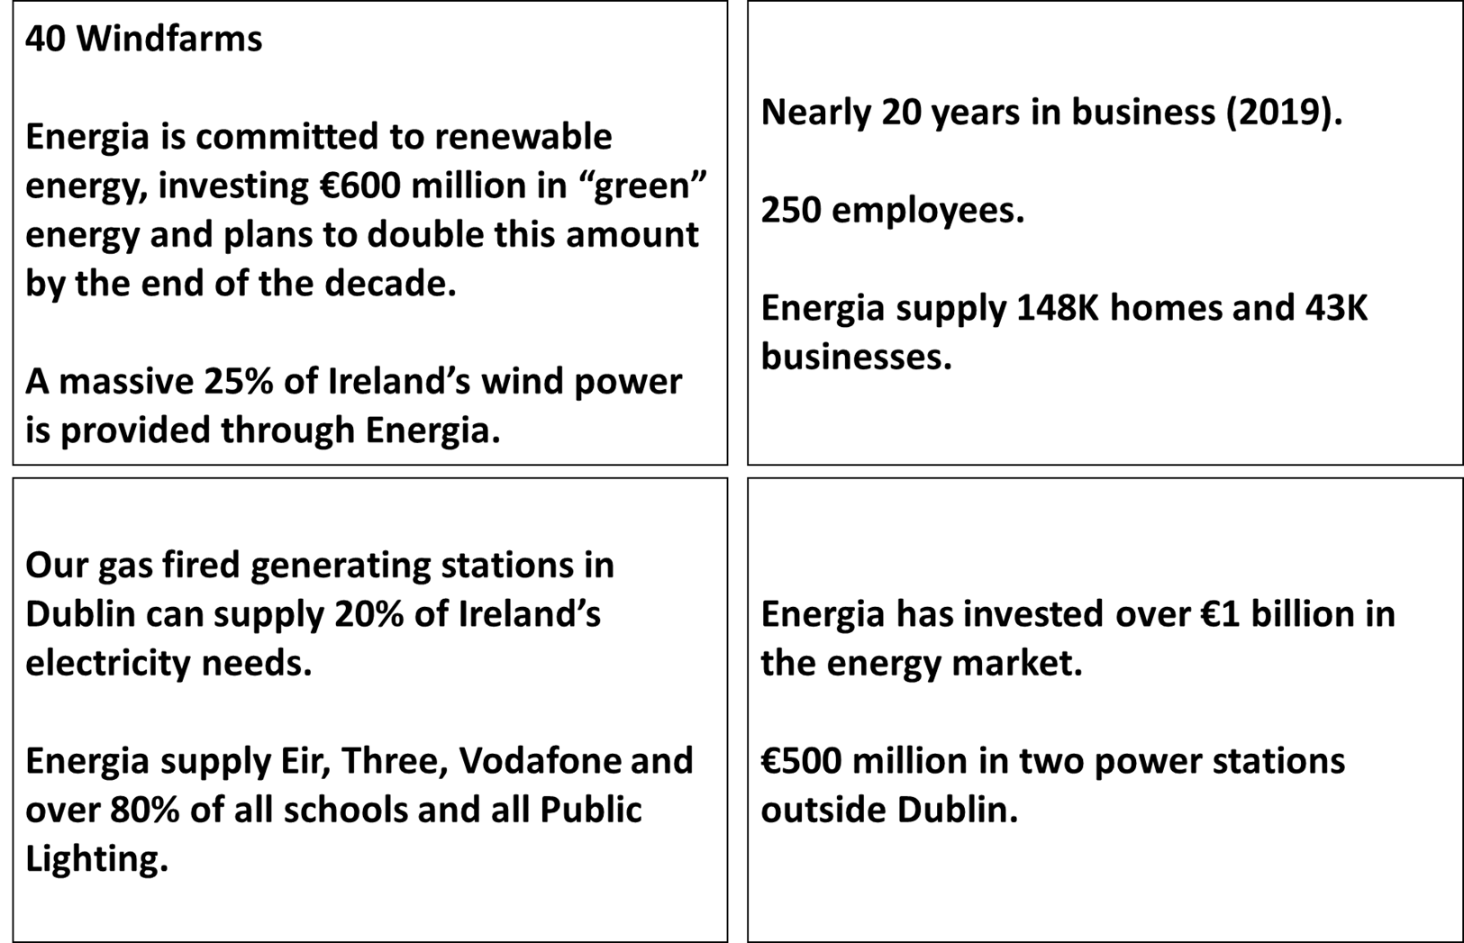
Techniques to decode trust
All respondents pre-tasked
In-group interactive brand mapping
Spontaneous associations with energy providers
Review of sponsorship material across competitive set
Assessment of Energia’s ‘Proof Points’

Slide 13

Trust drivers for all brands
Reliability
The view from here
Fit with life
Frequency of interaction
Proximity:
Cultural
Physical
Market trajectory

Slide 14
Key focus
Awareness raising
Build greater awareness of the stability and scale of the brand.
Sense of connection to place
While many other brands lack a tangible expression, there is a greater priority for Energia to be present in the real world.
This is not a brand people distrust they just lack a foundation of confidence on which to build trust over time.

Slide 15

Long term goal:
Building Blocks for Trust in Energia
OVER
TIME
TRUST
CONFIDENCE
DELIVERED
CONSISTENTLY
RELIABILITY & SCALE
PROXIMITY
1.
2.
3.
AFFINITY

Slide 16



Affinity
Strategic building blocks
Characterful communications are part of the answer, but also tailored solutions.
Reliability and scale
Memorable reference points that speak to the scale of the brand.
Proximity
A sense of presence for the brand as a platform for confidence and ultimately trust.

Slide 17

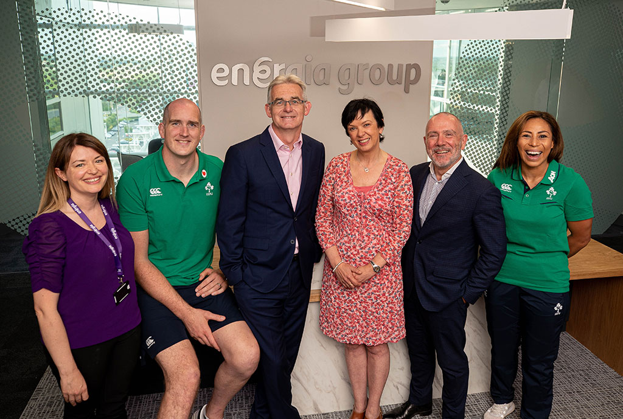
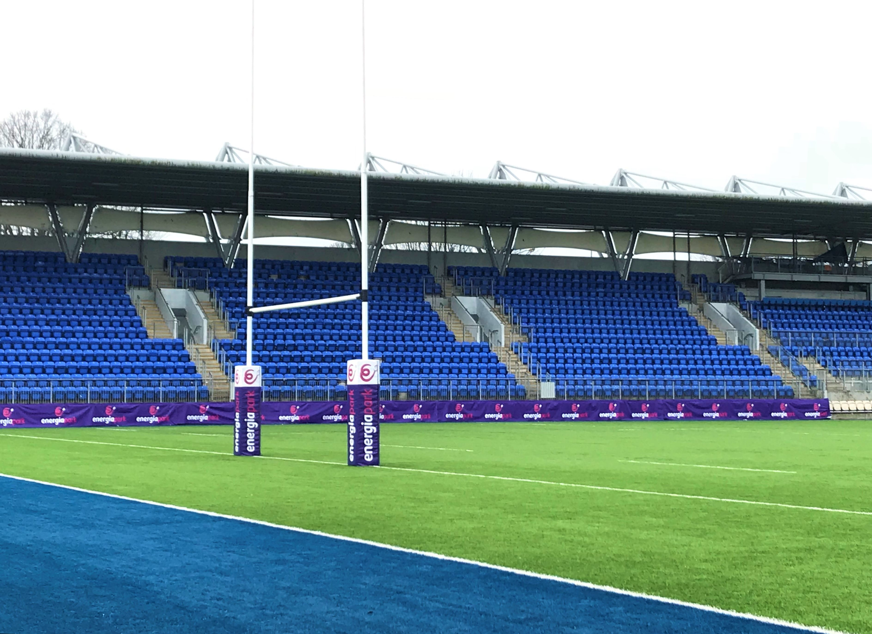
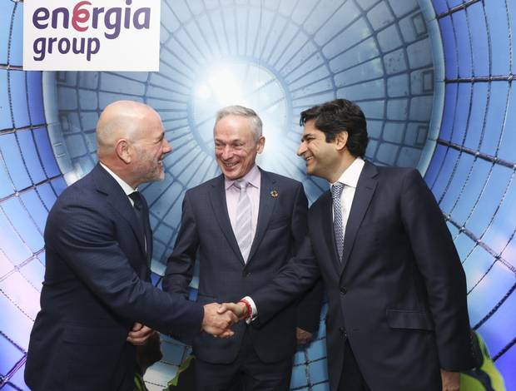


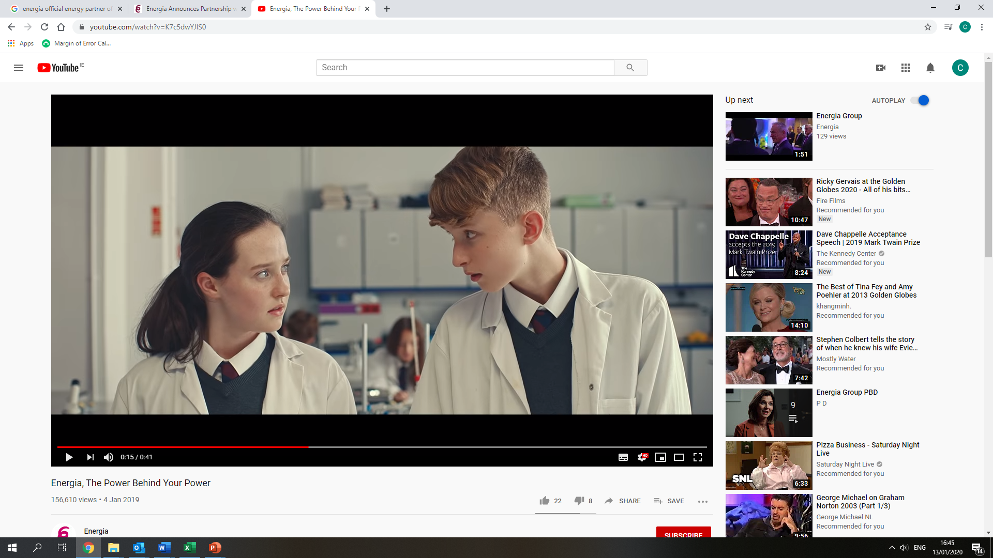
Energia’s roadmap
Proximity
Reliability & Scale and Affinity
7.
Internal Changes
3.
Qual Research
Official Energy Partner of IRFU
8.
5.
2.
Renewable Energy Investment
Energia Park
4.
9.
Energia AIL
Rugby Heroes
6.
Power Behind Your Power
1.
The mission

Slide 18
Performance Review
From Feb-Aug 2017 to Feb –Aug 2019
+53%
+52%
+27%
+13%
Spontaneous awareness
Overall awareness
‘A company I recognise as Irish’
‘A company I trust’

Slide 19
Performance Review
From September 2018 to
September 2019
From August 2018 to August 2019
+83%
Annualised Churn Rate
+78%
Customer Acquisition
-23%
+8.5%
Transactional NPS
Sales Direct on Energia Site

Slide 20

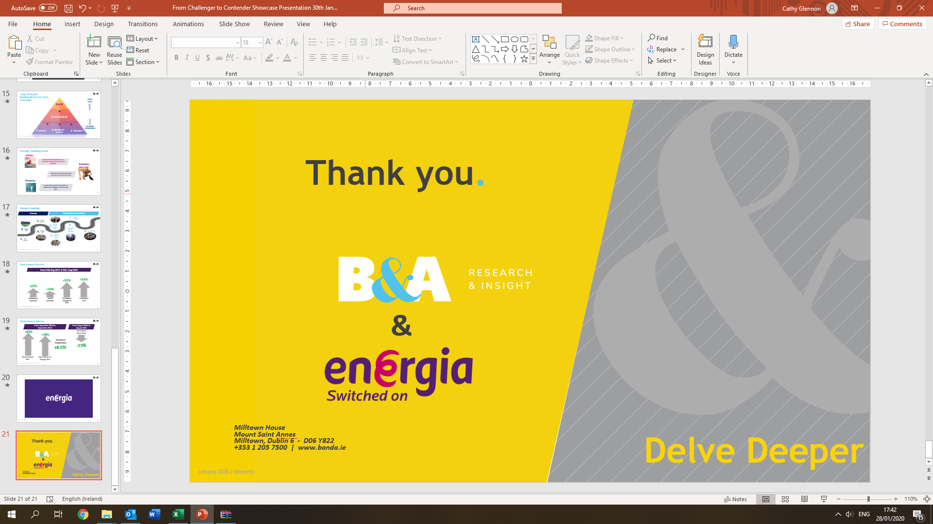
Thank you.
&
Milltown House
Mount Saint Annes
Milltown, Dublin 6 - D06 Y822
+353 1 205 7500 | www.banda.ie

