Slide 1





Research Excellence Awards 2019
Winner: Customer Experience Research
Prepared by:
Luke Reaper (MD, B&A)
Sarah Gallagher (Head of CX, RSA Ireland/123.ie)
January 2020
@banda_.ie

Slide 2
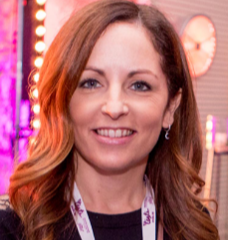
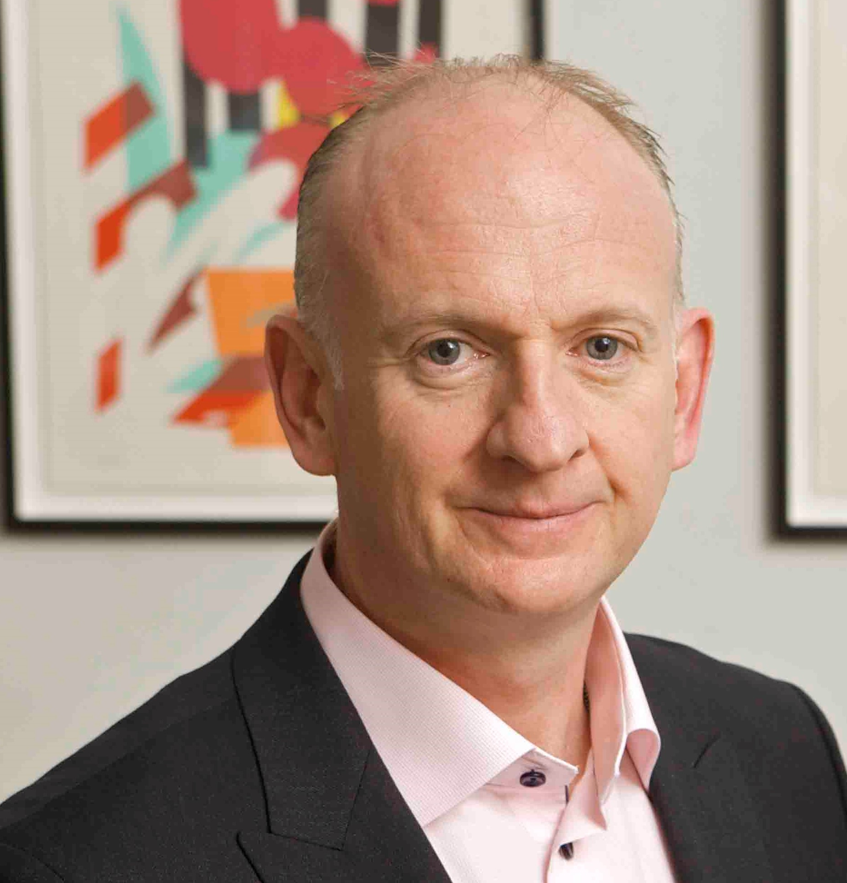
Good morning!
Sarah Gallagher
Head of Customer Experience
RSA Ireland & 123.ie
Luke Reaper
Managing Director
Behaviour & Attitudes

Slide 3
Introduction
1.
123.ie and RSA Ireland needed to break down the organisational and functional barriers, that naturally occur with different business units and brands, to put the customer at the heart of what they do. We needed to embed the voice of the customer within every department. An organizational transformation was required.
A few persistent issues existed:
Fragmentation - individual teams focused on great customer service and experience, but it was happening in pockets - using different providers and metrics.
Not inclusive, CX wasn’t an enduring focus through the business.
It excluded those who may never talk to a customer directly, but whose actions could impact the customer downstream.
Isolation, individually, it felt like staff were all working on delivering great, worthy, relevant improvements for their individual customers but no one really knew about them.
No awareness as to whether brands’ were being truly customer-centric as a whole.
1.
2.
3.

Slide 4
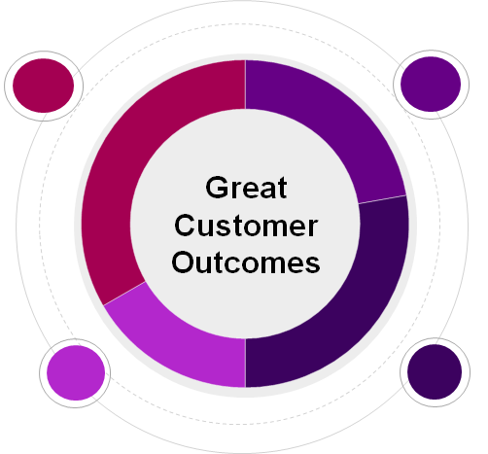
The Customer Experience Excellence (CXX) strategy was developed with 4 key pillars
1.
Introduction
Listen and Understand
Think Customer
Great Customer Outcomes
Simplify
Propositions

Slide 5

Research Objectives
2.
1.
To align core customer experience metrics across channel and key stages of the customer journey, to establish a single customer service quantified standard for 123.ie and RSA.
The research objectives were challenging
2.
Devise the key metrics for measurement based on best practice.
3.
Implement the most appropriate methodologies for measurement (together with timescales on their journey).
4.
Real-time continuous reporting with insight and actionable reporting with driver analysis. Benchmarking 123.ie vs competitors. Deliver internal and affinity partner engagement.
5.
Provide a structure for internal and client governance and management. All conforming to the latest data protection regulations.

Slide 6















Methodology
3.
B&A had to design and implement a very complex and integrated CXX study.
One of the key objectives delivered was to be up and running with 100 days - no mean feat.
Key Stakeholder Workshop (key)
Restful API/
31 feeds/Data Security Protocols
Continuous Customer Survey Programme
Real-time Reporting And Engagement
Background Review
Implementation Session
Weekly Review Call
1.
2.
3.
4.
5.
6.
7.
First 100 Days
(This was a major target milestone - delivered)
Machine Learning For Sentiment Analysis
External Bench-marking
Quarterly Insight Reporting
Stop, Think & Act Sessions
Training Sessions
Qualitative Deep Dives
8.
9.
10.
11.
12.
13.
14.

Slide 7
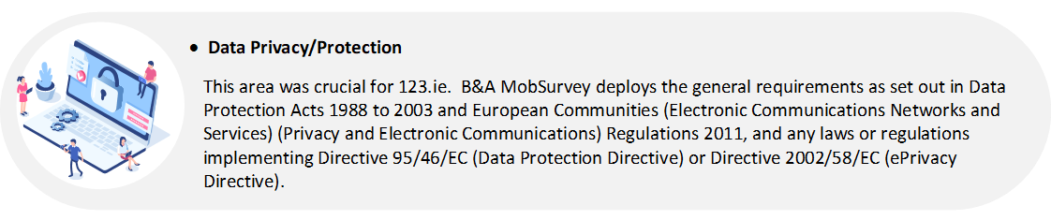
Highest level of data privacy
3.
Methodology
In relation to GDPR, B&A’s MobSurvey has implemented the following:
Logging and timestamping changes in contact data including: opt-ins, opt-outs.
Cleaning tools – remove contacts that haven’t opened surveys in X months or have received Y surveys in the past Y months and never engaged.
Further opt-in permission for follow-ups.
Data encrypted at rest.
Process to allow controllers execute GDPR basic rights.
Successful penetration test has been conducted by PWC in July 2018.

Slide 8
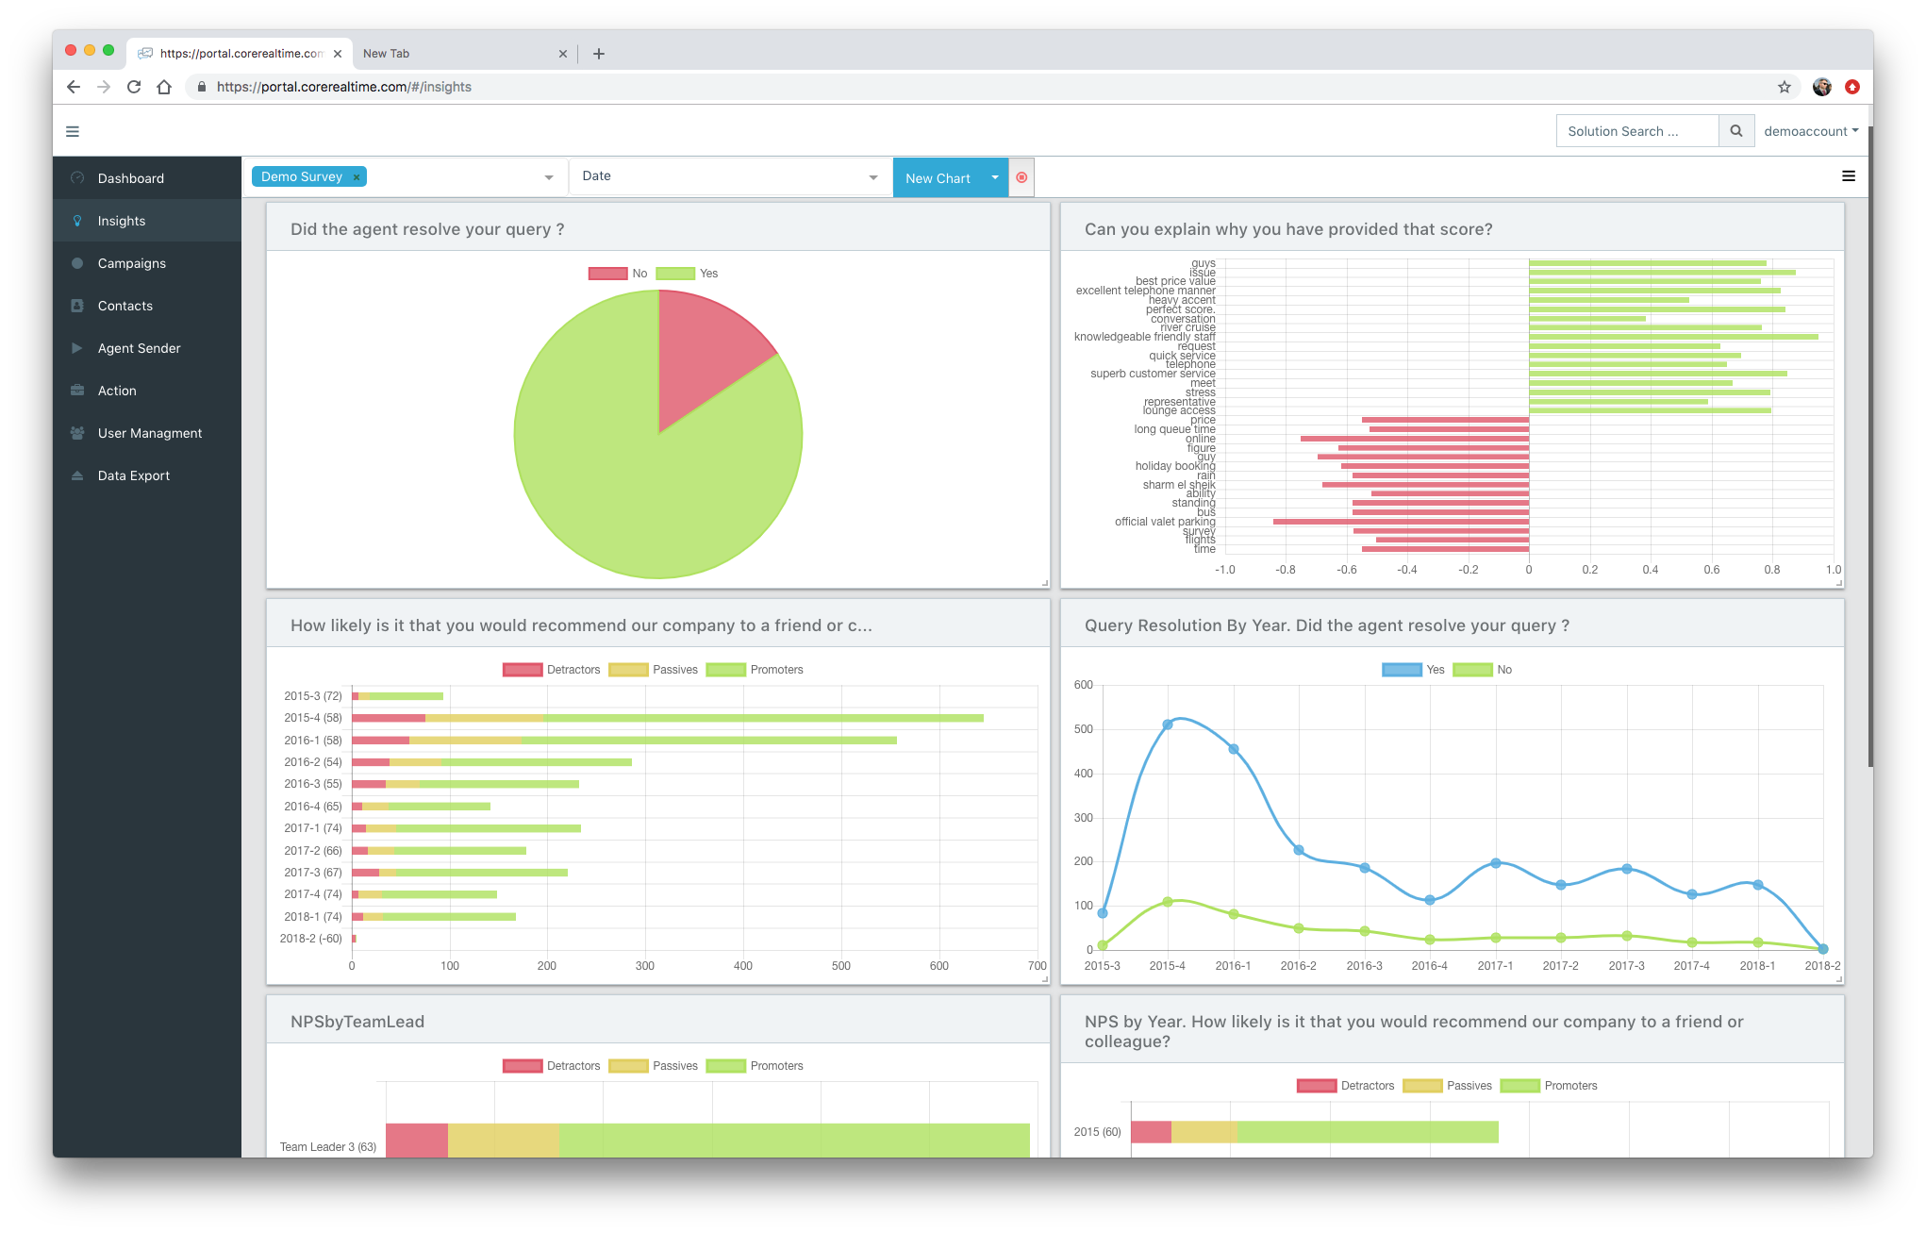
Outcome & Learnings
4.
This continuous CXX programme enables 123.ie to keep a finger on the customer experience pulse 24x7.
Every piece of customer feedback is analysed and measured which allows a personalised and automated way of closing the customer feedback loop in realtime.
We analyse the aggregated data and display beautifully presented reports to help 123.ie understand where they are doing well and where improvement is required.
In the first 12 months over 24,000 customers have been surveyed across the 123.ie, RSA and affinity partner brands, across 31 different customer journeys.

Slide 9
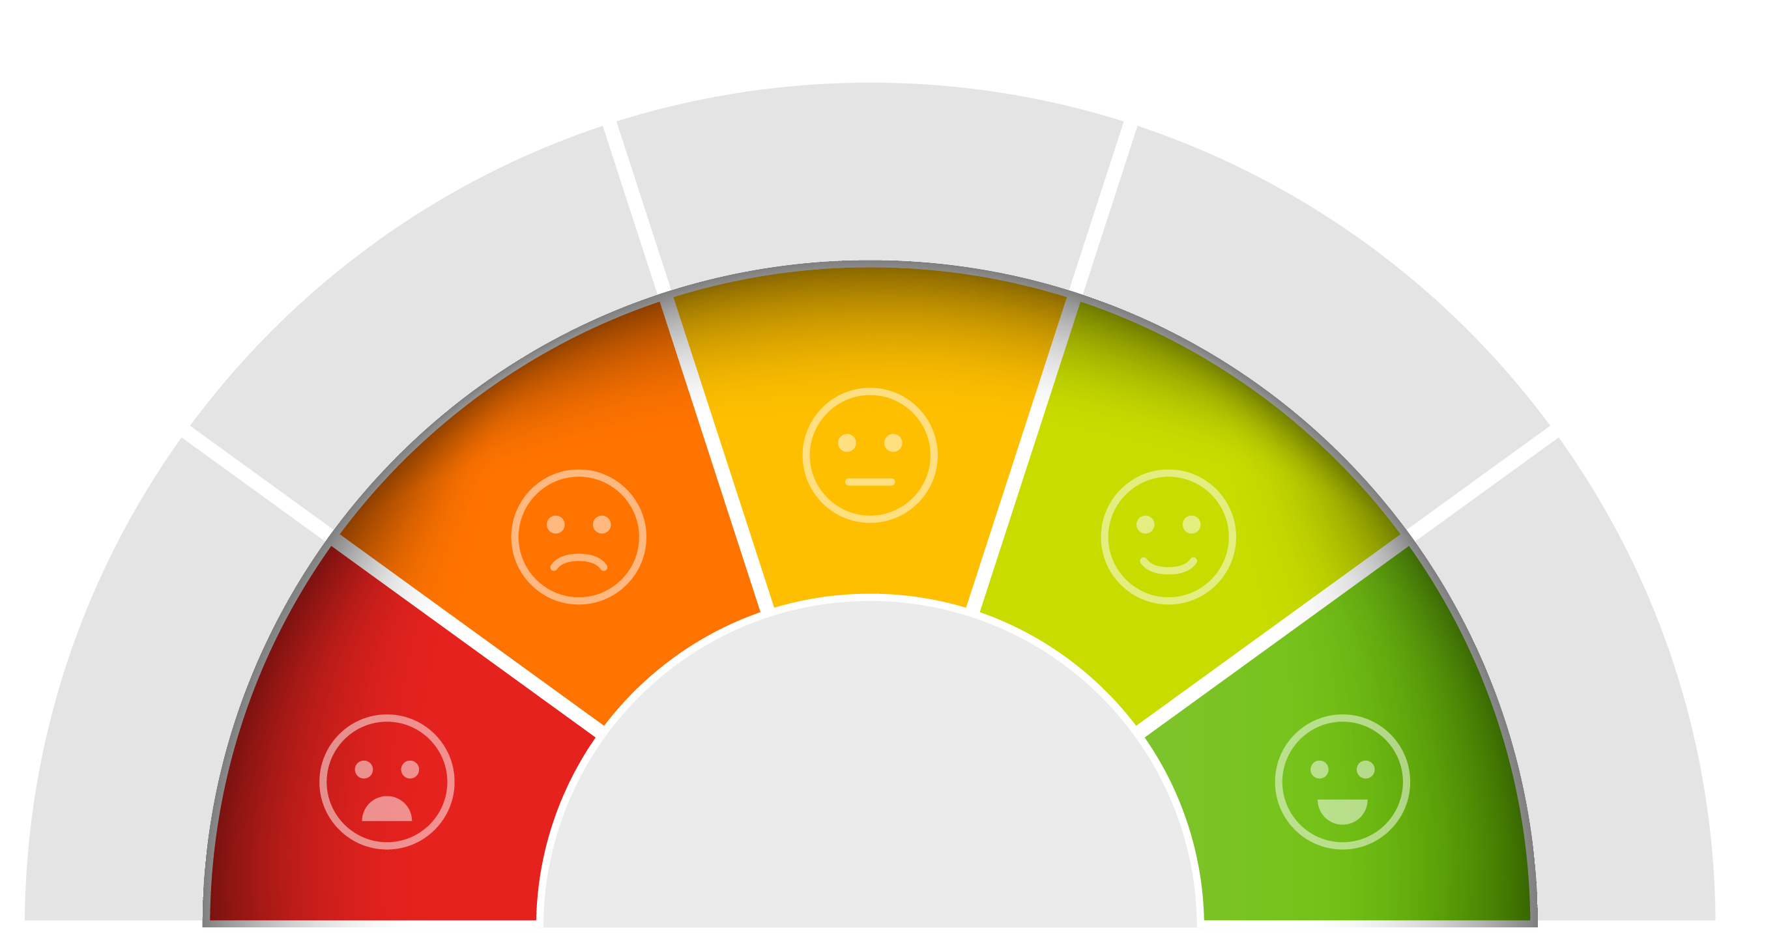

Outcome & Learnings
4.
When a customer has an interaction they are served the relevant survey automatically within 24 hours via email or SMS.
Results were viewable and exportable, enabling the data to be used easily in reporting and enabling speedy actions across the organisation. Live reporting democratises the results.
For the first time the organisation has one continuous measurement system – comparisons across the business can now be made.
RSA Group have seen significant positive improvement in results:
Overall organisational NPS has increased
5% - 20%
Increase in NPS

Slide 10

What really made the programme come alive is….
4.
Outcome & Learnings
Buy in from all levels of the organisation
A slickly designed digital surveying platform (B&A MobSurvey)
Which allows the Stop, Think & Act sessions to focus on implementing change to enhance customer experiences
We can then delve deeper in qual for NPD on specific areas and we understand the context via external benchmarking.
….. and a great client-agency partnership.

Slide 11
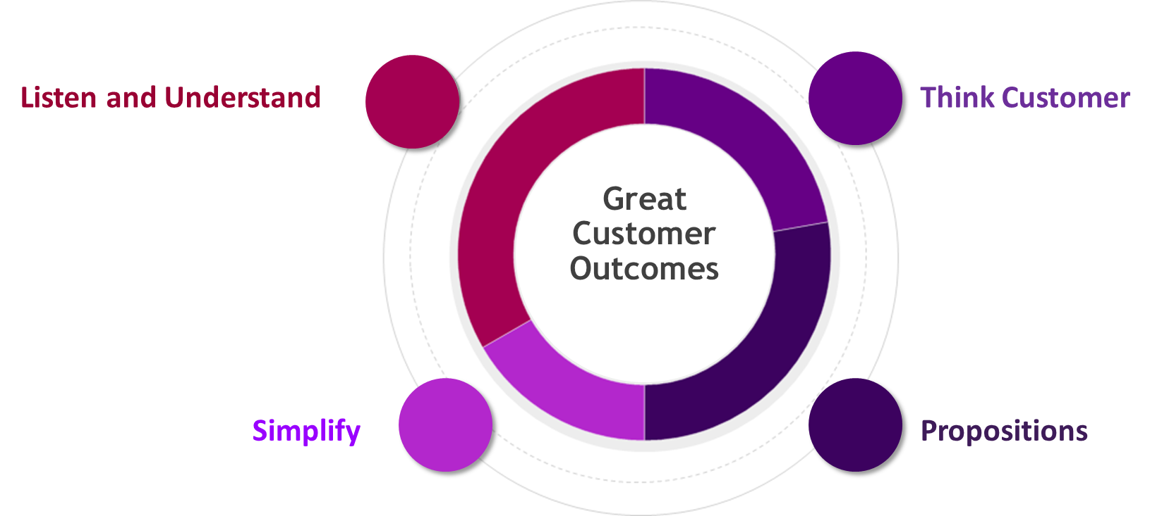
Impact on the business
5.
Research does not sit in isolation. Like all research, it should and does sit at the heart of an overall customer experience excellence (CXX) strategy for the RSA insurance group. As such it is transformational and is at the centre of all that RSA do, with total buy-in throughout the organization, even with teams previously removed from customer interactions.
12 months post launch of the Customer Experience Programme we have seen fantastic impacts the four strategy CX pillars:
Examples of Impact

Slide 12

Impact on the business
5.
Listen and Understand our Customers and take action to improve their experience:
Making the car insurance quote and sale journey easier & faster reducing the time to get a quote to just 4 mins.
Improving the document upload system to make it easier and faster for customers to send 123.ie the required documentation.
Making it easier for customers to find 123.ie contact details in the event of claims.

Slide 13

Think customer
5.
Impact on the business
Building a stronger customer culture within the team’s front- and back-offices:
Customer focused goals set from the top down.
A “random acts of kindness programme” building a strong customer focus.
In 2019 staff felt that the customer focus has increased by +5% that we are beginning to ‘up the ante’.
I am emailing you to thank you for the Smyth’s voucher that was given to our family. It was a very nice and kind gesture. It has been put to good use already! The kids are delighted with their new toys. Rosie is 3 and she understands and remembers what happened to our house so to see her smiling and excited picking out her new toys was lovely. Thank you so much for the voucher which allowed us to spoilt the kids at this difficult time. It was very much appreciated.
This feedback came after the customer and their family suffered a traumatic household fire. The couple and their two young children, one of whom has a disability, were in bed at the time.

Slide 14

5.
Impact on the business
Think customer
The B&A MobSurvey platform flexibility now used for other customer interaction services.
Weshare customer compliments fortnightly via company e-mail to congratulate employees and acknowledge what they did to provide brilliant CX.
Cross-departmental team meets monthly to track and report on progress of customer experience initiatives (“Voice of the Customer” forum).

Slide 15



Simplify for customers & deliver better propositions
5.
Impact on the business
123.ie has multiple Operational Excellence / Simplification initiatives in train, but one worth highlighting is the process to improve the “Damage Claims” experience for customers as it’s the point where they rely on their support the most, it is one of the key moments that matter for customers.
Some of the ideas 123.ie are now implementing are::
New propositions is an area of key focus and the VOC insights strongly support us in this area.
The standout achievement to date is the launch of a Telematics-based motor insurance product (123GO) designed to provide young drivers with competitively-priced insurance and more choice.
Simplified Contact Process & Digital-First.
Team Restructure to ensure the customer gets to speak to the right person first time.

Slide 16
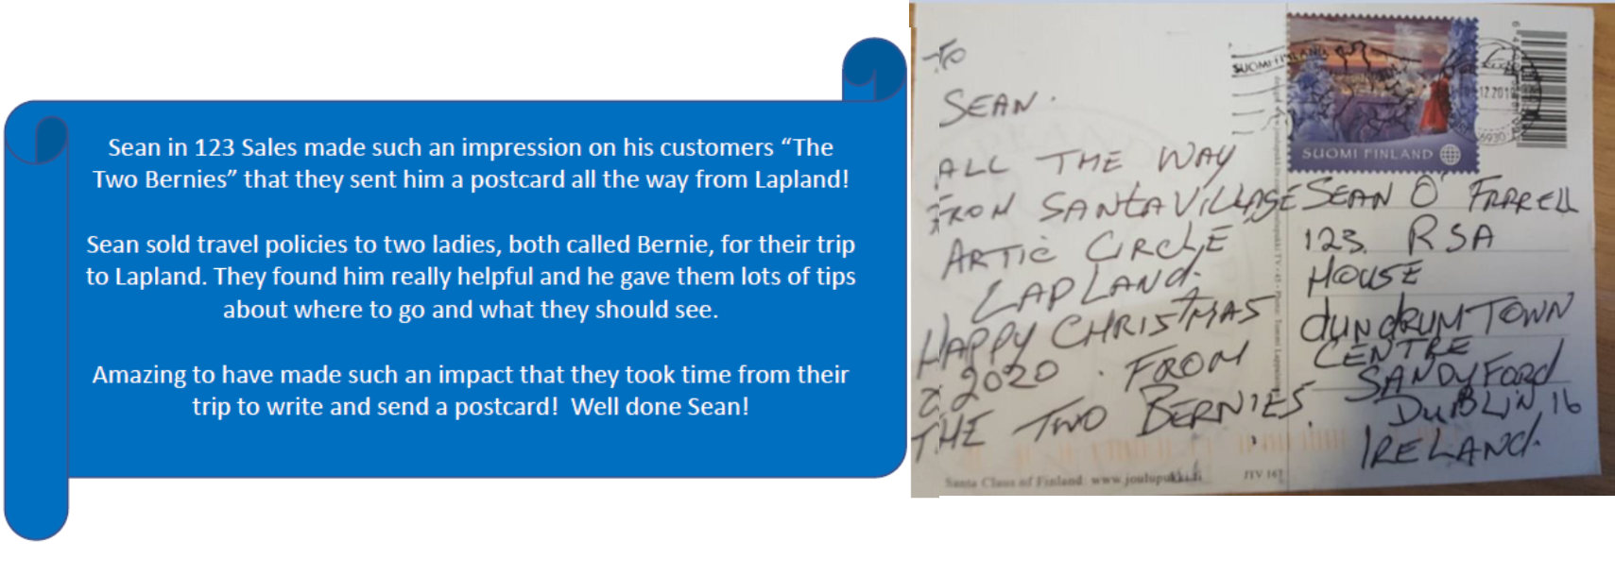
Leave you with a Customer quote
Well done Sean, 123.ie on this excellent response from our very happy customers the ‘Two Bernies’!
The programme has been truly transformational.

Slide 17


Thank you.
&
Milltown House
Mount Saint Annes
Milltown, Dublin 6 - D06 Y822
+353 1 205 7500 | www.banda.ie

