Slide 1
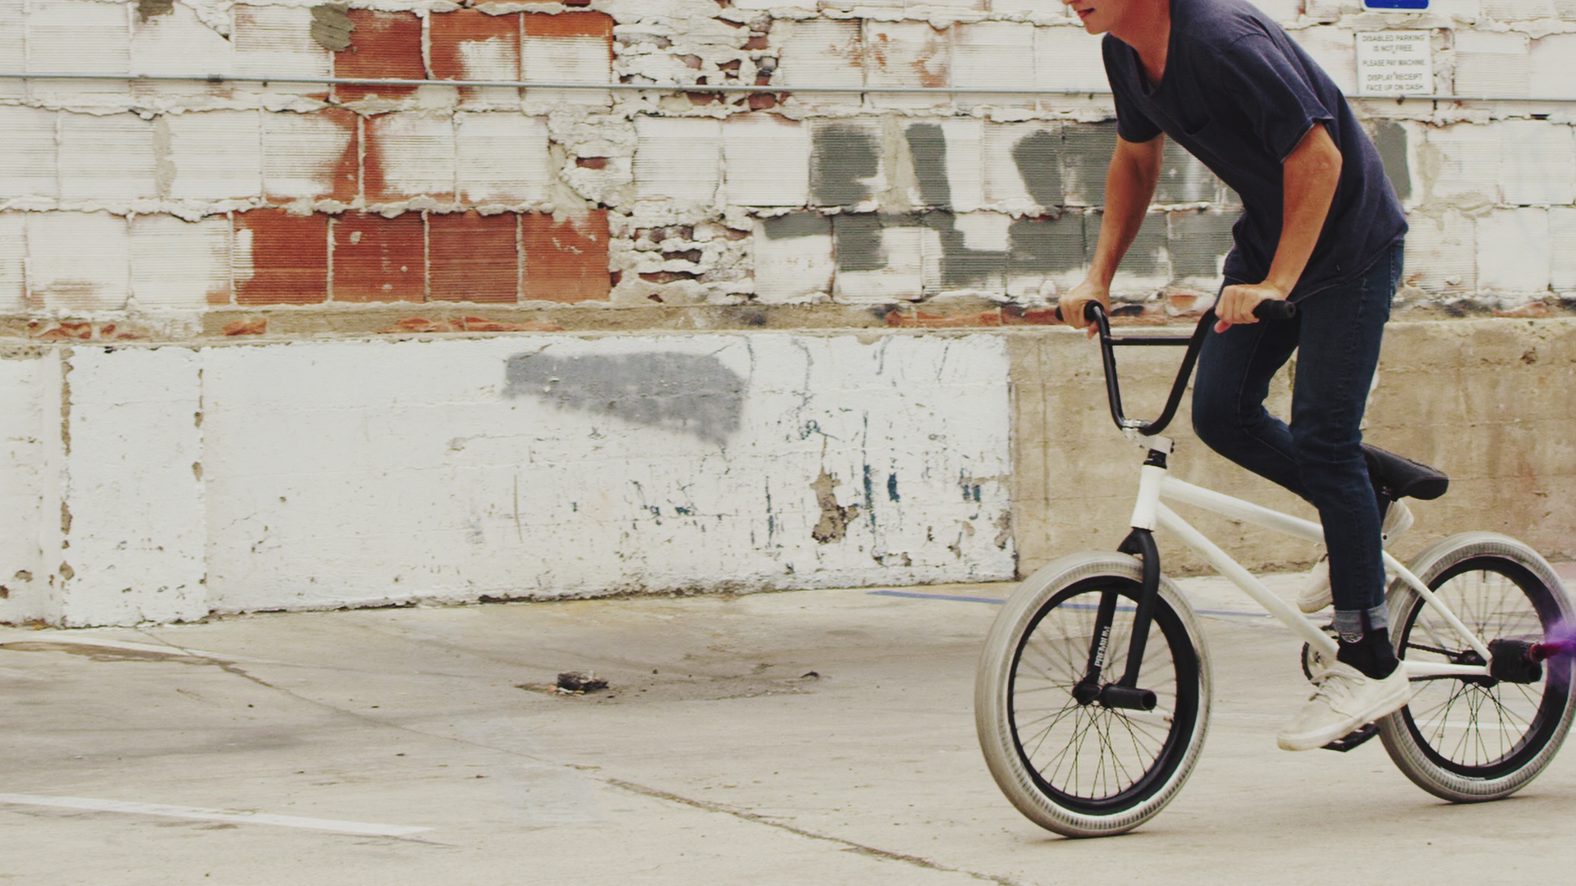

KIDS THESE DAYS
BROUGHT TO YOU BY:

Slide 2
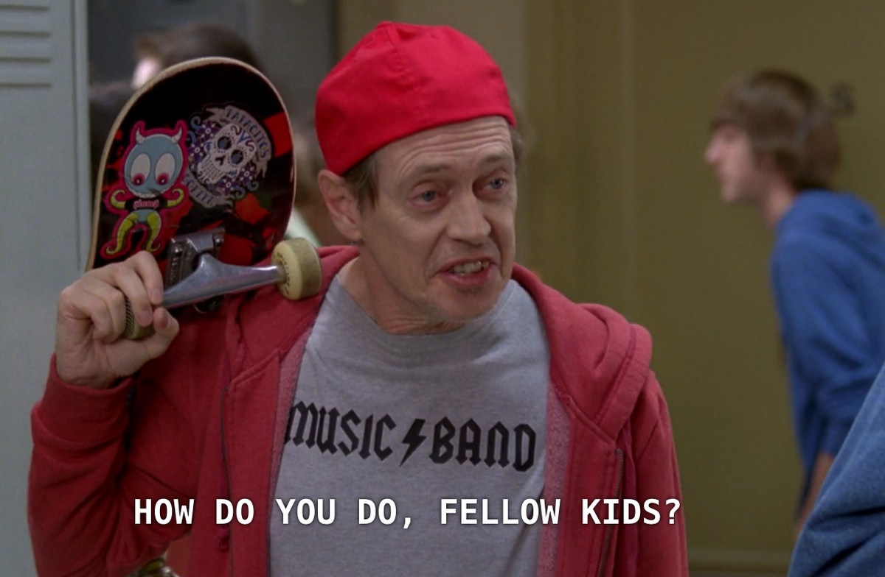
#KIDSTHESEDAYS

Slide 3







#KIDSTHESEDAYS
BABY BOOMERS
GENERATION X
GENERATION Y
GENERATION Z
GENERATION ALPHA
GREATEST GENERATION
GREAT-GRANDPARENTS
GRANDPARENTS
PARENTS
OLDER SIBLINGS
YOUNGER SIBLINGS
AGED 71+
AGED 52-70
AGED 37-51
AGED 22-36
AGED 7-21
AGED >7

Slide 4
#KIDSTHESEDAYS
Generation Y
Generation Z
Raised by Baby Boomers
Grew up during an economic boom
Tend to be idealistic
Mobile pioneers
Prefer brands that share their values
Prefer Facebook and Instagram
Raised by Gen Xers
Grew up during a recession
Tend to be pragmatic
Mobile natives
Prefer brands that feel authentic
Prefer Snapchat and Instagram Stories
GENERATION Y
GENERATION Z

Slide 5
#KIDSTHESEDAYS
BABY BOOMERS
GENERATION X
GENERATION Y
GENERATION Z
GENERATION ALPHA
GREATEST GENERATION

Slide 6
#KIDSTHESEDAYS
Born into survivors
Conservative
“Fixers”
GENERATION Z
GREATEST GENERATION

Slide 7


#KIDSTHESEDAYS
RESEARCH METHODOLOGY
  WHO WE SPOKE TO
ADULTS 18+ COMPARISON
! ATTENTION !
  12-17 year olds
  300 respondents quant
  12 respondents qual
  Mindshare Day in the Life Of research (DILO)
  Running since 2012
  25 media activities
  Reach/time spent
  Time of the day
  Multi-screening

Slide 8

#KIDSTHESEDAYS
TV is not dead

Slide 9

TEENAGERS: DAILY MEDIA REACH
WHAT IS THE TOP REACHING MEDIUM
FOR 12-17 YEAR OLDS?
Which of the following activities did you do yesterday? N=300

Slide 10
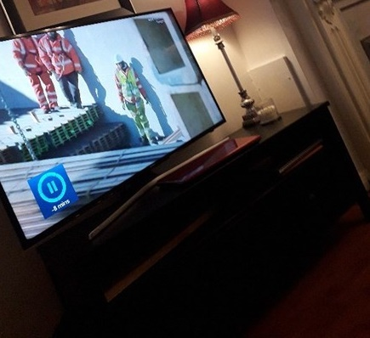


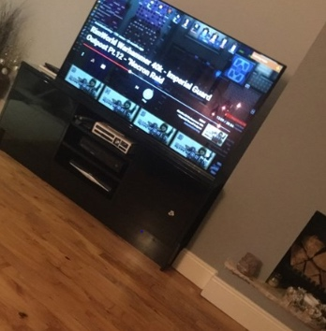
#KIDSTHESEDAYS
TV IS A SHARED EXPERIENCE
“I just watch whatever’s on I don’t really mind I just like sitting with my family.”
They watch TV with their families, their dog, with a cup of tea on tablets etc.

Slide 11

AV – SHARE OF VIEWING
HERO SLIDE
#KIDSTHESEDAYS
18+
ADULTS
TEENS
241
daily mins spent watching AV content
211
daily mins spent watching AV content

Slide 12
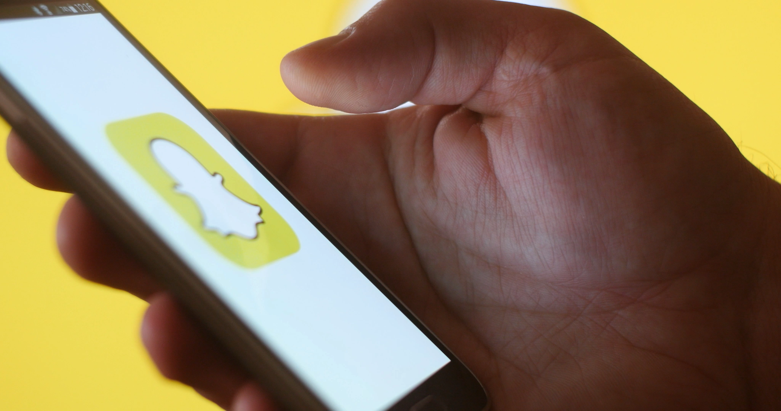
#KIDSTHESEDAYS
TV is not dead
It’s competing with Snapchat for attention

Slide 13
#KIDSTHESEDAYS
TOP TV MULTI-SCREENING ACTIVITIES
86%
OF TEENS
MULTISCREEN YESTERDAY
65%
OF ADULTS 18+
MULTISCREEN
YESTERDAY
VS.

Slide 14

TEENAGERS: DAILY MEDIA REACH
WHAT IS THE TOP REACHING MEDIUM
FOR 12-17 YEAR OLDS?
Which of the following activities did you do yesterday? N=300

Slide 15
Social Media hour by hour – all adults 18+
SOCIAL MEDIA CONSUMPTION HAS BEEN DOMINATED BY FACEBOOK
When you used [social media channel] yesterday, please select the time you did so? N=2110

Slide 16
Social Media hour by hour – all adults 18+
SOCIAL MEDIA CONSUMPTION HAS BEEN DOMINATED BY FACEBOOK
When you used [social media channel] yesterday, please select the time you did so? N=2110

Slide 17
#KIDSTHESEDAYS
SNAPCHAT
IS THE NUMBER ONE WAY TO STAY IN TOUCH WITH FRIENDS
SNAPCHAT & INSTAGRAM CONTROLS THE NEWS THEY HEAR
  Important things usually show up on my Instagram or Snapchat

Slide 18

Curation Generation
#KIDSTHESEDAYS

Slide 19

AUDIO – SHARE OF LISTENING
#KIDSTHESEDAYS
TEENS
18+ ADULTS
132
daily mins spent listening
across radio and streaming
102
daily mins spent listening
across radio and streaming

Slide 20
#KIDSTHESEDAYS
RADIO & MUSIC STREAMING
BY TIME OF THE DAY

Slide 21

#KIDSTHESEDAYS
KEY TAKEAWAYS
Align to Gen Z’s attitudes as pragmatic people who value authenticity above all else
TV is not dead and attention is on Snapchat and music streaming
The opportunity to target teenagers is open and will continue to be in the future

Slide 22
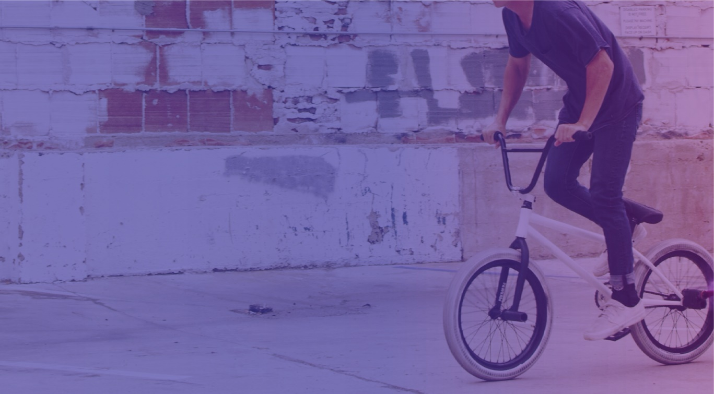
#KIDSTHESEDAYS
FOR THE FULL RESEARCH STUDY
EIMEAR MCGRATH
Research Director
Mindshare Ireland
eimear.mcgrath@mindshareworld.com

