Slide 1
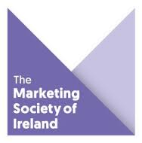
Applying Behavioural Science
23rd May 2019

Slide 2
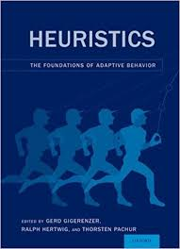
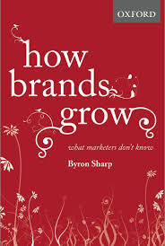
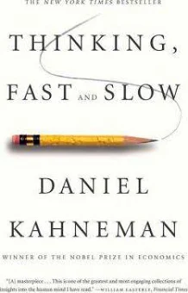
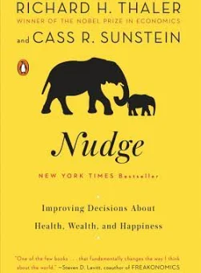
The Science Behind System 1 Decision Making – Behavioural Economics
How do people make decisions in the real world?
Behavioural economist Gerd Gigerenzer says that humans make “fast and frugal” decisions to arrive at “good enough” choices.
How do we know which choices are good enough? Not by careful comparison. Instead we use heuristics, or mental shortcuts. In 2003, Daniel Kahneman identified “baseline” heuristics involved in nearly every human decision.

Slide 3

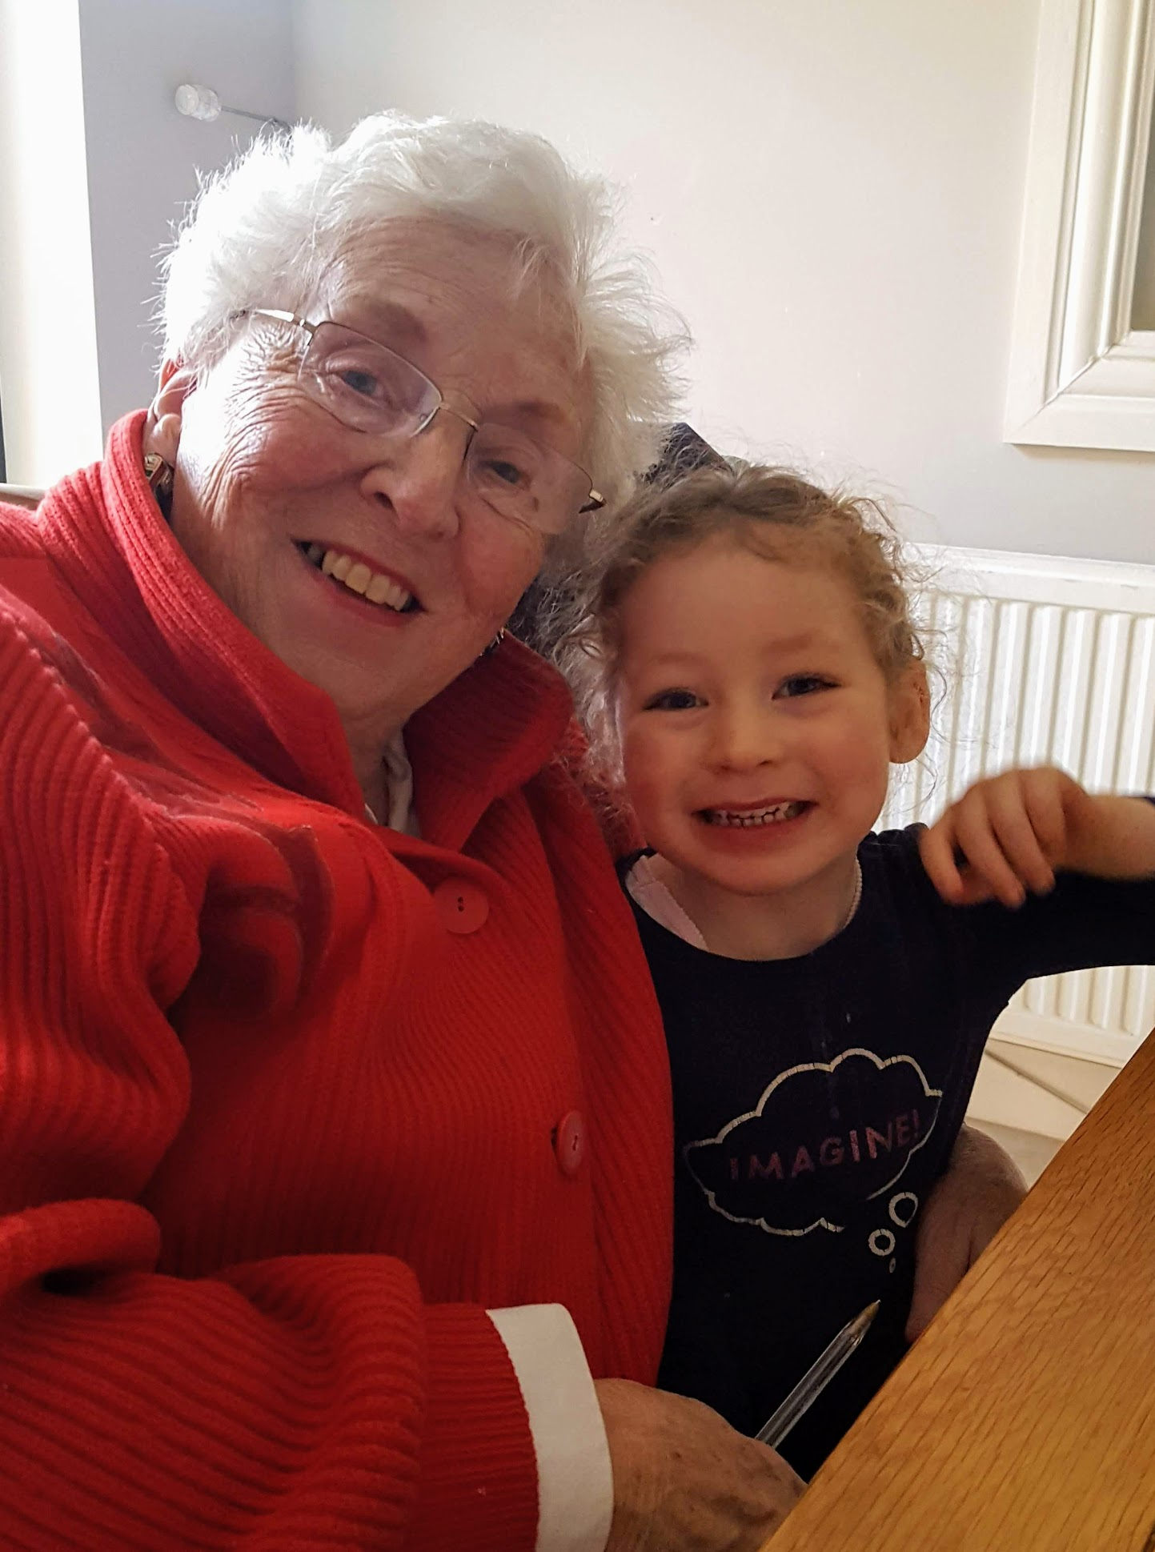
Rational versus Irrational

Slide 4









Some Findings…
Consumers move from being highly reflective to highly intuitive by age – more life experience, less time/motivation for reflection, etc.
Lifestage

Slide 5

We think much less than we think we think
How do people make decisions in the real world?
Behavioural economist Gerd Gigerenzer says that humans make “fast and frugal” decisions to arrive at “good enough” choices.

Slide 6
System 1 Brand Tracking Measures – Three baseline Heuristics
The Availability Heuristic
Choices need to be mentally available.
The Processing Heuristic
The most likely choices are those processed with minimum effort.
The Affect Heuristic
Positive emotion makes choices easier and faster.
Recall – or mental availability.
If a brand is easily recalled in context, it’s a good choice.
Recognition – Ease of processing. The most likely choices are those processed with minimum effort.
If a brand is easily recognised, it’s a good choice
Reaction - Brand Valance or Affection. This is a positive emotional connection at a basic brand level.
If a brand has a strong emotional connection, it’s a good choice.

Slide 7
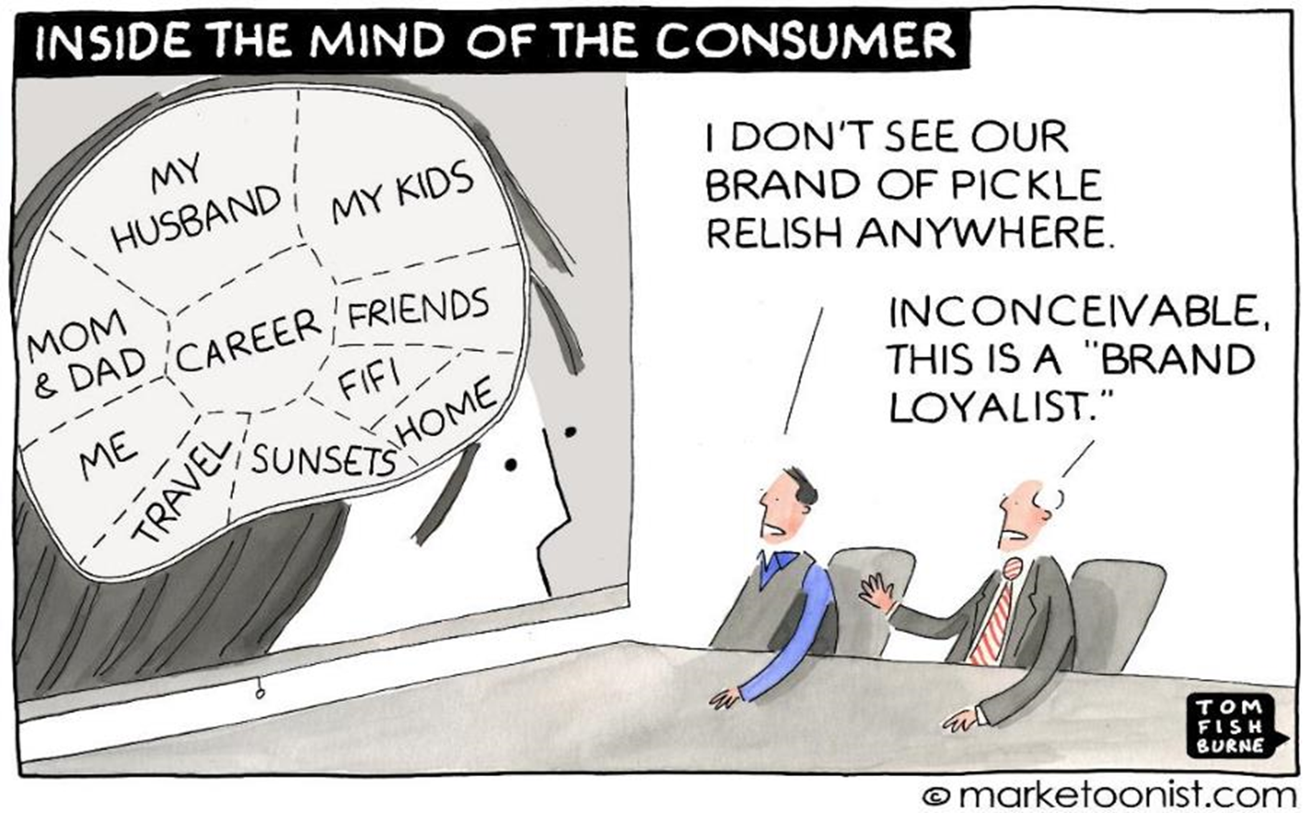
Recall

Slide 8
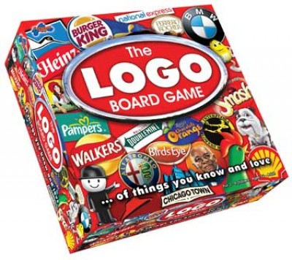
Recognition – brand collateral

Slide 10
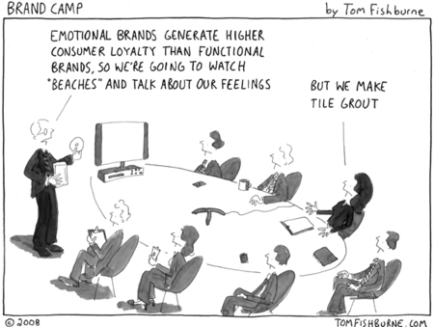
Reaction – a positive emotional connection

Slide 11

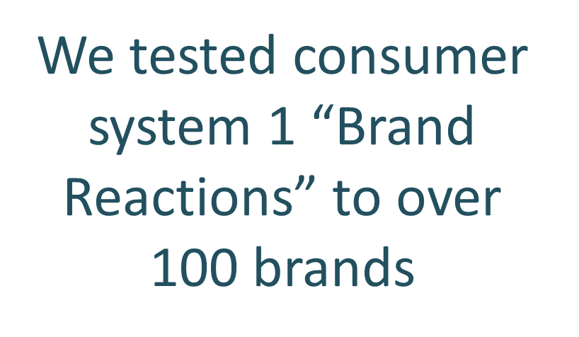
The Brand Reaction Index

Slide 12
Three Key Indices Emerge
1
2
3
Happiness
Net positive
Any Reaction
The proportion of consumers that instinctively have a “happy” emotional reaction when they see a brand
The net proportion of consumers that instinctively have a “positive” vs. a “negative” emotional reaction when they see a brand
The proportion of consumers that instinctively have a ANY reaction to a brand when shown it

Slide 13

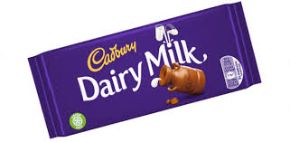
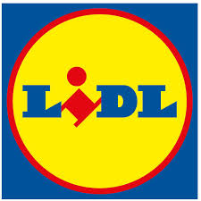








BRI – The Top Ten Brands
#1
65%
#2
64%
#3
63%
#4
52%
#5
51%
#6
43%
#7=
42%
#7=
42%
#7=
42%
#10=
39%
#10=
39%

Slide 14
The Index of Brands with the best System 1 Brand Reaction
TOP 10 BRI Brands
11-19 Ranked BRI Brands
 |  | Happiness Score | NET BRI Index Score | Total Reaction Score
1 | Aldi | 69% | 65% | 76%
2 | Cadbury Dairy Milk | 71% | 64% | 83%
3 | Lidl | 71% | 63% | 82%
4 | Netflix | 59% | 52% | 70%
5 | Boots | 54% | 51% | 60%
6 | Google | 56% | 43% | 71%
7 | Aer Lingus | 56% | 42% | 66%
7 | Twix | 52% | 42% | 68%
7 | Samsung | 48% | 42% | 59%
10 | Dublin Airport | 54% | 39% | 71%
10 | SuperValu | 51% | 39% | 66%
 |  | Happiness Score | NET BRI Index Score | Total Reaction Score
12 | Tesco | 49% | 37% | 63%
12 | M & M's | 46% | 37% | 61%
13 | Toyota | 41% | 35% | 50%
14 | 7Up | 46% | 34% | 62%
14 | Amazon | 48% | 34% | 68%
16 | Dunnes | 44% | 31% | 58%
16 | Marks & Spencer | 42% | 31% | 57%
16 | IRFU | 44% | 31% | 59%
19 | BBC | 43% | 30% | 58%

Slide 15
Brand Reaction Map - Supermarkets
DRIVE POSTIVE EMOTIONAL CONNECTIONS
STRONG POSITION FOR GROWTH
Total Emotional Reaction
Concept Strength (CS)
NET Positive Emotional Reaction
LOW AND NEGATIVE REACTION
POSTIVE BUT NEED TO PUSH HARDER

Slide 16
Brand Reaction Map
DRIVE POSTIVE EMOTIONAL CONNECTIONS
STRONG POSITION FOR GROWTH
Total Emotional Reaction
Concept Strength (CS)
NET Positive Emotional Reaction
LOW AND NEGATIVE REACTION
POSTIVE BUT NEED TO PUSH HARDER

Slide 17
