Slide 1
Have we hit peak retail?
Marketing Society
Cormac Long
Head of Insights & Information
Tesco Ireland

Slide 2
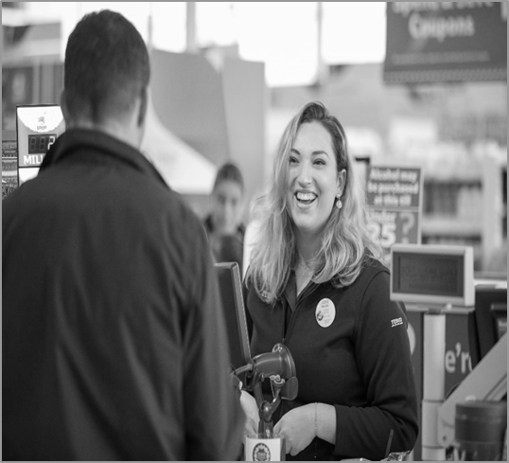
Content
WHERE WE ARE TODAY
WHAT THE FUTURE LOOKS LIKE
HOW WILL WE GET THERE

Slide 3
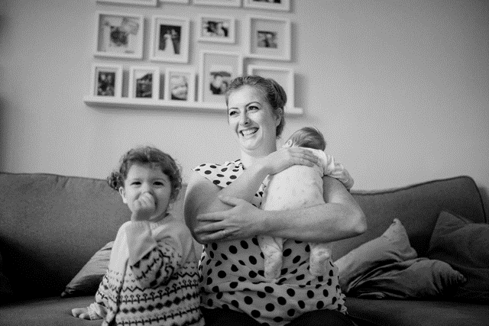
The current environment provides a strong growth platform
1.1%
Consumer price
index
March 2019
4.3%
Residential
Property Index
February 2019
5.4%
Monthly
Unemployment
rate
March 2019
2.1%
Retail
Sales index
February 2019
6.7%
Real GDP
2018 (prelim)
4.86m
Population
April 2018
Source: CSO

Slide 4
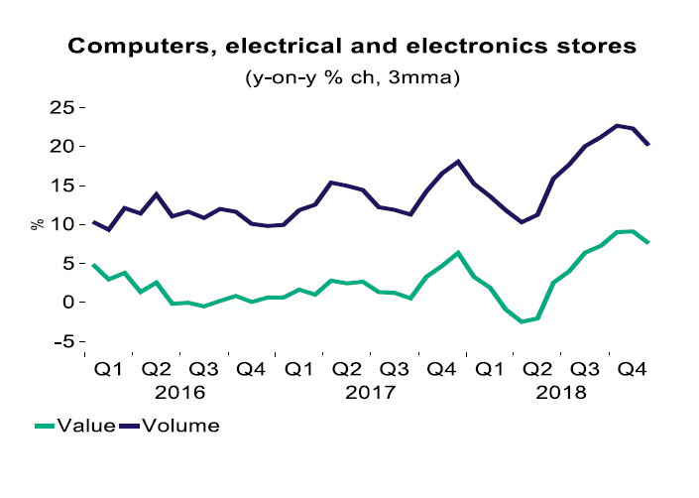
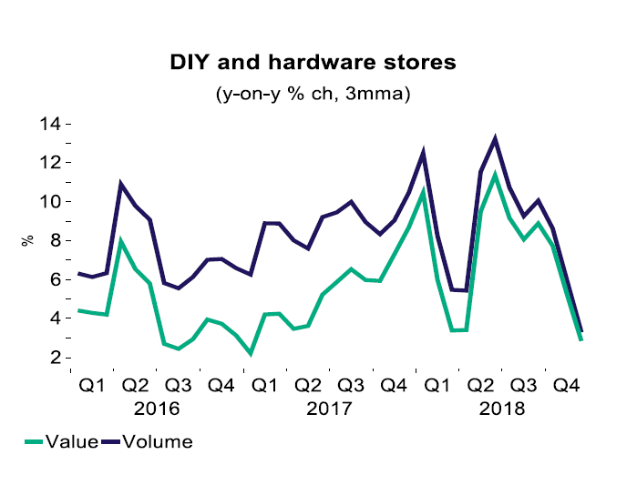
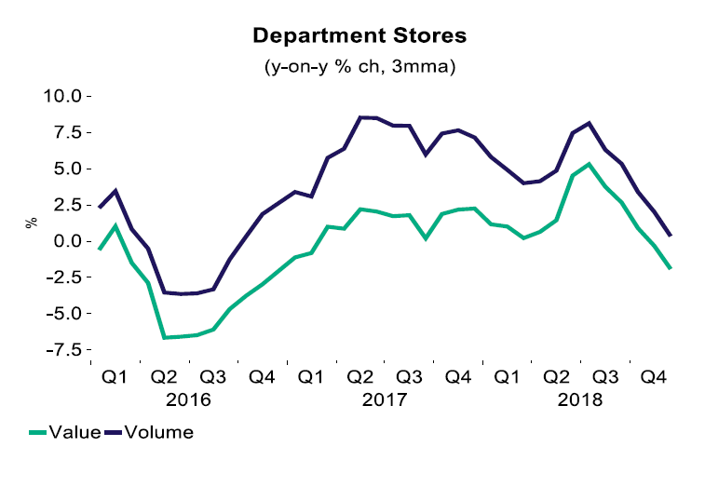
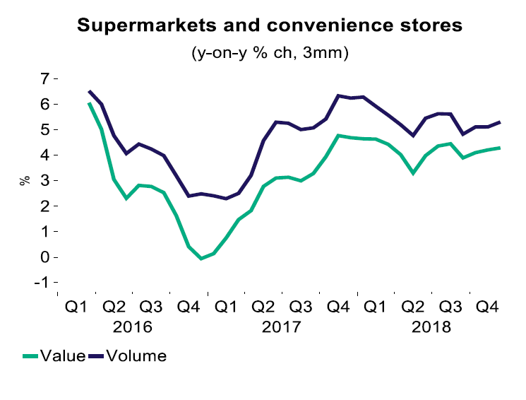
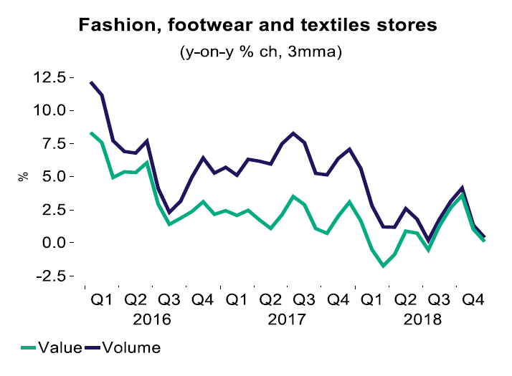
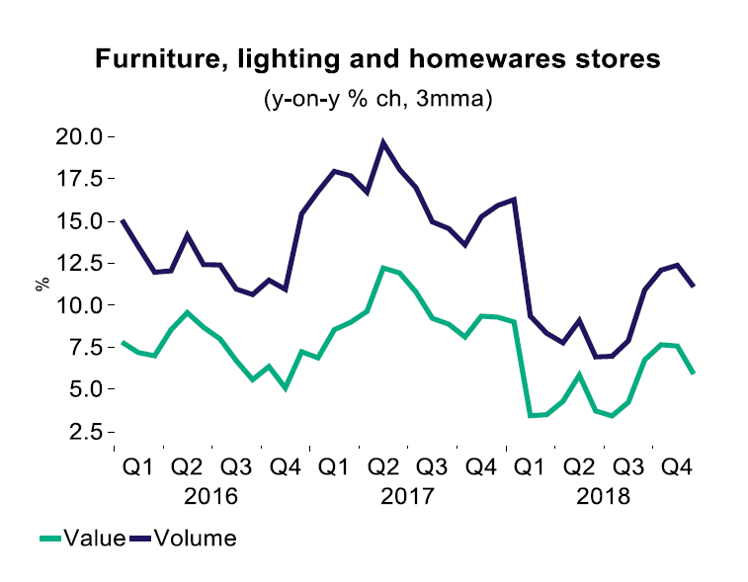
The current environment provides a platform for growth
However each part of retail has its own challenges
Source: Retail Ireland Q4 Monitor

Slide 5
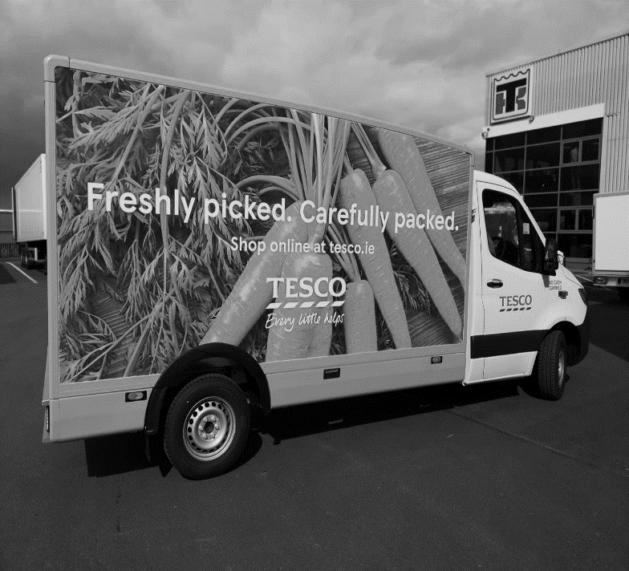
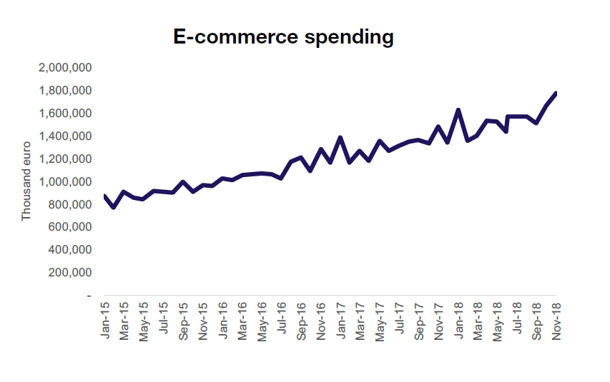
eCommerce is affecting each retail sector
Source: Retail Ireland Q4 Monitor

Slide 6
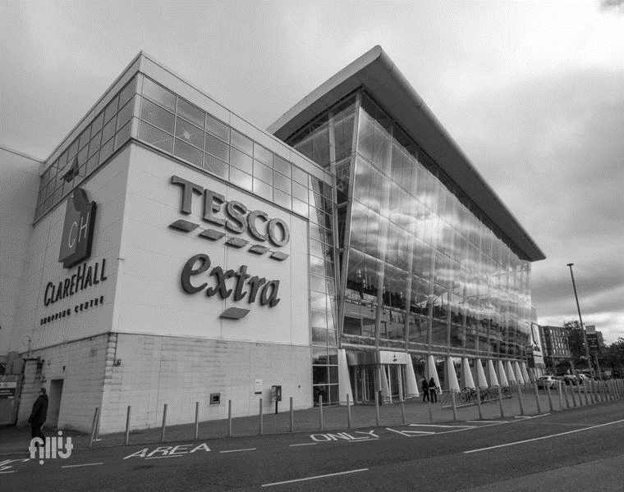
4.8m live in Ireland
37% live in GDA
By 2031
5.8m will live in Ireland
43% will live in GDA
By 2050
6.3m will live in Ireland
Source: CSO

Slide 7
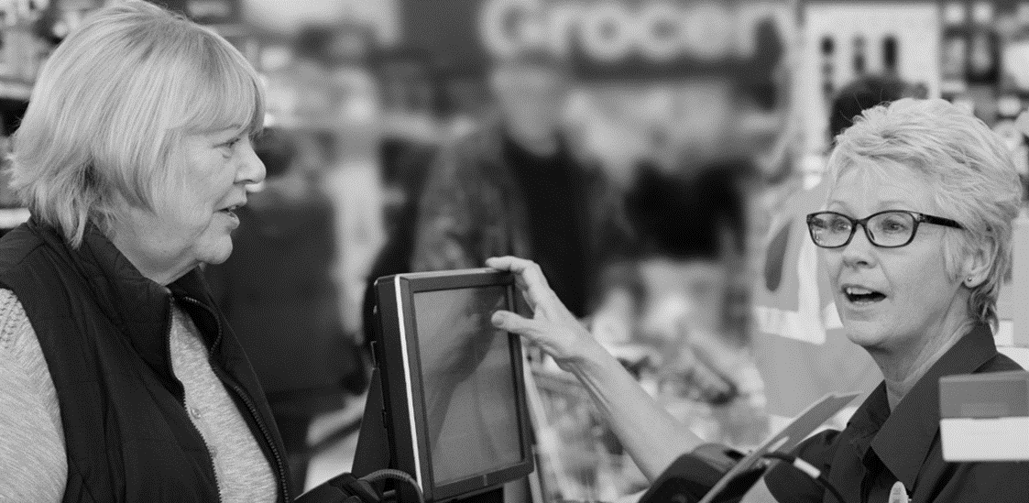
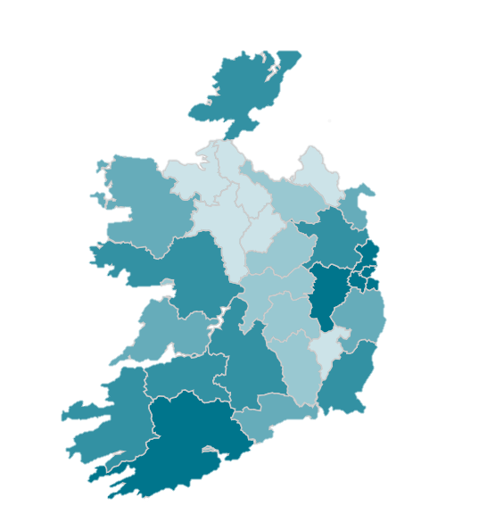
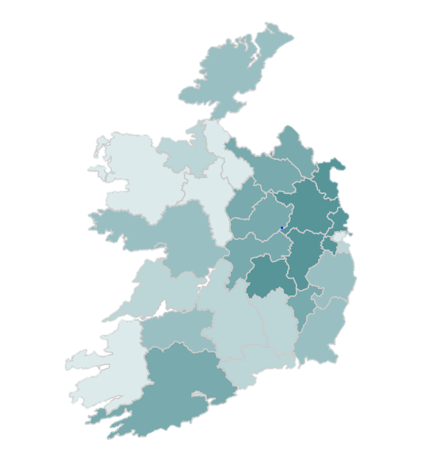
Not only will more people live in the GDA they will be younger
Source: CSO

Slide 8
50% OF GLOBAL POPULATION LIVES IN CITIES TODAY
80% OF GLOBAL GDP COMES FROM CITIES TODAY
60% OF GLOBAL POPULATION WILL LIVE IN CITIES BY 2030

Slide 9
HOW DO WE GET THERE
A CORE PURPOSE
A CLEAR Ambition A RELENTLESS focus on your customers
PASSIONATE PEOPLE ALIGNED MEASUREMENT

Slide 10
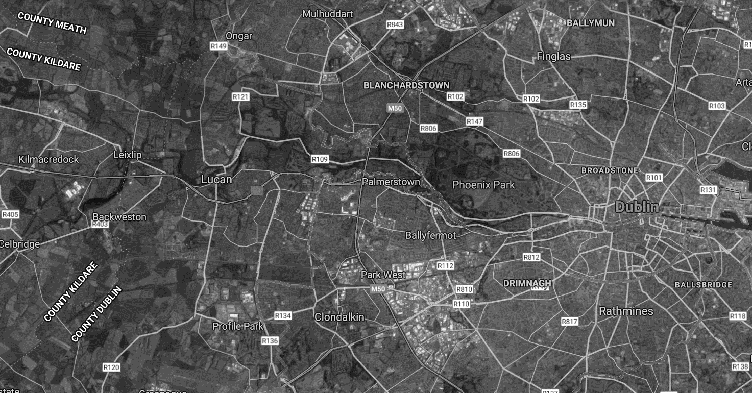
SOCIAL/ MEDIA
CLICK & COLLECT
HOME SHOPPING
PREMIUM PRODUCT EXPERIENCES
CONVENIENCE
OUT OF TOWN LARGE STORES
COLLEAGUES
SUBURBAN STORES

Slide 11
Thank you.

