Slide 1
NOT ALL REACH IS EQUAL
Professor Karen Nelson-Field

Slide 3



































Research
integrated into
Research reported in
Speaker for

Slide 4
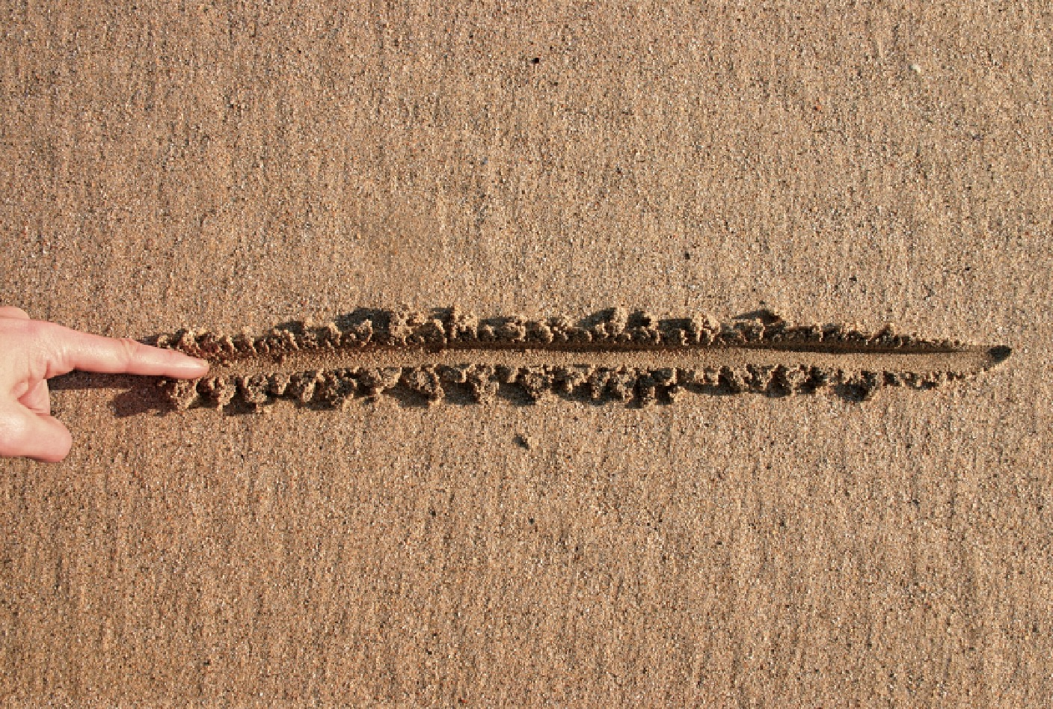
We were commissioned to
Re-Establish the Media Baseline.
Underpinned by independence, rigour, credibility, forward thinking.

Slide 5
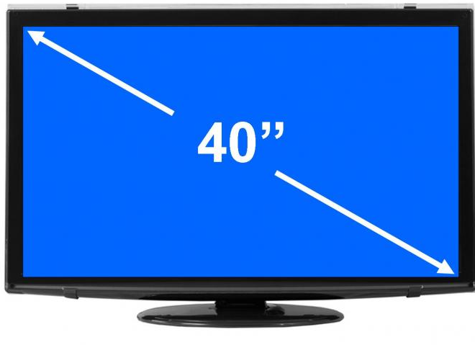

Phase 1: Tested cross platform performance
against ATTRIBUTES that matter
CUT THROUGH
Via Attention
MEMORABILITY
Via Product Choice
Notes:
Brand growth 101 - Advertising needs to cut through and be remembered to be thought of at the purchase occasion.
And good media supports these two very simple, but very important conditions
In the last 12 months we have considered just how TV, Facebook and YouTube perform under these conditions – using some pretty cool tech along the way

Slide 6


TRANCHE 1
Natural Viewing – NO Lab – Same Ads - Passive – Single Source - Sales and Attention.
Notes:
22 GROUPS
5000 VIEWER SESSIONS
MORE THAN 50’000 TEST AD EXPOSURES
1: APP
2: Test & Control Groups
3: Choice
4: Analytics & ML Framework

Slide 7
Which platform commands the most
ATTENTION
Notes:
We started by considering Attention as a measure of cut through.

Slide 8



In an average ad second TV commands 58% ATTENTION
 | OVERALL AVERAGE | Active Viewing | Passive Viewing | NON- Viewing
 | 58 | 58 | 40 | 2
 | 45 | 31 | 37 | 32
 | 20 | 4 | 94 | 2
TV gets twice the active viewing as YouTube and 15x Facebook.
Passive plays a role, but not as much as active
Notes:
We released these results

Slide 9
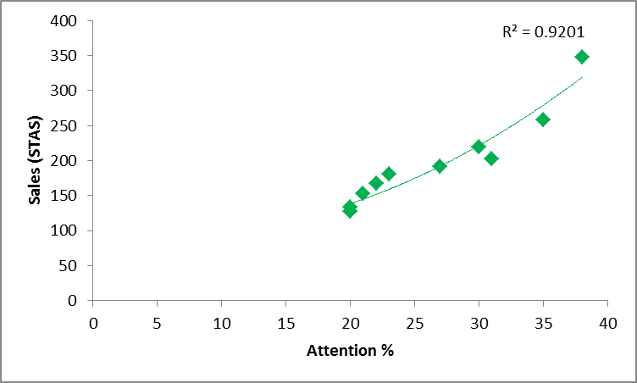
Our two measures of impact are related - ATTENTION & PRODUCT CHOICE
Consistent across ALL sets of data (8)
Sig. sameness renders greater predictive value.

Slide 10
What does this mean for
PRODUCT CHOICE

Slide 11
Discrete Choice and STAS; a powerful combination.
Both Gold Standard (empirically) in their own right.
Discrete Choice Modelling
A choice of competitive products (controlling for price)
Short. Term. Advertising. Strength
Did Buy and Exposed / Did Buy and Not Exposed
 | Not Exposed | Exposed
Did Buy | 36% | 42%
Did NOT Buy | 64% | 58%
Total | 100% | 100%
STAS | 42/36*100 = 117
i.e. Exposure to this ad drove 17% more sales, than not seeing the ad at all
Notes:
We have also used regression modelling and mental availability measures

Slide 12

No surprises, TV drives more overall attention
AND more SALES
 | Product Choice (STAS – index exposed did buy/not exposed did buy)
TV | 144
Facebook | 118*
YouTube | 116
*Passive attention does nudge sales, but less so than active
Notes:
Subconscious processing

Slide 13

Hang on…..
“but mobile is the optimal platform for Facebook”
…..we listened
Notes:
Our Response - "If Facebook and YouTube display greater visibility on Mobile, then YES, STAS and Attention could be improved over what these platform achieve on a PC, but is it enough of an improvement to outperform TV?"

Slide 14
TRANCHE 2a - Mobile
Notes:
22 GROUPS
5000 VIEWER SESSIONS
MORE THAN 50’000 TEST AD EXPOSURES
1: APP
2: Test & Control Groups
3: Choice
4: Analytics & ML Framework

Slide 15
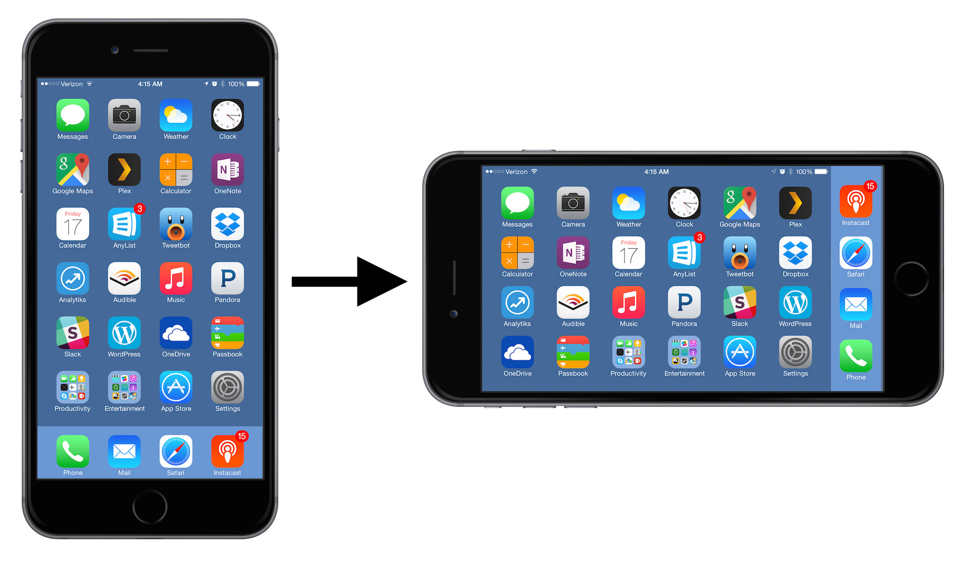
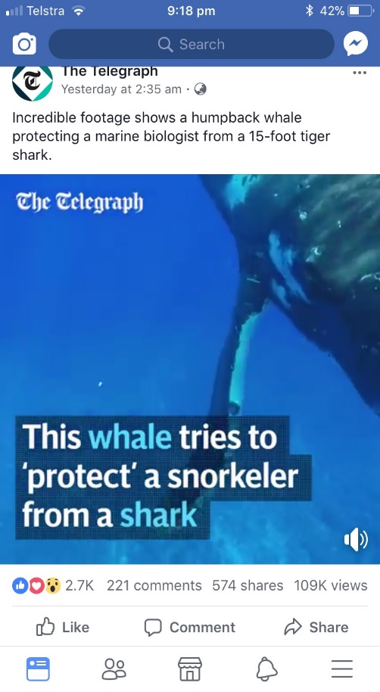
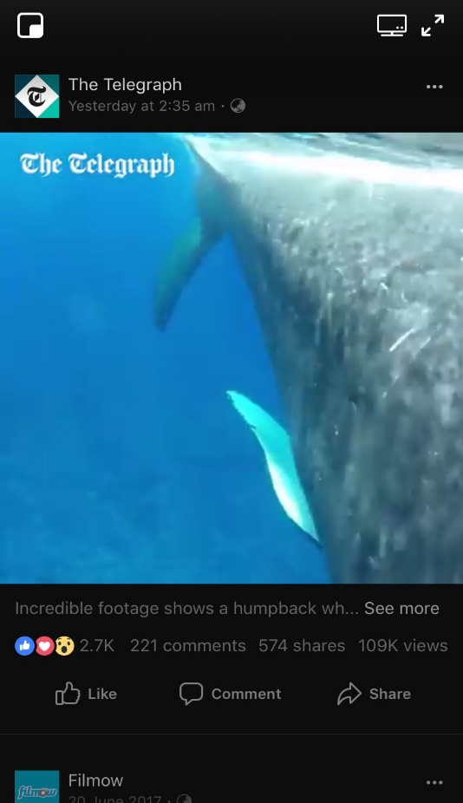
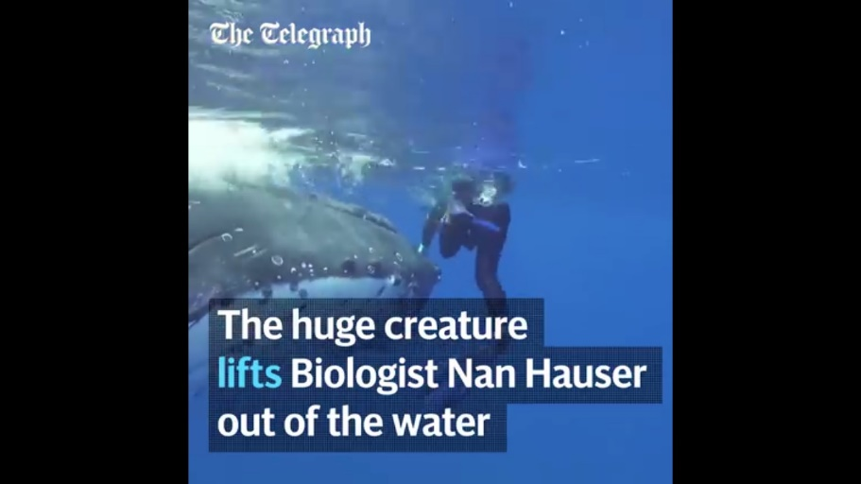
And YES, the viewability software AND the attention model was optimized for viewing orientation.

Slide 16




STAS does increase on Mobile, but does so for ALL platforms.
 | 144 | 153 | 161
 |  | 118 | 121
 |  | 116 | 137
Small screens deliver more sales for all platforms, INCLUDING TV.
TVs lowest STAS device still outperforms the best of online (YT mobile 137).

Slide 17
People pay more attention to Mobile generally, TV still commands the greatest attention.
 | 58 | 39 | 63
 | - | 20 | 54
 | - | 45 | 44
All of the smaller screens get more passive attention, which is worth more to sales on smaller devices.

Slide 18
Why does ATTENTION vary between platforms?
Put another way, what is different about FACEBOOK and YOUTUBE that drives impact down?

Slide 19

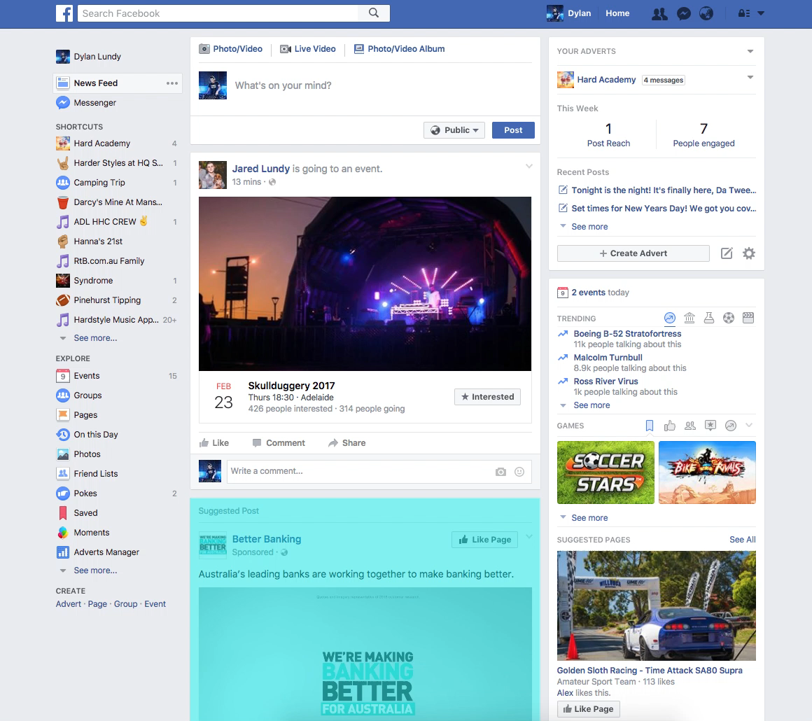
COVERAGE – % of screen that the ad covers
Via AD TAGGING TECHNOLOGY
All devices, all platforms

Slide 20
How does COVERAGE, an artefact of clutter, impact ATTENTION?
Notes:
How does coverage, as an artefact of clutter, impact attention ?

Slide 21
Firstly, Avg. COVERAGE by media type and device varies – a lot.
 | 100% | 100% | 100%
 | - | 10% | 27%
 | - | 30% | 32%
Coverage is better on mobile
TV screen coverage is about 3x YouTube and Facebook on mobile
This means, most online ads are NOT viewed in full horizontal screen view

Slide 22
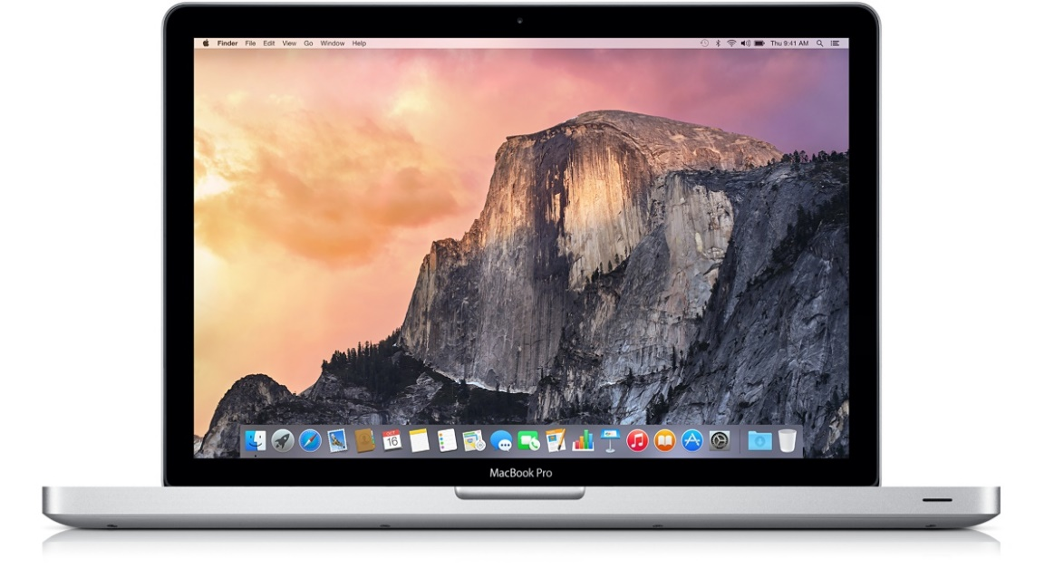

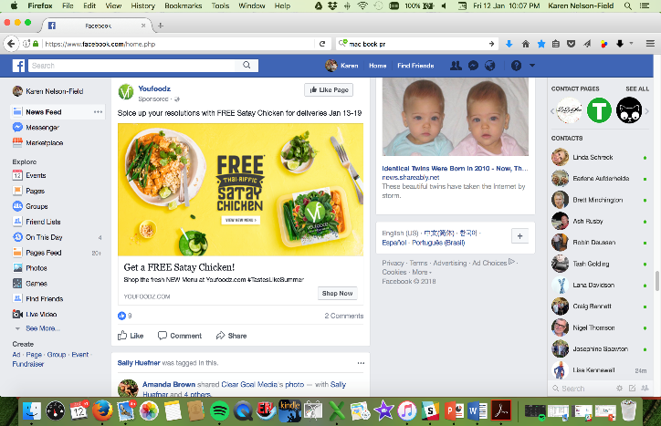
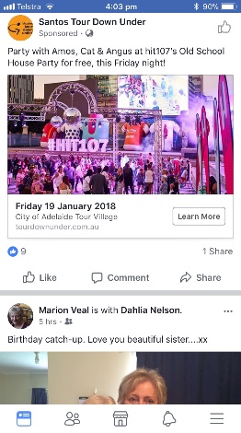

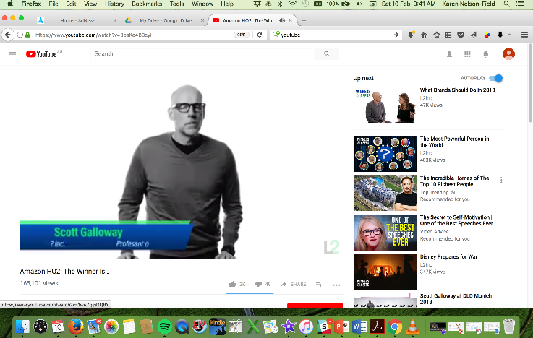
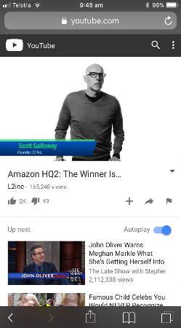
Makes Sense.
Ad real estate differs significantly by device

Slide 23
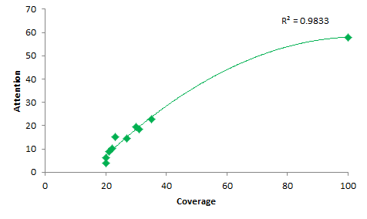
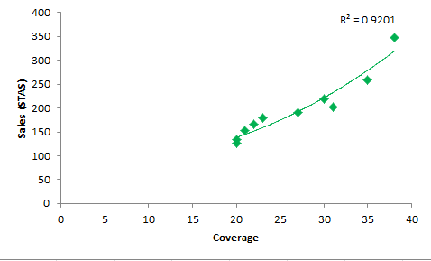
COVERAGE MATTERS to attention and sales
VERY strong relationship - Coverage & Sales, Coverage & Attention

Slide 24
HANG
ON
If COVERAGE is so vital, could the viewability standard be fostering underperformance in online?

Slide 25

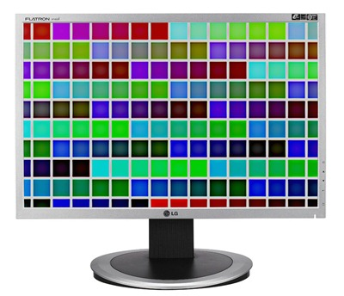
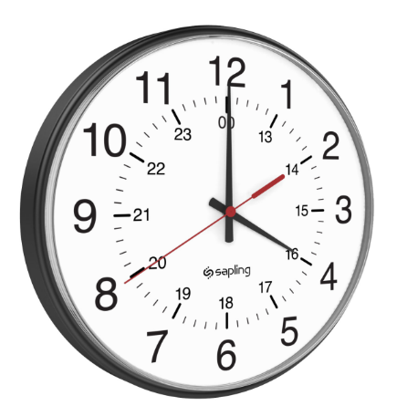
Viewability Standard
50% PIXELS and
2 CONTINUOUS SECONDS OF TIME
(in that order)

Slide 26
PIXELS and TIME (and coverage)
We considered relationship between pixels, time, attention and sales.

Slide 27
Firstly, Avg. PIXELS by media type and device also varies – a lot.
 | 100% | 100% | 100%
 | - | 51% | 58%
 | - | 66% | 82%
Pixels are also better on mobile, in line with attention and STAS

Slide 28


The minimum standard does render an impact, but..
Pixels are especially important for Facebook given the shorter (than YT) view time
Current Standard
Current Standard
PIXELS
50%
100%
10%
PIXELS
50%
100%
10%
There is material uplift in sales above 50% pixels
and 2 seconds
Pixels matter more. 100% pixels always 2x impact over 50%, regardless of time
Notes:
Relationship between Viewability (Seconds & Pixels) and Sales Impact

Slide 29
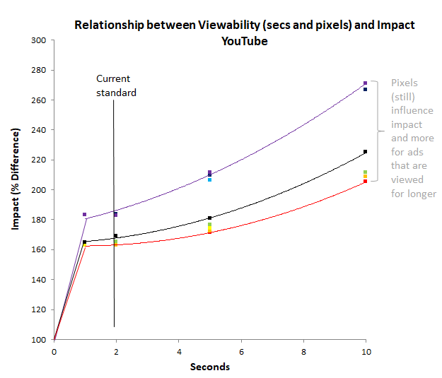
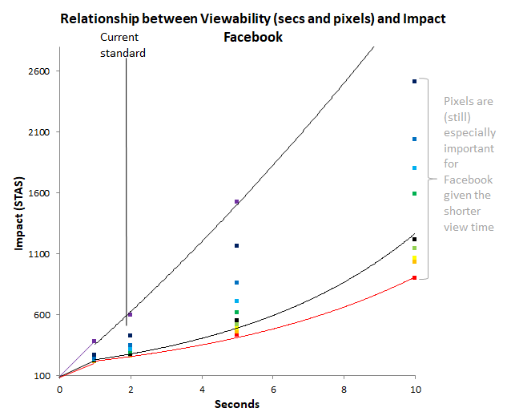
VIEWABILITY patterns hold (curve same shape)
We STILL see a material uplift after 50% pixels and 2 seconds.
Means anything less that 100%, 100% of the time diminishes return.

Slide 30
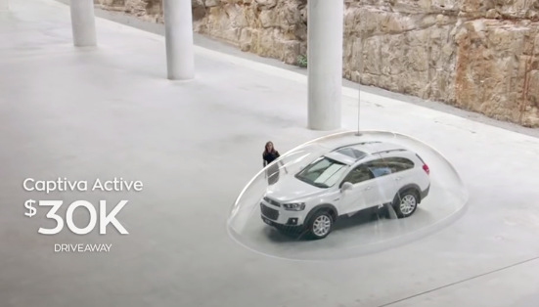
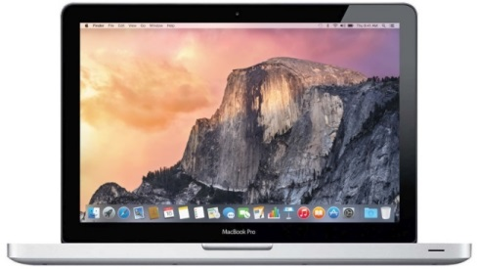



PLUS as pixels approach their limit of possibility, coverage becomes more vital.
100% pixels playing full screen, has a greater impact than 100% pixels covering a smaller proportion of the screen.

Slide 31
We Know There is Performance Upside Beyond the Current Standard.
And brand owners should fight
for pixels over time.
Notes:
30% less stas
1.5X faster decay

Slide 32

VISIBILITY is KING

Slide 33

But short term memory is one thing, does this translate to the long term?
The degree to which impact erodes with time.
Notes:
But everything we did last year considered short term impact.
Long term affects are important because not all people are ready to buy right then and there, when an ad hits them.
So being remembered for longer means that the ad could still nudge a purchase long after someone has seen the ad.

Slide 34
STAS is built to capture short term effects, but is noted as capable of capturing impact up to a month after exposure.
Day 1 View and Choice
Same People
14 Day Choice
Same People
28 Day Choice
TV on TV _ TV on Mobile _ BVOD on Mobile _ TV on PC _ FB on Mobile _ YT on Mobile
Notes:
TV on TV and TV on Mobile exactly the same STAS

Slide 35
Which platform offers advertisers the slowest rate of DECAY?

Slide 36
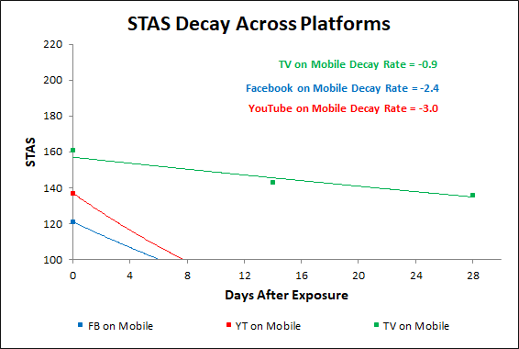
The length of time that an ad on TV (mobile) continues to impact sales, far exceeds that of either FB or YT (mobile).
Impact is greatest immediately after exposure, but then declines as time passes. A steeper slope (bigger number) shows a more rapid loss of impact.
FB decays 2.5x and YT decays 3x faster than TV.
TV ad retention is so strong that it generates a greater impact at 28 days than FB and YT do immediately after exposure.

Slide 37
TV on Mobile stays in memory for longer (consistent with Field and Binet).
Group | Initial STAS | Zero impact point (# days) | Decay Rate (slope)
TV on Mobile (OTT) | 161 | 66 | -0.9
Facebook Mobile | 121 | 6 | -2.4
YouTube Mobile | 137 | 8 | -3.0
Online :TV | 1 : 2.1 | 1 day : 9 days | 1 : 0.4
For every 1 Online STAS point (above baseline), TV delivers 2.1
TV takes 9 times longer to decay to zero impact point than Online
(66 days cf 7days)
Notes:
When we look at it a different way

Slide 38
Again device does play a role.
TV screen is the best device for impact longevity.
Group | Initial STAS | # days until no more impact | Decay Rate (slope)
TV on TV Screen | 144 | 109 | -0.4
TV Mobile | 161 | 66 | -0.9
Facebook Mobile | 121 | 6 | -2.4
YouTube Mobile | 137 | 8 | -3.0
Put another way, the TV Screen remains the strongest in memory.
TV on TV takes 109 days to have no impact.
That’s 103 days longer in memory than Facebook on Mobile and 99 days longer than YouTube on Mobile.

Slide 39
The DOUBLE JEOPARDY
in decay
“
Overall TV gains in two ways.
It starts from a higher STAS
and it decays slower.
High STAS upfront is at least as important as the decay rate.
Notes:
High STAS is important

Slide 40

    But what happens in a multi-platform buy?
    Investigating the impact of sales from repetitive exposure across two platforms

Slide 41

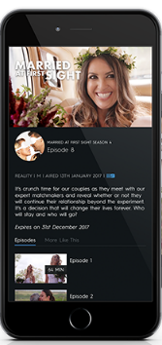
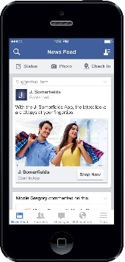
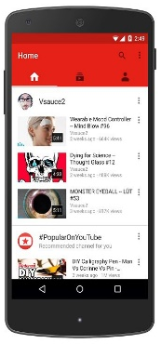
100% natural exposure, this time with a second view (same day).
BVOD
Facebook
YouTube
2-Platform
Sales Impact

Slide 42
If you split your campaign across 2 platforms, there is some evidence of synergy, BUT….
First View | Second View | Based on n choices | First Platform STAS
TV on TV | TV on BVOD | 1740 | 144
TV on TV | Facebook on Mobile | 2850 | 144
TV on TV | YouTube on Mobile | 3090 | 144
Second Platform STAS
164
121
137
Expected STAS
154
133
141
Actual STAS
172
135
130
Turns out a combination of TV+BVOD is best for highest combined STAS.
This combination more than 2x more sales impact.
Poorer performing platforms drag down the STAS that could have been achieved simply by one single exposure on TV.
Notes:
Directionally the same

Slide 43
Poorer performing platforms drag down the expected synergy effects.
“
Best to stick to the highest performing platforms for all reach points. Period.
Notes:
High STAS is important

Slide 44
    And then there is the question of how valuable the dual buy is to long term brand growth.
    Put another way, brand growth will be limited if this added reach skews away from light buyers.

Slide 45
Brand growth comes from nudging light buyers, not by attempting to increase loyalty.
Aligning to Dirichlet norms, bigger Media should deliver proportionally more light buyers.

Slide 46
But Facebook under deliver on light buyers relative to their size
Advertised Brands Usage
 | Claimed Penetration % | Light Buyers
Facebook | 85 | 38
TV | 73 | 40
YouTube | 70 | 39
Instagram | 52 | 37
Snapchat | 33 | 36
Facebook
Television
Instagram
Snapchat
YouTube
Notes:
Underperforms by 4 points

Slide 47

At a brand community level the buyer distribution is
much worse
Purchase concentration of Brand Fans (chocolate)
Notes:
Skewing heavy has big implications to brands
Brand Communities are suboptimal for brand growth

Slide 48

At a brand community level the buyer distribution is
much worse
Purchase concentration of Brand Followers (chocolate)
Notes:
Skewing heavy has big implications to brands
Brand Communities are suboptimal for brand growth

Slide 49

At a brand community level the buyer distribution is
much worse
Purchase concentration of Brand Followers (chocolate)
Notes:
Skewing heavy has big implications to brands
Brand Communities are suboptimal for brand growth

Slide 50

Skew of chocolate buyers on TV aligns to Dirichlet norms
Purchase concentration of Brand Buyers (chocolate)
Notes:
Skewing heavy has big implications to brands
Brand Communities are suboptimal for brand growth

Slide 51
The apparent advantages of gaining UNIQUE REACH due to high penetration can be
watered down by its reduced ability to deliver an appropriate proportion of the highly sought after light brand buyers.

Slide 52

This is Why Not All Reach is Equal

