Slide 1
Emotions and Fame remain most efficient
Source: IPA Databank, 2004-16 cases

Slide 2
Emotive audio-visual media build brands
Rational information
media
Emotive audio-visual
media
Source: IPA Databank 2008 - 2016

Slide 3

Emotional priming – Aldi UK

Slide 4
Aldi UK share growth

Slide 5
Powerful emotions drive long-term effectiveness
Advertising response metric | Correlation with long-term effectiveness
Hilarity | 34%
Exhilaration | 27%
Amazement | 25%
Happiness | 17%
Surprise | 14%
Warmth | 4%
Pride | 3%
ALL POSITIVE EMOTIONS | 22%
Better than before | 10%
Purchase intent | -4%
Knowledge | -7%
ALL COGNITIVE RESPONSES | -3%
But cognitive responses drive short-term sales activation

Slide 6
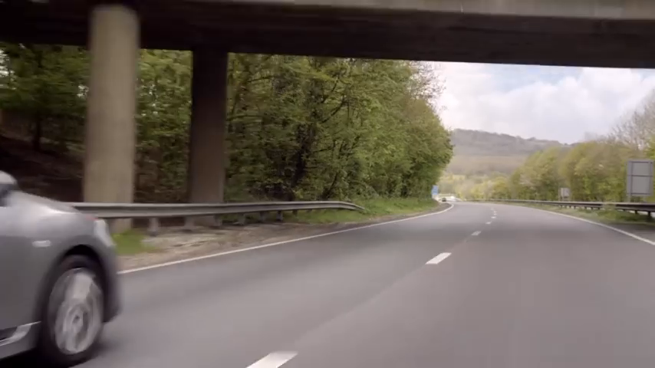
The AA

Slide 7
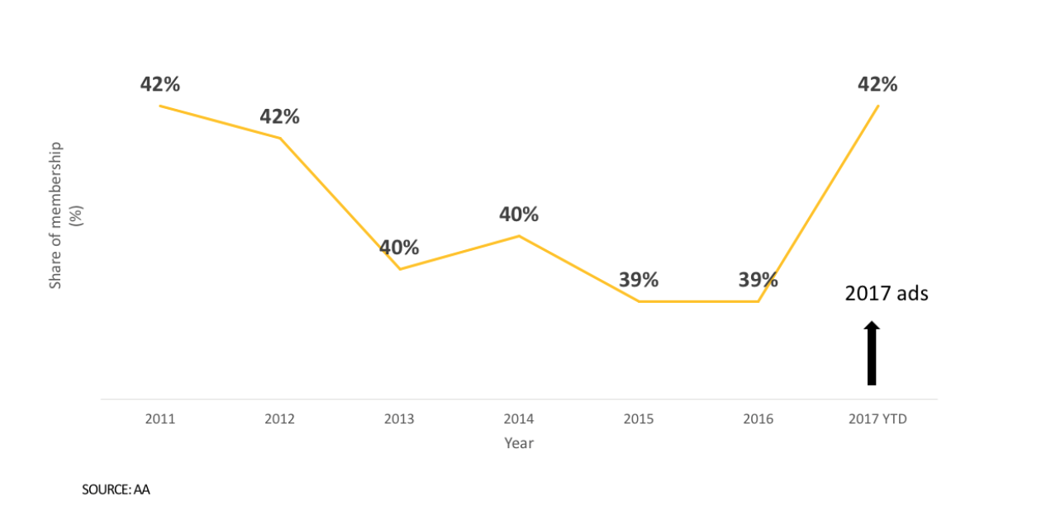
The AA
Source: AA IPA case study 2018

Slide 8
3. Mass marketing and media are essential to long-term growth

Slide 9
Targeting vs. Reach
Source: IPA Databank, 2008-16 cases

Slide 10
Targeting vs. Reach
Source: IPA Databank, 2014-16 cases

Slide 11
“We targeted too much, and we went too narrow…The bigger your brand, the more you need broad reach and less targeted media.”
Marc Pritchard, CMO P&G
Wall Street Journal, Aug. 17, 2016

Slide 12
Reaching UK adults in 2016
Reaching UK adults in 2017
Broadcast TV
OOH
Radio
Email
Other online
Texting
Newsbrands
Social networking
Search
Shopping/
transacting
Messaging
Online video
Internet for work
Subscriber VoD
Cinema
Source: IPA Touchpoints

Slide 13
How people spend their time online
Source: IPA Touchpoints, Wave 6 (April 2016)

Slide 14
Mark Ritson
“It’s called ‘social media’ for a reason: most Australians use it to connect with people not companies.”
Mark Ritson, Financial Review 10/4/13

Slide 15
TV is best for market share growth
Source: IPA Databank, 2014-16 cases

Slide 16
And digital makes mass media more effective
Source: IPA Databank
*Outdoor = 2012 - 2016

Slide 17
Major tech firms use traditional media
Brands: Amazon, Google, Apple, Facebook,
Twitter, AirBnB, Uber, Spotify
Media: TV, Outdoor, Press, Radio, Cinema
Source: Nielsen

Slide 18
Online video makes TV more effective
Source: IPA Databank, 2014-16 cases

Slide 19
TV consistently outperforms online video across 2017 research studies
Sources: IPA Databank ‘Media in Focus’ , Professor Karen Nelson-Field PhD ‘Media Attributes that (really) Matter’ ,
Ebiquity ROI campaign database & Gain Theory ‘Profit Ability: the business case for advertising’

Slide 20
Scalability: John Lewis

Slide 21

You can get broad reach viewing with online video – but it’s tough

Slide 22
SOV is getting more important
Source: IPA Databank

Slide 23
Conclusions
Short-termism damages effectiveness: we need to ensure balance between long & short term objectives. Remember the 60:40 rule.
The most powerful long-term media are able to stir emotions and build fame for brands.
Campaign reach and scalability are vital to long-term brand success.
Narrow-targeting is seductive in the short term but underperforms in the long term.
TV reigns supreme for long-term effectiveness.
Share of voice is getting more important not less.
Thank you

