Slide 1
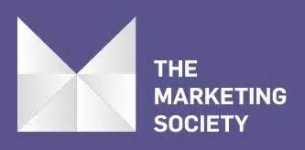
The Inconvenient Truths of Effectiveness in the Digital Era
Exploiting the potential of the evolving media landscape

Slide 2
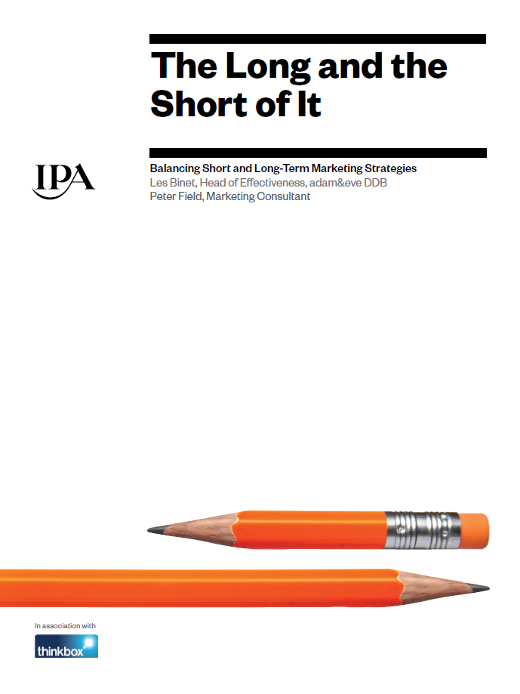
Previous research and this
How is the changing media landscape altering the rules of effectiveness?
500 digital era cases,
120 in 2014/16
http://www.ipa.co.uk/Document/Media-in-Focus-PDF#

Slide 3
3 important truths
Effectiveness requires media and strategies that work over the short and long-terms:
  The 60:40 effectiveness rule
Emotional campaigns and media drive long-term effectiveness
Mass marketing still rules effectiveness: scalability is essential for growth

Slide 4
1. Short and long-term effectiveness are different
You need strategies for both

Slide 5
The deception of short-termism
Brand building
Long term sales growth
Sales activation
Short term sales uplifts
Short term effects dominate ~6 months
Source: Binet & Field 2013

Slide 6
Balancing brand and activation for best success
Source: IPA Databank, 2016 cases

Slide 7

ROI focus drives short-termism
Top drivers of profit
Top drivers of ROI
 | Correlation with profit
No. VL biz effects | 64%
VL Sales gain | 40%
VL mkt share | 23%
No. brand effects | 23%
VL penetration | 21%
VL price | 18%
VL loyalty | 17%
VL activation effects | 15%
ROI | 15%
 | Correlation with ROI
VL activation effects | 23%
VL profit | 15%
No. brand effects | 8%
VL Sales gain | 8%
No. VL biz effects | 7%
VL price | 4%
VL mkt share | 1%
VL loyalty | -1%
VL penetration | -3%
Not significant
Significant at 95% confidence
Significant at 99% confidence
Source: IPA Databank, 2008-2016 cases

Slide 8
Short-termism has been rising
Source: IPA Databank, 1998-2016 cases

Slide 9
Activation levels have exceeded optimum

Slide 10
Activation effects have been achieved at the expense of brand
Source: IPA Databank, 1998-2016 cases

Slide 11
Effectiveness has fallen
Source: IPA Databank, 1998-2016 cases

Slide 12
Short-term campaign’s sales effects

Slide 13
Specsavers: a long-term campaign
Source: Specsavers IPA case study 2014

Slide 14
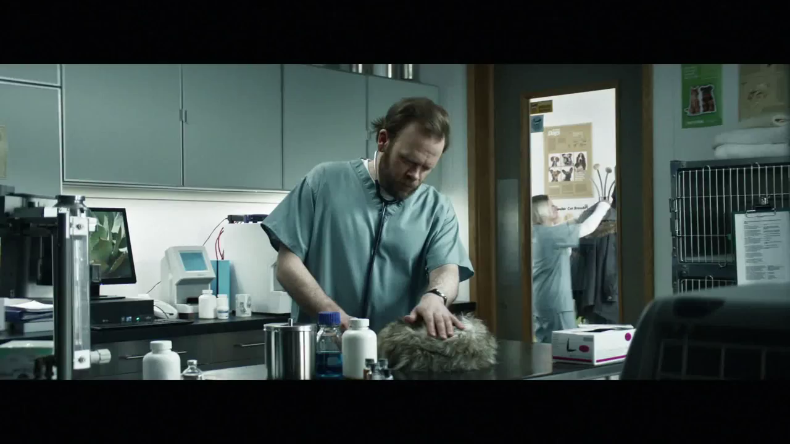
Specsavers: a long-term campaign

Slide 15
Online brands need greater brand investment
Source: IPA Databank, 1998-2016 for-profit cases

Slide 16
The optimum brand:activation balance is trending higher
Source: IPA Databank, 1998-2016 for-profit cases

Slide 17
Why brand building: Easyjet

Slide 18
Why brand building: Easyjet
Easyjet budget allocation 2010-2013

Slide 19
2. Emotional campaigns and media drive long-term growth

Slide 20
Emotional campaigns build stronger brands
Source: IPA Databank

