Slide 1
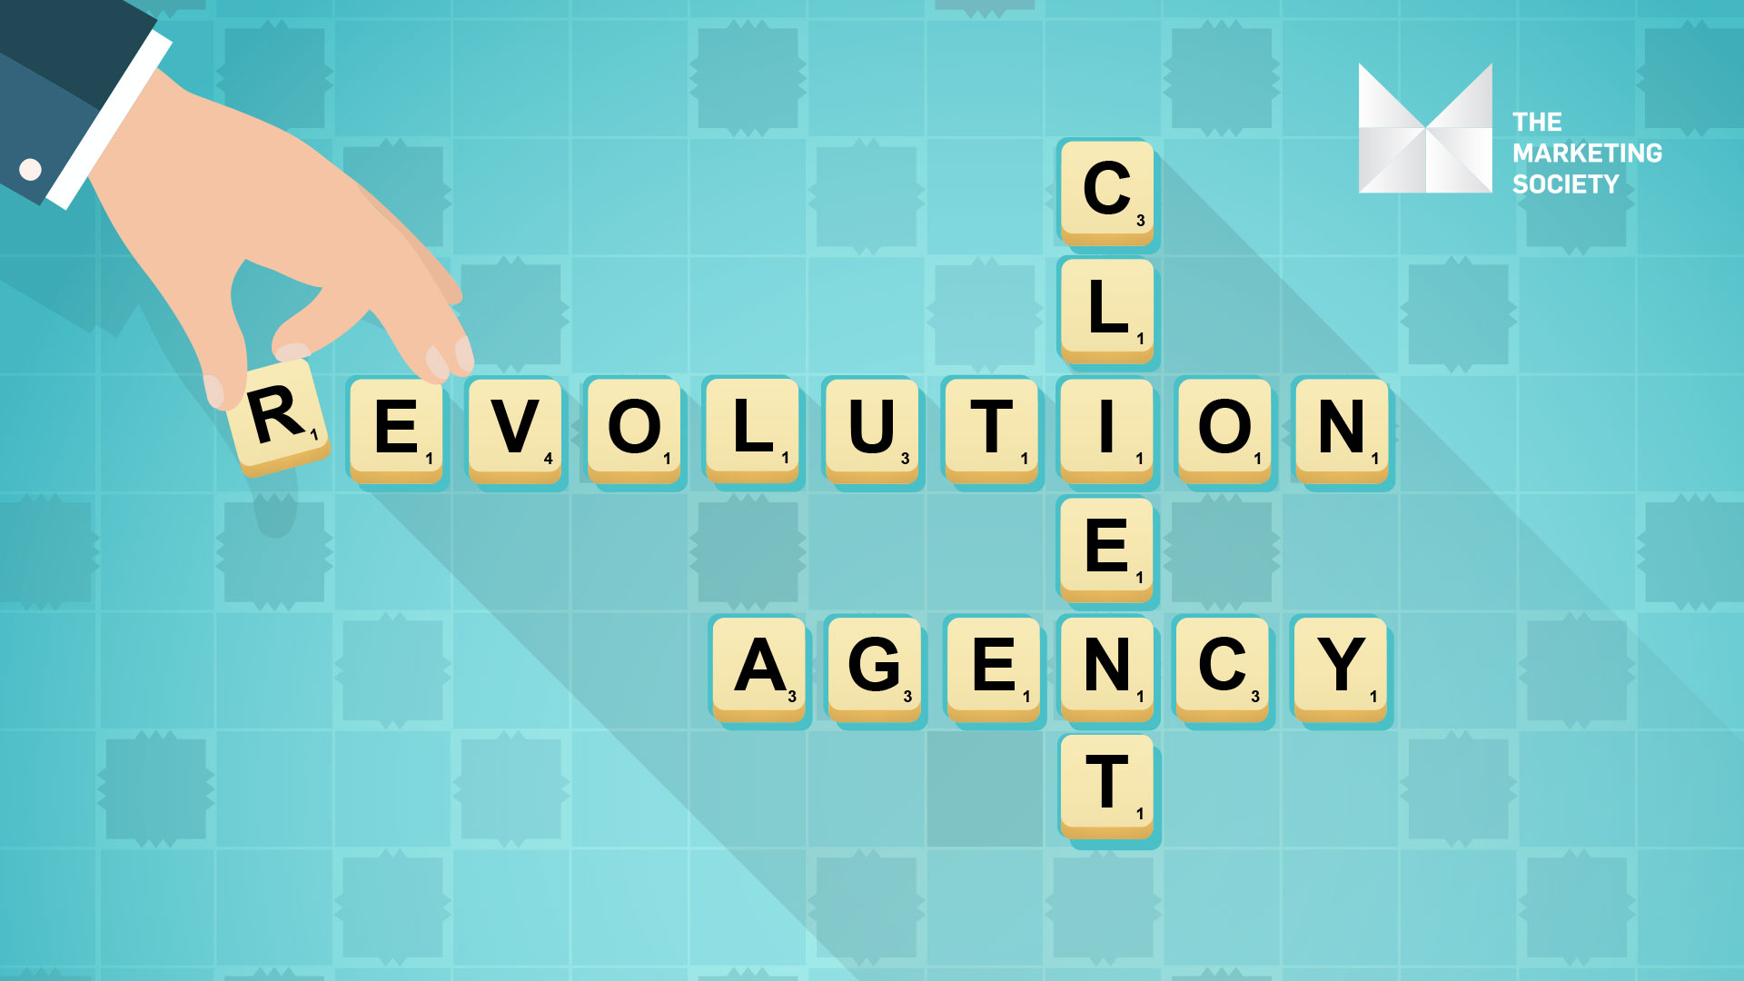
Patrick Hickey, CEO, Rothco
@patrickdublin
@Mktsociety #mktsoctalks

Slide 2
Party Starters
Tv ads are still dying/Dead.
Traditional creative teams of Art and Copy are on the way out.
Traditional Media Agencies are on the way out.
Marketing is Now an experience and commercial role.
We have the opportunity to earn our permanent place in the board room.

