Slide 1
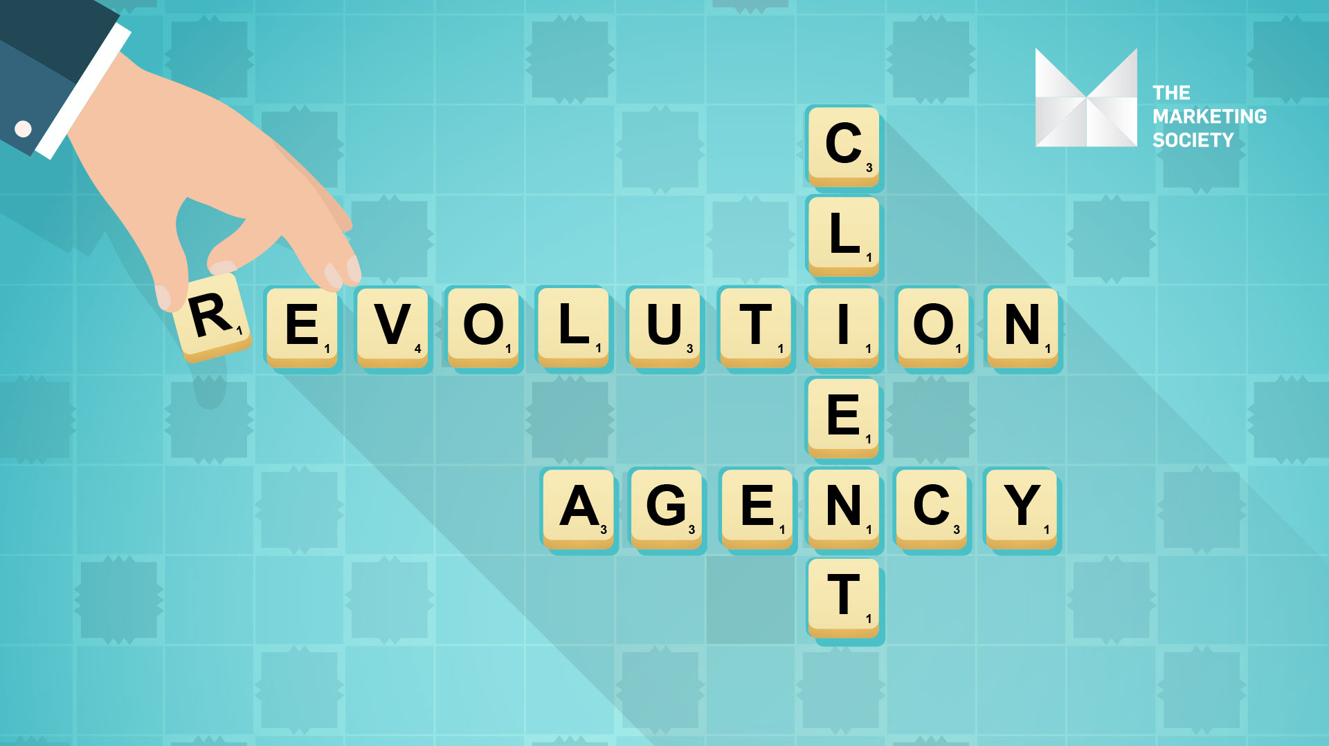
Paul Dervan, Senior Director of Brand Strategy, Indeed
@pauldervan
@Mktsociety #mktsoctalks

Slide 2
A perspective through a client lens
Notes:
http://www.saffo.com/about-paul-saffo/

Slide 3
An Irish agency success story...
Notes:
Effective and effecient.

Slide 4
An Irish agency success story...KV13
Notes:
Effective and effecient.

Slide 5

Notes:
We are a mass marketing advertiser in a number of markets. Meet Eoin O’Brien and Paddy Geraghty. They have written, sold in and made 7 global TV ads for us in past six months. Their work is live in the US and we’re testing the work in multiple languages for several of our other markets, and expect will go live in many of these. Remember this is a global operation, a mass marketing advertiser.

Slide 6

Notes:
We are a mass marketing advertiser in a number of markets. Meet Eoin O’Brien and Paddy Geraghty. They have written, sold in and made 7 global TV ads for us in past six months. Their work is live in the US and we’re testing the work in multiple languages for several of our other markets, and expect will go live in many of these. Remember this is a global operation, a mass marketing advertiser.

Slide 7

Notes:
We are a mass marketing advertiser in a number of markets. Meet Eoin O’Brien and Paddy Geraghty. They have written, sold in and made 7 global TV ads for us in past six months. Their work is live in the US and we’re testing the work in multiple languages for several of our other markets, and expect will go live in many of these. Remember this is a global operation, a mass marketing advertiser.

Slide 8
Indeed is big.
But KV13 is not.
Just two people.
Notes:
Effective and effecient.

Slide 9
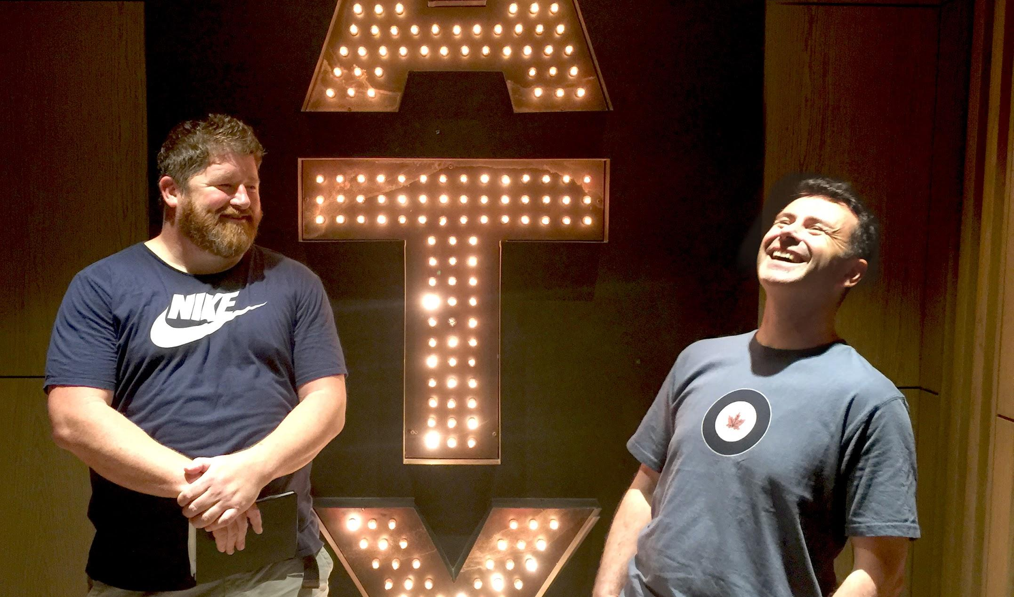
Notes:
We are a mass marketing advertiser in a number of markets. Meet Eoin O’Brien and Paddy Geraghty. They have written, sold in and made 7 global TV ads for us in past six months. Their work is live in the US and we’re testing the work in multiple languages for several of our other markets, and expect will go live in many of these. Remember this is a global operation, a mass marketing advertiser.

Slide 10
But in 2018, they have written, sold-in, and produced six global TV ads.
Notes:
Effective and efficient.

Slide 11
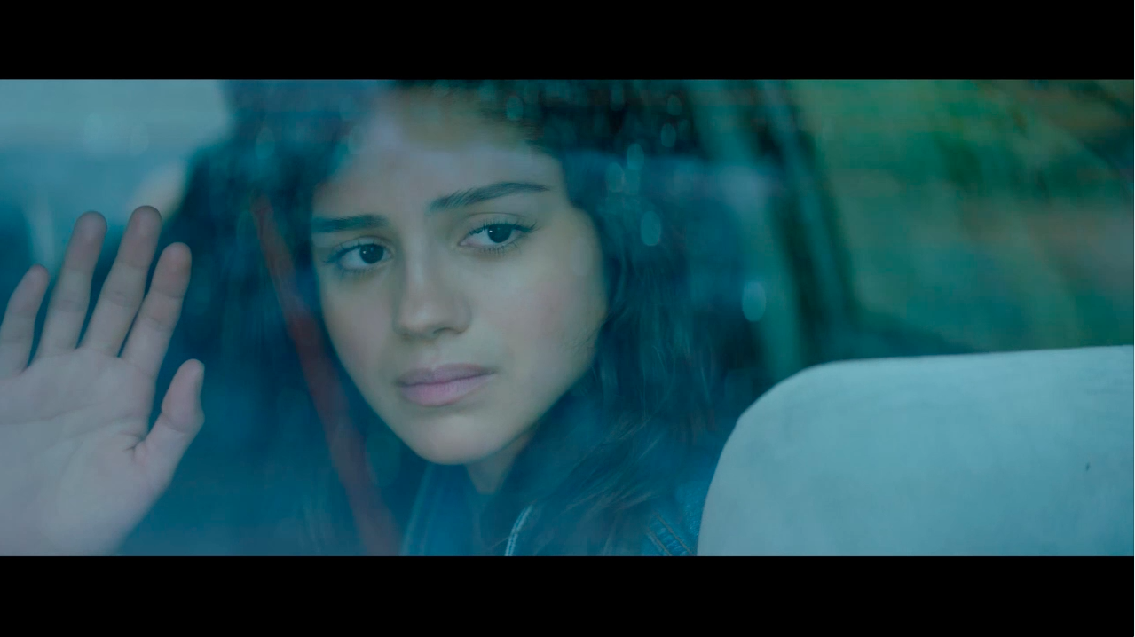

Slide 12
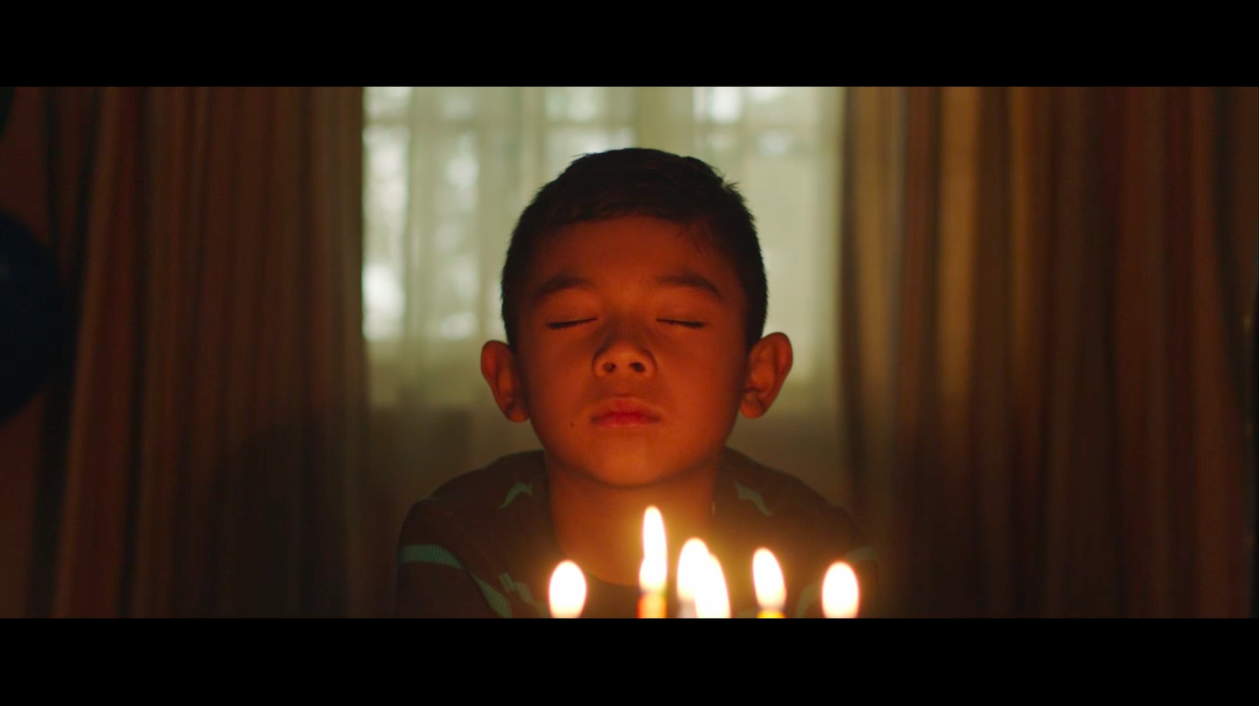

Slide 13
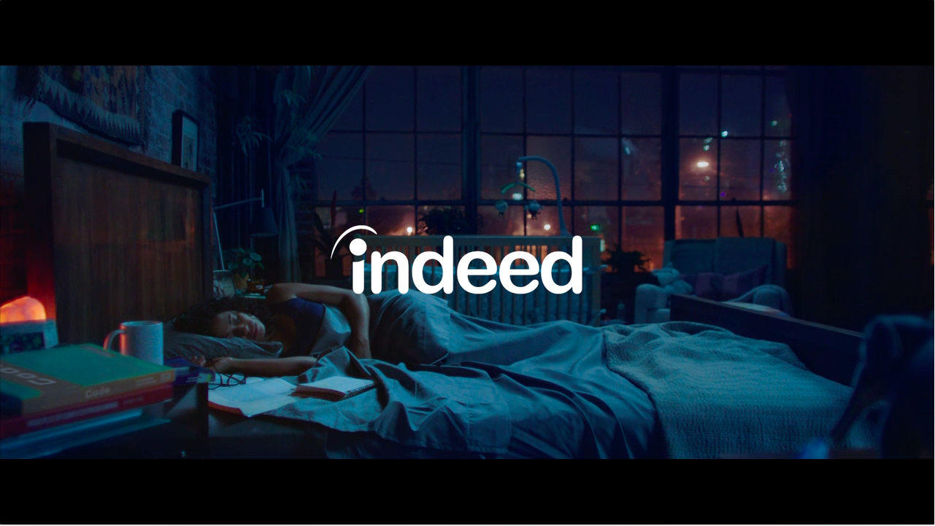

Slide 14
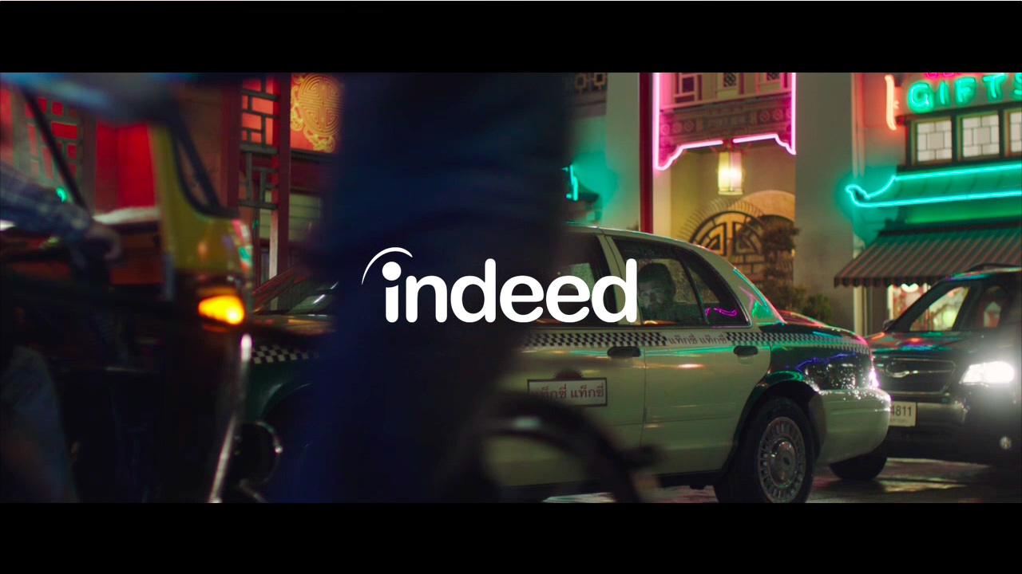

Slide 15
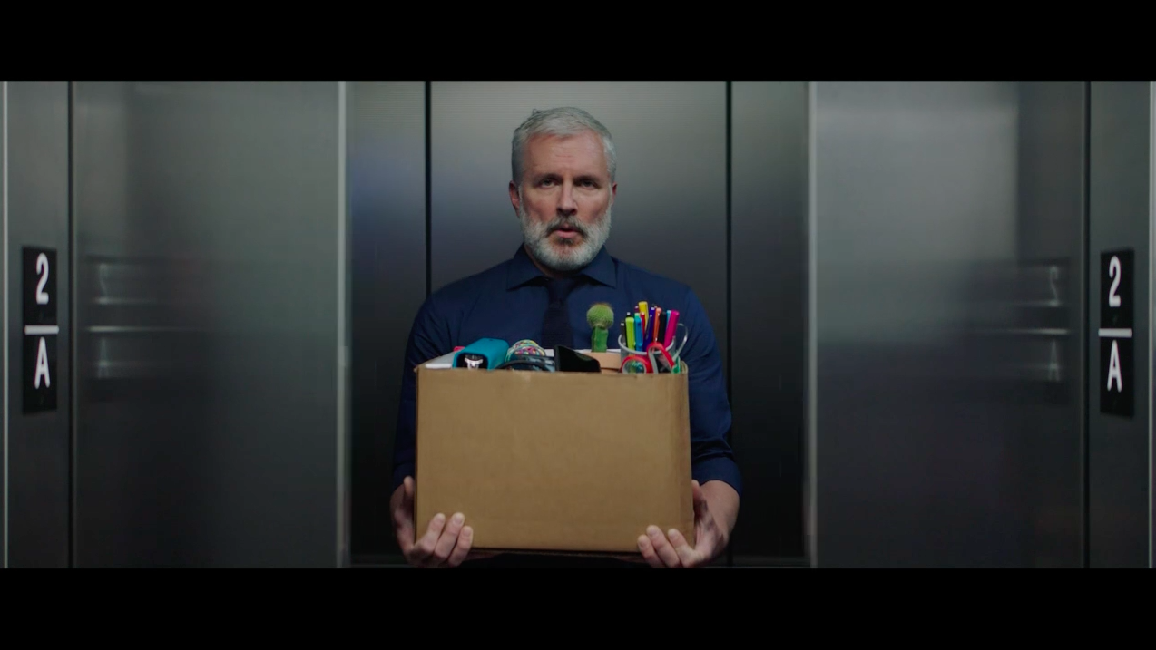

Slide 16
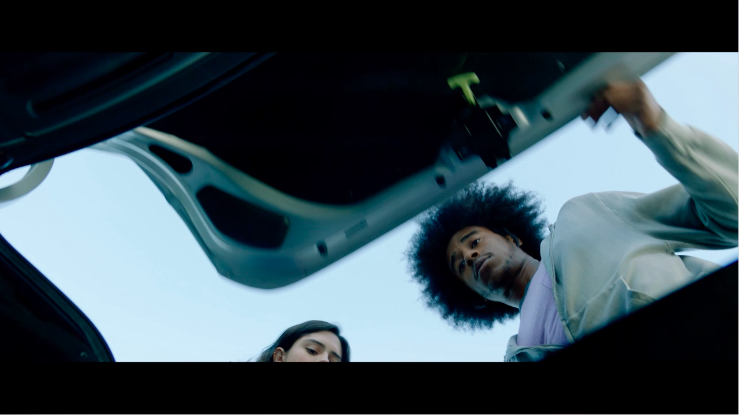

Slide 17
What is the secret of their success?
Notes:
Effective and effecient.

Slide 18
We try to remove all barriers to great work - time zones, time wasted, timesheets.
Notes:
Geographical, time zones, timesheets,

Slide 19
Is KV13 the exception or the norm in future of agency-client relationships?
Notes:
Effective and effecient.

Slide 20
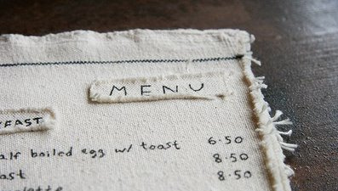

Slide 21
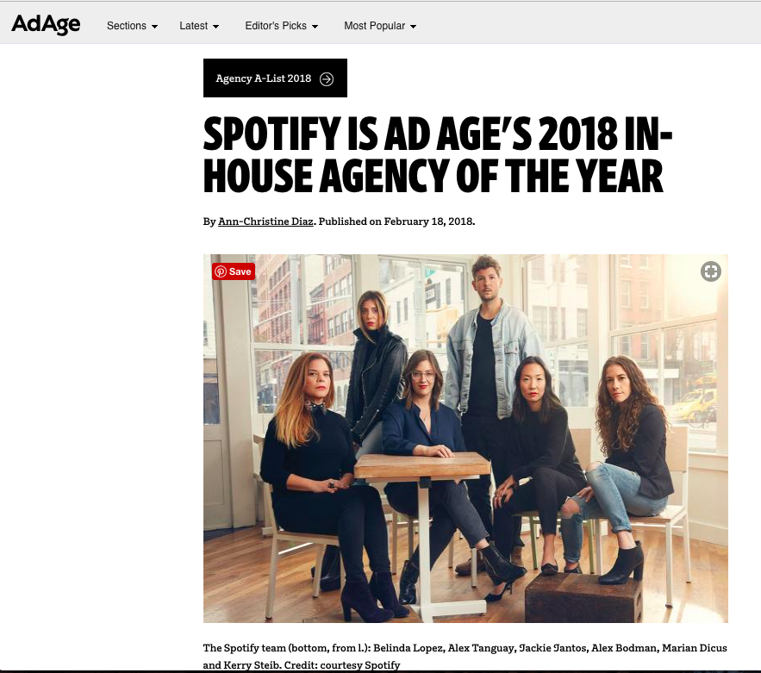
Notes:
Effective and effecient.

Slide 22
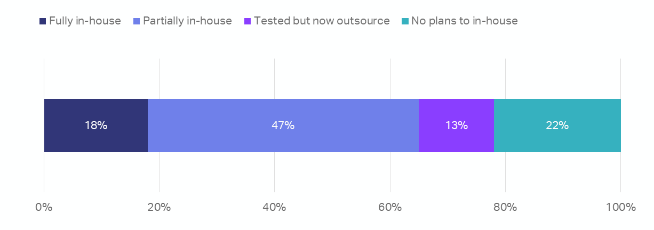
Almost a fifth of US advertisers have fully moved programmatic buying in-house
Source: WARC May, 2018
Notes:
The main reasons for bringing programmatic in-house were ROI attribution (cited by 47%), better audience targeting (44%) and improved campaign effectiveness (44%).

Slide 23
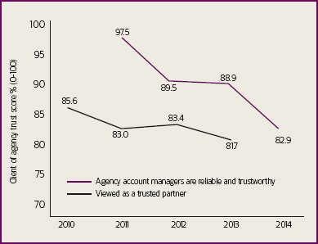
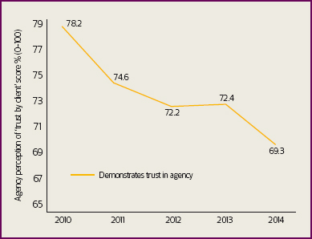
Client-Agency trust is declining.
Source: Declining trust: Client-agency relationships face continued pressure, Market Leader 2016
Notes:
Aprais has been collecting data on client–agency relationships for 14 years. This covers 15,463 client–agency relationship evaluations from 91 countries. While the data covers creative and media agencies, it also extends to research, PR and other communication disciplines.

Slide 24
Length of Client-Agency relationship | 1984 | 2013
 | 7 years, 2 months | 2 years, six months
Source: Campaign, the UK-based trade magazine
Notes:
Campaign, the UK-based trade magazine, reported in 2013 that the average client-agency relationship dropped in length from seven years and two months (1984) to just two years and six months (2013).

Slide 25
A perspective through a client lens
Notes:
Build engineering capabilities.
Build a learning culture that is open and fast.
Help clients create a proper culture of effectiveness.
Stress test the assumptions you have about what is creating value for clients.

Slide 26
Challenge your assumptions on what clients value
Don’t sell hours. Charge for an agreed outcome.
Scope. Scope. Scope
Advance client culture of marketing effectiveness
Build engineering capabilities
Hypothesis-driven Thinking

Slide 27
Challenge your assumptions on what clients value
Don’t sell hours. Charge for an agreed outcome.
Scope. Scope. Scope
Advance client culture of marketing effectiveness
Build engineering capabilities
Hypothesis-driven Thinking

Slide 28
Agency compensation down 50% within 15 years.
Agency workloads have been growing 2-3% every year. Agency fees have been declining by 2-3% every year. It only takes 15 years for an agency’s compensation to be cut in half for an equivalent amount of work.
Source: Manslaughter on Madison Avenue, by Michael Farmer

Slide 29
"If you're at an agency, what can you stop doing that doesn't add to the creative output? And what can you start doing to bring value to clients that is truly unique?"
- Marc Pritchard, Chief Brand Officer at Procter & Gamble.

Slide 30
The current structure is typically based around a buddy system, where executives from the client and agency are paired up in the name of servicing the relationship. The actual outcome? A lot of time wasted in meetings, travel, off-sites, reports and presentations.
- Marc Pritchard, Chief Brand Officer at Procter & Gamble.

Slide 31
Over 95% of our investment with KV13 goes directly into creative development. Everything else stripped away.
Notes:
All clients won’t be the same.

Slide 32
Challenge your assumptions on what clients value
Don’t sell hours. Charge for an agreed outcome.
Scope. Scope. Scope
Advance client culture of marketing effectiveness
Build engineering capabilities
Hypothesis-driven Thinking

Slide 33
Challenge your assumptions on what clients value
Don’t sell hours. Charge for an agreed outcome.
Scope. Scope. Scope
Advance client culture of marketing effectiveness
Build engineering capabilities
Hypothesis-driven Thinking

Slide 34
Challenge your assumptions on what clients value
Don’t sell hours. Charge for an agreed outcome.
Scope. Scope. Scope
Advance client culture of marketing effectiveness
Build engineering capabilities
Hypothesis-driven Thinking

Slide 35
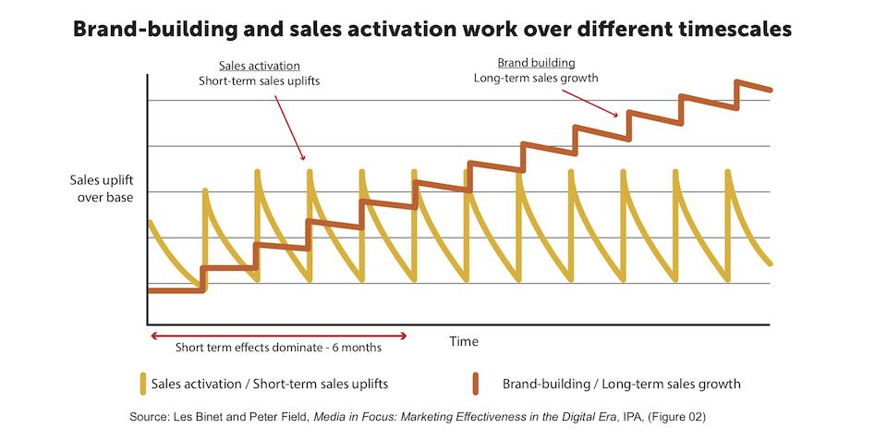

Slide 36
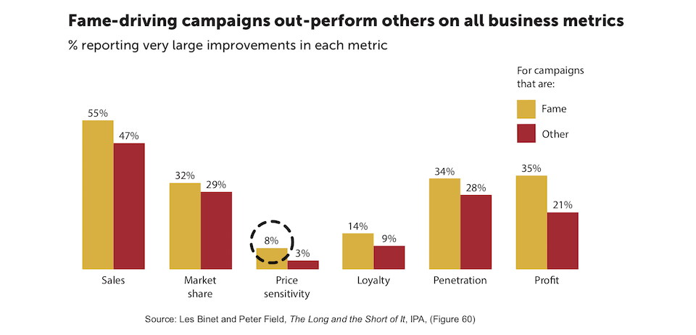
Notes:
It isn’t enough to roll out the charts saying that emotional advertising or fame campaign are more profitable. We need people to understand why, in which circumstances, and what the risks are. So if fame campaigns are profiltable, why is every brand not doing it?

Slide 37
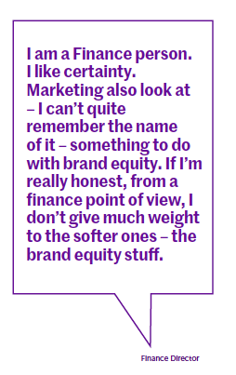
This is your client.
Source: Culture First, by Fran Cassidy

Slide 38
Take ROI as example.
Good metric for sales activation.
Not as useful growth metric.

Slide 39
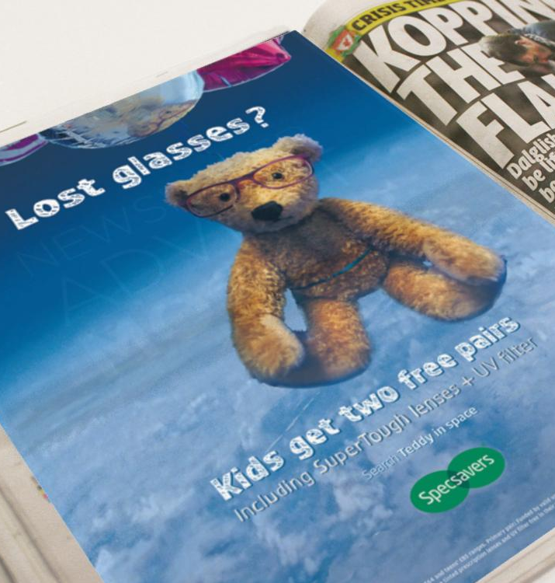
How we evaluate this...
Notes:
Has an offer. Hopefully media placement has some targeting towards parents.

Slide 40
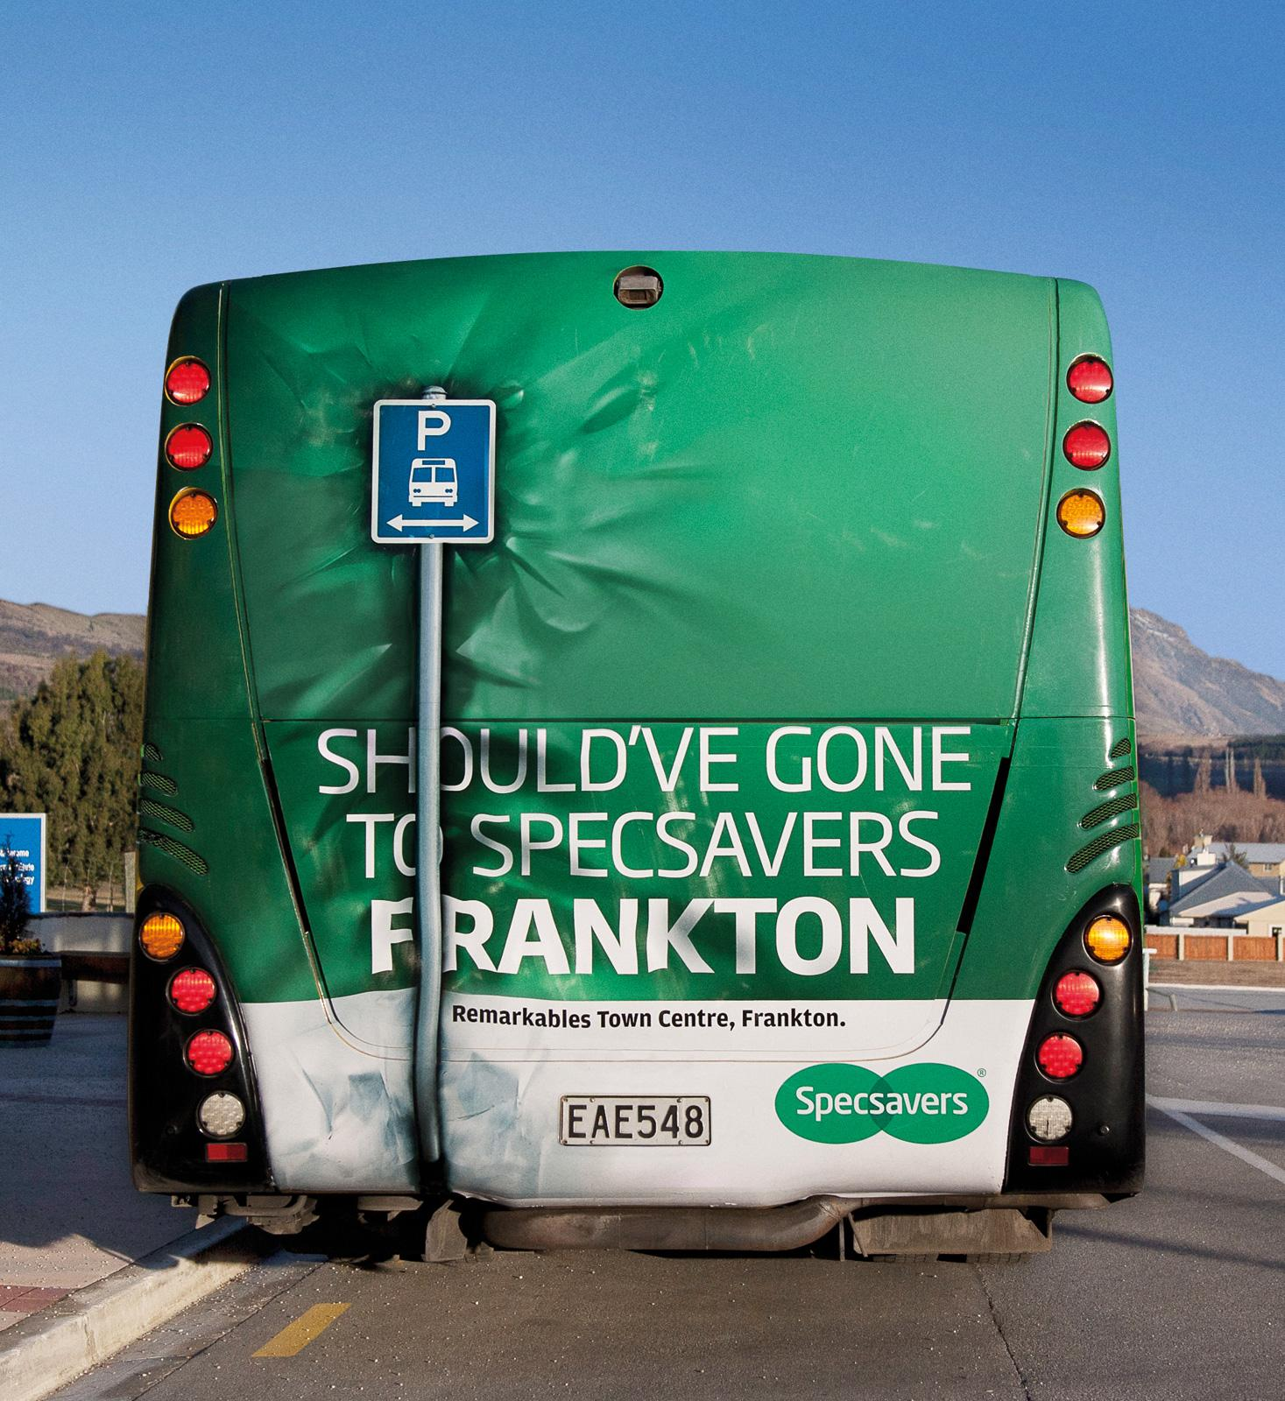
...is not how we should evaluate this.
Both matter and both have a role in effectiveness planning.

Slide 41
Challenge your assumptions on what clients value
Don’t sell hours. Charge for an agreed outcome.
Scope. Scope. Scope
Advance client culture of marketing effectiveness
Build engineering capabilities
Hypothesis-driven Thinking

Slide 42

Notes:
Love and hide buttons on spotify

Slide 43
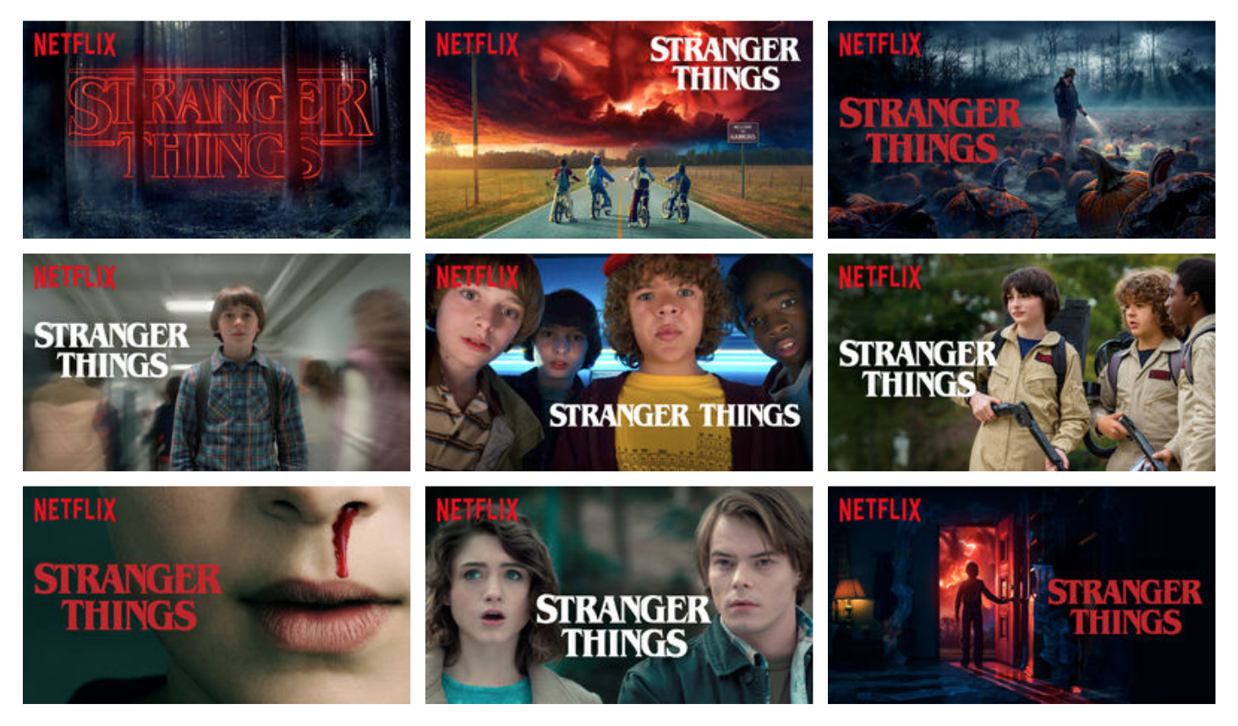
Notes:
Good Will Hunting starring Matt Damon and the late Robin Williams.
It explains that users who mostly watch romantic films will be shown artwork featuring an image of the main character and his love interest. Alternatively, users who predominantly watch comedies are more likely to be shown artwork displaying the character played by Williams – who was a well-known comedy actor.

Slide 44
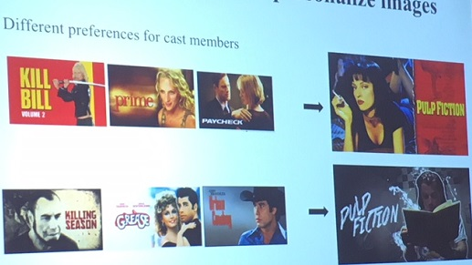

Slide 45
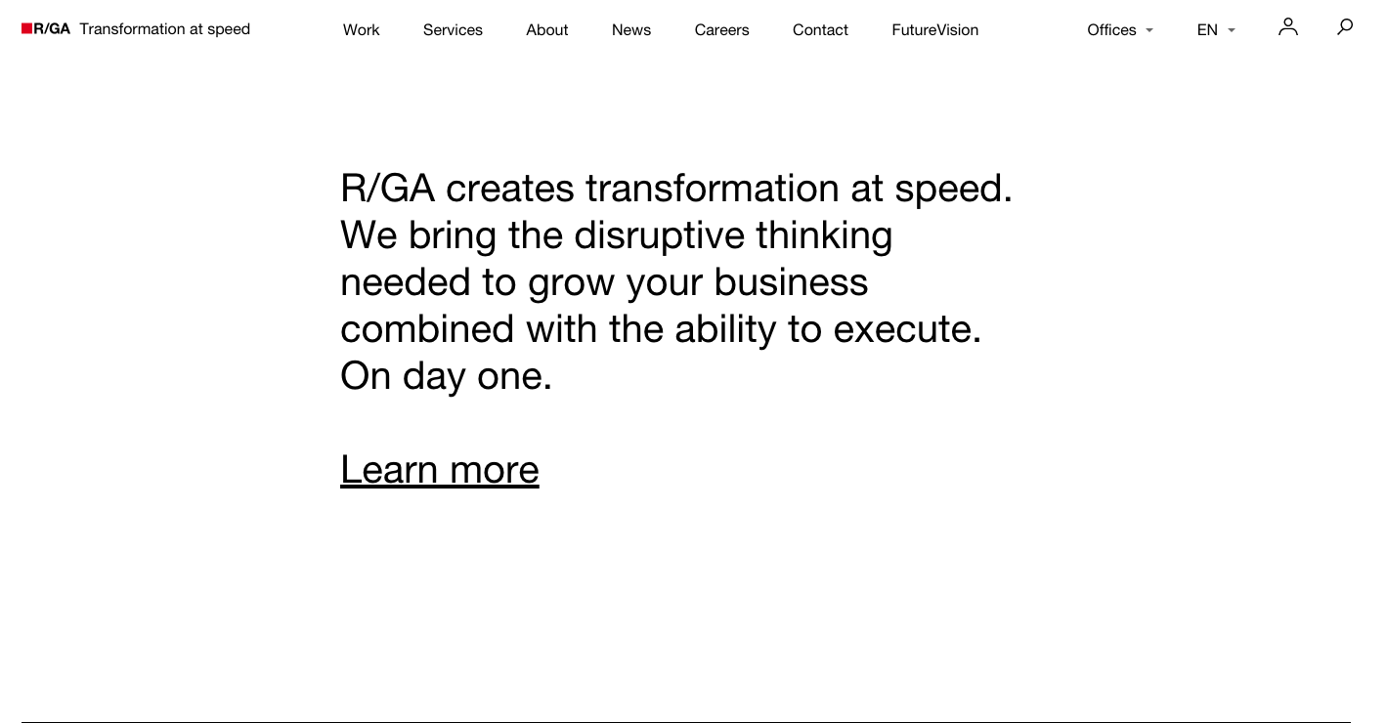

Slide 46
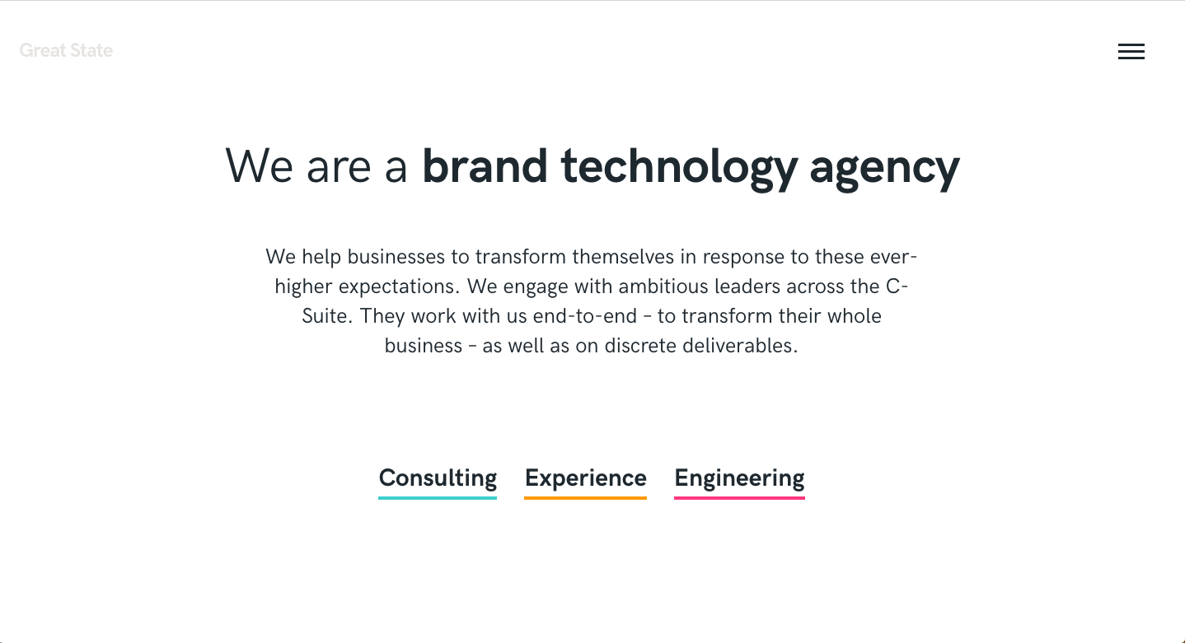

Slide 47
Challenge your assumptions on what clients value
Don’t sell hours. Charge for an agreed outcome.
Scope. Scope. Scope
Advance client culture of marketing effectiveness
Build engineering capabilities
Hypothesis-driven Thinking
Notes:
When our self-image is at stake, we treat our fielding decisions as 100% or 0%: right versus wrong, skill versus luck, our responsibility versus outside our control. There are no shades of grey.
There is lot of space between unequivocal “right” and “wrong.” When we move away from a world where there are only two opposing and discrete boxes that decisions can be put in—right or wrong—we start living in the continuum between the extremes.
The smarter you are, the better you are at constructing a narrative that supports your beliefs, rationalizing and framing the data to fit your argument or point of view.

Slide 48
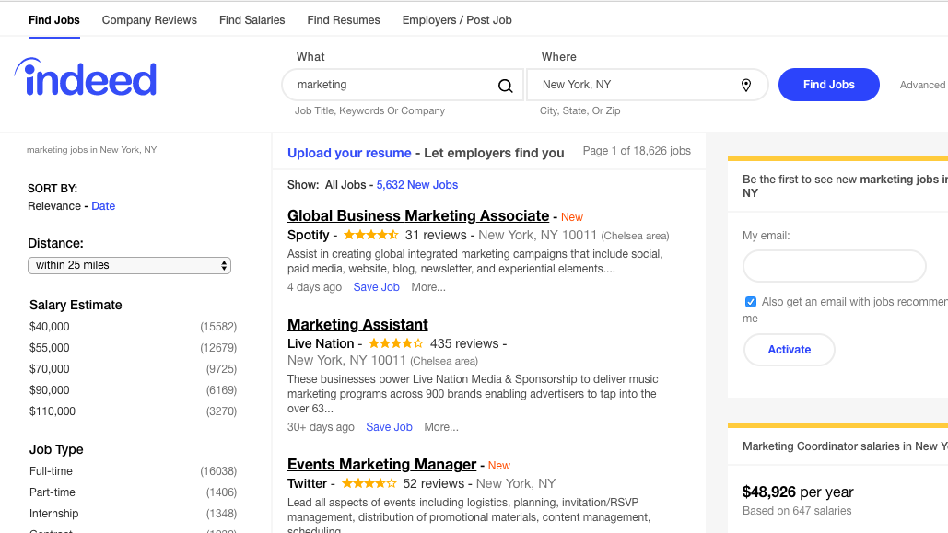

Slide 49
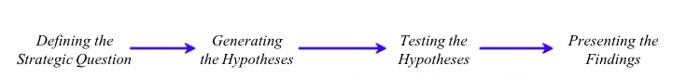

Slide 50
Hypothesis example
We can efficiently increase broad awareness for a brand using only facebook advertising only.
Notes:
So with no support from other channels such as TV, OOH etc. If, this would be helpful for channel decisions.

Slide 51
Hypothesis example
Our investment in direct response advertising can also efficiently build our long term brand metrics.
Notes:
Want to prove or disprove.

Slide 52
Hypothesis example
If we increase salience, customer sales growth will follow.
Notes:
Want to prove or disprove.

Slide 53
When our self-image is at stake, we treat our fielding decisions as 100% or 0%: right versus wrong, skill versus luck, our responsibility versus outside our control. There are no shades of grey.
Annie Duke
Notes:
Want to prove or disprove.

