Slide 1
CMO to CEO: Why Marketing Matters
Mary Lambkin
Marketing Society May 9, 2018

Slide 2
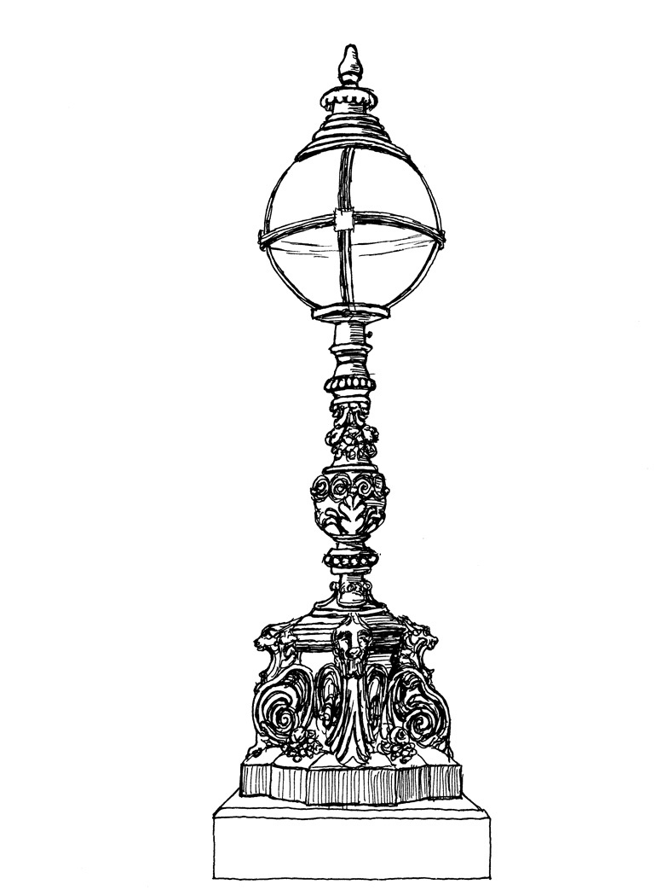
CMO to CEO: Why Marketing Matters
CMOs are still poorly represented
in the boardroom and at CEO Level
Evidence and reasons
What will it take to change the trend?
www.smurfitschool.ie

Slide 3
Other Corporate Executives
Ops/Technology 20%
Marketing 4%?
Spencer Stuart U.S. Board Index 2017
www.smurfitschool.ie

Slide 4
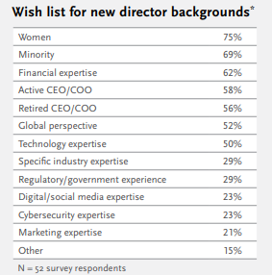
Spencer Stuart U.S. Board Index 2017
www.smurfitschool.ie

Slide 5
Why are Marketers not valued at Board level?
Most Boards are CEO/CFO-driven, with both being accountants.
Focused on corporate level rather than products or brands
Prioritise financial performance and shareholder value
Will not necessarily understand or care about some of the metrics presented by marketers.
www.smurfitschool.ie

Slide 6
Corporate Hierarchy
Corporate
Shareholders, financiers,
Regulators, consumers
Business
Unit
Trade customers,
suppliers, competitors
Products/Brands
Consumers
A
B
C
www.smurfitschool.ie

Slide 7
Management Priorities
ROI
Reputation
Customers
Competition
Brand Equity
Brand Value
www.smurfitschool.ie

Slide 8
Gap actually widening with data analytics
C-Suite
Marketing

Slide 9
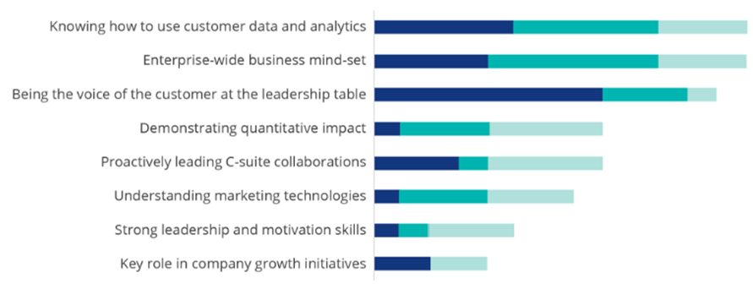
Top Three factors driving CMO Success
Redefining the CMO: 40 interviews with C-suite Deloitte Review, Issue 22, January 22, 2018.

Slide 10
Some Reasons for Optimism
Intangible assets large part of corporate value
High premium paid for intangible assets in M&A
Intangible assets based on reputation/brand value
Concepts marketing people know best
www.smurfitschool.ie

Slide 11
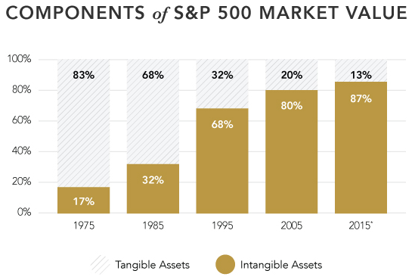
Intangible Assets becoming most important
www.smurfitschool.ie

Slide 12
Getting CMOs to the CEO Position
Takes ambition and leadership
A corporate strategic mindset
Focus on financial performance
Evangelism on the role of
marketing in minding the
intangible assets
www.smurfitschool.ie

