Slide 1



Grand Prix
Public Policy &
Social Research
Sponsored by

Slide 2
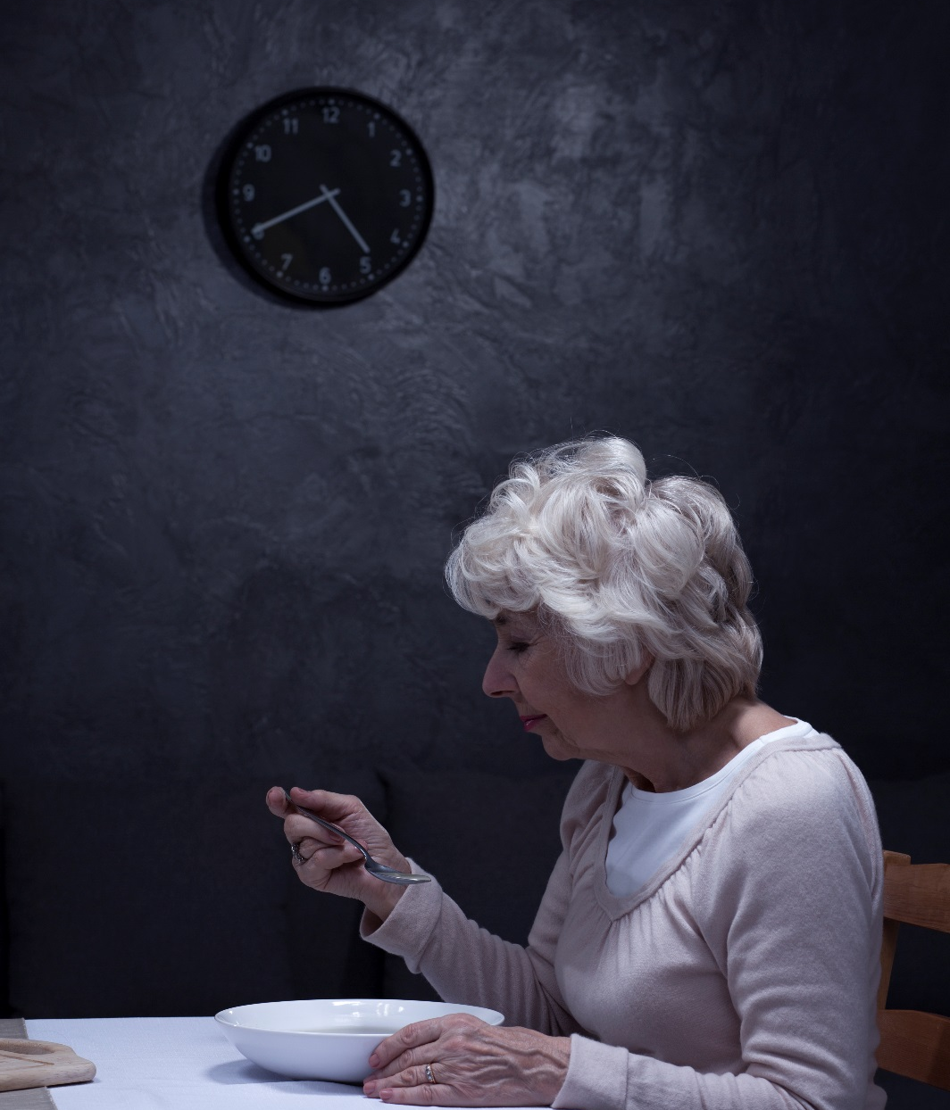


Dinner With Dementia
The impact of dementia on food and nutrition
TARIK LAHER
  Director
© 2018 Ipsos MRBI All rights reserved. Contains Ipsos’ confidential and proprietary information and may not be disclosed or reproduced without the prior written consent of Ipsos.

Slide 3

Every day in Ireland, eleven people will develop dementia
Objective was to understand how dementia can affect nutrition and diet
Exploring the full spectrum of our relationship with food

Slide 4
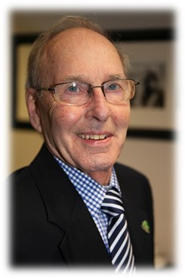
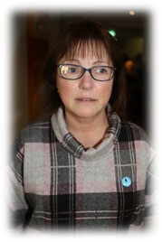
A person-centred approach – all about the respondents
“I’d say in the last year my weight has gone down.
My belt was getting a bit tighter and I know myself when I see pictures that I have lost it.
And I don’t know why.”
[Seamus Cunningham]
“Out there, it’s about creating awareness and educating people.
That this is the face of dementia, it’s not just elderly, there are young people out there who are challenged with this situation every day.”
[Kathy Ryan]

Slide 5
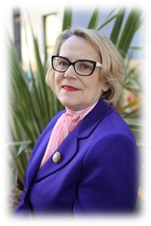
How to conduct research with people with dementia?
A range of conditions which cause damage to our brain, affecting memory, thinking, language and our ability to perform everyday tasks.
Memory loss? Concentration?
Mood changes? Disorientation?
Decreased judgement?
Struggle to follow conversation,
find the right word or keep track?
“That instant confusion,
if you have somebody pushing you forward,
it only exacerbates the whole thing and more confusion sets in.”
[Helen Rochford Brennan]

Slide 6
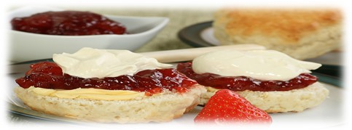
Focus group with Alzheimer Society Working Group
Meticulous planning
Mingling informally beforehand
Reassurance and patience
Using language that empowers
Constant reminders on objective
Recognising confusion
Humour and flexibility
Breaking bread afterwards!

Slide 7
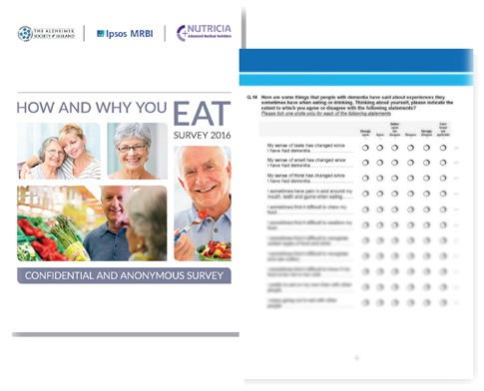
Postal survey with clients of Alzheimer Society
Physical reminder of task
Complete at own time and pace
Clear, unambiguous language
Pilot, detailed instructions, helpline
Assistance if required to ensure inclusion
“Learn to treat the person with dementia with respect as they didn't ask for this disease and they are still the same person.”
[Survey respondent]

Slide 8
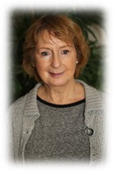

Multiple learnings across the entire project
Dementia causes gradual changes that can go unnoticed
Almost 9 in 10 can find shopping for food a confusing experience
Preparing and eating meals is far from straightforward
“I’d say I eat more now [since diagnosis], but I’d say it’s comfort eating.”
[Anne McKeown]
“People in shops should be aware of people with Alzheimer’s…. What happens is you get annoyed and you walk out. And you’re upset.”
[Seamus Cunningham]
“I recognise eggs and tea but cannot sometimes find the correct words for some foods, like cake and biscuits.”
[Survey Respondent]

Slide 9

Multiple learnings across the entire project
“I don’t know why but I’m eating less.
I only eat when I want to eat.
If I have to go and cook it, it’s not worth it. I’m not that hungry.”
[Brian Doyle]
Eating is a comforting, social experience to be enjoyed
A balanced diet becomes even more important
There is a significant gap in nutritional advice for those with dementia
“Mentally I‘m being really challenged in how to put something together that’s nutritionally balanced. I need somebody to work with it, because my brain is deteriorating. So putting a plan together is just overwhelming for me with the dementia.”
[Kathy Ryan]

Slide 10
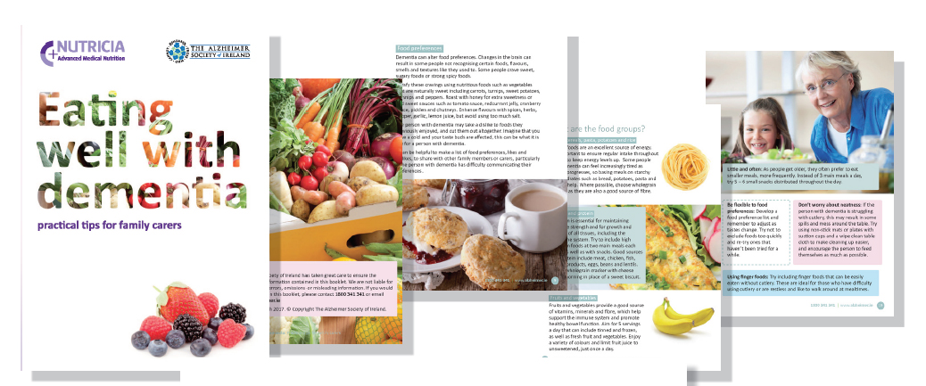
50,000 advice booklets produced and available now

Slide 11
Research has had impact across multiple stakeholders
On Nutricia Medical
  Understanding this fundamentally neglected area
  Unique Irish data, validating European norms
  Highlighting the value of patient-centric research
On Alzheimer Society, people with dementia and their carers
  66% increase in calls to ASI helpline during week of launch
  Booklet available in 51 day centres, as well as social clubs/cafes
  Incorporated into family care training and the organisational agenda

Slide 12
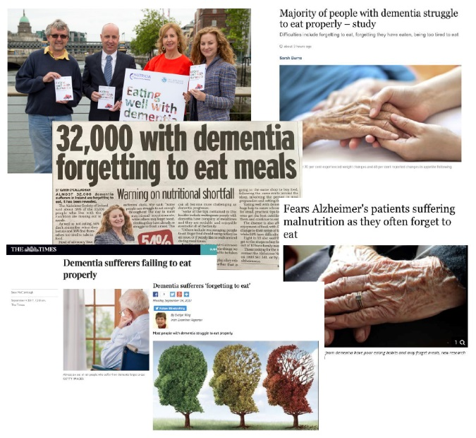
Research has had impact across multiple stakeholders
On Healthcare Professionals
  Booklet distributed across 1,300 display stands,
  reaching over 2,000 GPs and 1,100 Practice Nurses
  Increase engagement from HCPs as a result
On public awareness and society
  High profile launch (September 2017)
  Widespread coverage across print, radio, online

Slide 13
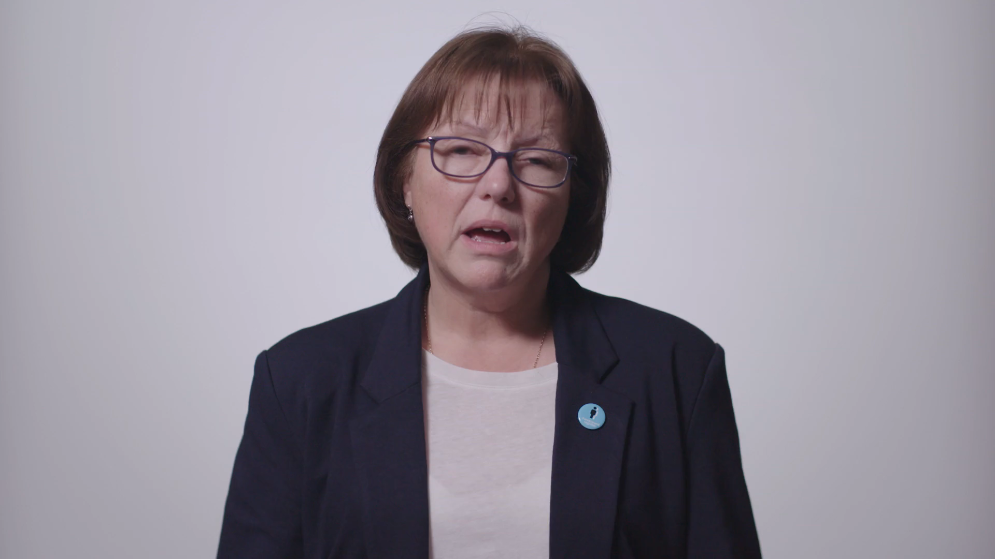
A final word…..

Slide 14
Dinner With Dementia
The impact of dementia on food and nutrition
TARIK LAHER
  Director
© 2017 Ipsos MRBI All rights reserved. Contains Ipsos’ confidential and proprietary information and may not be disclosed or reproduced without the prior written consent of Ipsos.

