Slide 1


Advertising & Ad Media Research
Sponsored by

Slide 2

Award Winner: Advertising & Ad Media Research
Lidl & Spark – Breaking Behaviours
Copyright 2018, Spark Ltd
All rights reserved

Slide 3
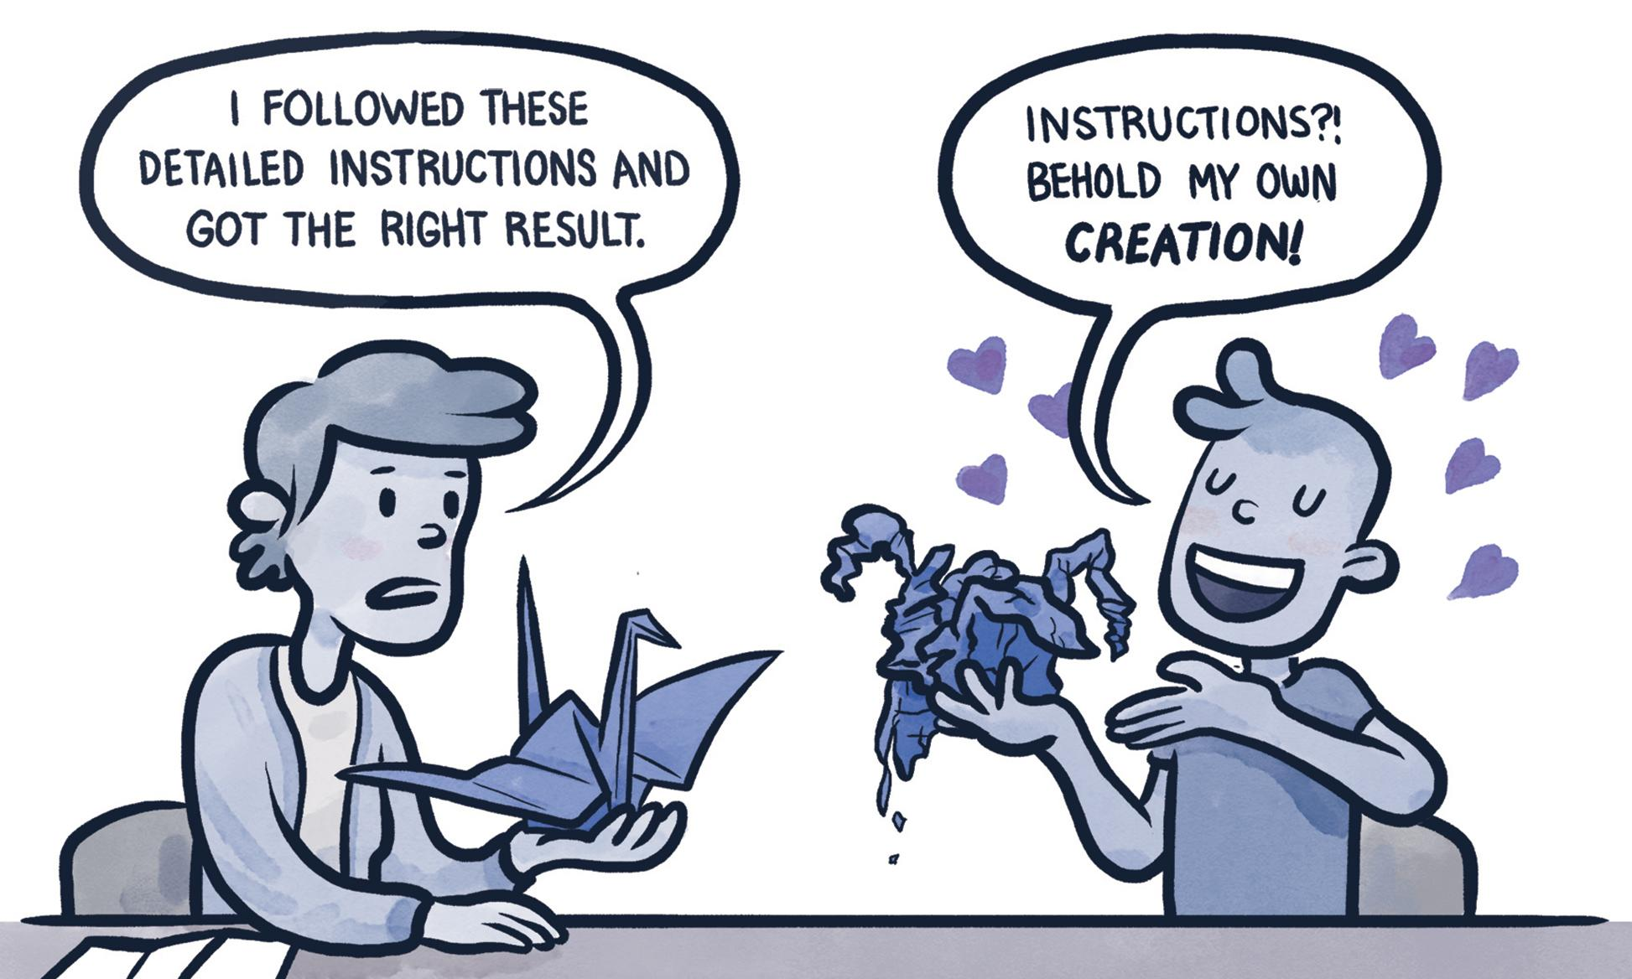
Firstly, this project was rooted in behavioural economics –
here’s a brief explanation
“In sum, the basic message of behavioral economics is that humans are hard wired to make judgment errors and they need a nudge to make decisions that are in their own best interest. The understanding of where people go wrong can help people go right”
Source: Pyschology Today

Slide 4
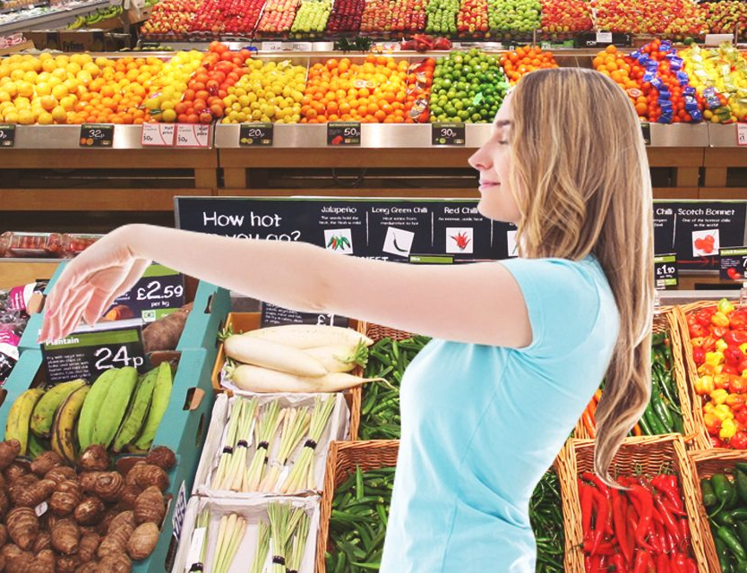
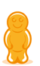
Our challenge – how can we understand shopper journeys when
autopilot inhibits their own knowledge?
Getting people to change their behaviour is not simple, neither is understanding exactly what they are currently doing as they often don’t know this themselves

Slide 5
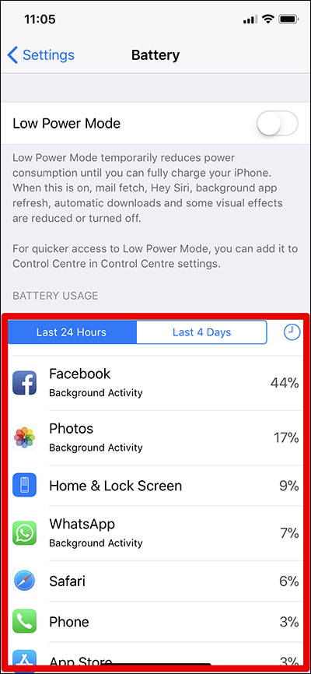
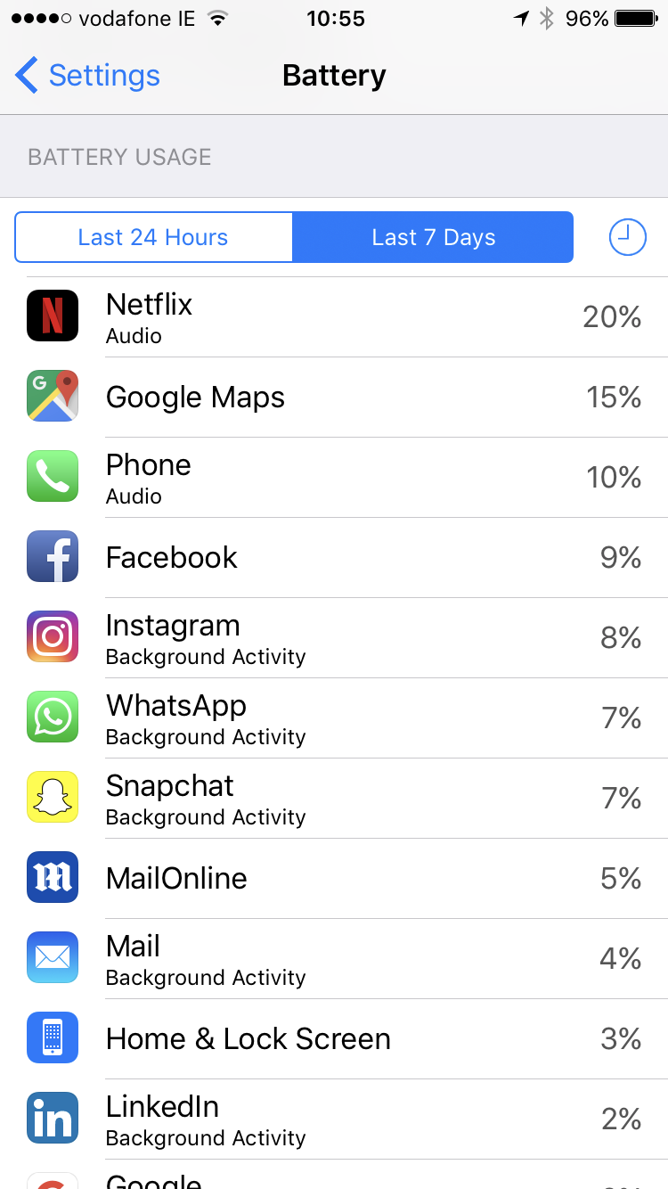
Do you know your own habits?
Accessing REAL Vs REPORTED behaviour is a constant challenge in research
“I hardly ever go on Facebook these days”
Participant X

Slide 6

Lidl Trolley Cam
Steps to Success

Slide 7

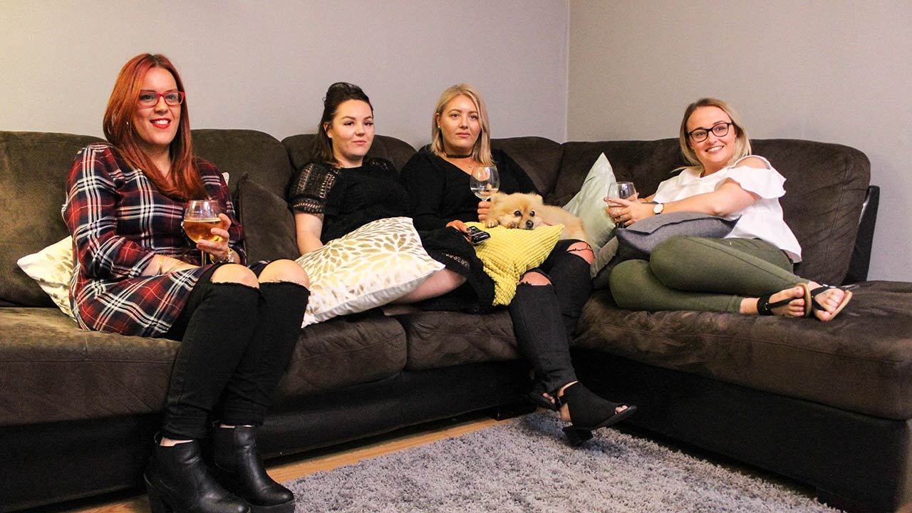
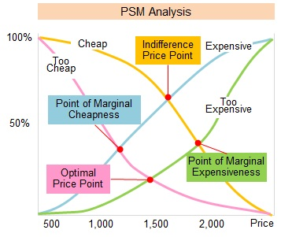
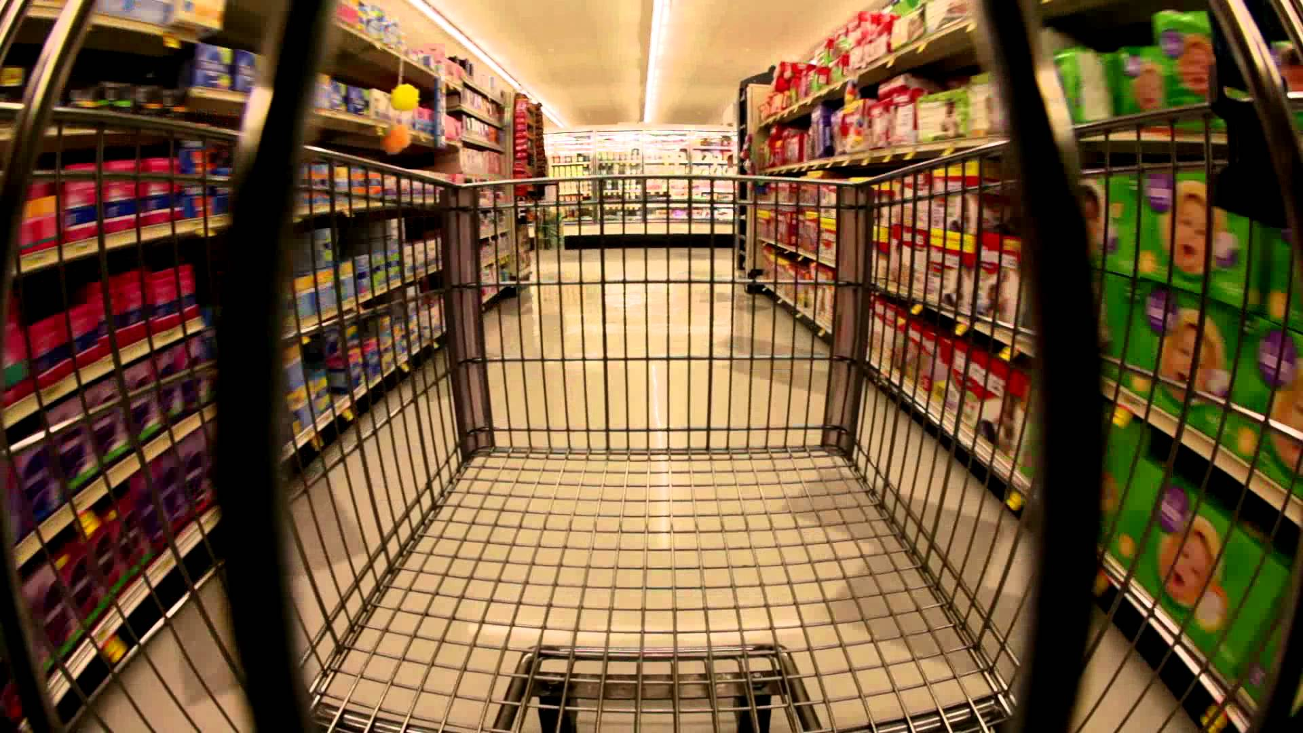
Research Programme Steps to Success
PRE CREATIVE - SHOPPERCAM
PRE-CREATIVE SURVEY
PRE-LAUNCH TRIADS
Online Quant survey amongst repertoire Lidl Shoppers
POST-LAUNCH IMPACT MEASUREMENT & UNDERSTANDING
Ethnographic approach using clip on video cameras
Switching main shop to break habitual behaviours
Life-stage triads in home
Audience style research – reactions to campaign
Friendship triads in comfort of home setting
Observing natural reaction and levels of interest
Quantitative campaign awareness, appeal and impact measurement
Qualitative groups on behavioural change
Correlating actual behaviour with claimed behaviour
Triggers and Barriers to full shop in Lidl
Spend / optimal price points
Cross referenced with TGI data
Price sensitivity analysis

Slide 8

Lidl’s Trolley Cam advertising development –
key pre-launch inputs
Capturing Moments
Defining shopper behaviour
‘Full shop’ key moments of discovery (good and bad)
Customer journeys
Pen Portraits by lifestage
Identifying ‘Nudge’ opportunities
Creating Context
Calculating Spend
Spending habits
Optimal price points
Savings predictor

Slide 9
Research outputs that helped
shape the campaign

Slide 10
Key ‘Nudge’ points identified
Showcasing Quality products across fresh produce, particularly meat
Reveal the broad range of products in store – move beyond fresh bakery
Demonstrate the easy and enjoyable shopping experience in store
Highlight health food ranges such as Gluten Free
Reveal how much a full shop costs across different household sizes
Nudge Moments

Slide 11
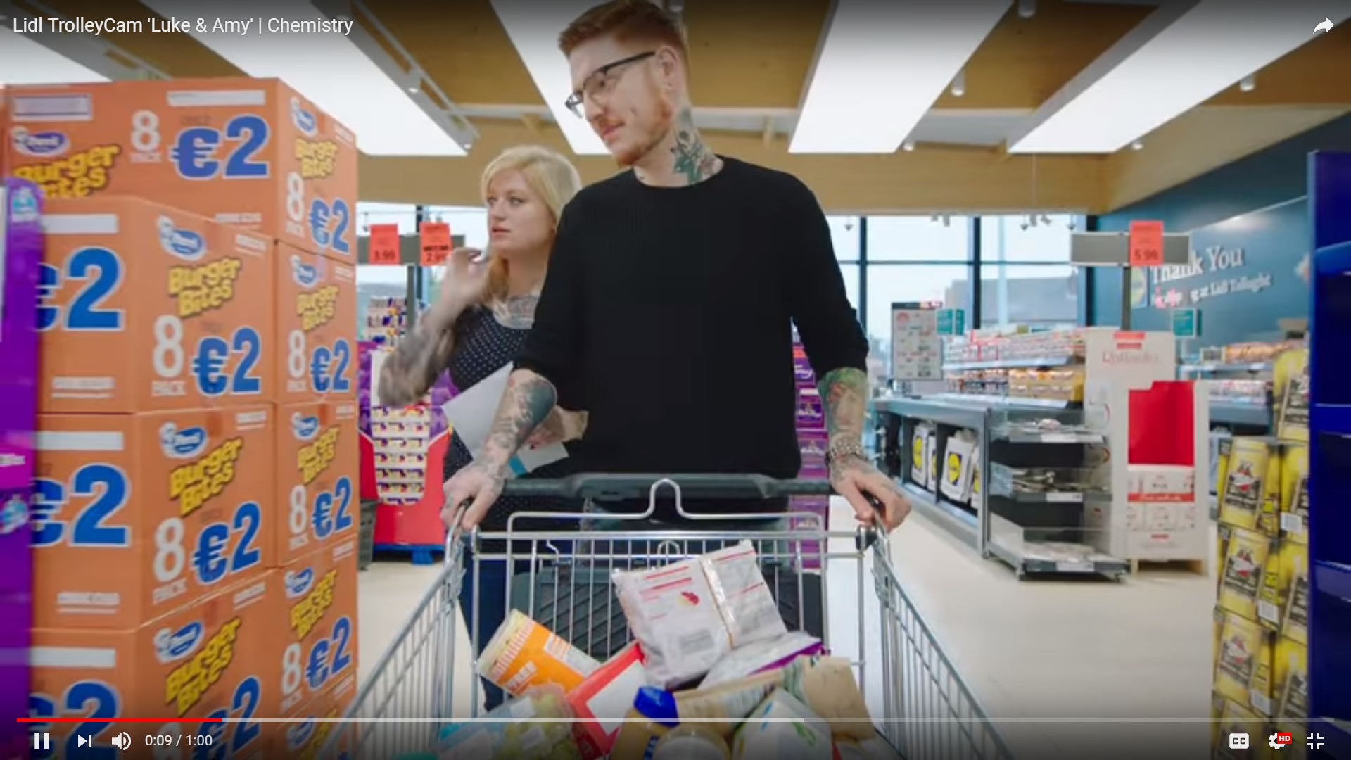
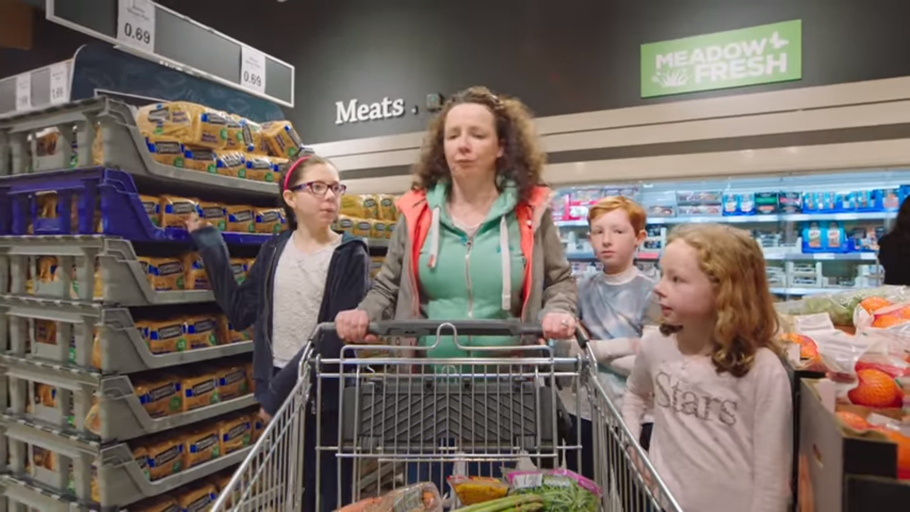
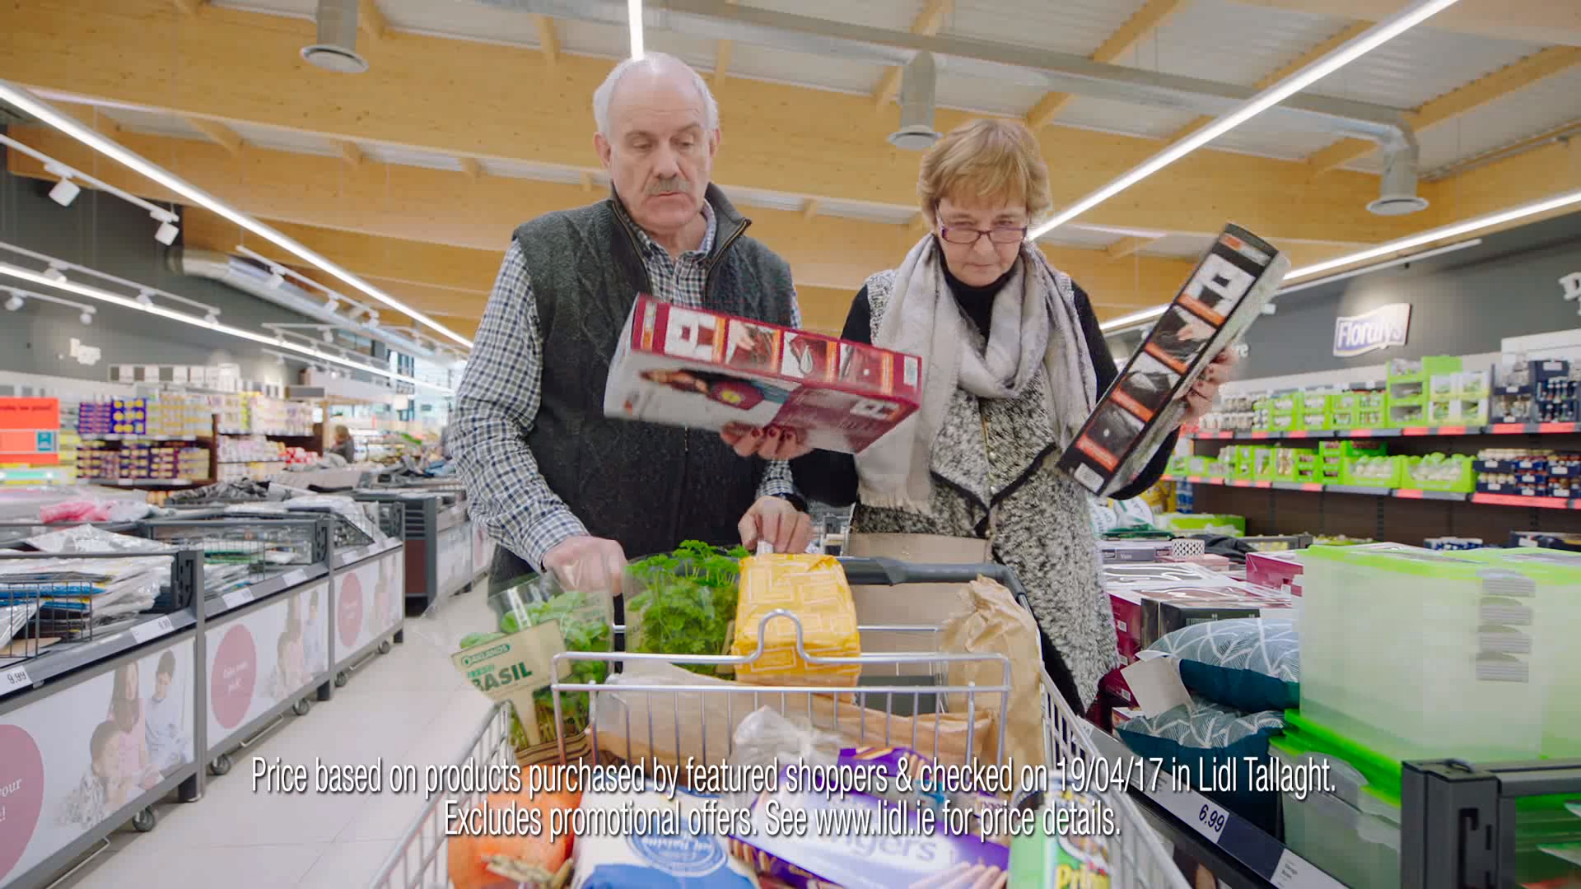
Examples of how our personas ended up on screen
Pre-family pen portraits turned into Luke & Amy
For each key life-stage our research demonstrated:
Key Need-states
Shopper Journey
Triggers and barriers to Lidl full shop
Average weekly spend
Typical trolley content
Nudge moments
Middle family pen portraits turned into The Smyths
Older family pen portraits turned into Adrian & Mary

Slide 12
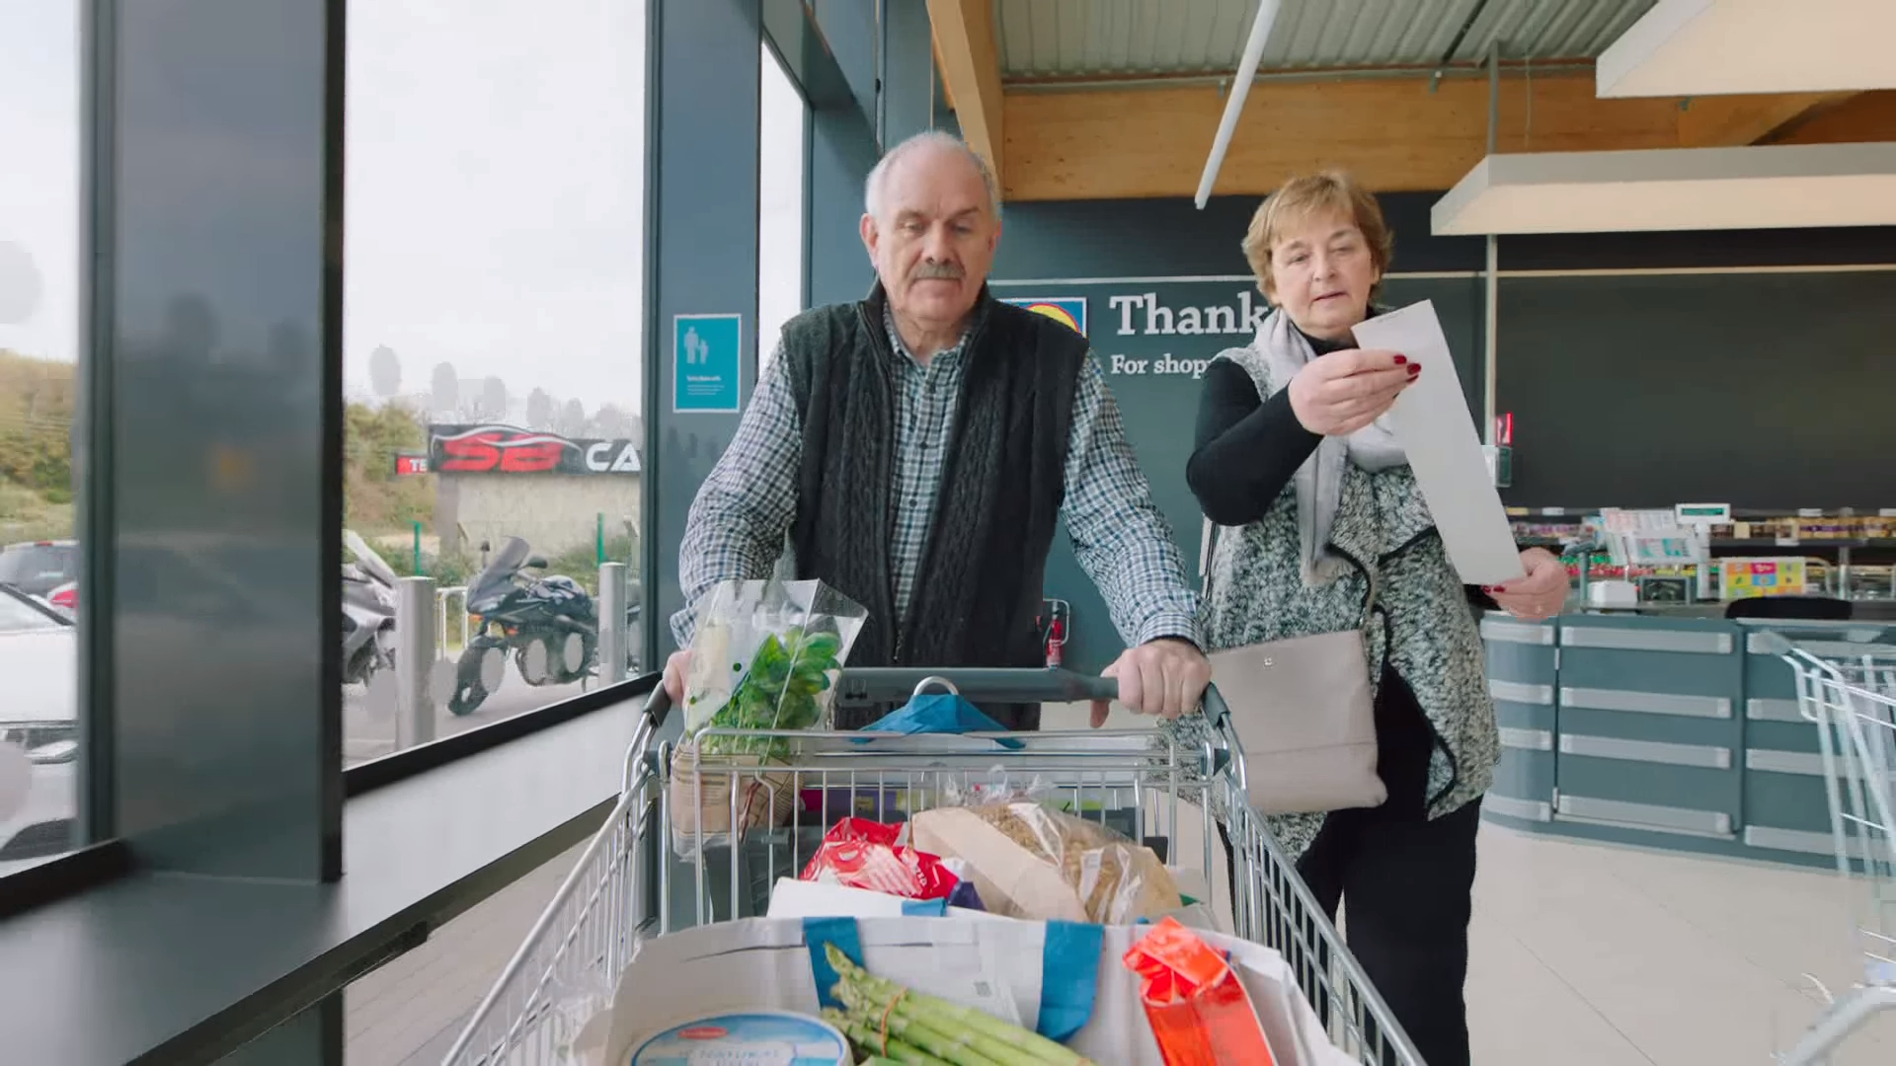
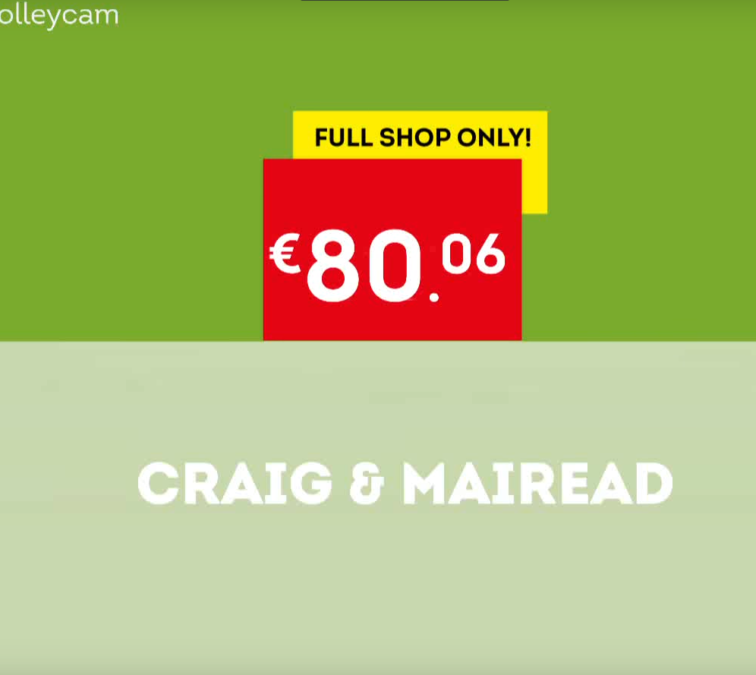
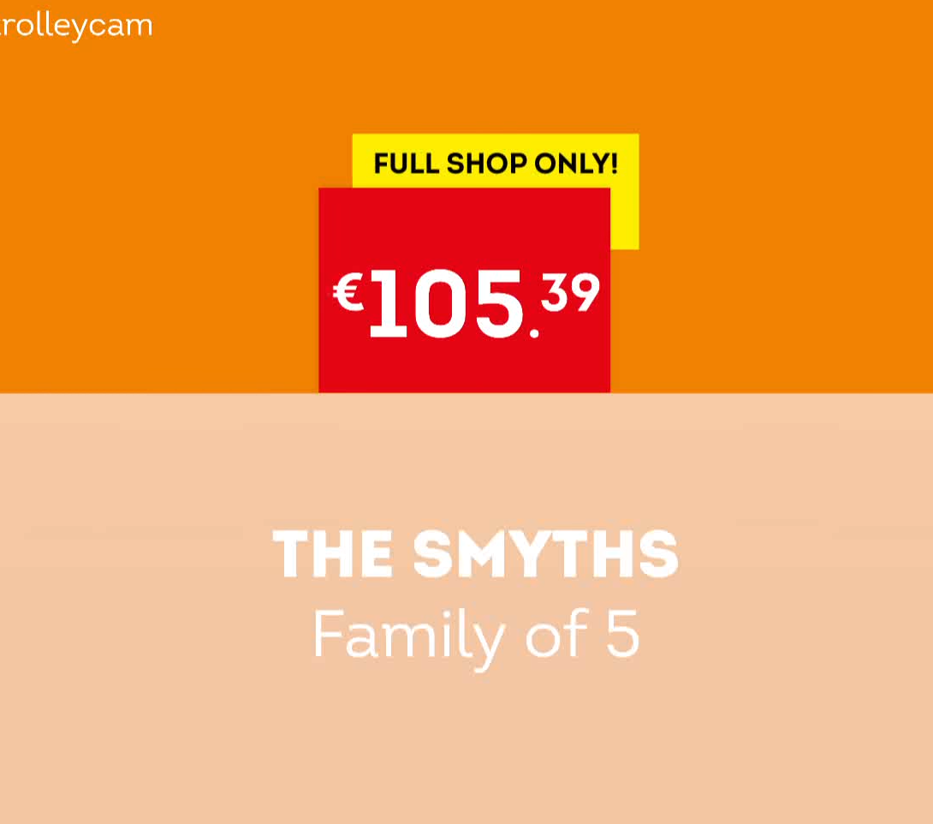
Pricing
Understanding exactly what the cost of a ‘full shop’ means for each lifestage group
Developing a targeted call to action that directly relate to individual lifestage groups

Slide 13
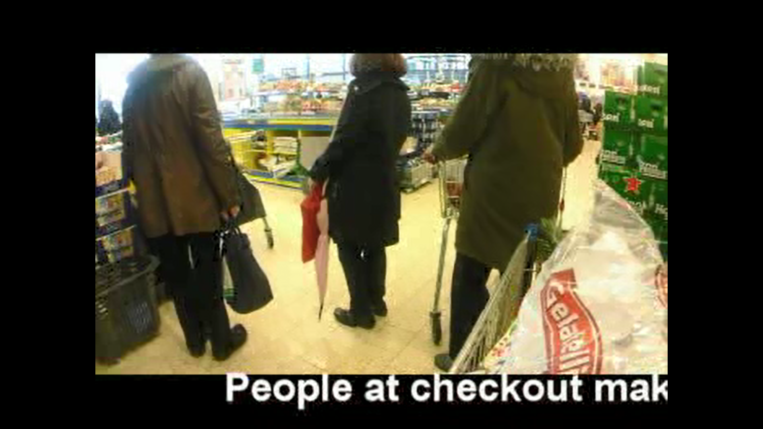
Trolley cam pre-development research journey

Slide 14
Campaign success

Slide 15
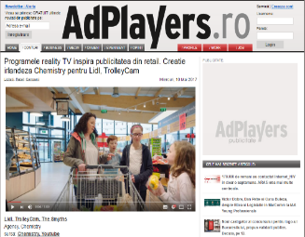
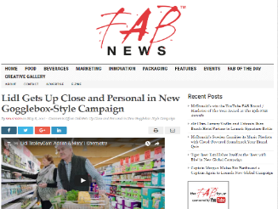
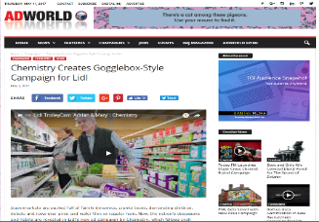
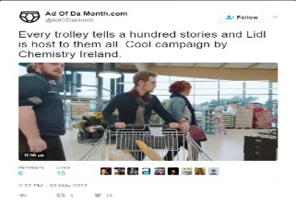
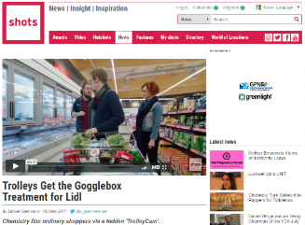
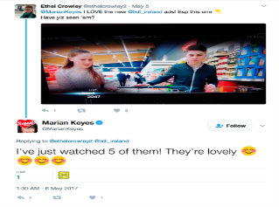
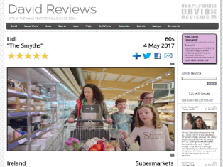
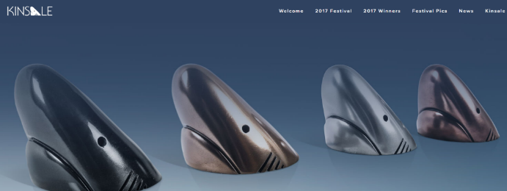
Campaign Success & Impact
Very high advertising recall @ 73%
Highest ad recall compared to competitors advertising
Source: Spark Lidl Ad Tracker
73%
It got the country talking, liking & sharing
Lidl achieved its highest ever main shop share
Plus 76% convinced of Lidl own brand quality
Source: Spark Lidl Brand Tracker
21%
Lidl achieved its highest ever market share at 12.1%
Post campaign launch
Source: Kantar
12.1%

Slide 16
Thank you for listening!
Copyright 2018, Spark Ltd
All rights reserved

