Slide 1
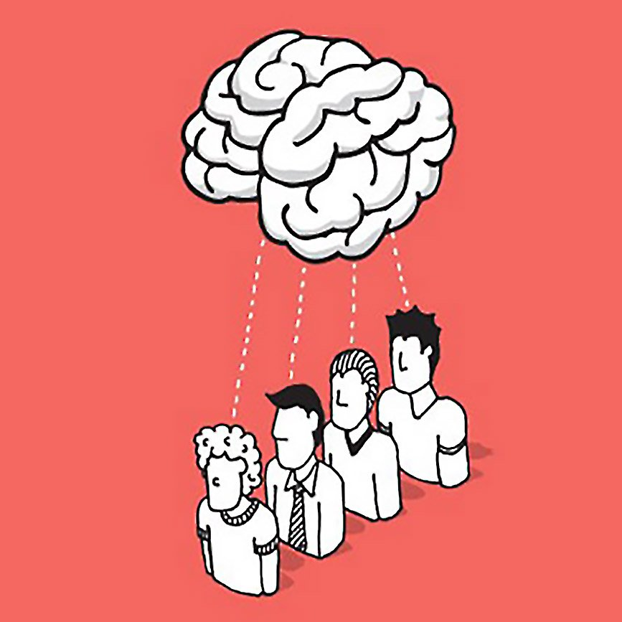

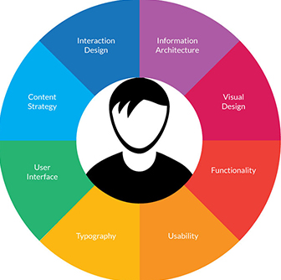

Today’s Marketing Obsession
Persuasion
Engagement
‘User’ Experience

Slide 2




User Experience is becoming increasingly complex
INTEGRATION & CONSISTENCY
Branches
Telephone
Desktop Web – multiple browsers
Mobile Web – multiple browsers
Mobile App – iOS, Android, Windows
Tablet – iOS, Android, Windows, Kindle
Wearables

Slide 3

AND NOW: Voice Interfaces
Alexa
(Amazon Echo)
Google Now
(Android)
Siri
(iPhone)
Cortana
(Windows 10)

Slide 4


Slide 5



Learning from the Wild Hogs
2007
Technology embetterment
Context & Use Cases relevance
Command & Control unnatural

Slide 6

Chatbots
Natural Language

Slide 7
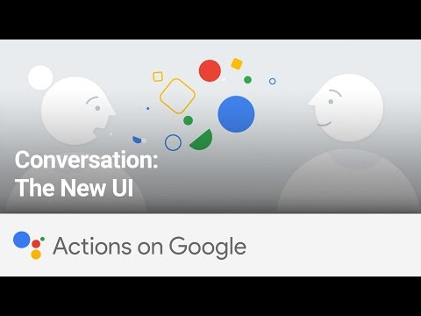

Slide 8

From VUIs to CUIs
Conversational Interfaces

Slide 9



New skillset
From ‘tone of voice’ to language systems
(compare customer service script writing)
Sonic Branding increasingly important
(think car industry)
Merging Persuasion, Engagement & Experience
(think AI Sales Engine)

Slide 10

It costs as much to lead as to follow

