Slide 1
ROLE OF VOICE TECHNOLOGIES
IN BRAND MARKETING

Slide 2
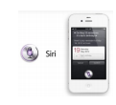




Interface adoption
Punch Cards for Informatics
Electronic Computers (Z3)
Joystick
Commercial Use of Windows-Based GUI
Commercial use of mobile computing
Voice on mobile (Siri)
Microsoft Cortana
Google Home
1832
1943
1997
1981
1996
2011
2013
2016
1872
1948
1975
1983
2007
2012
2014
2017
QWERTY Keyboard
Mainframe
Computers
(IBM)
Portable Computers (IBM)
Commercial Use of Mouse (Apple)
Touch & Camera based Mobile Computing
Google Now
Amazon Echo
Voice First Device
Apple HomePod

Slide 3
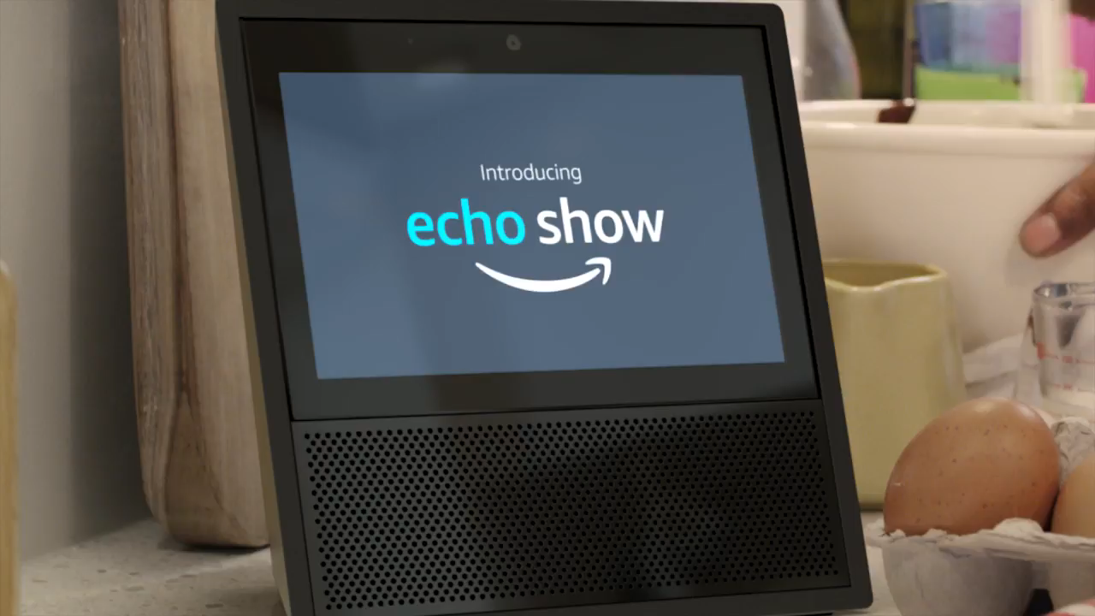

Slide 4
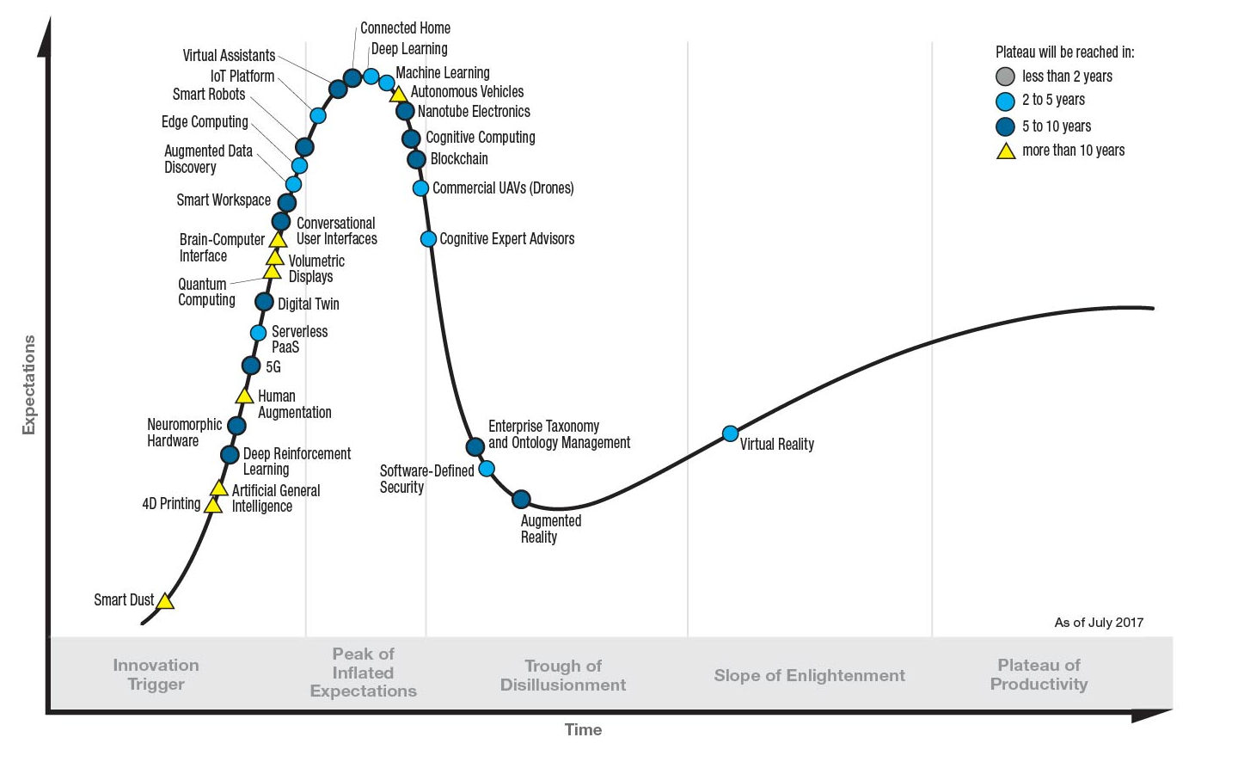
What’s all the noise about?
Conversational User Interfaces
Source: Gartner: http://www.gartner.com/newsroom/id/3784363

Slide 5

can you repeat that please?
GOOGLE MACHINE LEARNING
Achieving Higher Word Accuracy, 2013 - 2017
100%
95%
95%
90%
80%
Word Accuracy Rate (%)
70%
2013
2014
2015
2016
2017
Threshold for
Human Accuracy
Source: https://9to5google.files.wordpress.com/2017/06/mary-meeker-google-voice-recognition.jpg?quality=82&strip=all&w=411&h=307

Slide 6


Slide 7

Designing for voice

Slide 8


Slide 9
NEW DIMENSION, NEW ROLES
The advanced
analyst with NLP expertise
The Conversation
Strategist
The Creative
Technologist

Slide 10

The opportunity
EDUCATION ABOUT ARTIFICIAL INTELLIGENCE
FOCUS ON CUSTOMER EXPERIENCE DESIGN
BE PART OF PRODUCT DEVELOPMENT AND INNOVATION
INVEST IN SPECIALISTS

Slide 11
Thank
You

