Slide 1

Investing in brand growth
Bill Kinlay
CEO GroupM Ireland
@billkinlay @groupmireland

Slide 3

1.
Investing in advertising yields results

Slide 4
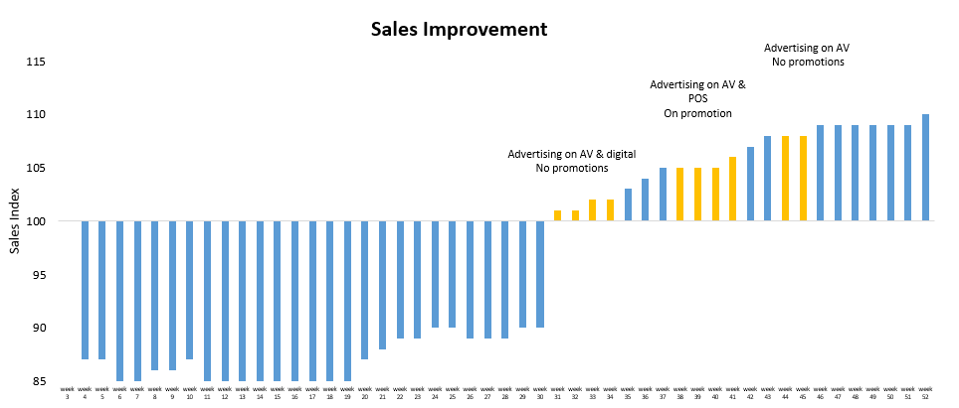

Slide 5

2.
Evidence minimises risk

Slide 6



You can build long-term growth

Slide 7
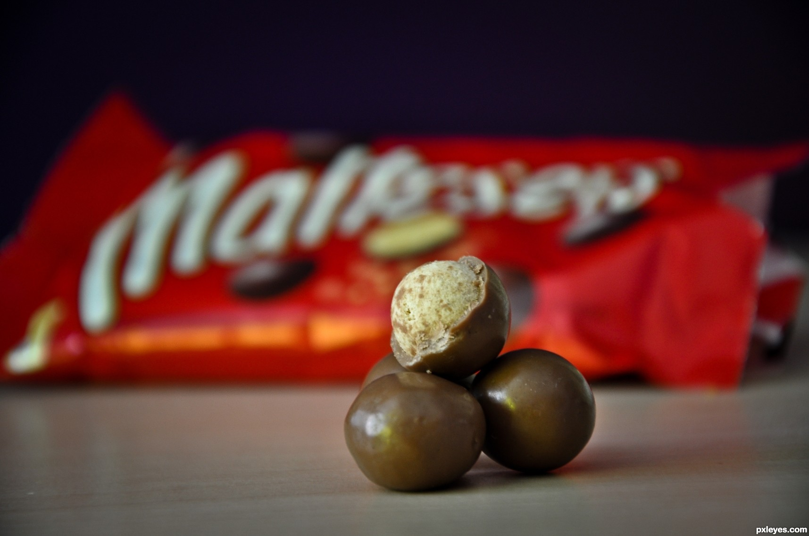
you can go your own way

Slide 8

3. integrating science & art

Slide 9


Slide 10
4.
Cultural commitment

Slide 11


Slide 12
It is not that marketers have chosen to reject empirical evidence, it is just that few have looked for it.
Bruce McColl, Mars Inc.
The Journal of Advertising in 2012 How the Global Marketer Embraced Ehrenberg’s Science with Creativity.

Slide 13
Thank you

